Slide 1
Kafka
Hands on tutorial for beginners

Slide 2
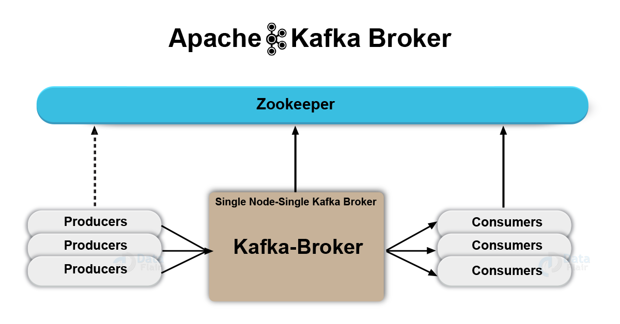
Introduction
What is Kafka?
Kafka is just like a messaging system
It is distributed platform / application
In production it is referred as Kafka cluster
Each Kafka server is called as broker
Kafka is fault tolerant
In Kafka cluster messages are replicated in multiple broker
Replication factor
Kafka is scalable system
You can add new brokers
You can increase the number of consumers

Slide 3
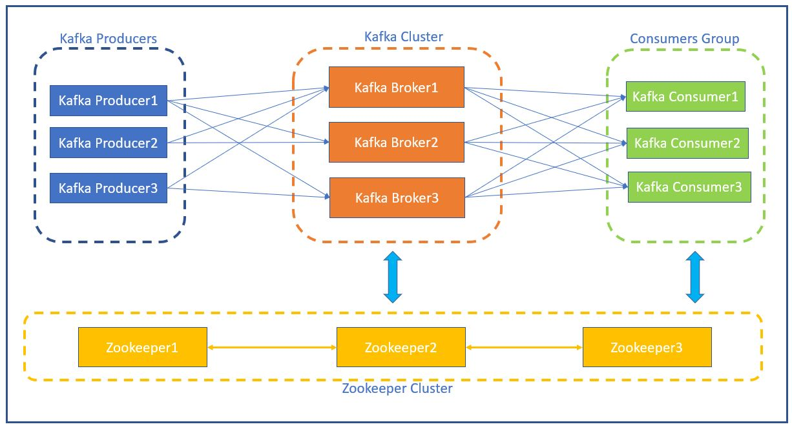
Architecture
Zookeeper is distributed, open-source configuration, synchronization service
Which information consumer has read (offset details)
Cluster information
Topic configuration

Slide 4
Install Kafka and Zookeeper
Download will contain both kafka server and zookeeper
https://downloads.apache.org/kafka/3.5.0/kafka-3.5.0-src.tgz
Tar -zxvf kafka-3.5.0-src.tgz
To compile:
./gradlew jar -PscalaVersion=2.13.10
Zookeeper:
Configfile=zookeeper.properties
To start zookeeper:
Bin/zookeeper-server-start.sh config/zookeeper.properties
Kafka server:
Configfile=server.properties
Advertised.listeners=<ip>:9092
Zookeeper.connect=localhost:2181
Start the Kafka server: JMX_PORT=8004 bin/kafka-server-start.sh config/server.properties
NOTE: Start zookeeper first and then Kafka server

Slide 5
Install Kafka Manager
Graphical user interface to view Kafka cluster.
You need java11 installed in your machine
https://github.com/yahoo/CMAK
./sbt clean dist # run this command after cloning the repo
Cd target/universal
Unzip cmak-x.x.x.zip
Cd cmak-x.x.x.x
Vi conf/application.conf
Cmak.zkhosts=<ip>:port
Bin/cmak -Dconfig.file=conf/application.conf -Dhttp.port=8080
Open http://<ip>:8082/addCluster
{clustername = parthidemo, cluster zookeeper hosts = <zookeeper ip>:2181}
Select Enable jmx polling and poll consumer information

Slide 6
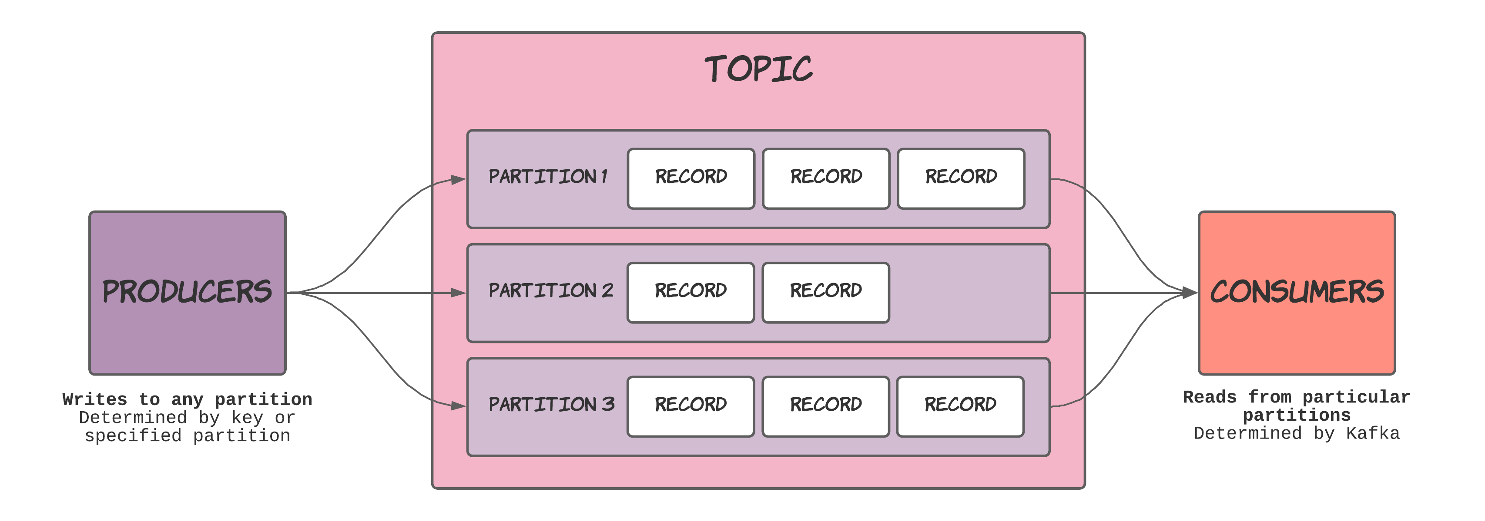
Kafka topic
Topic is the Kafka component where producers are connected.
Producer publish message in Kafka topic.
Topics in Kafka is multi subscriber.

Slide 7
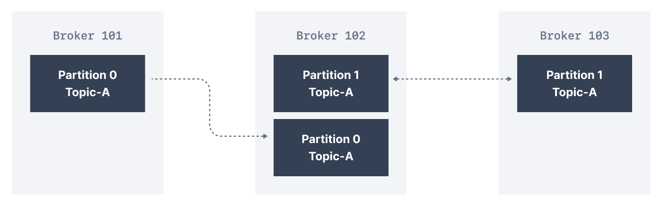
Kafka topic replication factor
In Kafka, replication means that data is written down not just to one broker, but many.
The replication factor is a topic setting and is specified at topic creation time.
A replication factor of 1 means no replication. It is mostly used for development purposes and should be avoided in production Kafka clusters
In the cluster below consisting of three brokers, the replication factor is 2. When a message is written down into Partition 0 of Topic-A in Broker 101, it is also written down into Broker 102 because it has Partition 0 as a replica.

Slide 8
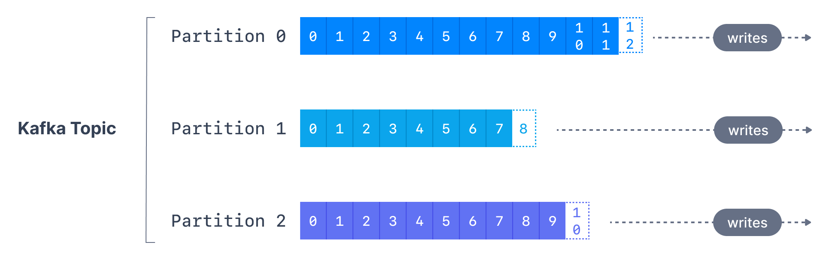
Kafka topic partition
Kafka topic is divided into multiple parts that is called as partition.
Partitions can be considered as the linear data structure. Just like array.
Messages are published to a partition in the topic.
Every partition has a partition number.
Each partition has increasing index called offset.
New messages are always pushed at the rear end.
Data is immutable after publish.
In multi broker Kafka cluster partitions for a topic are distributed across the whole cluster.

Slide 9
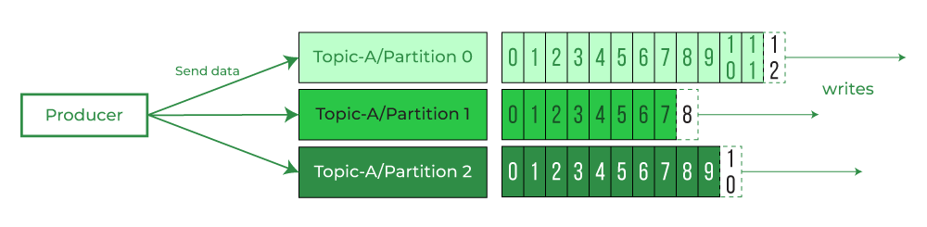
Kafka producer (python)
Producers publish message to the topics of their choice.
Messages are published to topic partition.
Configuration needed by producer:
Bootstrap_servers
Topic
Value_serializer
Python packages used:
kafka-python
faker
Examples:
Single broker – 1 topic - 1 partition
Single broker – 1 topic - 2 partition
Single broker – 1 topic - 2 partition (send message to only 1 partition)
Send method is called on producer to publish the data

Slide 10
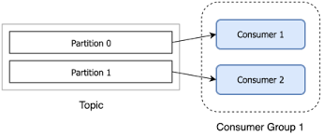
Consumer Group
Consumer group can be defined as logical grouping of one or more consumer.
It is mandatory for a consumer to register itself to a consumer group.
Consumer instances are separate process.
Consumer instance of same consumer group can be on different nodes.

Slide 11
Kafka Consumer (python)
Examples:
Single broker – 1 topic - 1 partition
Single broker – 1 topic - 1 partition – 2 consumer (same group)
same partition can’t be assigned to multiple consumer in same group
same partition can be assigned to multiple consumer in different group
Single broker – 1 topic - 2 partition – 2 consumer

Slide 12
Thank you

