Slide 1
Soil Moisture Prediction Project
Full Academic EDA + ML Justification (Option C)

Slide 2
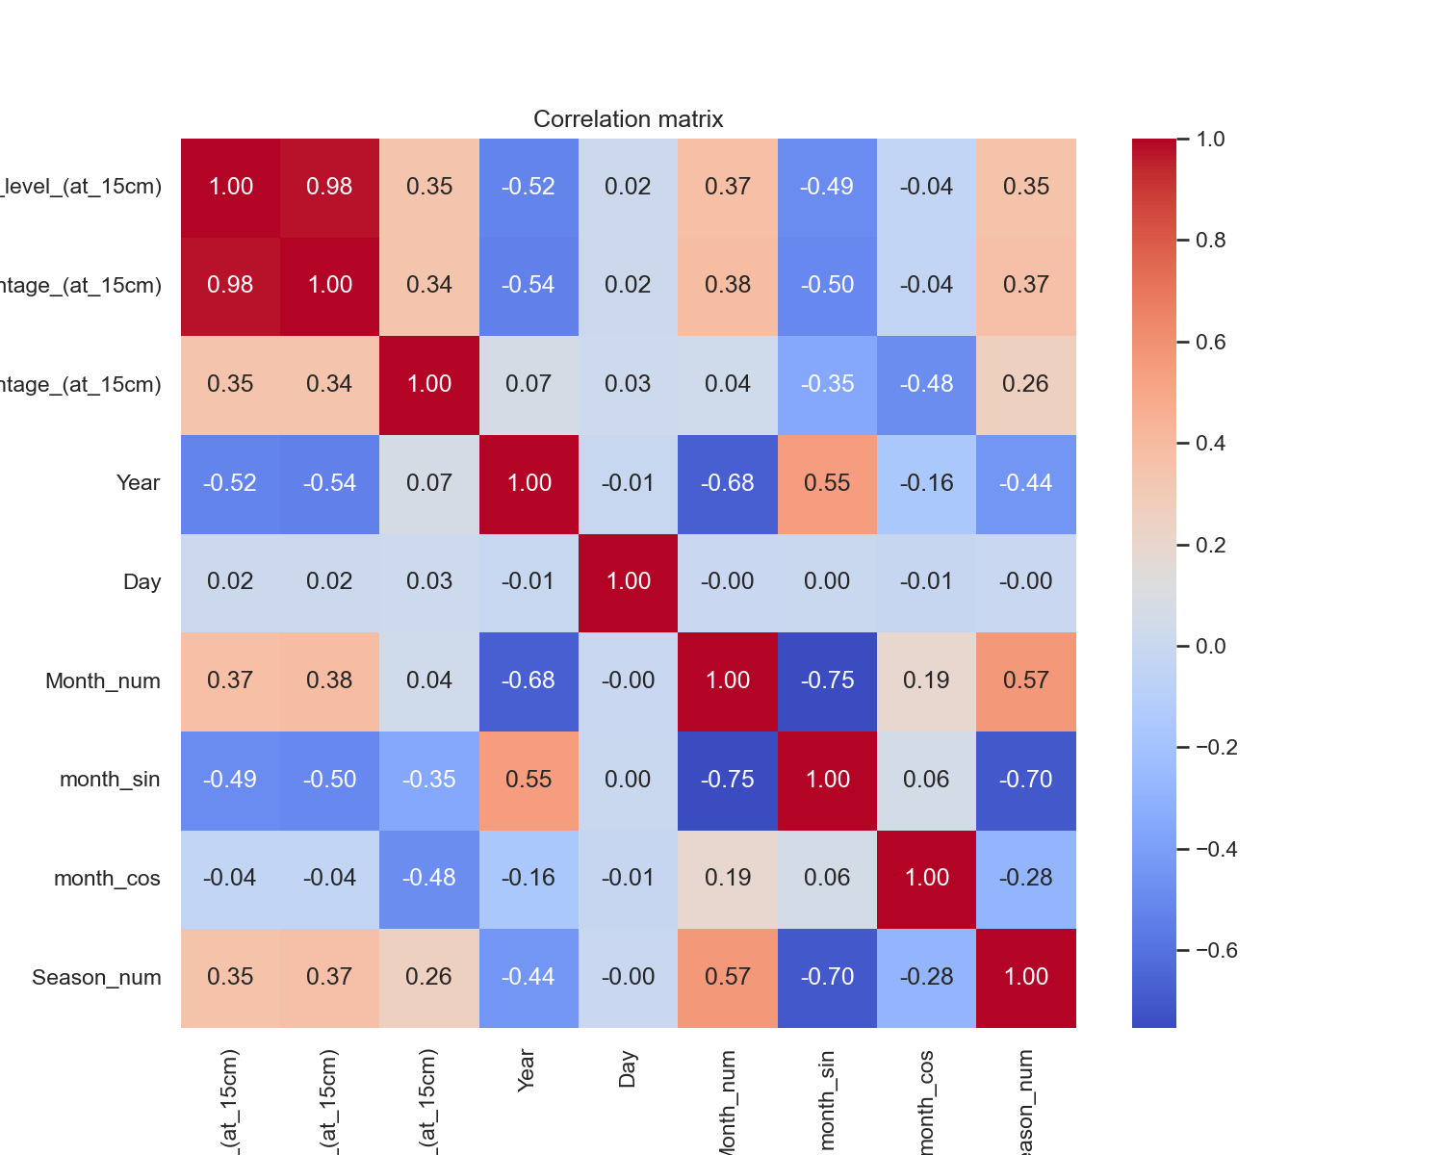
Correlation Matrix

Slide 3
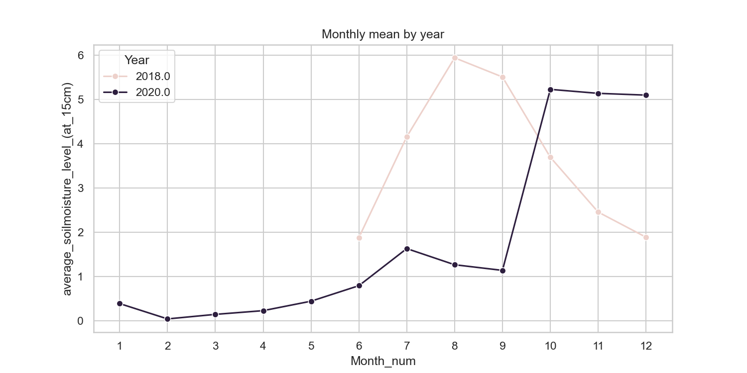
Monthly Mean by Year

Slide 4
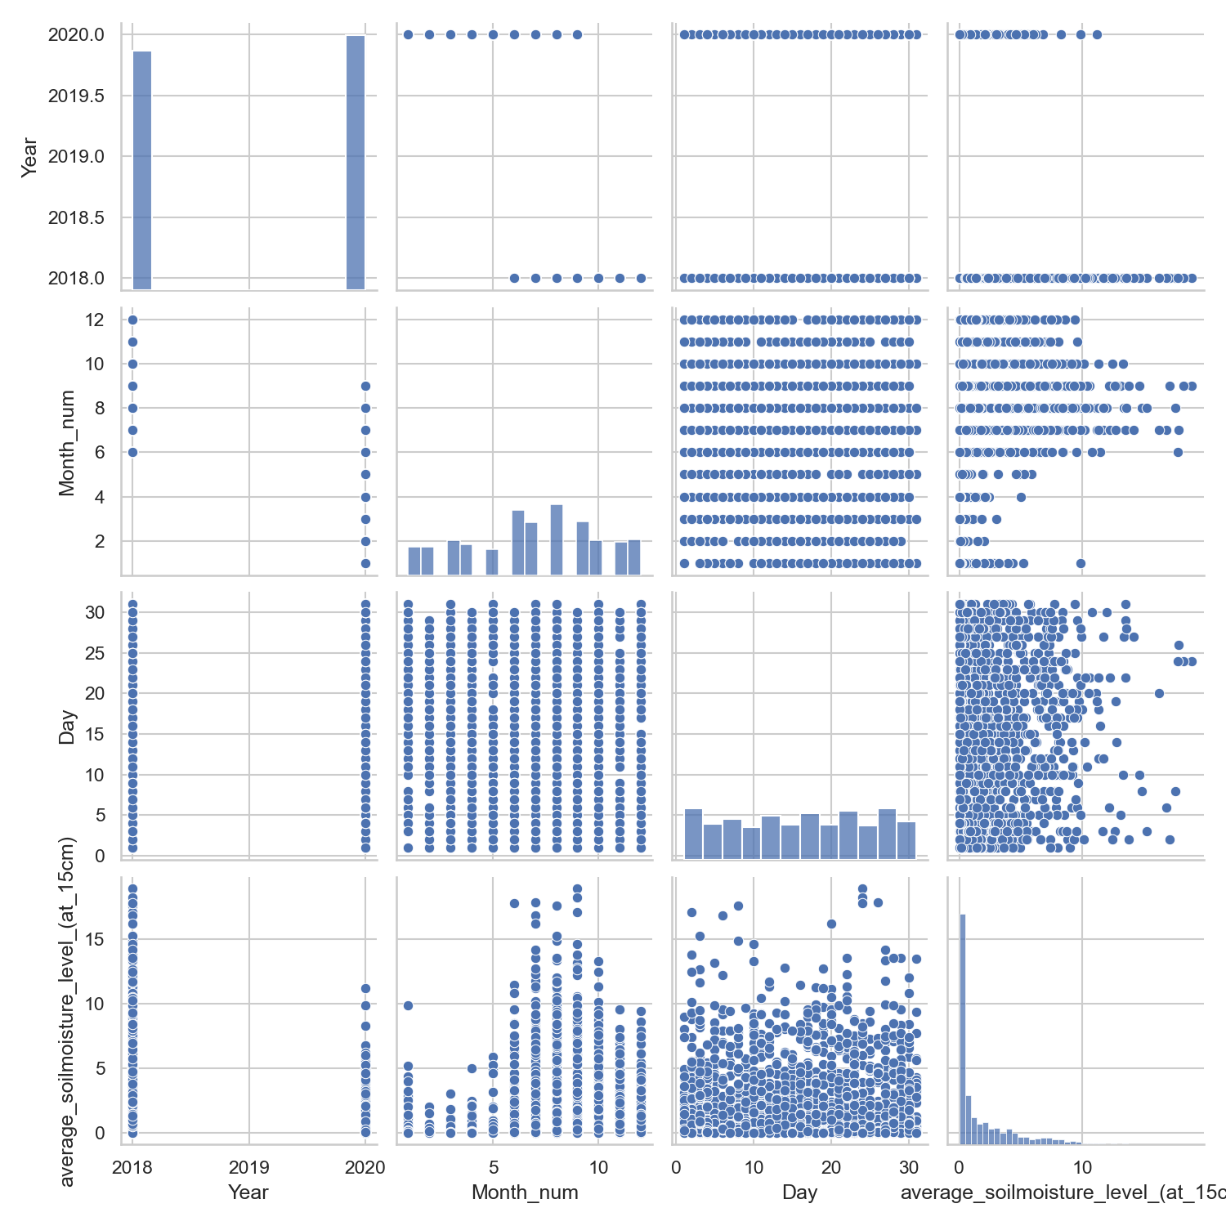
Pairplot Sample

Slide 5
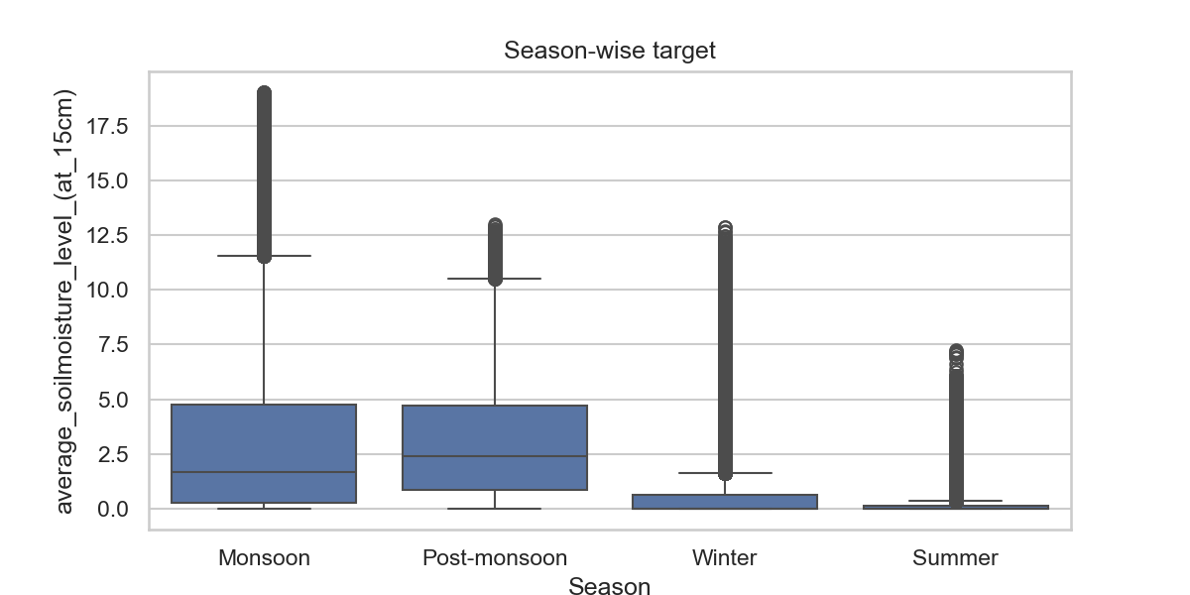
Season-wise Target Distribution

Slide 6
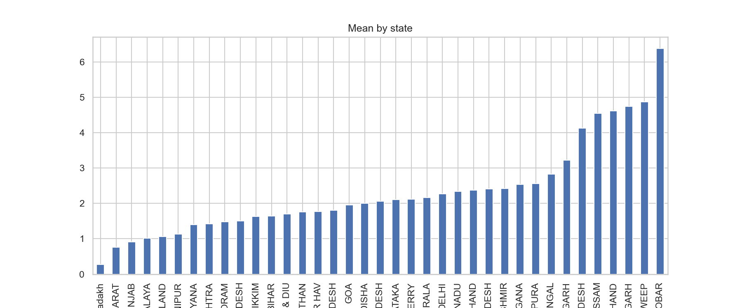
Mean Moisture by State

Slide 7
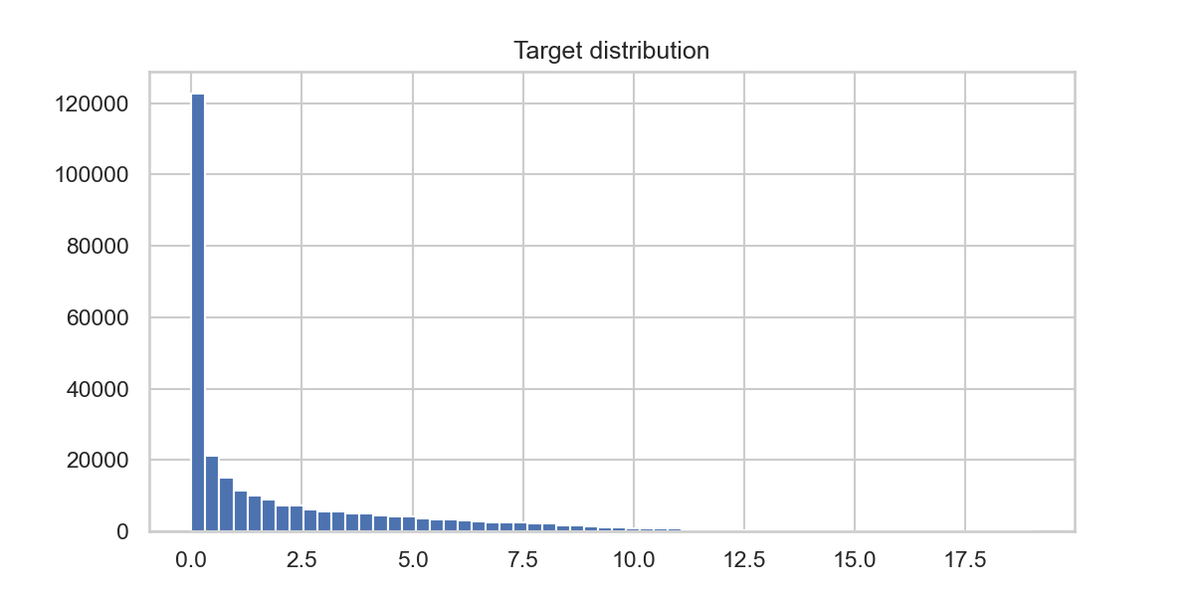
Target Distribution

Slide 8
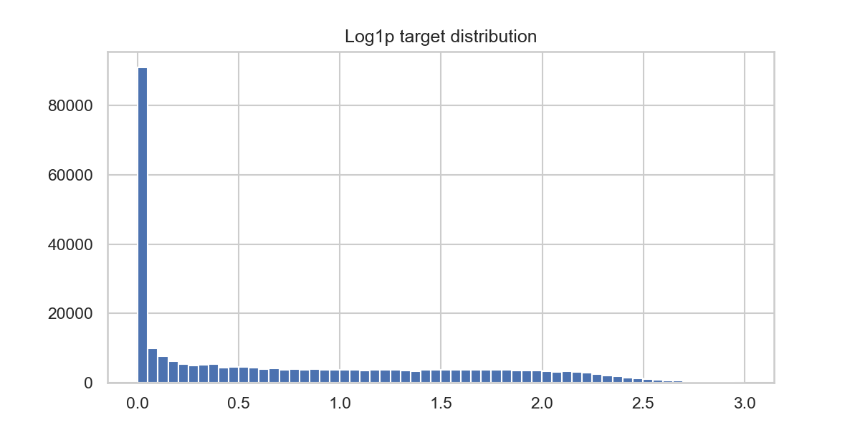
Log1p Target Distribution

Slide 9
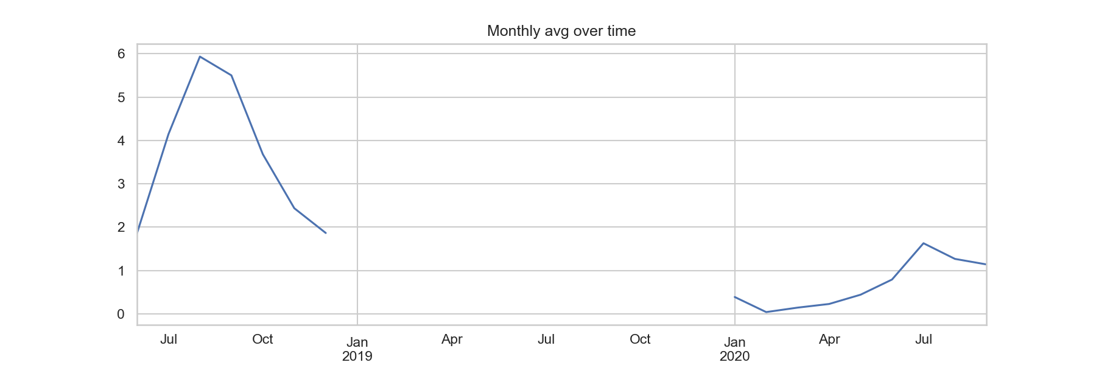
Monthly Average Over Time

Slide 10
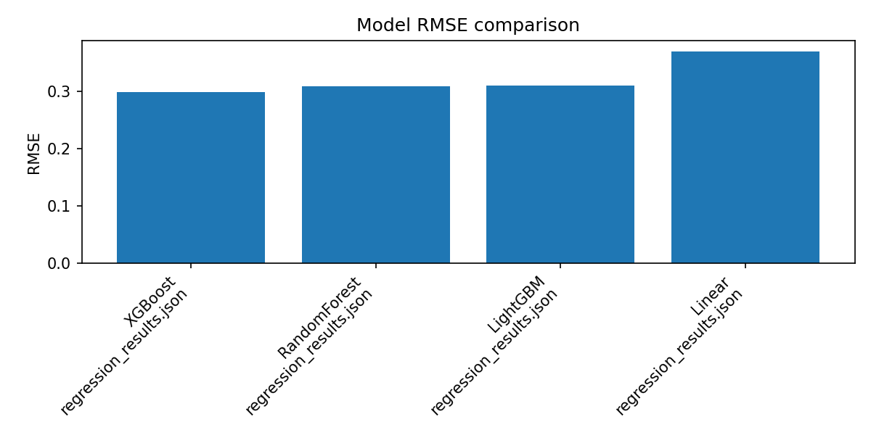
Model RMSE Comparison

Slide 11
Why Regression (Not Classification)
• Soil moisture is a continuous variable
• Classification loses precision
• Regression fits ML lecture recommendations

Slide 12
Why Not Deep Learning
• Dataset size small
• Tree models outperform DL on tabular data
• DL needs GPU + more tuning
• Higher risk of overfitting

Slide 13
Why Ensemble Models (XGBoost & LightGBM)
• Capture non-linear patterns
• Boosting reduces residual errors
• Best performance on tabular data
• Recommended in Ensemble Learning lectures

Slide 14
Why Not Linear Regression
• Fails for non-linear seasonality
• Assumes feature independence
• Performs poorly on skewed targets

Slide 15
Why Feature Engineering Was Necessary
• Month cyclic encoding captures seasonality
• Lag features capture temporal effect
• Rolling windows smooth short patterns
• Frequency encoding handles categorical features

Slide 16
Why Log1p Transformation
• Target extremely right-skewed
• log1p normalizes distribution
• Improves model stability and RMSE

Slide 17
Why Time-based Train-Test Split
• Prevents data leakage
• Reflects real deployment scenario
• Matches lectures on time-series ML validation

Slide 18
Why RMSE and MAE Metrics
• RMSE penalizes larger mistakes
• MAE gives average deviation
• Both are standard in regression evaluation

Slide 19
Why Streamlit for Deployment
• Easy to deploy ML models
• User‑friendly for farmers
• Real‑time inference + visualization

Slide 20
Why This End-to-End Workflow
• Matches full DS lifecycle taught in class:
Data → EDA → FE → Modeling → Validation → Deployment

