Slide 1
DESIGN AND ANALYSIS OF ALGORITHMS
STUDENT
SORTING
Applying sorting algorithms to student records
Presented by: __Rakholiya parthil NO:_12402080601103_________
A practical example of algorithm design and efficiency

Slide 2
1. Introduction to Student Sorting
What does sorting mean in a student management system?
Student sorting means arranging student records in a specific order.
Records can be sorted by marks, roll number, name, or attendance.
Each record contains multiple fields, such as student ID, name, and marks.
Sorting makes student data easier to search, compare, and understand.
DESIGN AND ANALYSIS OF ALGORITHMS • STUDENT SORTING
2

Slide 3
2. Problem Statement
Example: arrange students by marks in descending order
Roll No. | Student | Marks
101 | Aarav | 72
102 | Diya | 91
103 | Kabir | 65
104 | Meera | 84
Input
Student records are in an unsorted order.
Goal
Output records from highest marks to lowest marks.
DESIGN AND ANALYSIS OF ALGORITHMS • STUDENT SORTING
3

Slide 4
3. Sorting Criteria
A sorting key determines the order of records
By Marks
By Roll Number
By Name
Descending: highest marks first
Ascending: lowest marks first
Usually ascending order, from the smallest roll number to the largest.
Alphabetical order, such as Aarav, Diya, Kabir, Meera.
In this presentation, marks are used as the sorting key and the order is descending.
DESIGN AND ANALYSIS OF ALGORITHMS • STUDENT SORTING
4

Slide 5
4. Bubble Sort — Basic Idea
Compare adjacent students and swap them when they are in the wrong order
For descending marks, compare two adjacent marks.
If the left mark is smaller than the right mark, swap the records.
Repeat passes until the records are sorted.
Easy to understand, but inefficient for large student lists.
Before:
→
72
91
65
84
91
84
72
65
DESIGN AND ANALYSIS OF ALGORITHMS • STUDENT SORTING
5

Slide 6
5. Algorithm / Pseudocode
Bubble Sort in descending order of marks
for i = 0 to n - 2:
for j = 0 to n - i - 2:
if marks[j] < marks[j + 1]:
swap(student[j], student[j + 1])
The whole student record is swapped, not only the marks.
n = number of student records
DESIGN AND ANALYSIS OF ALGORITHMS • STUDENT SORTING
6

Slide 7
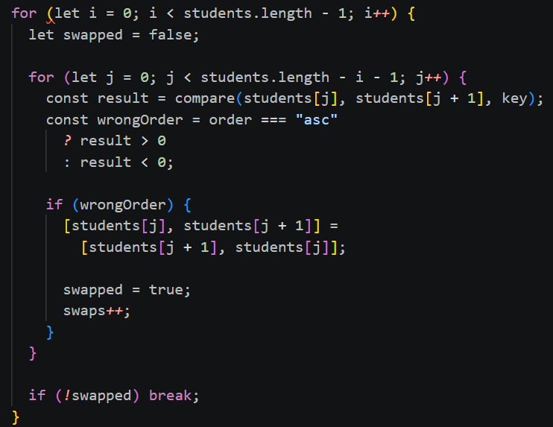
This is example of Bubble sort used in source code
How Bubble Sort Works
Bubble Sort compares adjacent elements and swaps them when they are in the wrong order.
Start from the first student.
Compare two adjacent student records.
Swap them if they are in the wrong order.
Repeat until the records are sorted.

Slide 8
6. Worked Example
Sorting marks: 72, 91, 65, 84 (descending)
Initial
72, 91, 65, 84
↓
Sorted student list
1. Diya — 91
2. Meera — 84
3. Aarav — 72
4. Kabir — 65
Pass 1
91, 72, 84, 65
↓
Pass 2
91, 84, 72, 65
↓
Final
91, 84, 72, 65
DESIGN AND ANALYSIS OF ALGORITHMS • STUDENT SORTING
7

Slide 9
7. Time and Space Complexity
How does the algorithm scale as the number of students grows?
Best Case
Average Case
Worst Case
O(n) with an optimized version that stops when no swaps occur.
O(n²) comparisons and swaps may be needed.
O(n²) time, for example when the list is in reverse order.
Auxiliary space: O(1) — Bubble Sort sorts in place.
For large datasets, algorithms such as Merge Sort or Quick Sort are usually more efficient.
DESIGN AND ANALYSIS OF ALGORITHMS • STUDENT SORTING
8

Slide 10
8. Applications and Advantages
Why student sorting is useful
Applications
Advantages
• Rank students by exam marks
• Sort records by roll number
• Display names alphabetically
• Prepare merit lists and reports
• Makes records organized
• Helps compare student performance
• Supports faster review and reporting
• Demonstrates a real use of sorting algorithms
Important: Keep each student's name, roll number, and marks together while sorting.
DESIGN AND ANALYSIS OF ALGORITHMS • STUDENT SORTING
9

Slide 11
CONCLUSION
Student sorting is a practical application of sorting algorithms in DAA.
Student records can be sorted by marks, roll number, or name.
Bubble Sort is simple and suitable for learning the sorting process.
Its O(n²) time complexity makes it less suitable for very large datasets.
Choosing an appropriate algorithm improves performance.
THANK YOU
10

