Slide 1

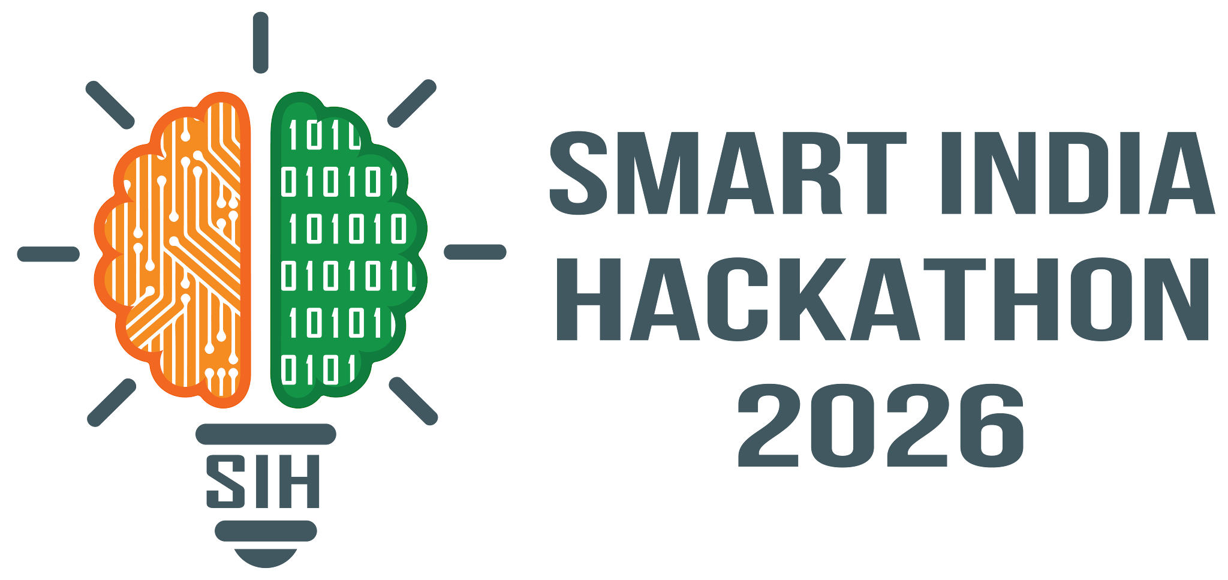

Smart India Hackathon 2026
PROJECT PROPOSAL
Problem Statement Title
AI-Powered IPsec VPN Protocol Analyzer and Security Assessment Framework
Problem ID: 26160 Category: Software
Theme: Blockchain & Cybersecurity
Team ID
[Insert Team ID]
Team Name
400-Squad

Slide 2
IDEA TITLE
400-SQUAD
Proposed Solution: AI-Augmented IPsec Cryptographic Auditor
An AI-powered command-line audit pipeline that combines deterministic PCAP packet dissection with an LLM verification and remediation engine.
Postural Scoring: Ingests IKEv2/IPsec capture files and programmatically scores cryptographic posture against NIST SP 800-77 Rev.1 standards.
LLM Verification: Queries an LLM API (via user API key) to verify findings and explain attack surfaces in plain language.
Automated Remediation: Synthesizes multi-vendor remediation scripts to fix gaps quickly and securely.

Slide 3
TECHNICAL APPROACH
400-SQUAD
1. Technologies to be Used
Programming Language & Core Runtime: Python 3 utilizing standard library modules (subprocess, argparse, json, re, pathlib) for zero-dependency execution across environments.
2. Methodology & Process
Implementation & Flow: Structured process for implementation including detailed flow charts, architectural images, and a working prototype.
[PCAP/PCAPNG] ──> [1. ike_parser.py: Extract to JSON] ──> [2. scorer.py: NIST Grading]
│
[4. analyze.py: CLI Dashboard & Target Configs] <── [3. AI Engine: Verify & Translate] <──┘

Slide 4

FEASIBILITY AND VIABILITY
400-SQUAD
Highly Feasible
The proposed AI-Augmented IPsec Cryptographic Auditor is highly feasible for immediate implementation, built upon a proven working architecture.
Working Prototype Validation
The most complex component extracting encrypted network parameters from raw traffic is already solved by your working prototype:
ike_parser.py: Successfully utilizes tshark to deterministically parse IKE_SA_INIT and CREATE_CHILD_SA payloads.
scorer.py: Reliably maps these findings to rigid NIST SP 800-77 Rev.1 compliance metrics.

Slide 5
IMPACT AND BENEFITS
400-SQUAD
Target Audience Impact
SecOps & Network Engineers: Eliminates hours spent manually decoding hex transforms in Wireshark by automatically generating ready-to-deploy, hardened firewall configurations.
Compliance & Risk Auditors: Replaces subjective assessments with automated, deterministic auditing benchmarked against NIST SP 800-77 Rev.1, streamlining HIPAA, PCI-DSS, and FIPS reviews.
SysAdmins & Generalists: Bridges the cryptographic skill gap by translating complex mathematical risks (SWEET32, Logjam, Harvest-Now-Decrypt-Later) into plain-language actionable tasks.
Benefits of the Solution
Economic Impact: Drastically cuts labor costs and specialized consulting fees while shielding enterprises from multi-million dollar breaches, regulatory fines, and corporate espionage.
Strategic & Security Governance: Enhances resilience against state-sponsored interception and future quantum threats with a clear migration path toward Post-Quantum Cryptography (PQC / ML-KEM) standards.
Operational & Resource Efficiency: Lightweight, zero-dependency CLI tool that executes locally on low-compute resources, eliminating the need for power-hungry cloud security infrastructure.

Slide 6
RESEARCH AND REFERENCES
400-SQUAD
1. Educational Videos
PowerCert Animated Videos: Highly visual explainers for networking and IT fundamentals. Great for understanding encapsulation inside IPsec tunnels.
NetworkChuck: High-energy, practical walkthroughs on VPNs, OSI model, and real-world deployment.
2. GitHub Projects & Tools
IKEv3Analytica: Modern, containerized Python framework for next-gen IPsec VPN analysis, risk scoring, and reporting.
ikeforce (Legacy): Classic CLI tool for IKE phase 1/2 enumeration, valuable for historical context.
hwdsl2 / setup-ipsec-vpn: Highly popular setup scripts to understand production strongSwan and Libreswan configurations.
3. Standards & Research
NIST SP 800-77 Rev. 1: The definitive guidelines and compliance benchmarks for IPsec VPN security policies.
RFC 7296 & 8221: Core specifications defining standard IKEv2 packets, cryptographic mandates, and algorithm lifecycles.
NIST FIPS 203 (ML-KEM): Newly finalized Post-Quantum Cryptography standards designed to prevent future quantum decrypt attacks.

