Slide 1






Python individual project
PDF password setter and cracker
Parthiv shah
Roll no.:: 101
210021721210163

Slide 2



Introduction
KEY TOPICS DISCUSSED IN THIS PRESENTATION
Libraries used in project
How pdf is encrypted
How password of the pdf is searched
Password list used

Slide 3

Libraries used
Pikepdf:: this library is used to do all the functions related to pdf in python eg:- import-export of pdf , encryption & decryption
Pyler:: from pyler library we imported notification function , which provides us with notification on dekstop

Slide 4



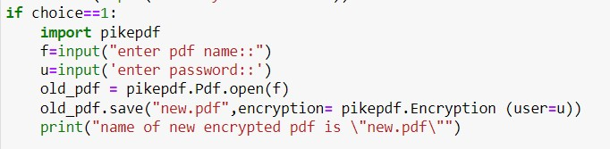
Pdf encryption
First pdf is imported from a folder
All the pages of pdf copies and encrypted and inserted in a new pdf giving us an encrypted pdf

Slide 5
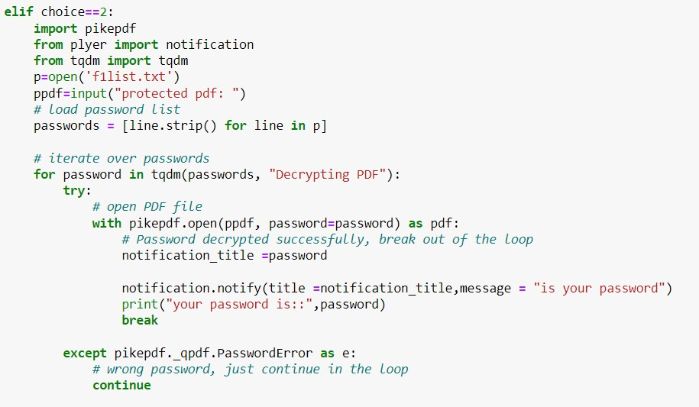
Decryption of pdf
We import pdf which is to be decrypted
The code starts comparing the password with every word in password list and returns the perfect match

Slide 6

Password list
Password list contains 31566 text lines , with unique passwords , it also has all the combination of a 4 digit and 6 digit code

Slide 7

Thank you

