Slide 1
NICU SMART APP
Aniruddha, Neil, Parthiv, Sai Praveen and Vetri
Guys on FHIR
12/09/2016

Slide 2
Introduction
Problem Statement
Solution
Newborns in an incubator are constantly being disturbed which disrupts their sleeping pattern.
The parents of new-borns(who are in NICU) cannot always get access to their babies. This can generate a mental depression.
Remote monitoring of a new-born inside an incubator without disturbing their sleeping pattern.
The parents of new-born will get 24/7 video feedback of their babies.

Slide 3
Motive
Parental experiences/concerns with the infant care in NICU
Improve patient care through SMART apps

Slide 4
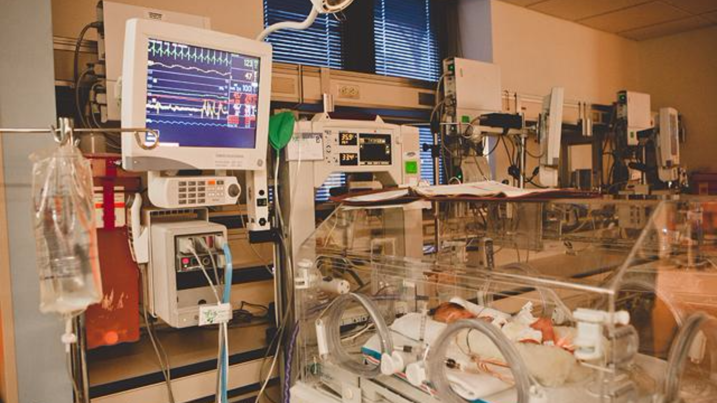
Neonatal Intensive Care Unit

Slide 5
SMART on FHIR®
SMART on FHIR is a new approach that will enable "plug-in apps" to run natively inside any compliant EHR systems at the point of care
FHIR - a new HL7 standard that creates a RESTful API for EHR data stores
The SMART Platform, an open-source toolkit for embedding apps into EHR workflow

Slide 6







NICU + FHIR SMART

Slide 7
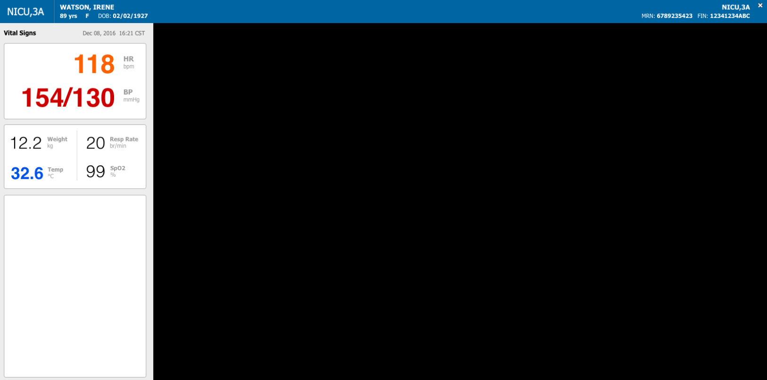
NICU SMART App

Slide 8
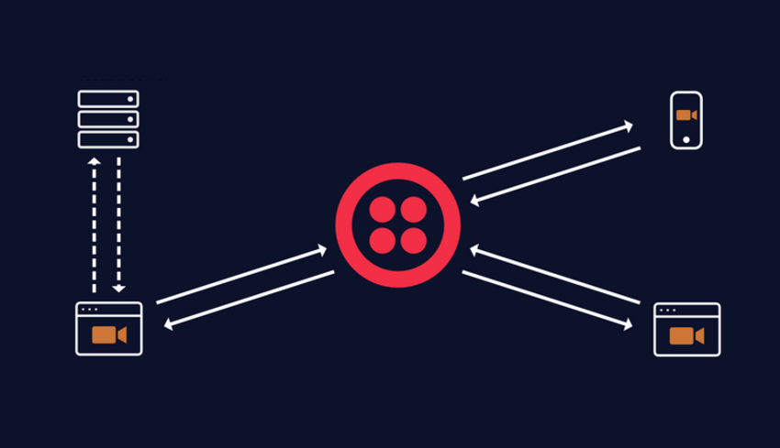
Twilio real-time video integration

Slide 9
Moving forward
Video streaming integration
Integrate 3rd party APIs – alert service, analyze sleeping patterns
Remote access of data

