Slide 1
Meta Learning A1 : NumerAi
Parthiv A Dholaria 2021078
Lakshay Kumar 2021061

Slide 2
Contents
Brief Formulation of Problem as Meta Learning
Approaches Explored
Results
Rankings
Analysis

Slide 3
Formulation as Meta Learning
Meta Training :
The tasks are as follows : T → [ Era_i-1 , Era_i ] can be thought as [D_train , D_tests] where we have access to X_train, y_train as well as X_test,y_test during meta training.
Here Era_i-1 represents the Era from the previous week and Era_i is the current week’s Era.
I build a list of such tasks where the Nth task would be [Era_N-1 , Era_live] i.e I try to predict on Era_live using the few examples from the Last Era of the training data.

Slide 4
Formulation as Meta Learning
Meta Validation :
The task looks like : T → [Era_i] can be thought of as [D_val] where we have access to both the X_val and y_val but we use our meta trained model to predict on the X_val.
We use y_val to report the metrics for analyzing how well our model performs on unseen tasks testing its generalization ability.

Slide 5
Formulation as Meta Learning
Meta Testing :
The task is : T → [Era_live] that consists of only the X_test and the y_test are missing. We make a prediction using the x_test given which will be evaluated and the results will be shown after 20 days or so.

Slide 6
Approach : LSTMs
Architecture :
A simple classifier that has LSTM as its backbone for remembering long and short term context of the time series.
It is followed by a linear layer and finally a softmax layer for classification.
The model uses cross-entropy loss and the Adam optimizer, tracks training history, and includes functions for training, evaluation, and plotting performance metrics.

Slide 7
Approach : LSTMs
Pre Processing Data :
We introduce a time series window length based approach with LSTMs. We choose a window length say of size K.
We flatten many chunks of size K x M (No. of features) into a single 1-Dimensional vector and associate a target label of the Kth entry of that chunk.
So if you have a window length of 100 and say 50 features then we choose a chunk of 100 rows and reshape a chunk of size 100 x 50 into a 1-D vector of size (5000x1).
The target associated with this 1-D vector would be of the 100th entry in that chunk. We do this for all the possible chunks in training data.

Slide 8
Approach : LSTMs
Training :
We do it for 50 epochs , Learning rate = 0.001, Batch Size = 32
Loss → Cross entropy loss , Optimizer → Adam,
We then plot the training loss vs training f1 to assess the model further.
Only for around 53-60 eras of data due to resource constraints.
Metric : f1 , accuracy , class wise f1 and accuracy.

Slide 9
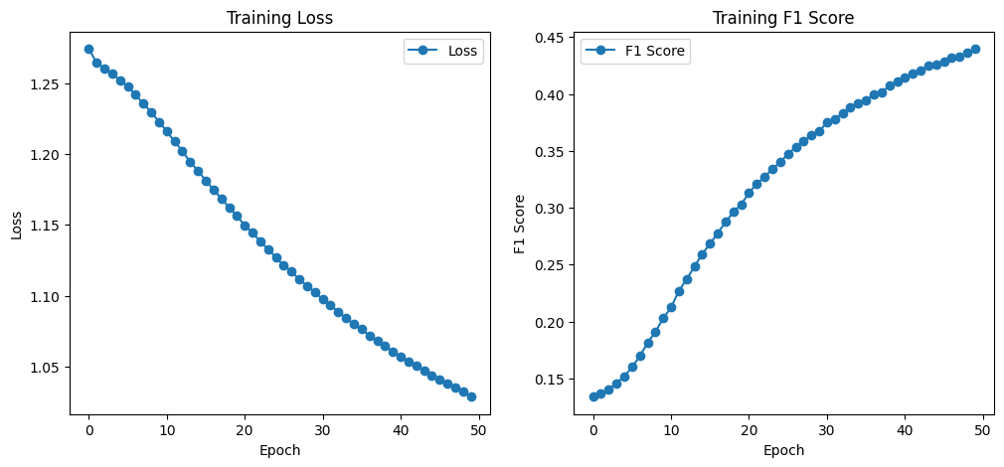
Approach : LSTMs
Training Results:

Slide 10
Approach : LSTMs
Results
Metric | Correlation with Target | Overall F1 | Overall Accuracy
Results | 0.0221 | 0.1914 | 0.4419
Metric | Class 0 | Class 0.25 | Class 0.5 | Class 0.75 | Class 1
F1 | 0.0413 | 0.1146 | 0.6252 | 0.1319 | 0.0438
Accuracy | 0.0021 | 0.0164 | 0.4119 | 0.0200 | 0.0024

Slide 11
Approach : Deep Residual Networks
Pre Processing : Same as LSTM
Architecture :
1D ResNet architecture comprises multiple residual blocks with two convolutional layers each, connected by skip connections to improve gradient flow.
It has six layers of residual blocks with increasing channels and adaptive average pooling
fully connected layer for classification, optimized with cross-entropy loss and Adam optimizer.

Slide 12
Approach : Deep Residual Networks
Training :
Num epochs → 10 , Batch Size → 32, Input Channel → 1, Learning rate → 0.001.
Loss → Cross Entropy Loss , Optimizer → Adam
Metric : F1

Slide 13
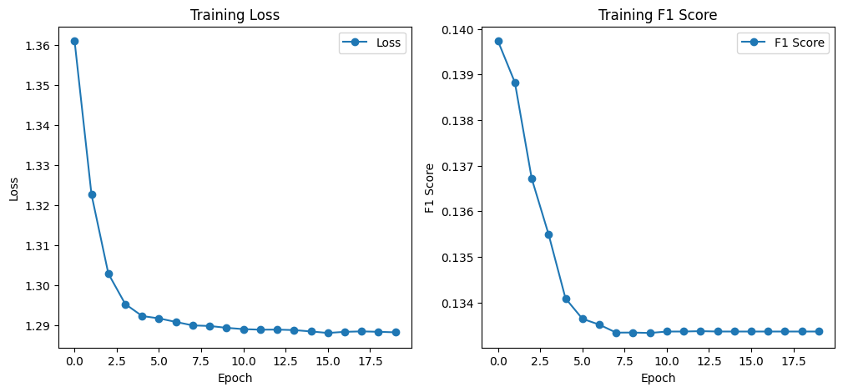
Approach : Deep Residual Networks
Results of Training :

Slide 14
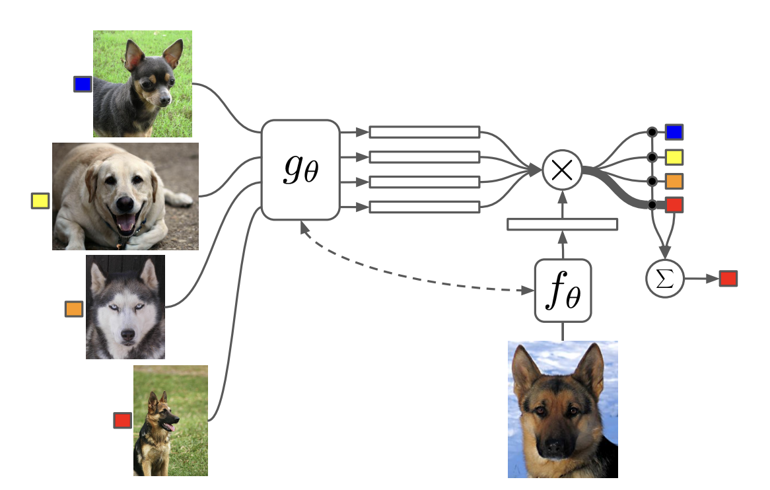
Approach : Matching Network
Architecture :

Slide 15
Approach : Matching Network
Results :
Very Poor Results
The training f1 remained constant
The loss did not decrease at all
All the prediction remained constant and predicted class 0.5 as the answer
Verdict : Did not capture the relationship well.

Slide 16
Approach : Prototypical Network
Architecture :
The model combines an LSTM-based feature extractor with a Prototypical Network for few-shot learning.
The LSTM Feature Extractor captures temporal dependencies in sequential data, transforming inputs into a feature representation.
In the Prototypical Network, class prototypes are computed by averaging feature embeddings for each class in the support set, using an attention mechanism to weigh similarities between test samples and prototypes.
The model calculates cosine similarity between test embeddings and class prototypes, using this similarity to assign class probabilities.

Slide 17
Approach : Prototypical Network
Pre Processing the dataset to create Tasks :
Explanation on creation of meta train set : T → [ Era_i-1 , Era_i ].
Sort the training data by era. Start creating pairs of [ Era_i-1 , Era_i ] in a sequential manner.
Create a data loader with batch size = 1 and shuffle as True to enable random shuffling of tasks.

Slide 18
Approach : Prototypical Network
Training :
Calculation of Weights : We see that F1 for minority class is very low. To handle this imbalance we add weights to the loss function. These weights are calculated as the 1 / frequency of class labels.
For each epoch, feature embeddings were extracted, prototypes for each class were computed, and cosine similarity was calculated between test samples and prototypes.
Loss → Cross-entropy loss with class weights addressed class imbalances, Optimizer → Adam.
Metric → F1 score

Slide 19
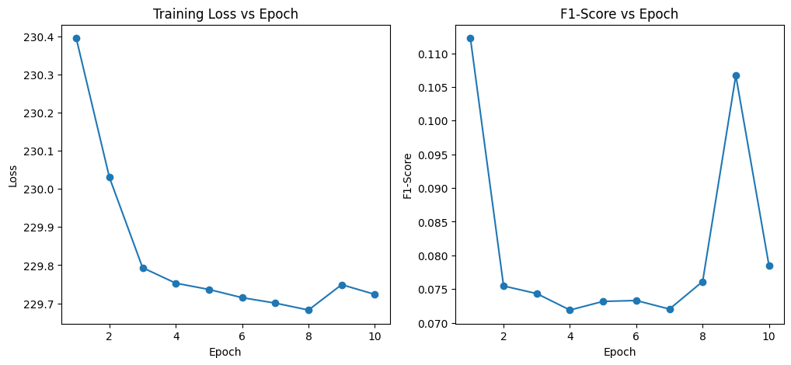
Approach : Prototypical Network
Training Results:

Slide 20
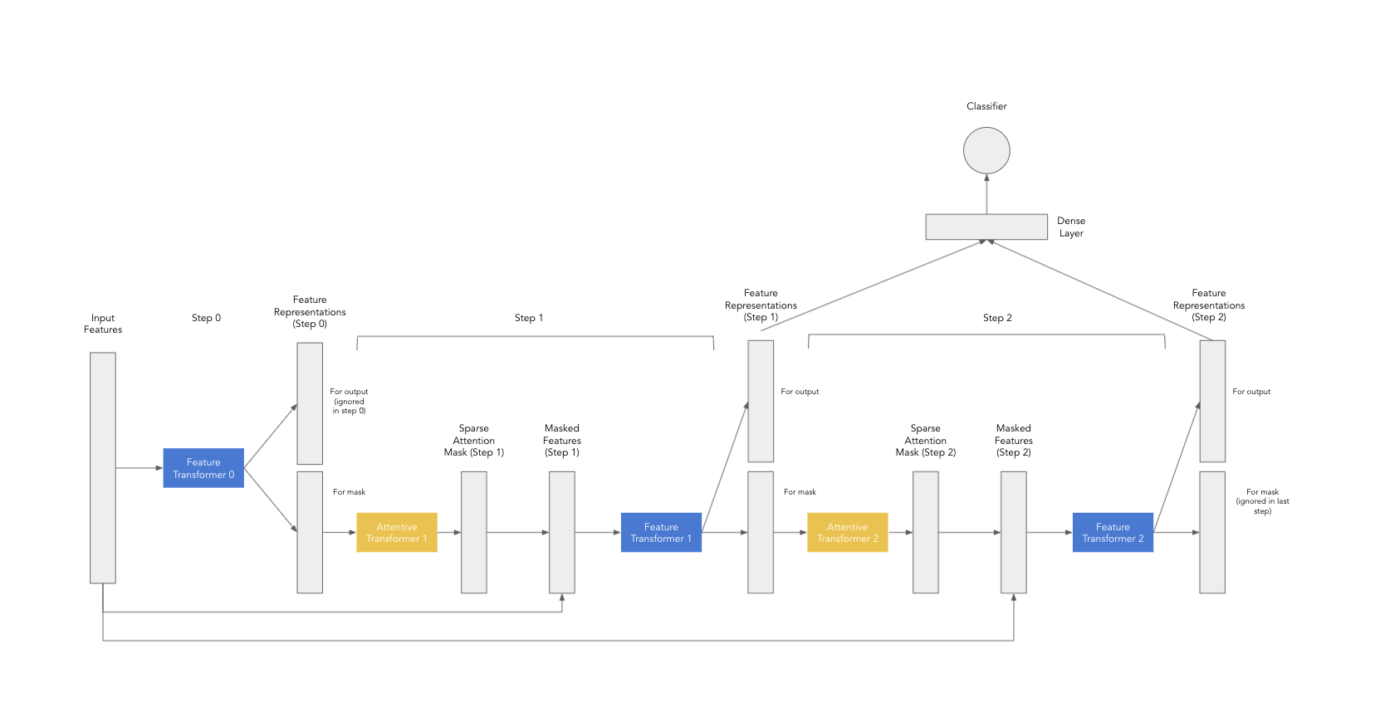
Approach : TabNet Fine Tuning
Architecture :

Slide 21
Approach : TabNet Fine Tuning
Fine Tuning :
TabNet model uses feature transformers (GRUs) and attentive transformers in a sequential multi-step process.
The feature transformer processes the data, while the attentive transformer generates sparse feature selection masks.
It uses sparse feature selection masks to focus on salient features at each decision step.
Max Epochs → 30 , Batch Size = 64.

Slide 22
Approach : TabNet Fine Tuning
Handling Feature Selection:
identify the available feature vectors and find the intersection with those in the training data to obtain a common set of features.
For each era, I compute a correlation vector between the live feature vector and the target column vector of that era.
This results in 574 correlation vectors, one for each era. Some of these vectors may exhibit strong correlations with the live data, while others may not.
To determine the most significant features, I sum all the correlation vectors across eras and select the top K features from this aggregate.

Slide 23
Approach : TabNet Fine Tuning
Fine Tuning Results on Val:
Metric | Overall F1 | Overall Accuracy
Results | 0.3333174009229427 | 0.4999237686897642
Metric | Class 0 | Class 0.25 | Class 0.5 | Class 0.75 | Class 1
F1 | 0 | 0 | 0.66 | 0 | 0
Accuracy |  | - | - | - | -
Precision | 0 | 0 | 0.4999 | 0 | 0
Recall | 0 | 0 | 1.0000 | 0 | 0

Slide 24
Analysis
Feature selection can be improved by using LSTM model, trained on the correlation vectors, to predict the correlation vector for the live data feature vector.
Traditional techniques like Deep Residual Networks are not that great for Time series data whereas LSTMs can be used to predict on time series data instead.
Meta Learning technique that are based on metric such as Prototypical Network / Matching Network do not work on Numerai and require further exploration.
PreTrained networks like TabNet can be fine tuned for Numerai. They give the best results on validation as for me.

Slide 25
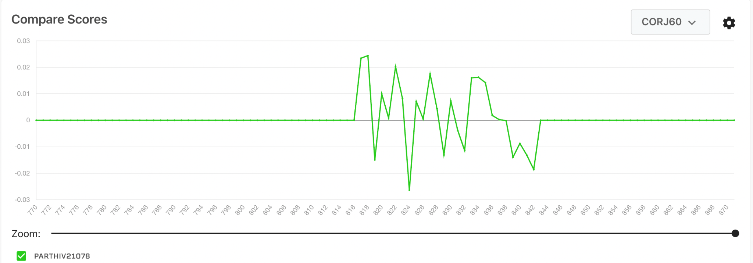
Rankings

Slide 26
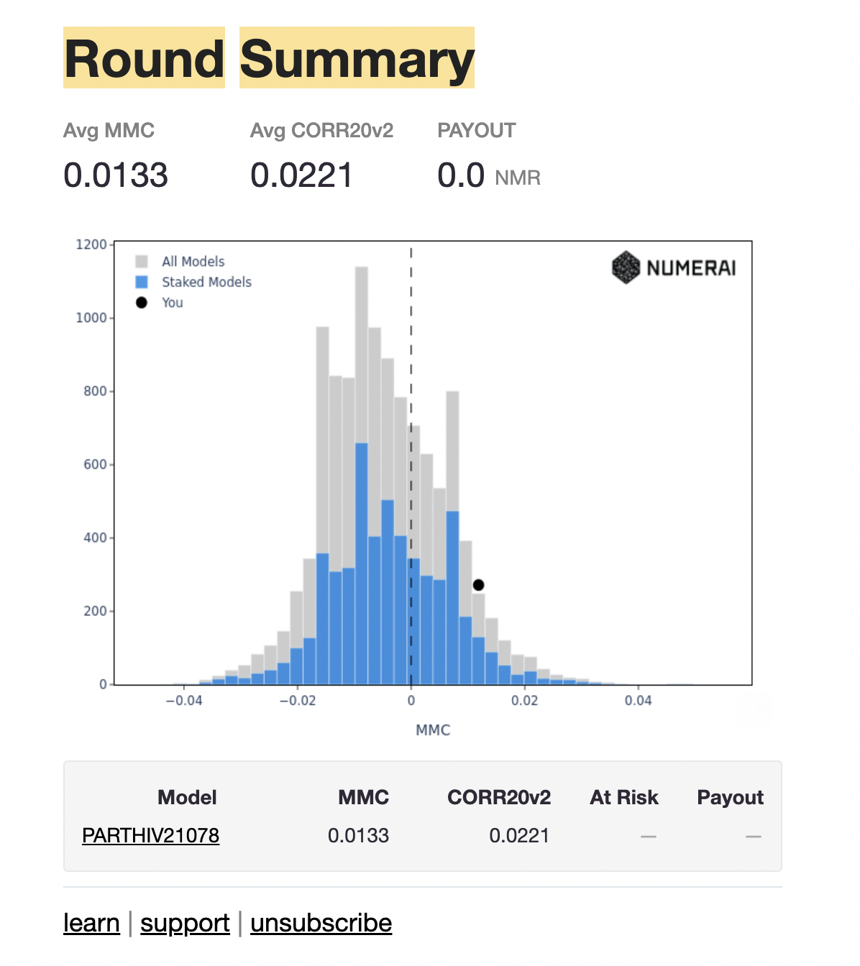
Best Results

Slide 27
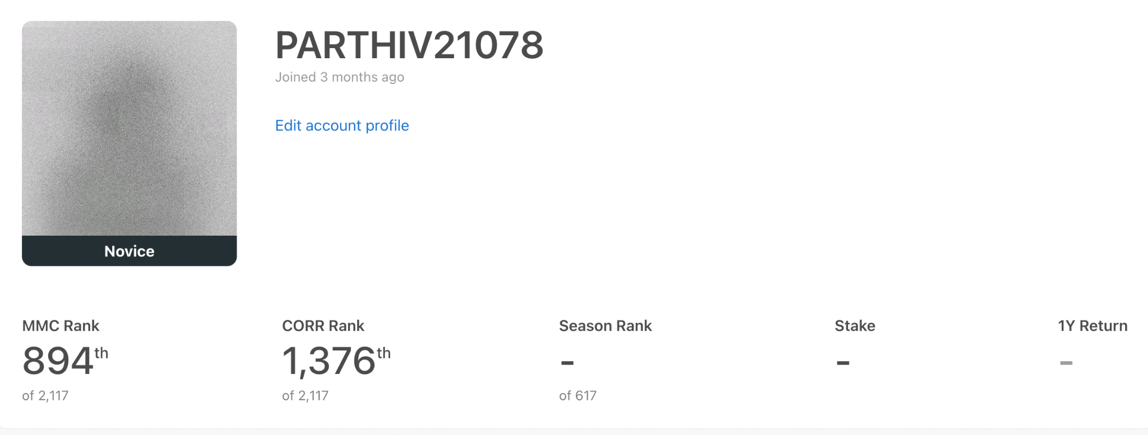
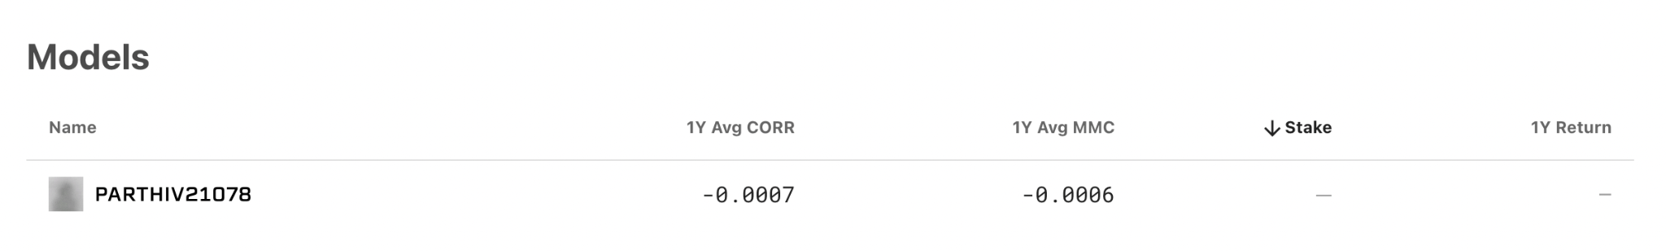
Rankings

Slide 28
Thank You
Q&A

