Slide 1
CAPSTONE-II

Slide 2
TEAM MEMBERS
PARTHIV JANI - 100950996
JOCKY MACWAN - 100946478

Slide 3
Scope of Work
The scope of work involves developing a comprehensive facial recognition-based attendance system tailored for educational institutions. The system will feature accurate facial identification under varying lighting conditions, secure database management for storing student images and details, and a user-friendly interface for administrators to manage student records and view attendance statistics. It will include a notification system to alert students and teachers about attendance status and generate automated reports for authorities. Advanced capabilities will encompass real-time attendance tracking via live video feeds, multi-face detection, anomaly detection, and integration with school management systems for analytics. The system will ensure data privacy and security, adapt to diverse conditions, and be scalable for larger populations. Additionally, it will support remote attendance marking for online classes and offer customizable reporting tools for various administrative needs.

Slide 4
Features
Basic Features
Facial Recognition
Database Management
User-Interface
Notification System
Manual Override
Advance Features
Real-time Attendance
Multiface-Detection

Slide 5

Application
1. Main Dashboard

Slide 6
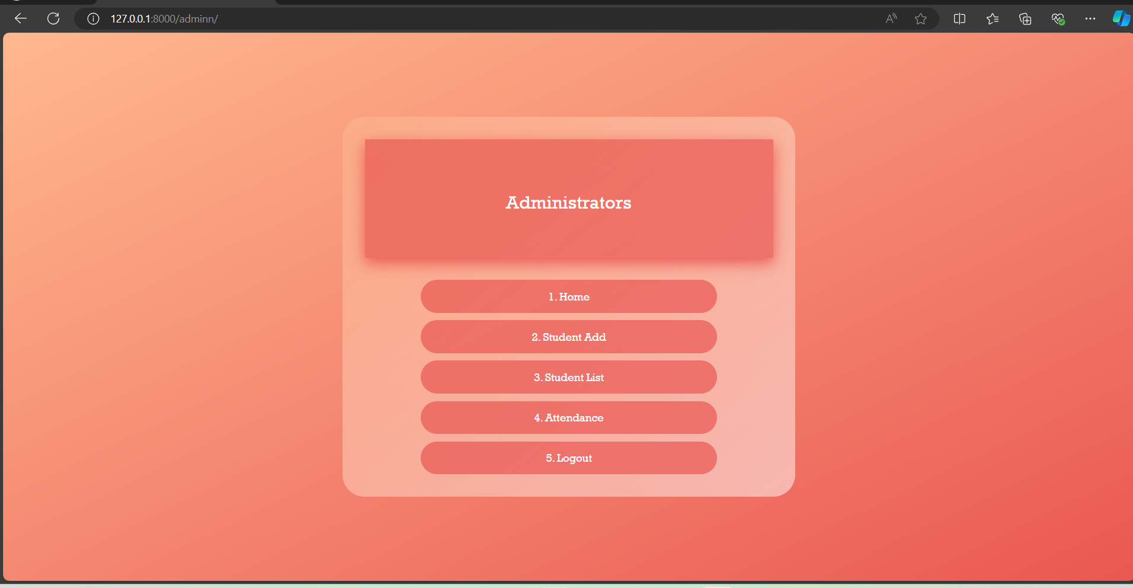
Application
2. Admin/Faculty Dashboard

Slide 7
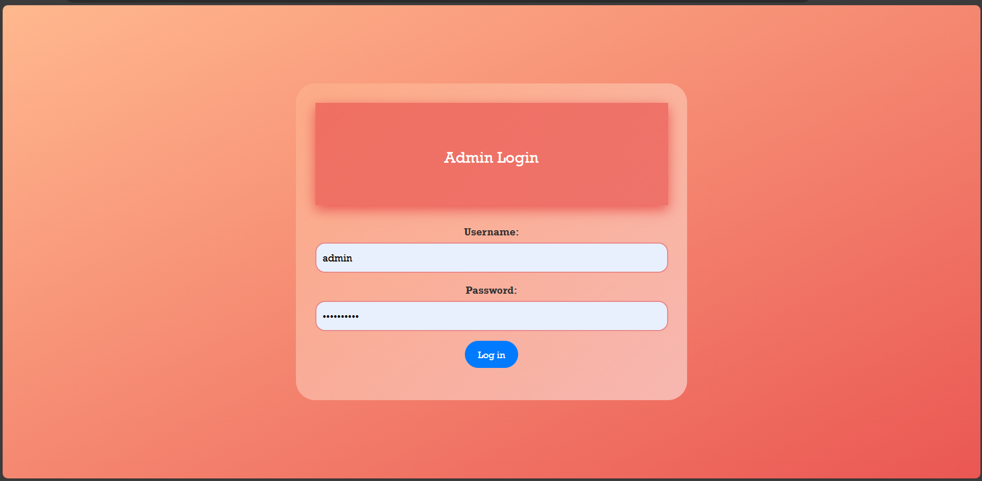
Application
2. Admin/Faculty Dashboard

Slide 8

Application
3. Add Student

Slide 9

Application
4. Student List

Slide 10
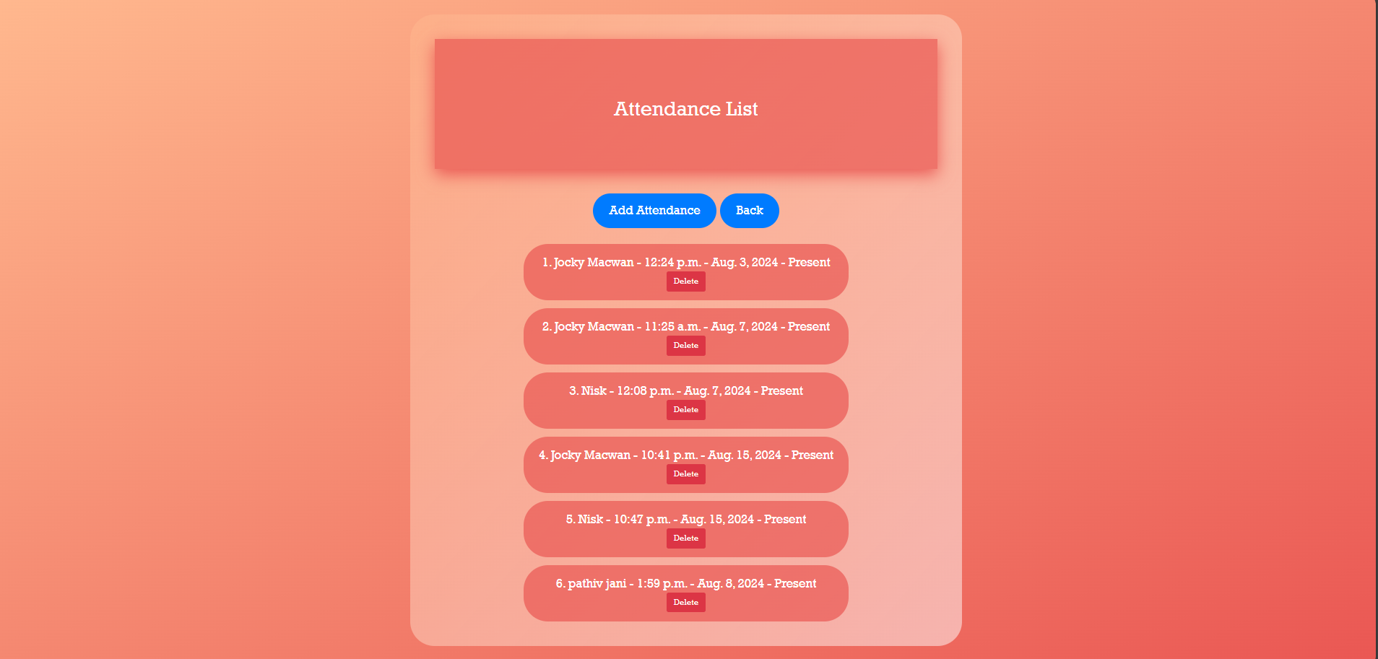
Application
5. Manual Override

Slide 11
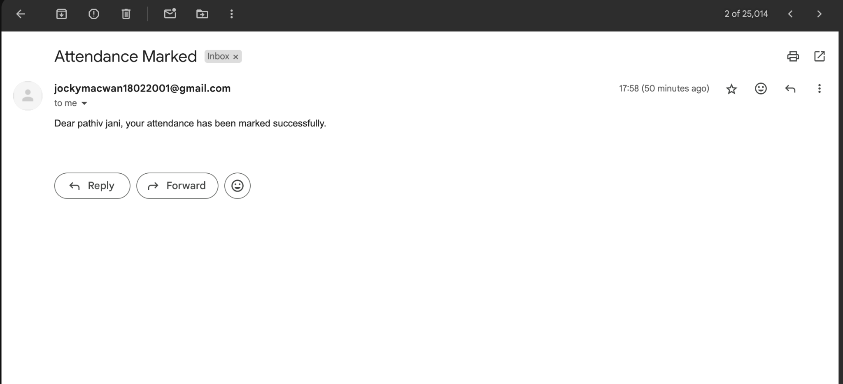
Application
6. Notification

Slide 12
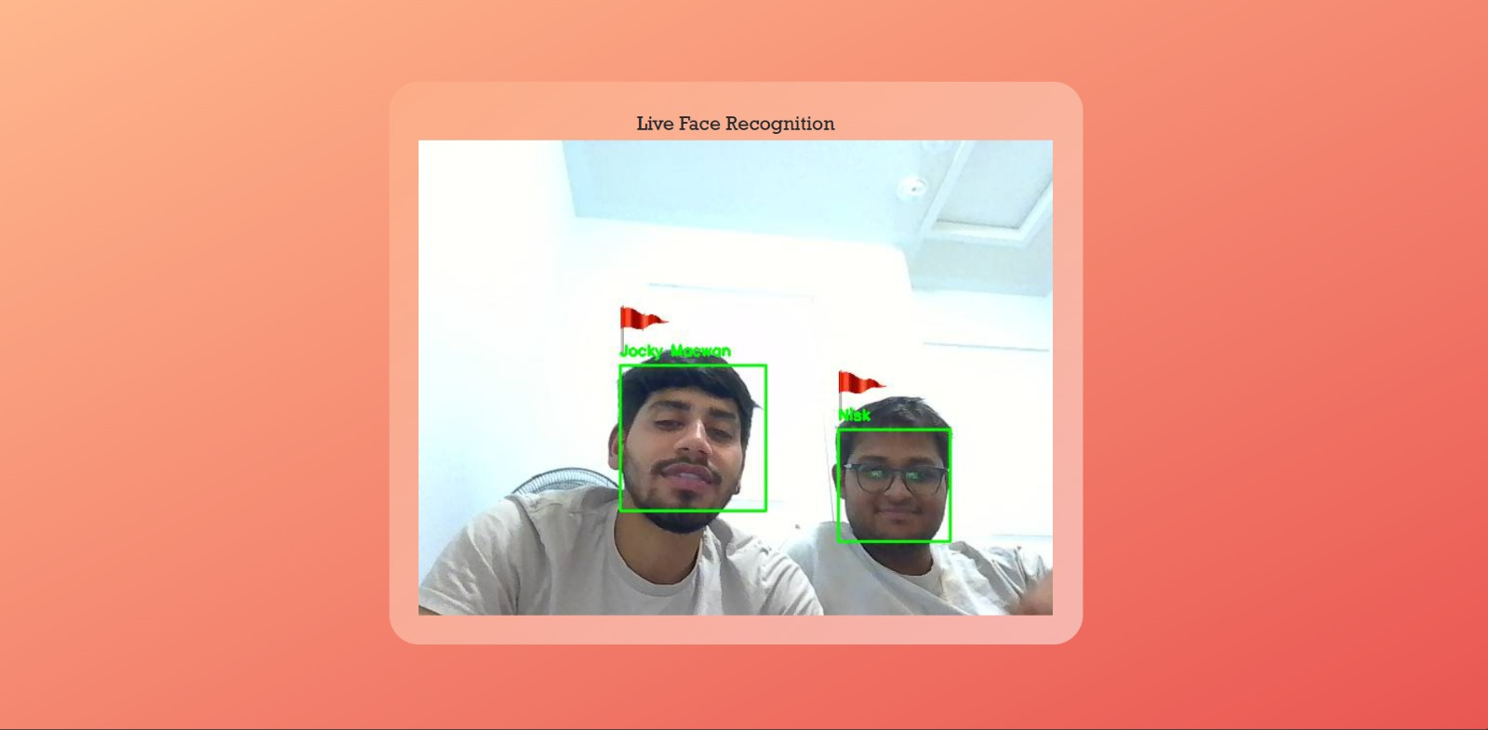
Application
7. Multi-face Detection

Slide 13
Team Contribution
Jockey Macwan
Web Design
Face Recognition
Multiface recognition.
Notification System.
Parthiv Jani
Real-time Attendance.
Front-End.
Database Connection.

Slide 14
GitHub Repository
URL: https://github.com/parthivjani28/capstone-II

Slide 15
Thank You

