Slide 1

Reinforcement Learning Using Unity ML-Agents
Group 12
Xinyue Sui
Parthiv Shah
Pranav Mujumdar

Slide 2
Reinforcement Learning?
Area of machine learning
One of the basic three branches of ML, alongside Supervised and Unsupervised learning
Inspired by behaviourist psychology
Conceptually probably the easiest method of ML to grasp
Deals with decision making, in order to get the most rewards
SOFTWARE AGENT
The actor, controlled by the algorithm
Has a POLICY (it’s “Brain”)
State
S_{t+1}
State
S_{t}
Reward
R_{t+1}
Action A_{t}
ENVIRONMENT REWARDS
TAKES ACTIONS
PUNISHMENTS for bad actions
REWARDS for good actions
Initially randomly,
And then based on it’s past experiences
Notes:
Give an example of training a dog to explain reinforcement training
Famous examples: AlphaGo
Policy: rule used by an agent to decide what actions to take. Basically the “Brain” of the agent

Slide 3

Unity Engine
ML Agents
Gaming engine, Popular with Indie-game developers
C# based construction
Convenient tool for programmers
Helps develop and simulate 2D and 3D “Environments”
Python based Toolkit for RL
Provides communication between data collected in Unity and ML algorithms
Helpful in building a Neural Network using Tensorflow
Real-time Visualization using Tensorboard

Slide 4

Proximal Policy Optimisation (PPO)
“On-Policy” Algorithm developed by OpenAi, released in 2017
Their Dota 2 bot defeated the best human players
PPO strikes a balance between supervised learning and reinforcement learning
Easy to implement, compatible with gradient descent
Easy to tune the hyperparameters
Notes:
Supervised learning: As we have learned in this course, algorithms like Linear regression, Random Forest, SVM are fairly easy to implement, there is of course a lot of mathematical calculation that goes on under the hood, which we don’t need to worry about that much
On-policy methods attempt to evaluate or improve the policy that is used to make decisions.
PPO tends to keep the new policy as close as possible to the previous one. Because making drastic changes might cause it to fail

Slide 5

Soft Actor Critic
Developed and Released by BAIR lab in 2018
Central feature is Entropy Regularization
Off-Policy Algorithm
No Sensitive Hyperparameters
Notes:
Entropy: the average level of "information", "surprise", or "uncertainty" inherent in the variable's possible outcomes
Example, If A always leads to B, but B might lead to C with a 50% probability, we can say Entropy for B after is almost 0 while That of C after B is 0.5
Increasing entropy results in more exploration, which can accelerate learning later on. It can also prevent the policy from prematurely converging to a bad local optimum.
off-policy methods evaluate or improve a policy different from that used to generate the data, An algorithm is off-policy if we can reuse data collected for another task. In a typical scenario, we need to adjust parameters and shape the reward function when prototyping a new task, and use of an off-policy algorithm allows reusing the already collected data.

Slide 6
Key Concepts
Episode
Instance of training
Each episode must be similar
Example, the crashing bird in “Flappy Bird”
Each episode starts again from “zero”
Based on the problem the episode length changes
We can limit each episode for certain number of steps
Rewards
Positive, if the action is GOOD
Negative, if the action is BAD
GAIL (Generative Adversarial Imitation Learning)
Provide demonstration to the AI
So that it can learn faster
Notes:
If the bird in the Flappy bird crashes, it concludes the episode, new episode should start from the beginning

Slide 7
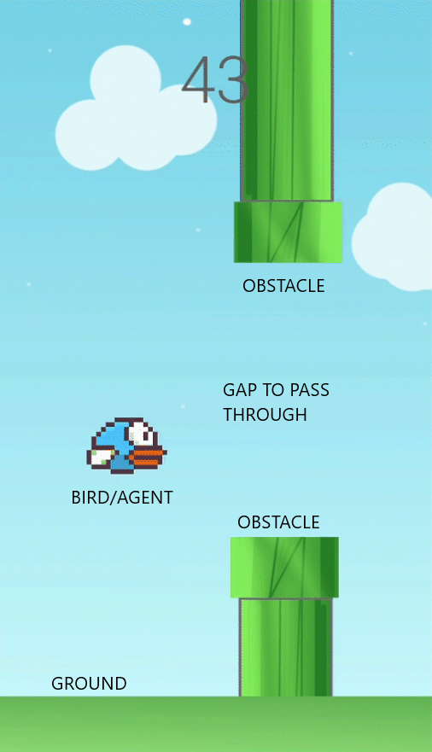
Flappy Bird Implementation
Simplest environment to create and understand
Environment
Agent has to stay alive for as long as possible
Bird Agent: has two “discrete” actions
Jump or Flap its wings
Don’t Jump
Rewards:
Punishment for crashing on the obstacles, and end of the episode (-1f)
Reward for staying alive and making decisions (+0.1f)
Image.1 Screen capture from our project
Notes:
Explain the Unity Construction:
Creating the Environment:
Pipes that are spawning randomly in Vertical axis with random gaps in between them, and are always moving from Right to left at a certain predefined speed
Ground that stays constant
Adding colliders onto the elements to detect the collision or crashing, adding tags that help identify which object has been collided with
Creating the Agent:
Writing the agent script which has methods to actually apply the physical forces onto the bird to make it jump, adding rigidbody to make it fall down due to forces of gravity etc.
Configuring the actions for agents of jumping and not jumping
Configuring how frequently the agent should make decisions

Slide 8
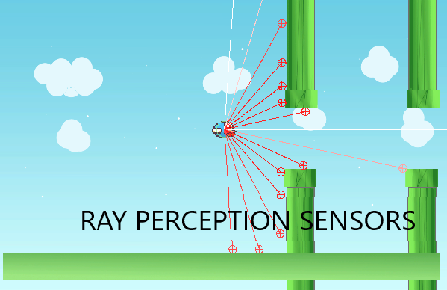
How does the agent understand the environment?
Using Ray Perception Sensors
Collect data about the distance from the obstacle
No information about the nature of the object in the proximity, only the tag can be identified by the agent
The agent learns whether this object is good or bad by trial and error
Notes:
We can configure how long the agent can sense, in what angles,
Here, we are basically replicating the vision of the bird, this sort of thing can also be done by using Image recognition technologies, if we had a camera that can capture what is in the vision of the bird, after trial and error the agent will understand not crashing onto it

Slide 9
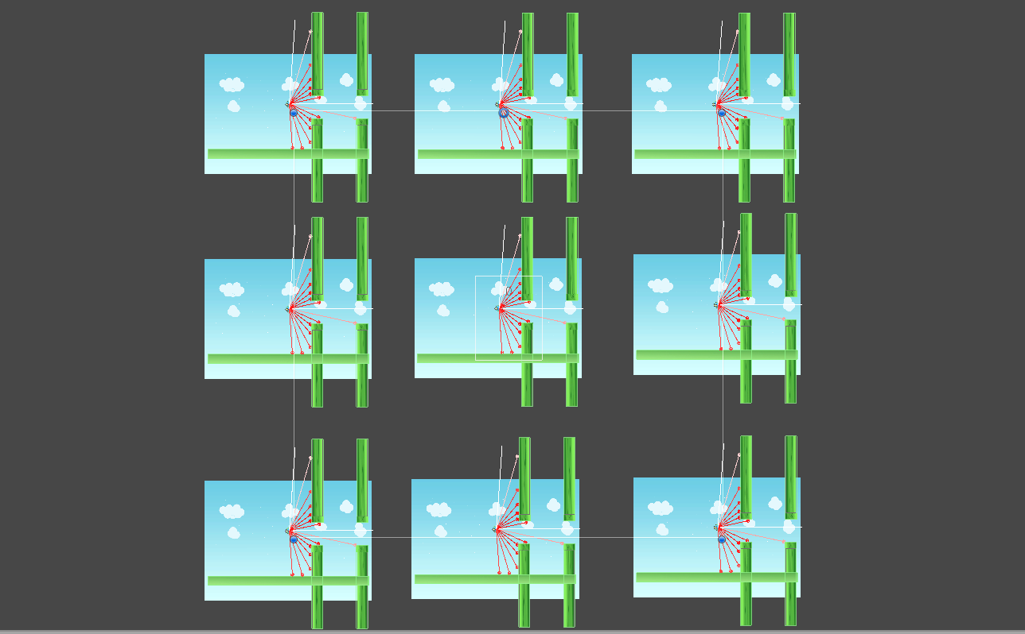
Time to train!
What is better than One agent?
Multiple agents that contribute to the same policy
Faster Training
We replicated the same environment 9 times
All agents contributing to the same policy or the “Brain”
Notes:
Experiences of one instance contributes to the policy which helps other instances avoid the mistakes it did.
Just like we humans learn from mistakes of others, we want our agent to become smarter, quickly.

Slide 10

Now let’s start training!
Notes:
Using standard hyperparameters given in the documentation for PPO training in the MLAgents
As we can see the agent is dying almost immediately but it’s too fast to understand, Normally the training occurs 20 times faster, let’s slow it down a bit

Slide 11
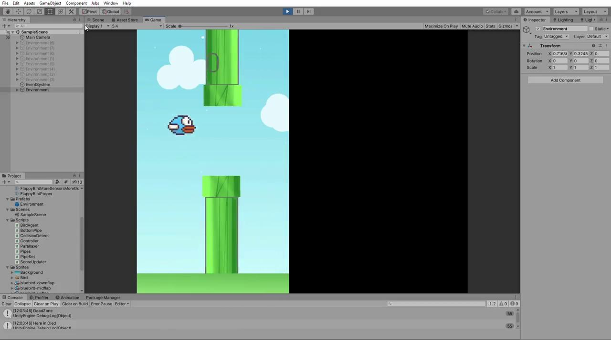
Let’s slow it down to understand whats happening
Notes:
We can mention the timescale parameter for training, to understand, we slowed it down to 1 which means one second is of same value for the training
The agent sometimes luckily passes through the gap and but then crashes on to the next immediately
we can see that the agent is aware of the actions it can take

Slide 12
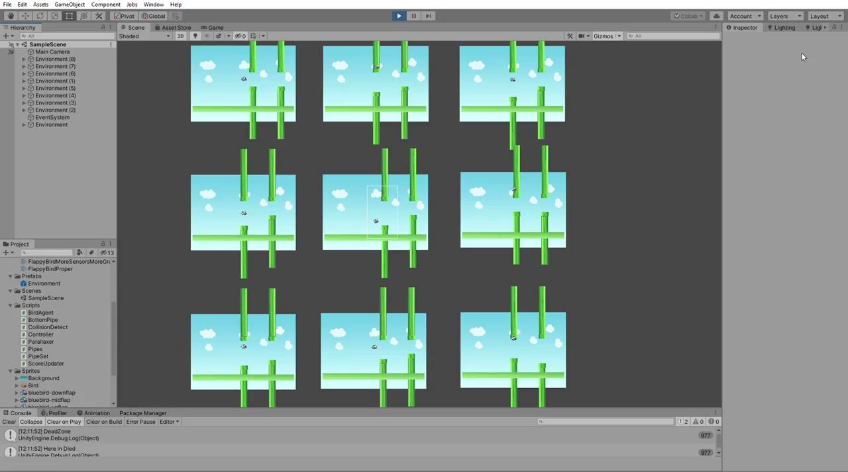
Let it train
Notes:
This is the view of all the instances of the environments training simultaneously, contributing to the same policy

Slide 13
Halfway through the training

Slide 14
Final trained Model
Use the final trained model as a “.nn” file that we can use for performing inference
Rewards (Must Increase)
At 60k Steps: 9.618
At 9.96M Steps: 482.3
Episode length(Must increase)
At 60k Steps: 20.46
At 9.96M Steps: 951.5
Notes:
Explain why the episode length is high.

Slide 15
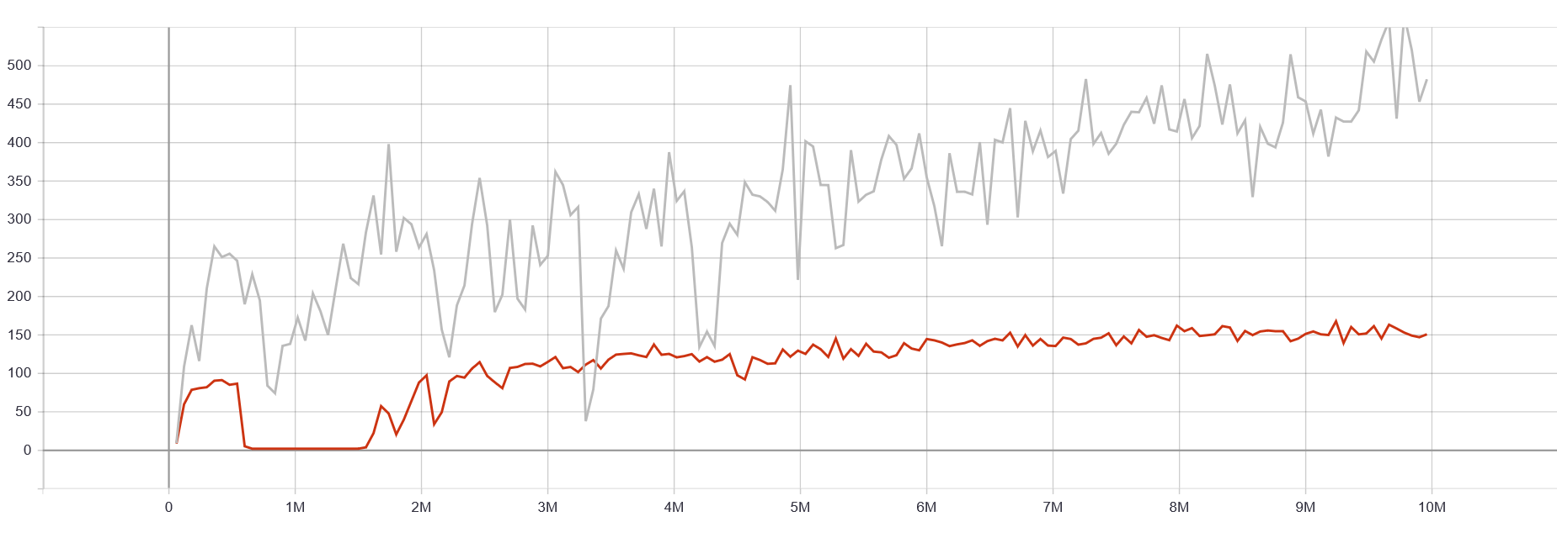
Cumulative Reward Graph

Slide 16
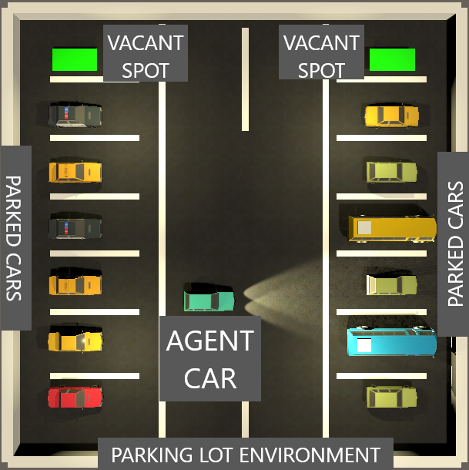
It’s after all just a simple game!
Real world problems are a lot complicated and difficult to simulate
Inspired by Autonomous cars, Tesla’s Autopilot
- Car that can find an empty parking spot
- Simple path finding but we added a lot of randomness to it
Notes:
Explain the parking lot environment,
Randomly spawning the parked cars and empty parking spot
Randomly spawning the agent car, anywhere between the free space, oriented in any direction
Adding colliders onto the cars and the parking spot, adding ray perception

Slide 17
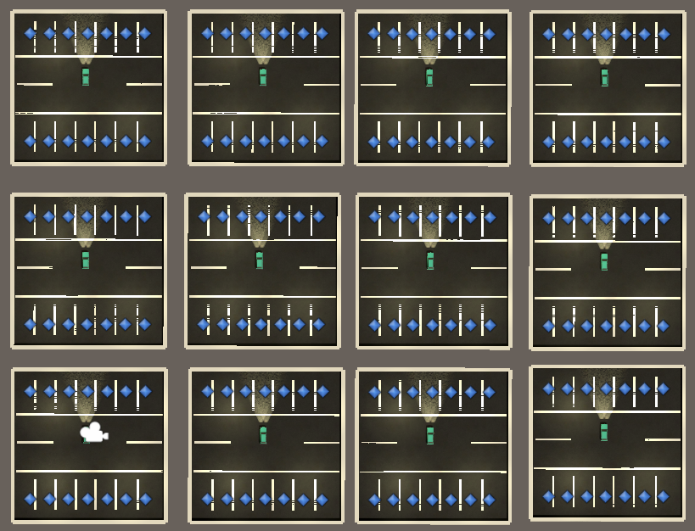
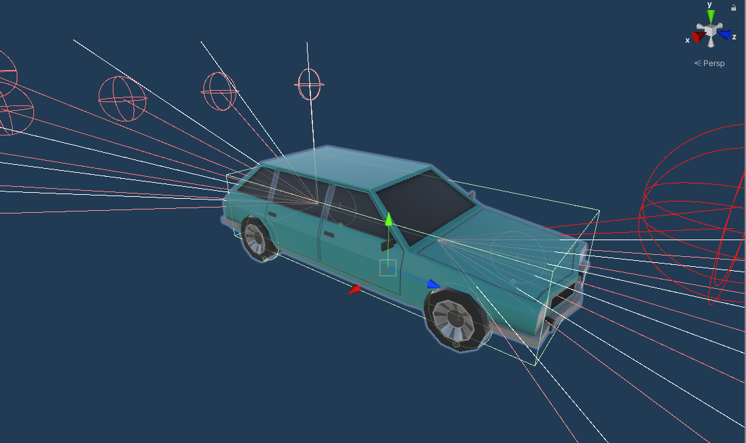
Configuring the Agent
Adding Ray Perception sensors
Rewards
If crashes on to another car, punishment of (-0.1f)
If finds and drives to the empty parking spot reward of (+5f), and episode ends
Punishment for taking too long to find the parking spot (-1/5000f)
Goal:
Find the empty parking spot
Drive there in least possible number of steps
Notes:
Explain replicating the environment

Slide 18
Training(Beginning)
Notes:
This is at timescale 20, the AI hasn’t explored the environment and all its actions

Slide 19
After a few hours of training
Notes:
By this time it has understood the rules, not to crash into another car, or the walls, roam around to find the empty parking spot and try to reach it as soon as possible

Slide 20
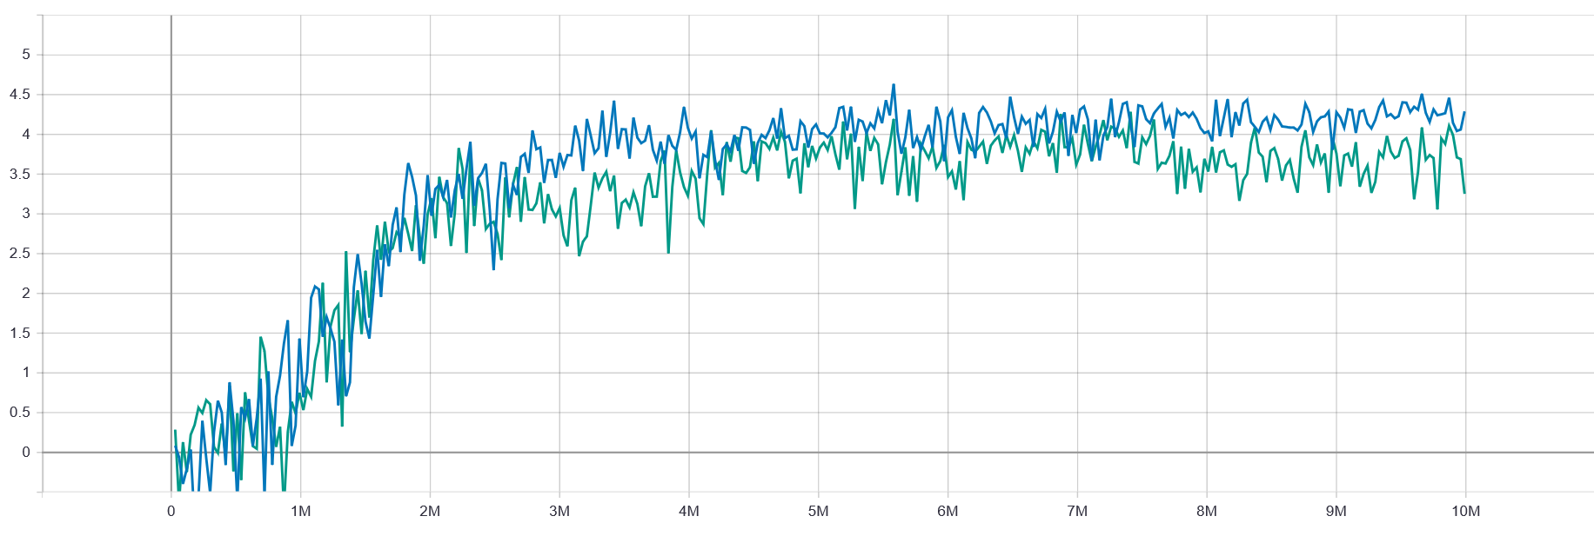
Fully trained AI (after 10 M steps)
Cumulative Reward
3.25 (without GAIL)
4.29 (With GAIL)
Episode Length(must decrease)
At 30k steps
840.2 (Without GAIL)
896.2 (With GAIL)
At 9.99M steps
370 (Without GAIL)
179.1 (With GAIL)
Graph Showing the Cumulative Reward
Notes:
Explain About GAIL:

Slide 21
Final trained AI

Slide 22
Conclusion
PPO and SAC both perform well
PPO paired with GAIL gives even better performance
On a general note
Complex world problem can be easily simulated
General purpose RL algorithms are versatile
With the applications in transportation, robotics, we can create AIs that can be trained to perform a variety of complicated tasks without having to hard code its actions

Slide 23
THANK YOU :)
Notes:
Don’t forget to thank the professor for letting us work on this!

