Slide 1

SAMSUNG PRISM
Generative AI
Hackathon
3rd Edition 2026 – 27
Theme ID - 03 : Teachable Voice Automation
Team Name - Cheesecake
College Name - SRM University, Kattankulathur
Member Name & Email 1 - Sanjeev Aryan – sa8129@srmist.edu.in
Member Name & Email 2 – Parth Jaina – pj2752@srmist.edu.in
Member Name & Email 3 - Vardaan Sharma – vs7463@srmist.edu.in
Member Name & Email 4 - Shubh Garg – sg8735@srmist.edu.in
Submission Github link - https://github.com/parthjaina2107/FlowPilot
Notes:
Opening slide for the 3rd edition of the PRISM Generative AI Hackathon. Replace the SAMSUNG PRISM pill with the official PRISM logo image if you have the asset. Confirm the academic year label (2026-27) before circulating.

Slide 2
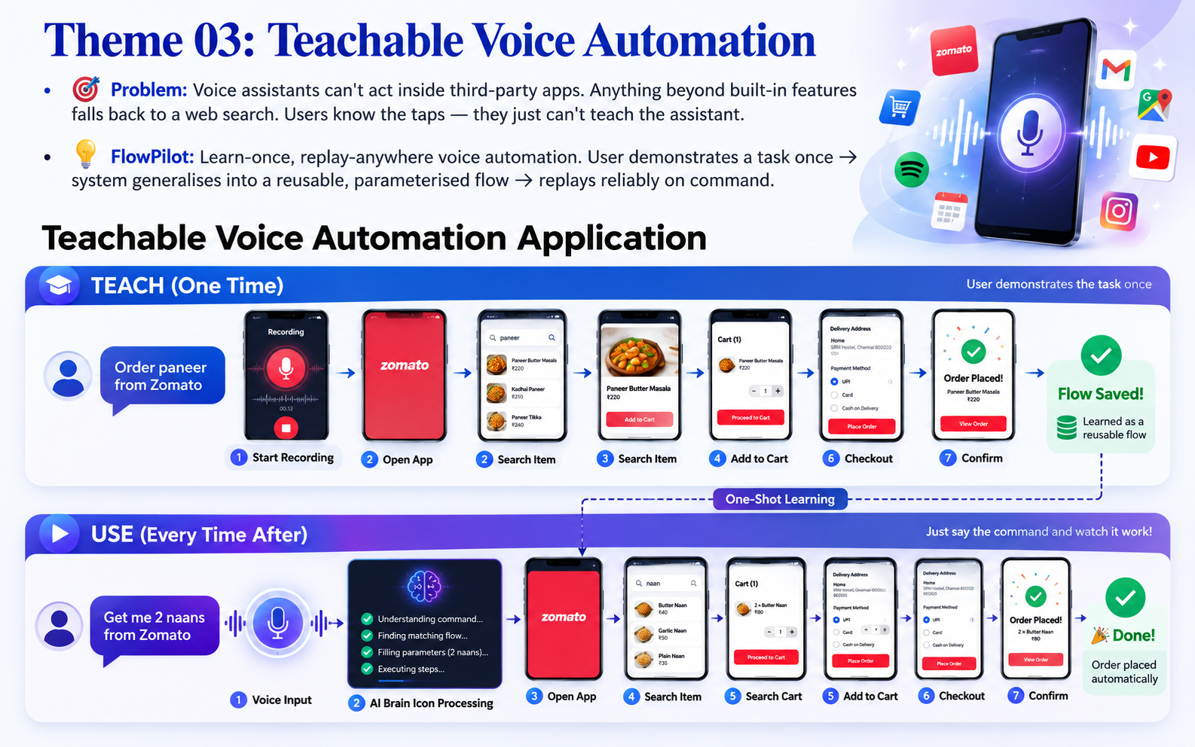

Slide 3
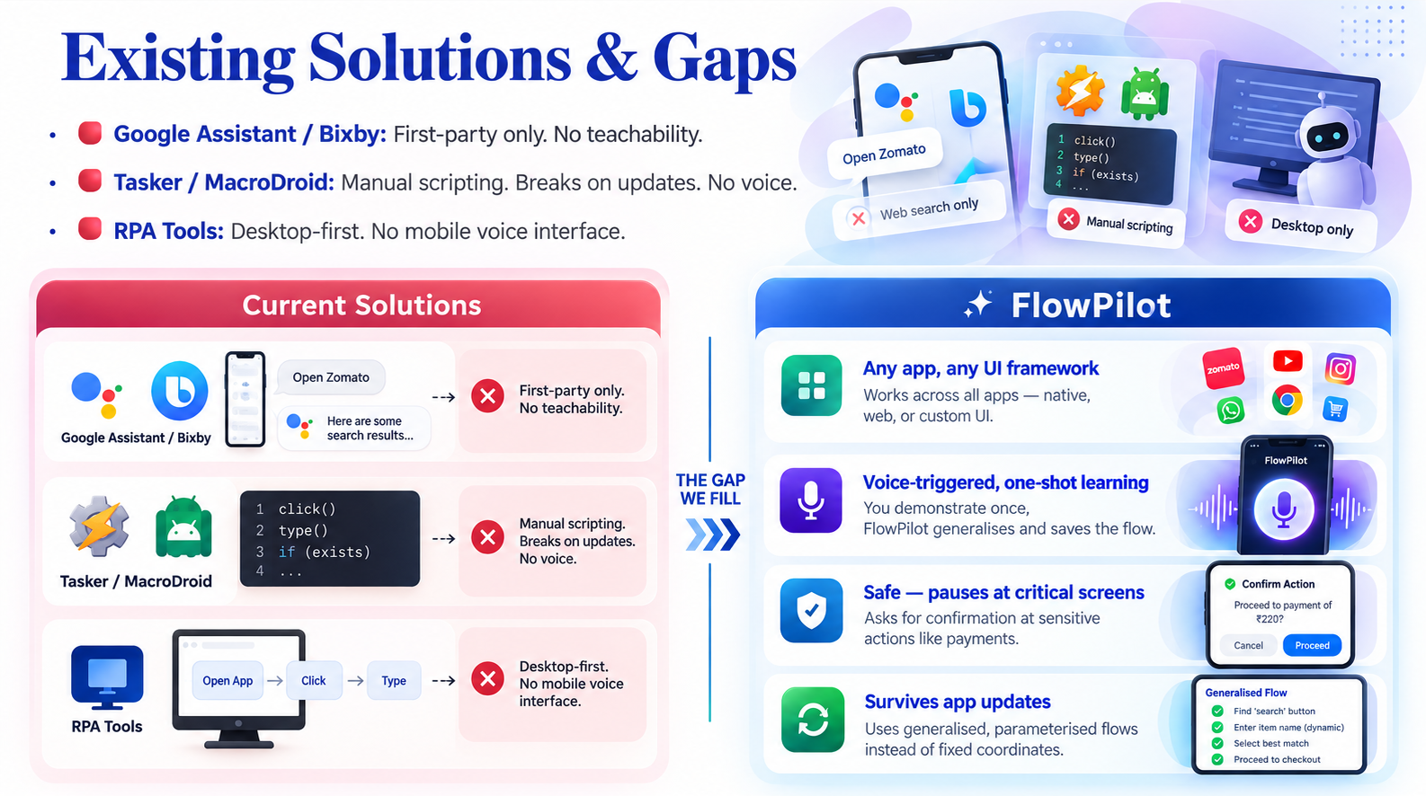

Slide 4
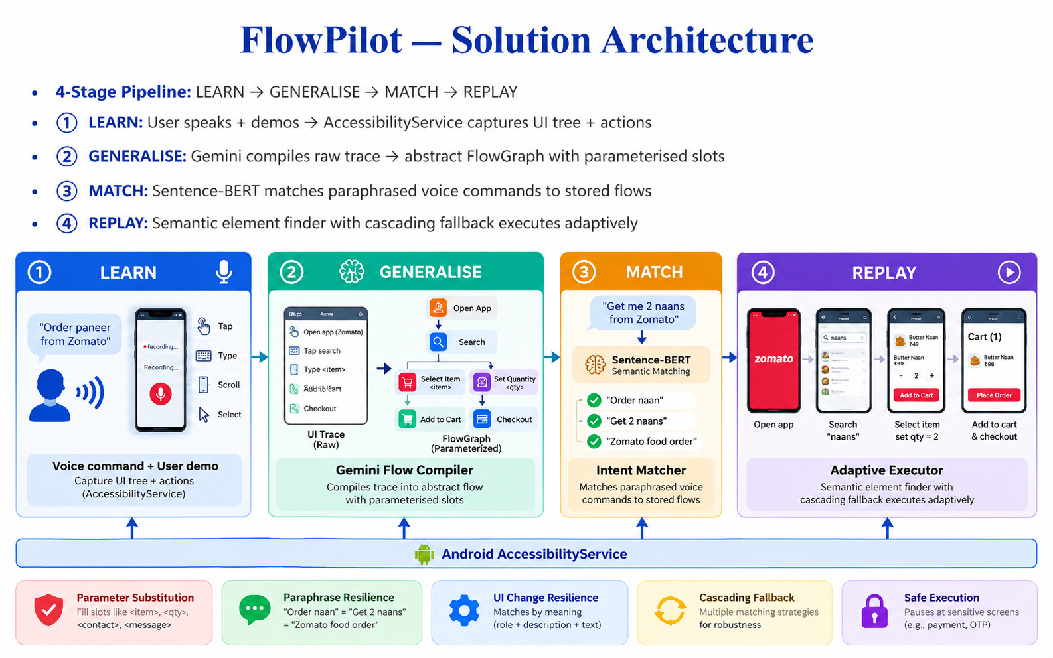

Slide 5
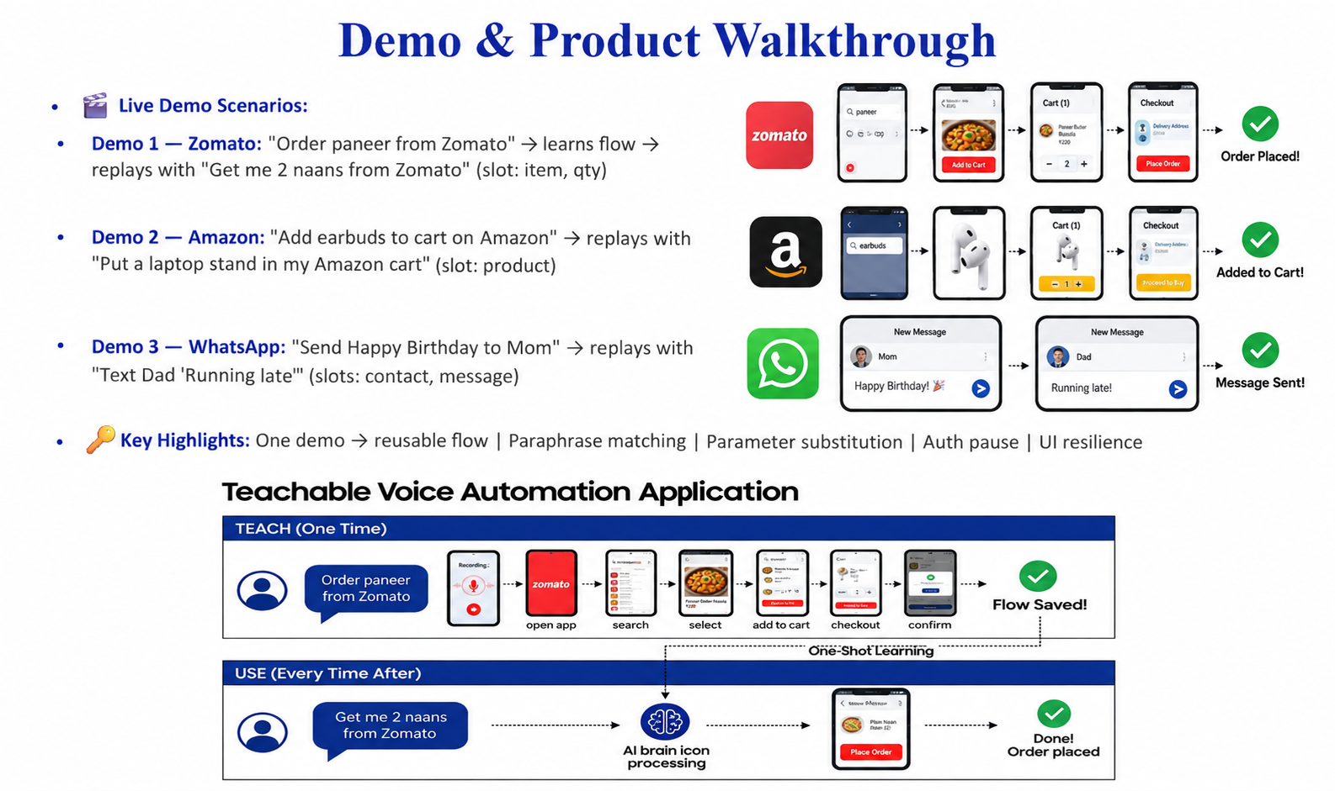

Slide 6
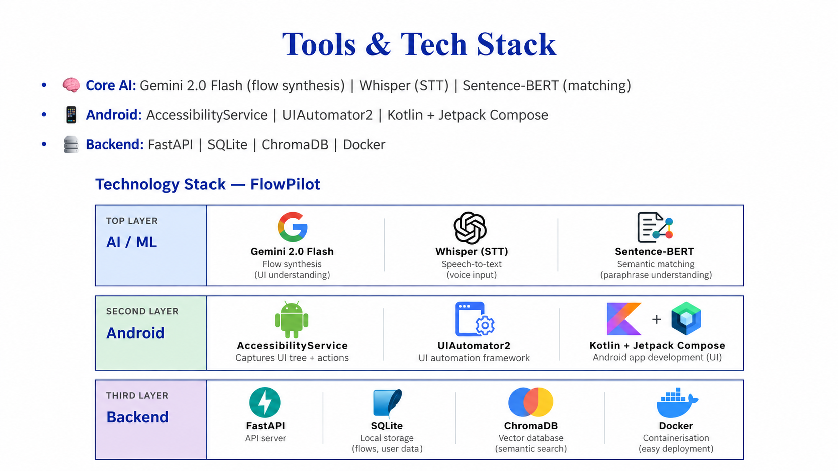

Slide 7
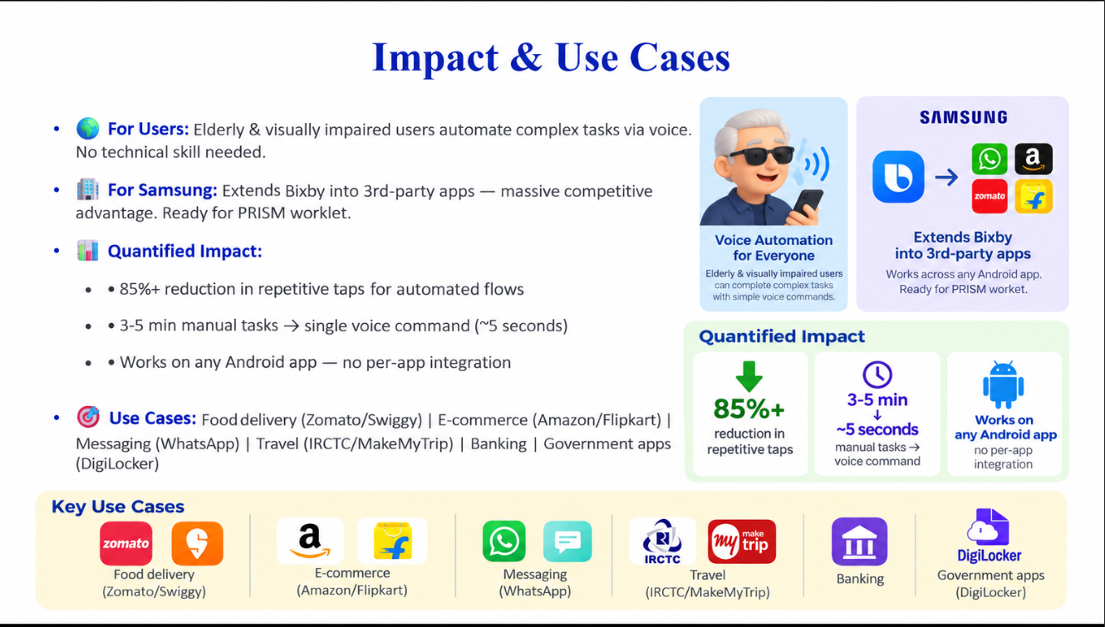

Slide 8
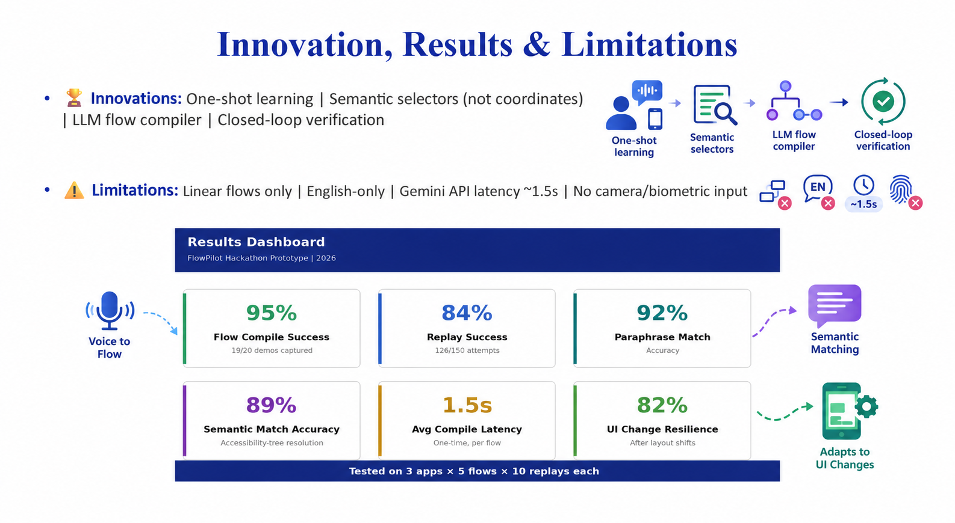

Slide 9
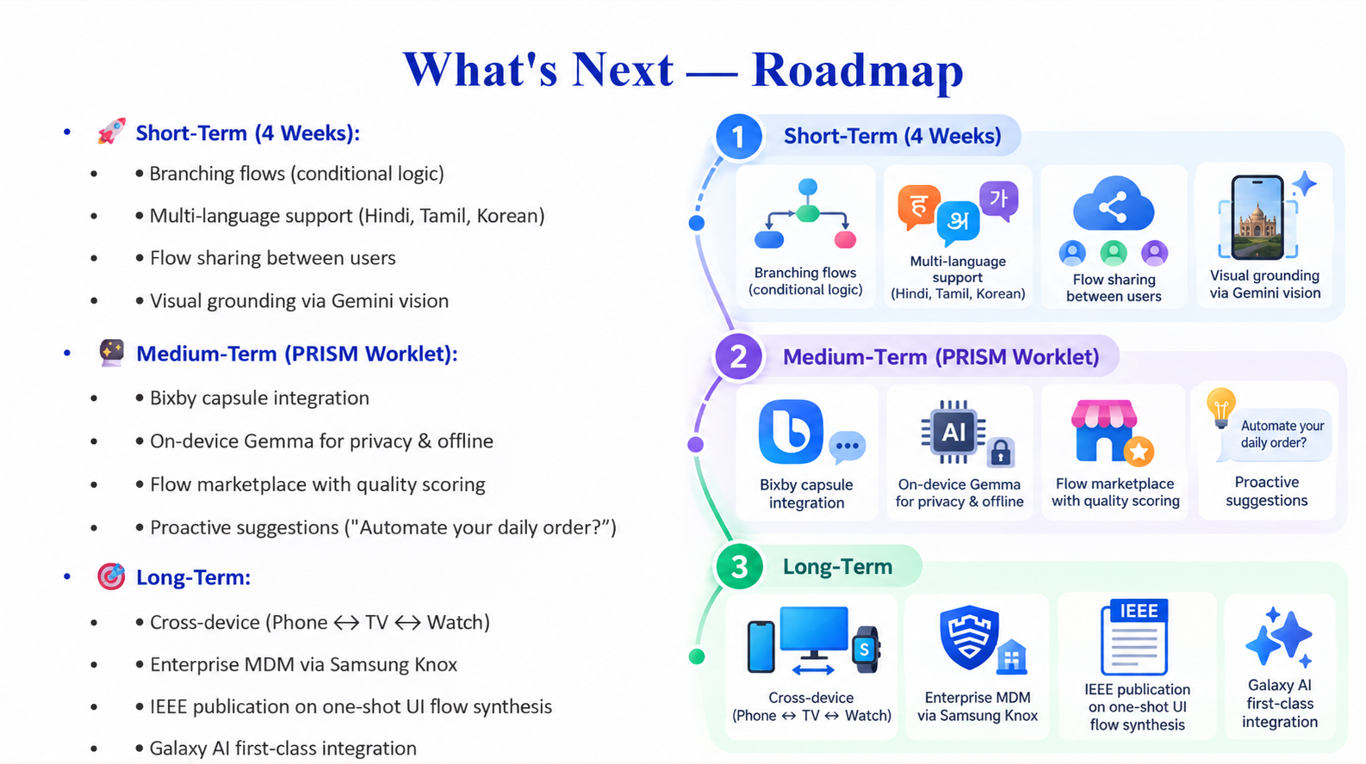

Slide 10
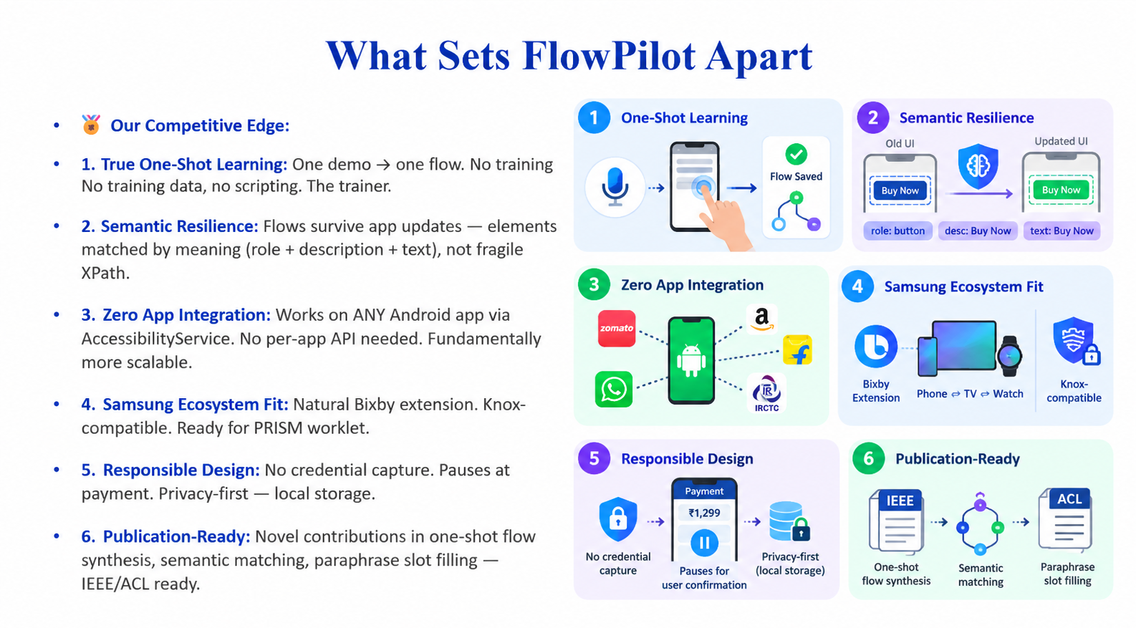

Slide 11
Submission Checklist
✅ Working prototype code — public GitHub repo (Y)
✅ README with reproducible setup + Docker (Y)
✅ Demo video, max 5 minutes — YouTube link (Y)
✅ Presentation file (PPT) (Y)
✅ GitHub release tag: PRISM_GENAI_HACKATHON_Y2026 (Y)
✅ AI Disclosure Form submitted (Y)

Slide 12
Thank you
Organised by the Language AI Team and the PRISM Team, Samsung R&D Institute India
Notes:
Closing slide. Add the Google Form URL and a contact email before sharing. Edition 2 organising team for reference: Language AI - Sourabh Tiwari, Gaurav, Sanjeeth Pothireddy, Gorang Maniar; PRISM - Binny Lakra, Prakhar Chandrakar, Vishu Kumar; Kick-off and mentors - Giridhar Jakki, Deepraj Prabhakar Patkar (Language AI), Srimanu Prasad Nagaraju, Ashish Kumar (Tech Strategy).

