Slide 1

Web Technologies Lab: Servlets → JSP → Spring Boot
MCS-220 · Section 2 · A 2-hour hands-on crash session (including doubt solving)
Setup · Servlets · JSP · Spring MVC + Bootstrap · Lab roadmap · Q&A
Notes:
Welcome (2 min). Today's promise: in two hours every student will have installed the toolchain, run a Servlet, a JSP page and a Spring Boot MVC app, and know exactly what to do in the 10 lab sessions. Tell them a printed/PDF handbook covers every step in detail, so they should focus on understanding rather than copying.

Slide 2







Our 120-minute plan
00–10 min
70–100 min
Kick-off & the big picture
Spring Boot MVC + Bootstrap
10–25 min
100–105 min
Set up JDK, IDE & Tomcat
Lab sessions roadmap
25–50 min
105–120 min
Servlets: request → response
Doubt solving & quick quiz
50–70 min
Doubt time is protected: park questions on the board during the talk and we answer them all at 105 min.
JSP: HTML with Java inside
Notes:
1 min. Walk through the timeline. Ask students to write questions on sticky notes or a shared doc ('parking lot') so the flow is not broken; we clear the lot in the final 15 minutes.

Slide 3

By the end of today you will be able to…
Install & configure
Write a Servlet
Build JSP pages
Run Spring Boot MVC
JDK, JAVA_HOME, NetBeans / Eclipse and Apache Tomcat
Read request data and send an HTML response, mapped in web.xml
Use directives, expressions and implicit objects to show form data
Controller + Model + Thymeleaf view, styled with Bootstrap
Notes:
2 min. These four outcomes map to the four technical blocks. Mention the 10 lab sessions build on these exact skills.

Slide 4
The big picture: how a web request travels
≈ 5 min
Browser
(HTML form / URL)
Web server
Apache Tomcat
Your Java code
Servlet · JSP · Controller
HTML response
back to browser
Servlet
JSP
Spring MVC
A Java class that receives the HTTP request and writes the HTML response itself.
An HTML page with small Java pieces; Tomcat converts it into a servlet for you.
A framework: a Controller handles the request, a template (Thymeleaf) draws the page.
Notes:
5 min. Draw this on the board too. Key idea: all three technologies sit in the same place (inside Tomcat) and do the same job (turn a request into a response). They differ only in how much code YOU write. Evolution: Servlet (all Java) -> JSP (mostly HTML) -> Spring MVC (separation of concerns).

Slide 5
Part 1 · Setting up the environment
10–25 min · JDK → JAVA_HOME → IDE → Tomcat → first project
Notes:
Transition. Ideally students installed software before class (send the handbook in advance). In class, demonstrate, don't wait for downloads.

Slide 6






Why an IDE? Everything in one window
≈ 2 min
Code editor
Compiler
Debugger
Syntax colouring and auto-completion
Turns .java source into runnable bytecode
Breakpoints, step-through, watch variables
Builder
Class browser
Hierarchy view
Ant / Maven build & deploy in one click
Explore classes, methods and objects
Visualise the project structure
Popular Java IDEs: Apache NetBeans · Eclipse IDE for Enterprise Java · IntelliJ IDEA
Notes:
2 min. Before IDEs we used a text editor + javac + manual deployment. The IDE automates compile -> build -> deploy -> run. We'll use NetBeans for Servlet/JSP (simplest Tomcat wiring) and Eclipse (or any IDE) for Spring Boot.

Slide 7
Your toolchain checklist
≈ 2 min
Tool | Why you need it | Recommended version | Get it from
JDK | Compiler + runtime for Java | LTS: 17 or 21 | oracle.com / adoptium.net
Apache Tomcat | Web server that runs Servlets & JSP | 9.0.x (javax code) | tomcat.apache.org
Apache NetBeans | IDE for Servlet & JSP projects | Latest release | netbeans.apache.org
Eclipse IDE (EE) | IDE for Spring projects (+ Spring Tools) | Latest release | eclipse.org/downloads
Maven | Downloads libraries, builds the project | Bundled with the IDEs | maven.apache.org
MySQL | Database for CRUD labs (sessions 1, 6–10) | 8.x | dev.mysql.com
Web browser | To test http://localhost:8080 | Chrome / Edge / Firefox | —
Tip: the manual's code uses javax.servlet → pair it with Tomcat 9. Tomcat 10+ needs jakarta.servlet imports.
Notes:
2 min. IMPORTANT gotcha that causes most 'my servlet gives 404/500' doubts: Tomcat 10 and later renamed javax.* to jakarta.*. The manual's screenshots use Tomcat 10.0.8 but the code imports javax.servlet — that combination fails. Either use Tomcat 9 with javax, or Tomcat 10/11 with jakarta imports (NetBeans generates the right one for the server you choose).

Slide 8
Step 1–2: Install the JDK and set JAVA_HOME
≈ 4 min
Windows 10 / 11
Linux (Ubuntu) – add to /etc/profile or ~/.bashrc
Check first: java --version in Command Prompt
Download & run the JDK installer (choose an LTS version)
Start → “Edit the system environment variables” → Environment Variables…
System variables → New: JAVA_HOME = C:\Program Files\Java\jdk-17
Edit Path → New → %JAVA_HOME%\bin → OK, OK, OK
Open a NEW Command Prompt and re-check java --version
$ sudo apt install openjdk-17-jdk
# then add these lines:
export JAVA_HOME=/usr/lib/jvm/java-17-openjdk-amd64
export PATH=$PATH:$JAVA_HOME/bin
$ source /etc/profile
$ java -version
Expected output
C:\> java --version
java 17.0.x LTS
Java(TM) SE Runtime Environment ...
Notes:
4 min. Demo on your own machine. Explain JAVA_HOME (where Java lives — used by Tomcat, Maven, IDEs) versus PATH (where Windows looks for the 'java' and 'javac' commands). Common doubt: 'java is not recognized' = PATH not set, or the old Command Prompt window is still open.

Slide 9
Step 3: Install NetBeans and Eclipse
≈ 3 min
Apache NetBeans
Eclipse IDE
Download installer from netbeans.apache.org
Run as administrator → Next
Accept the licence agreement
Choose install folder and JDK (Browse…)
Install → Finish → launch from Start menu
First project: enable Java Web/EE when asked
Download eclipse-inst-jre-win64.exe
Pick “Eclipse IDE for Enterprise Java and Web Developers”
Confirm JDK + install folder → INSTALL
Accept the user agreement (needs internet)
LAUNCH → choose a workspace folder
Help → Eclipse Marketplace → install Spring Tools
Notes:
3 min. Students only need ONE IDE to start; NetBeans is simplest for Servlet/JSP because Tomcat integration is built in. Eclipse + Spring Tools 4 (from Marketplace) gives Spring Boot support. IntelliJ Community also works with Maven projects.

Slide 10
Create your first web project in NetBeans
≈ 4 min
File → New Project
Java with Ant → Java Web → Web Application
Name: MyFirstServletProject
1
2
3
Server: Add… → Apache Tomcat → Browse to Tomcat folder
Set manager username / password
Frameworks: leave unticked → Finish
4
5
6
Run it
http://localhost:8080/MyFirstServletProject
host port context path
Right-click the project → Run. NetBeans compiles, deploys to Tomcat and opens the browser at:
Notes:
4 min. LIVE DEMO. Edit index.html to show 'Welcome to my First Web Application', run, show the browser. Explain the URL: localhost = your machine, 8080 = Tomcat's port, /MyFirstServletProject = the context path (project name).

Slide 11
Part 2 · Servlets
25–50 min · Lifecycle → RequestServlet → web.xml → form handling → GET vs POST
Notes:
Transition to servlets. 25 minutes for this block.

Slide 12
What is a Servlet? Its lifecycle
≈ 5 min
A Servlet is a Java class that extends HttpServlet. Tomcat (the servlet container) creates it, calls its methods for every request and destroys it on shutdown.
Class loaded &
object created
init()
once
service()
every request
doGet() / doPost()
destroy()
once
HttpServletRequest
HttpServletResponse
getParameter("name") – a form value
getMethod(), getRequestURI(), getProtocol()
getRemoteAddr() – client IP address
setContentType("text/html") – what we send
getWriter() – a PrintWriter to write HTML
sendRedirect(url) – send browser elsewhere
Notes:
5 min. Lifecycle: init() runs once (good for opening a DB connection), service() runs per request and dispatches to doGet/doPost according to the HTTP method, destroy() runs once at shutdown. One servlet object serves many requests using threads. Request object = everything that came IN; response object = everything going OUT.

Slide 13
Example 1: RequestServlet.java
≈ 5 min
public class RequestServlet extends HttpServlet {
protected void processRequest(HttpServletRequest request,
HttpServletResponse response)
throws ServletException, IOException {
response.setContentType("text/html;charset=UTF-8");
try (PrintWriter out = response.getWriter()) {
out.println("Current Date & Time: " + new java.util.Date());
out.println("<h3>Request Information Example</h3>");
out.println("Method: " + request.getMethod() + "<br>");
out.println("Request URI: " + request.getRequestURI() + "<br>");
out.println("Protocol: " + request.getProtocol() + "<br>");
out.println("Remote Address: " + request.getRemoteAddr());
}
}
@Override
protected void doGet(HttpServletRequest req,
HttpServletResponse res)
throws ServletException, IOException {
processRequest(req, res); // doPost() does the same
}
}
extends HttpServlet
makes the class a servlet Tomcat can call
setContentType
tells the browser “this is HTML”
try (PrintWriter out …)
try-with-resources: the writer closes itself
out.println(…)
every line becomes part of the HTML page
doGet → processRequest
GET and POST share one method
Notes:
5 min. Walk line by line using the right-hand cards. NetBeans generates this skeleton automatically: right-click Source Packages -> New -> Servlet; tick 'Add information to deployment descriptor (web.xml)'. Imports needed: java.io.IOException, java.io.PrintWriter, javax.servlet.ServletException, javax.servlet.http.* (jakarta.* on Tomcat 10+).

Slide 14
web.xml: connecting a URL to a Servlet
≈ 4 min
WEB-INF/web.xml (deployment descriptor)
URL
/RequestServlet
servlet-name
RequestServlet
servlet-class
RequestServlet
<web-app version="3.1" ...>
<servlet>
<servlet-name>RequestServlet</servlet-name>
<servlet-class>RequestServlet</servlet-class>
</servlet>
<servlet-mapping>
<servlet-name>RequestServlet</servlet-name>
<url-pattern>/RequestServlet</url-pattern>
</servlet-mapping>
<session-config>
<session-timeout>30</session-timeout>
</session-config>
</web-app>
<servlet> gives the class a nickname
<servlet-mapping> links that nickname to a URL
<session-timeout> session expires after 30 idle minutes
Shortcut: @WebServlet("/RequestServlet") on the class does the same job without XML
Visit: http://localhost:8080/ServletLab/RequestServlet
Notes:
4 min. The two names MUST match exactly (case-sensitive) or you get a 404 / deployment error. Mention annotation alternative @WebServlet which modern code prefers; the manual uses web.xml so students should know both.

Slide 15
Run it: what you should see
≈ 2 min
Browser output (tested)
Line | Comes from
Method: GET | Typing a URL in the browser always sends GET
Request URI | context path + servlet URL pattern
PathInfo: null | nothing extra after the mapped URL
127.0.0.1 | IPv4 loopback (you may see 0:0:0:0:0:0:0:1)
Current Date & Time: Mon Nov 09 16:07:34 IST 2026
Request Information Example
Method: GET
Request URI: /ServletLab/RequestServlet
Protocol: HTTP/1.1
PathInfo: null
Remote Address: 127.0.0.1
Try it live: add /extra/path to the URL and watch PathInfo stay null (it only fills for wildcard mappings like /RequestServlet/*). Change the mapping to /req/* and try again.
Notes:
2 min. Run it live. The output text is exactly what our tested project printed. Encourage students to experiment with the URL mapping — understanding mappings prevents most 404 doubts.

Slide 16
Example 2: a form handled by two Servlets
≈ 5 min
GET /PersonalInfoFrom
servlet prints a Bootstrap form
User fills form
clicks Submit
POST /info
PersonalInfo servlet
Reads getParameter()
prints values in a table
The form (HTML)
The handler (Java)
<!-- printed by PersonalInfoFrom -->
<form action="info" method="post">
<input type="text" name="name">
<input type="email" name="emailId">
<select name="state">...</select>
<button type="submit">Submit</button>
</form>
// inside PersonalInfo.doPost(...)
String name = request.getParameter("name");
String email = request.getParameter("emailId");
String state = request.getParameter("state");
out.println("<tr><th>Name</th><td>"
+ name + "</td></tr>");
Notes:
5 min. The golden rule: the 'name' attribute in the HTML input must exactly match the string passed to request.getParameter(). action='info' is relative, so it goes to /ServletLab/info, which web.xml maps to PersonalInfo. Bootstrap classes (container, row, col-md-6, form-control, btn btn-primary) only style the page — they don't affect the logic.

Slide 17

GET vs POST: which one and when?
≈ 3 min
 | GET | POST
Data travels in | URL: ?name=Asha&city=Pune | Request body (hidden from URL)
Visible / bookmarkable | Yes | No
Size limit | Limited by URL length | Practically no limit
Use for | Search, filters, reading data | Login, registration, saving data
Servlet method | doGet() | doPost()
Passwords must never be sent with GET: they end up in browser history and server logs.
Notes:
3 min. Demo: change the form method to get, submit, and show the data in the address bar (manual figure 2.36 vs 2.37). Then switch back to post.

Slide 18
Part 3 · JavaServer Pages (JSP)
50–70 min · How JSP works → syntax → the same form, rebuilt in JSP
Notes:
Transition: 'Writing HTML inside out.println() was painful, right? JSP flips it around.'

Slide 19
JSP flips the servlet inside out
≈ 4 min
Servlet
JSP
Java code with HTML inside strings:
out.println("<td>" + name + "</td>");
HTML page with small Java pieces:
<td><%= request.getParameter("name") %></td>
What Tomcat does with a .jsp file (first request only)
stdForm.jsp
Translate →
stdForm_jsp.java
Compile →
.class
Run as a servlet
_jspService()
So every JSP IS a servlet. Use JSP for the view (HTML), servlets for logic.
Notes:
4 min. The first request to a JSP is slower because Tomcat translates and compiles it. Later requests reuse the compiled servlet. JSP lifecycle: jspInit(), _jspService(), jspDestroy().

Slide 20
JSP syntax cheat sheet
≈ 5 min
Element | Syntax | Purpose / example
Directive | <%@ page ... %> | Page settings: <%@ page import="java.util.Date" %>
Expression | <%= expr %> | Print a value: <%= new Date() %>
Scriptlet | <% code %> | Java statements: <% int x = 5; %>
Declaration | <%! decl %> | Fields/methods: <%! int count = 0; %>
Comment | <%-- text --%> | Not sent to the browser
Action | <jsp:include page="x.jsp"/> | Also jsp:forward, jsp:useBean, setProperty
JSTL | <c:forEach>, <c:if> | Tag library instead of scriptlets (Session 2)
Notes:
5 min. Point out: an expression has NO semicolon (<%= x %>), a scriptlet needs one. Implicit objects (request, response, out, session, application, pageContext, config, page, exception) are available without declaring them — they're asked in Session 2 exercise 6.

Slide 21
Example 3: stdForm.jsp → studentView.jsp
≈ 6 min
stdForm.jsp (Web Pages folder)
studentView.jsp
<%@page contentType="text/html"
pageEncoding="UTF-8"%>
<!DOCTYPE html>
<html>
<body>
<form action="studentView.jsp"
method="post">
<input type="text"
name="name">
<input type="email"
name="emailId">
<input type="text"
name="zipCode">
<button type="submit">
Submit</button>
</form>
</body>
</html>
<%@page import="java.util.Date"%>
<%@page contentType="text/html"
pageEncoding="UTF-8"%>
<table class="table">
<tr><th>Name:</th>
<td><%= request.getParameter("name") %></td></tr>
<tr><th>Email Id:</th>
<td><%= request.getParameter("emailId") %></td></tr>
<tr><th>Zip Code:</th>
<td><%= request.getParameter("zipCode") %></td></tr>
<tr><th>Entry Date:</th>
<td><%= new Date() %></td></tr>
<tr><th>IP Address:</th>
<td><%= request.getRemoteAddr() %></td></tr>
</table>
Notes:
6 min. Create both files under Web Pages in NetBeans (right-click Web Pages -> New -> JSP). Run stdForm.jsp, fill and submit. Note: no web.xml entry is needed — JSPs are reached directly by file name. 'request' is an implicit object. Compare with the servlet version: same result, far less Java.

Slide 22
The 9 implicit objects (ready to use in any JSP)
≈ 3 min
request
response
out
form data, headers, IP
redirects, headers
write to the page
session
application
pageContext
per-user data (login)
data shared by all users
access to all scopes
config
page
exception
servlet init parameters
this JSP (like this)
only in error pages
Notes:
3 min. Quick tour. Most used: request, out, session. Session example: session.setAttribute("user", name) on login, session.getAttribute("user") on other pages. exception requires <%@ page isErrorPage="true" %>.

Slide 23
Part 4 · Spring Boot MVC + Bootstrap
70–100 min · Initializr → pom.xml → Controller → Model → Thymeleaf view → Bootstrap
Notes:
Transition. This is the longest block (30 min) because Sessions 3–10 are all Spring.

Slide 24
Create the project with Spring Initializr
≈ 5 min
Field on start.spring.io | Value for our lab
Project / Language | Maven · Java
Spring Boot | Latest stable (default)
Group | com.ignou.lab.webtechnologies
Artifact / Name | StudentAdmission
Packaging · Java | War (or Jar) · 17
Dependencies | Spring Web, Thymeleaf, DevTools
Then
Click GENERATE → a .zip downloads
Extract it into your workspace
Eclipse: File → Open Projects from File System → select folder
Wait while Maven downloads libraries (internet needed)
Right-click → Run As → Spring Boot App
Don't add Spring Data JPA yet: without database settings the app fails to start.
Notes:
5 min. LIVE: open start.spring.io and fill it in. The manual used Boot 2.5.4 + Java 11; Initializr now only offers newer versions (Java 17+), which use jakarta.* imports. If JPA is added, the 'Failed to configure a DataSource' error appears until spring.datasource.* properties are set (manual figure 2.45).

Slide 25
pom.xml and application.properties
≈ 4 min
pom.xml (Maven project file)
src/main/resources/application.properties
<parent>
<groupId>org.springframework.boot</groupId>
<artifactId>spring-boot-starter-parent</artifactId>
<version>…</version> <!-- manages all versions -->
</parent>
<dependencies>
<dependency> <!-- MVC + embedded Tomcat -->
<groupId>org.springframework.boot</groupId>
<artifactId>spring-boot-starter-web</artifactId>
</dependency>
<dependency> <!-- HTML templates -->
<groupId>org.springframework.boot</groupId>
<artifactId>spring-boot-starter-thymeleaf</artifactId>
</dependency>
</dependencies>
server.port=8080
server.servlet.context-path=/
# only when you add JPA + MySQL:
spring.datasource.url=jdbc:mysql://
localhost:3306/Student_Admission
spring.datasource.username=root
Starter = one dependency that brings a whole set of libraries
After editing pom.xml: right-click → Maven → Update Project
Port busy? change server.port=8082
Notes:
4 min. Maven reads pom.xml and downloads jars from Maven Central into ~/.m2. Newer Initializr versions name the web starter 'spring-boot-starter-webmvc' — same purpose. Tip for 'Web server failed to start. Port 8080 was already in use': stop the other app (often Tomcat from NetBeans) or change the port.

Slide 26
How Spring MVC handles a request
≈ 4 min
Browser
GET /stdForm
DispatcherServlet
(front controller)
@Controller method
@GetMapping
Model
(data object)
View
stdForm.html
M · Model
V · View
C · Controller
The data: a plain Java class (Student) with fields, getters and setters.
The HTML template (Thymeleaf) in src/main/resources/templates.
Java class that maps URLs to methods and returns the view name.
Notes:
4 min. Connect back to servlets: DispatcherServlet IS a servlet — Spring registers one for you and it forwards every request to the right @Controller method. Separation of concerns: data (Model), presentation (View), flow (Controller).

Slide 27
The Controller: StudentController.java
≈ 6 min
@Controller
public class StudentController {
@GetMapping("/")
public String welcome() { return "redirect:/dashboard"; }
@GetMapping("/dashboard")
public String mainPage() { return "dashboard"; }
@GetMapping("/stdForm")
public String studentInputForm(Model theModel) {
theModel.addAttribute("student", new Student());
return "stdForm";
}
@PostMapping("/student/view")
public String viewStdInfo(
@ModelAttribute("student") Student s,
Model theModel, HttpServletRequest request) {
s.setEntryDate(new Date());
s.setIp(request.getRemoteAddr());
theModel.addAttribute("student", s);
return "dashboard";
}
}
@Controller
marks the class as a web controller
@GetMapping("/x")
runs the method for GET /x
return "stdForm"
→ templates/stdForm.html
"redirect:/dashboard"
tells the browser to go to another URL
@ModelAttribute
copies form fields into a Student object
Notes:
6 min. Four methods, four URLs: '/', '/dashboard', '/stdForm', '/student/view'. The empty Student added in studentInputForm is what th:object binds to. In viewStdInfo, Spring creates a Student and calls setName(), setEmailId()… for every matching form field — that's data binding. Note: the manual titles this file 'Student.java (Controller Class)' but the class is StudentController, so the file must be StudentController.java. HttpServletRequest import is jakarta.servlet.http on current Spring Boot.

Slide 28
Model + Thymeleaf: binding the form
≈ 5 min
entity/Student.java (Model)
templates/stdForm.html (form)
public class Student {
private String name;
private String emailId;
private String zipCode;
// + getters and setters
}
<form th:action="@{/student/view}"
th:object="${student}" method="post">
<input type="text" th:field="*{name}">
<input type="email" th:field="*{emailId}">
<button type="submit">Submit</button>
</form>
dashboard.html (display)
Syntax | Meaning
@{/student/view} | builds a URL (adds context path)
${student} | reads a Model attribute
*{name} | field of th:object → name/id/value
student?.name | safe navigation: no error if null
<td th:text="${student?.name}"></td>
<td th:text="${student?.emailId}"></td>
Notes:
5 min. Thymeleaf files need xmlns:th="http://www.thymeleaf.org" on <html>. th:field="*{name}" expands to name="name" id="name" value="...". The '?.' (safe navigation) matters on the dashboard: on first visit there is no student in the model, and without '?' Thymeleaf throws SpelEvaluationException.

Slide 29
Add Bootstrap, jQuery and Font Awesome
≈ 3 min
Option A · WebJars (Maven)
Option B · CDN link
Add webjars-locator, jquery, bootstrap and font-awesome dependencies to pom.xml, update Maven, then:
Copy the starter template from getbootstrap.com and paste the <link> into <head>. Needs internet when the page loads.
<link th:href="@{/webjars/bootstrap/css/
bootstrap.min.css}" rel="stylesheet">
<link th:href="@{/webjars/font-awesome/
css/all.css}" rel="stylesheet">
...
<script th:src="@{/webjars/jquery/
jquery.min.js}"></script>
<link rel="stylesheet" href=
"https://cdn.jsdelivr.net/npm/
bootstrap@5.x/dist/css/bootstrap.min.css">
Classes used: container, row, col-md-6, form-control, form-select, btn btn-primary, table
Icons: <i class="fas fa-save"></i>
Notes:
3 min. WebJars work offline once downloaded — better for exam labs. The locator lets you omit the version in the URL. On Spring Boot 3.4+/4.x use the 'webjars-locator-lite' artifact (version managed by Boot); older Boot 2.x uses 'webjars-locator' as in the manual. CSS at <head>, JS just before </body>.

Slide 30
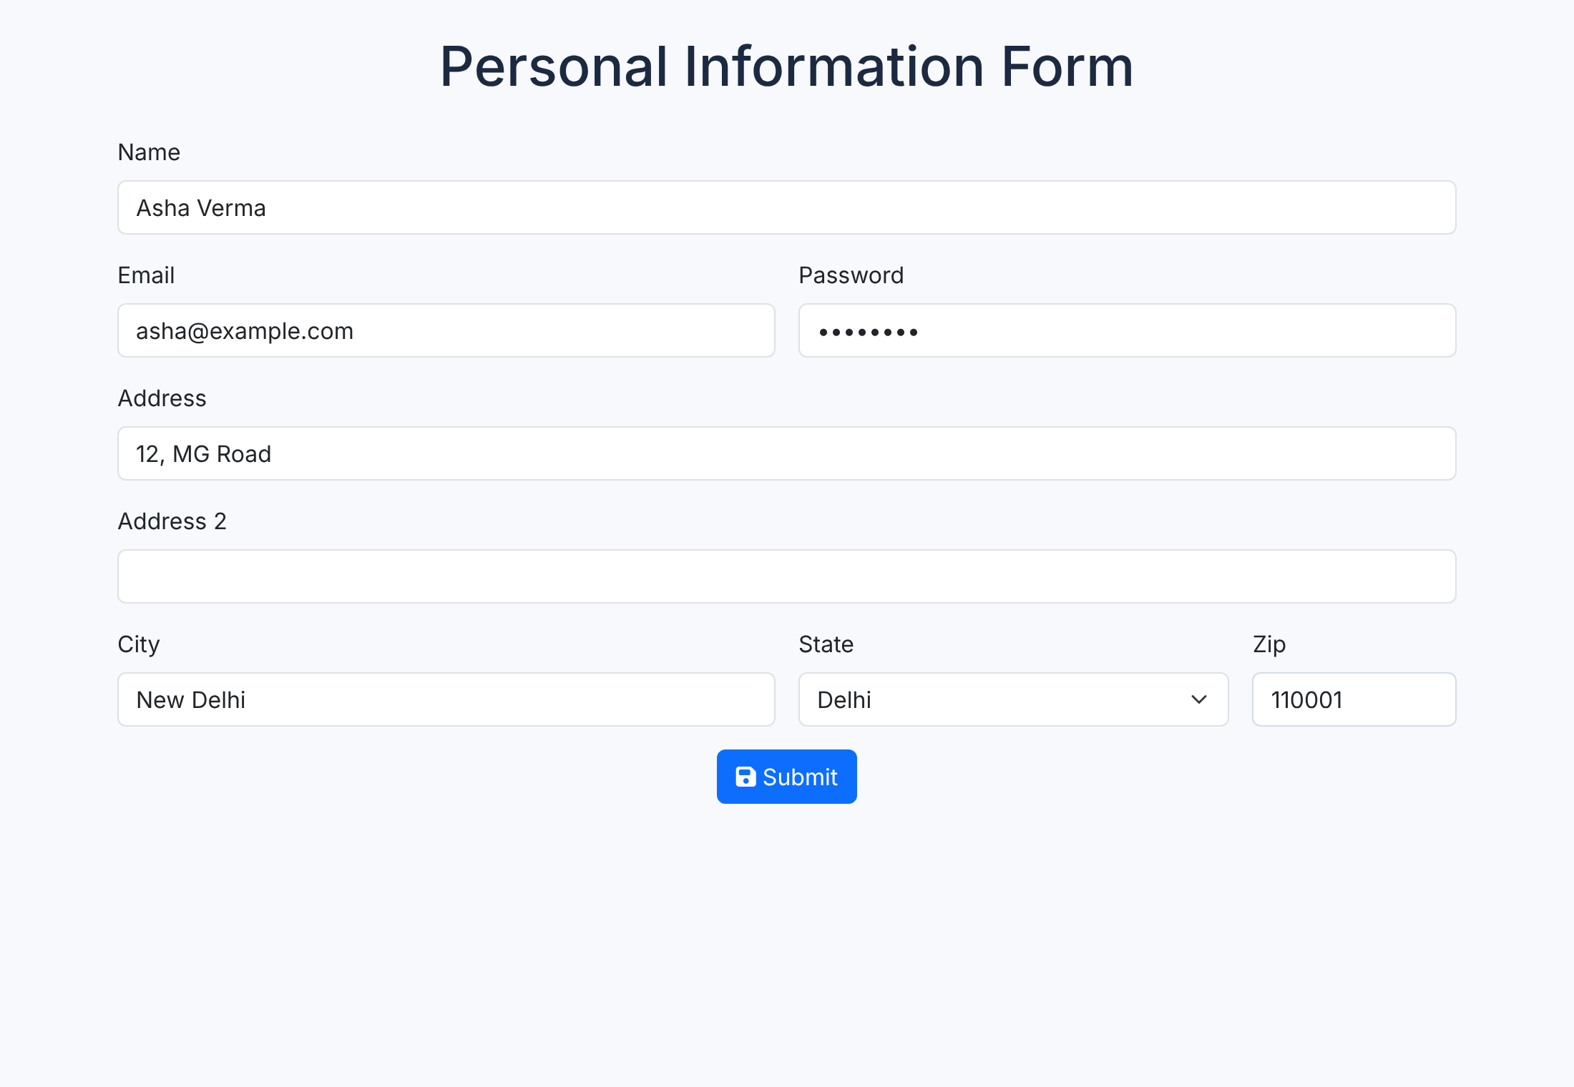
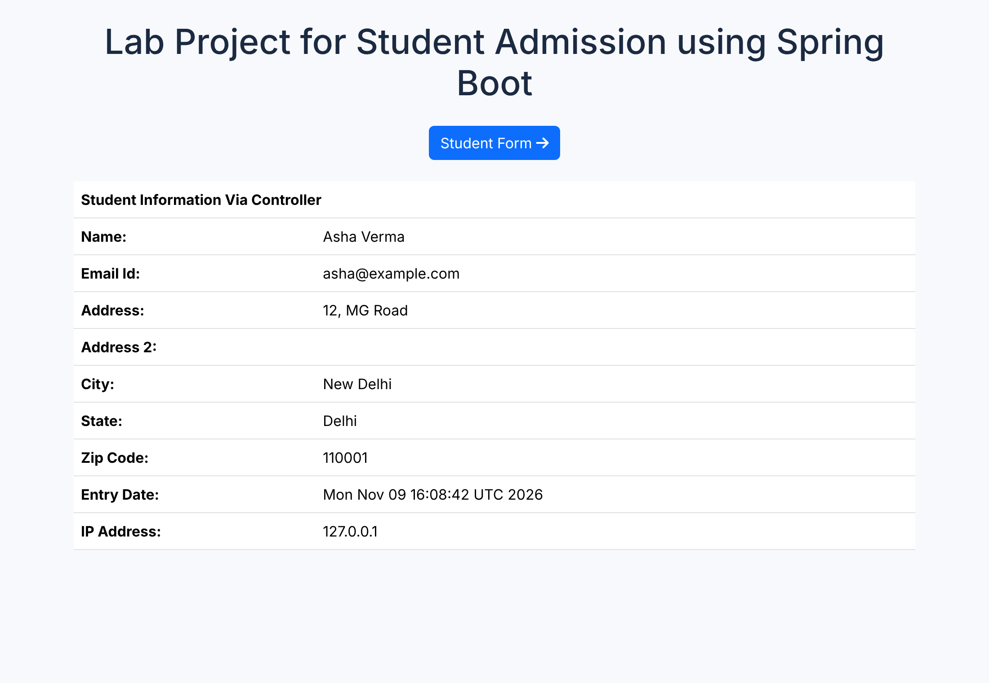
Run it: Run As → Spring Boot App
≈ 3 min
1 · localhost:8080/stdForm: fill and Submit
2 · POST /student/view → dashboard shows values + date + IP
Screenshots from the tested lab project. Console shows: “Tomcat started on port 8080”.
Notes:
3 min. LIVE: run the app, open http://localhost:8080 — '/' redirects to /dashboard (empty table), click Student Form, fill, submit, and the dashboard shows the data. DevTools restarts the app automatically when you save a file.

Slide 31
Your 10 lab sessions at a glance
≈ 5 min
1
Servlet basics
date/time, form, client IP, sessions & cookies, CRUD
2
JSP
tags, JSTL, JDBC, actions, implicit objects
3
Maven & frameworks
Initializr, Spring MVC, Hibernate/JPA, IoC
4
DI & Controller
dependency injection, @Get/@PostMapping
5
Validation & CSS
client + server validation, Bootstrap
6
Hibernate / JPA
entities, CRUD, batch update
7
Boot & REST
repositories, JSON responses
8
REST, Security, Actuator
CRUD API, default login
9
Spring Security
user table, custom login, logout
10
Roles & CSRF
role-based access, CSRF tokens
Notes:
5 min. Today's material directly covers Sessions 1–2 and the foundation of 3–5. Orange = what we did today. Teal = Spring MVC core. Navy = security & REST. Each session builds on the previous one's project, so keep your StudentAdmission project and database.

Slide 32
Part 5 · Doubt solving
105–120 min · Common errors → quick quiz → your questions
Notes:
Clear the parking lot. Start with the common-errors slide since it answers most typical doubts.

Slide 33
Top errors students hit (and the fix)
≈ 5 min
Symptom | Likely cause | Fix
'java' is not recognized | PATH not set / old terminal | Add %JAVA_HOME%\bin to Path, open new window
HTTP 404 Not Found | URL ≠ url-pattern or context path | Check web.xml / @GetMapping spelling and case
ClassNotFound / 500 on servlet | javax code on Tomcat 10+ | Use Tomcat 9, or change imports to jakarta.*
Port 8080 already in use | Another server running | Stop it, or set server.port=8082
Form value shows null | name attribute ≠ getParameter() | Make both strings identical
Failed to configure a DataSource | JPA added, no DB settings | Add spring.datasource.* or remove JPA
Template not found | HTML not in templates/ | Put views in src/main/resources/templates
Notes:
5 min. Go through each row quickly, then take questions from the parking lot that aren't covered here.

Slide 34
Quick quiz: 5 questions, 3 minutes
≈ 3 min
Q1
Which servlet method runs only once, when the servlet is first loaded?
Q2
In web.xml, which tag links a URL to a servlet name?
Q3
What is the difference between <%= %> and <% %> in JSP?
Q4
What does return "redirect:/dashboard" do in a Spring controller?
Q5
Why use POST instead of GET for a login form?
Notes:
ANSWERS: Q1 init(). Q2 <servlet-mapping> (with <url-pattern>). Q3 <%= %> prints the value of an expression (no semicolon); <% %> runs Java statements and prints nothing by itself. Q4 sends an HTTP 302 telling the browser to make a new GET request to /dashboard. Q5 POST sends data in the request body, so the password is not visible in the URL, history or server logs.

Slide 35

Your questions
≈ 7 min
Open floor: parking-lot questions first, then anything else.
Good prompts if the room is quiet:
When would I still write a plain servlet instead of using Spring?
Where does session data live, and how do cookies track it?
How does the Student object get filled without me calling setName()?
What changes when we connect MySQL with JPA in Session 6?
Notes:
Remaining time. If a question needs code, open the handbook's relevant chapter rather than live-coding from scratch.

Slide 36
Key takeaways
One request → one response. Servlets write it in Java, JSP writes it in HTML, Spring MVC splits it into Model, View and Controller.
Before the next lab: install everything using the PDF handbook, run all four example programs, then start Session 1 exercises.
Notes:
1 min wrap-up. Point students to the handbook (installation + step-by-step execution of every example with syntax explanation) as their homework companion.

