Slide 1
COMP 385 · Parth · Harsh · Rishi · Manav · Jasdish
Ontario wildfire
modelling prototype
Recorded-start risk on a 10 km grid
and a separate 90 m spread reconstruction
November 2, 2026 · 10-minute demo + 5-minute Q&A
Notes:
Presenter/time: Parth 0:00–0:45 (returns at 8:45)
Opening: Ontario has many locations to review. Our ignition classifier estimates recorded fire-start likelihood for a 10 km cell on a calendar day. A separate 90 m research simulator reconstructs how a known historical incident spread. We will run code and inspect real outputs. No operational warnings are issued. Presentation roles are proposed, not claims of original authorship. Source: local project README and frozen source registries.

Slide 2
Data and model workflow
Historical sources
Fire records
Weather + landscape
Prepare inputs
Check time + geometry
Keep missingness
Offline computation
10 km ignition
90 m spread
10 km cells: daily ignition risk
90 m grid: historical incident spread
Stored scores and replays
Python API → browser
Reported fires and weather: separate view; live scoring unavailable
Notes:
Presenter/time: Harsh 0:45–2:45
Explain recorded-start labels, dated weather and terrain inputs; fuels belong to the separate selected-source/spread contracts. Checks preserve geometry, issue-day timing and missing data. Offline computation produces model artifacts and saved evaluations served by the Python API. The reported-fire/HRDPS view is observations and forecast-weather context, with null live model outputs. Sources: /Users/parthkevadiya/Desktop/Centennial/sem-6/CAPSTONE/reports/live_workflow_2026-11-01/README.md; /reports/week_4_data_2026-10-16/historical_weather_v2_audit.json. Run the data step in the guide.

Slide 3
Models and evaluation
Four ignition model families
Evaluation
Historical fire rate
Logistic regression
Histogram gradient boosting
LightGBM
Validate on later years
Hold out geographic blocks
Calibrate on a separate period
Preserve prior final results
Ignition: calibrated LightGBM · Spread: FBP-inspired simulator
Notes:
Presenter/time: Rishi 2:45–4:45
Name the four ignition model families. Existing calibrated LightGBM bundles remain app defaults; no recent candidate passed the full replacement rule. Evaluation uses later years, held geography and a separate calibration period, not random row splitting. Run scripts.demo_model_inference: 2017-08-09, ofr10km_470000_40000, 31 inputs, target excluded, approximately 0.3417119%. This legacy exposed development example is distinct from the new wildfire-only comparison on slide 5 and the browser 2019 bundle. Sources: /reports/class_demo_2026-10-31/evidence/model_inference_2026-11-01.json; /reports/weather_history_2026-11-01/results.json.

Slide 4
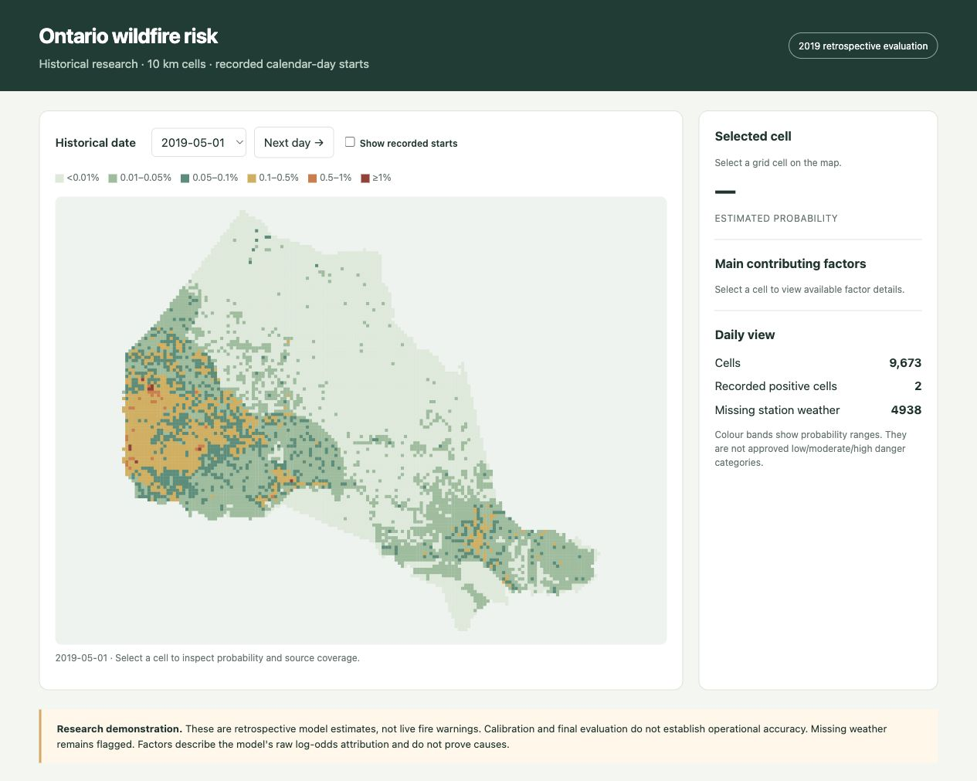
Prototype demonstration
Run a saved model on archived inputs
Inspect a cell and export its scores
Reconstruct historical spread
Inspect observations and live status
Dated backup capture · October 16, 2026
Local demo: http://127.0.0.1:8771/
Notes:
Presenter/time: Manav 4:45–6:45; Jasdish 6:45–8:45
Use the terminal and browser, not this static screenshot, for the demonstration. Screenshot source: local submission figures, captured 2026-10-16; it is a dated fallback. Show one cell, details and export; demonstrate saved 90 m historical reconstruction at 1/3/6 hours, then workflow observations and live unavailable status. Run the spread/workflow helper commands in the guide. Reconstruction uses final-perimeter-assisted inputs and does not establish forecast skill. Cached observations retain their collection clock and may be stale. Sources: /reports/week_5_completion_2026-10-16/spread_viewer_audit.json; /reports/live_workflow_2026-11-01/README.md.

Slide 5
Model results and next step
Reference: 2 of 92
Constrained model: 5 of 92
at 1% daily capacity
Earlier folds rejected it
Existing models retained
2017 exposed development · 87 of 92 still missed by the constrained model
Live forecasts unavailable · 212 passing software tests
Notes:
Presenter/time: Parth 8:45–10:00. Q&A 10:00–15:00.
November 2 update: two registered studies completed 27 fits using 2010–2015 fitting, earlier 2014/2015 selection folds and 2016 calibration. The same geographic reference reproduced exactly. Reference AP 0.002324260544534476 and 2/92 at fixed daily 1%. Past 24h lightning found 2/92; 24h plus 7d found 3/92. A separate physical-feature comparison found logistic 2/92 and constrained LightGBM 5/92, AP 0.003509015561797586. The constrained model still missed 87/92. Its earlier selection folds found 0 and 4 compared with reference 0 and 7, so the selection rule retained the reference before diagnostic scoring. Do not promote the candidate based on this exposed 2017 result. The conditional paired seven-day-bootstrap recall-change interval is [0, 0.06898050974512743], without adjustment for prior exploratory studies. This is not new unseen generalization or proof of universal detection.
Show Geographic performance in the dashboard, change candidate and explain the 1% review capacity. Increasing capacity changes workload, not model skill. Inputs cover 14,238,656 cell-days with no future lightning intervals, and the old 30-row pilot matches within numerical tolerance. No old final result changed. 212 passing tests check software behavior. Live probabilities remain unavailable. Next: verify historically dated fuel/access sources and reporting coverage under a new registered development protocol, then acquire a genuinely untouched evaluation and qualify issue-time live inputs.
Sources: /Users/parthkevadiya/Desktop/Centennial/sem-6/CAPSTONE/reports/lightning_development_2026-11-02/results.json; /reports/geographic_transfer_2026-11-02/results.json and rolling_results.json; /reports/demo_readiness_2026-11-02/regression_tests.txt. Data method: Cannon et al. (2025), https://doi.org/10.1038/s41597-025-05924-7.

