Slide 1
COMP 385 HISTORICAL WILDFIRE MODELLING
Ontario
Ignition Atlas
An interactive replay of daily ignition scores
May–October 2019
Model reconstruction, risk mapping and alert decisions
Notes:
Introduce the prediction as at least one recorded ignition per existing 10 km cell during a local calendar day. This is a historical demonstration. Sources: docs/ignition_demo/report.md; docs/modeling/final_report.md.

Slide 2
COMP 385 ONTARIO IGNITION ATLAS
The prediction problem
Element | Definition
Prediction unit | 10 km cell, one local day
Demonstration grid | 9,673 cells in Ontario
Historical full panel | 17,798,320 cell-days
Approved model inputs | 36 source features
Calendar, terrain, prior-day weather and earlier fire history
02
Notes:
Explain that ignition and fire spread answer separate questions. Identifiers and outcome labels are excluded from model inputs.
Sources: docs/modeling/final_report.md; data/metadata/ignition_feature_selection_v1.json

Slide 3
COMP 385 ONTARIO IGNITION ATLAS
Rebuilding the selected model
1. Verified sources
Exact audited CSV and pinned CWFIS archive checksums
2. Corrected inputs
Complete daily grids, past-only weather and explicit missingness
3. Frozen model
40 boosting iterations, seed 385, all 2010–2016 training rows
4. Independent comparison
Published 2019 metrics and all eight confusion tables match
03
Notes:
The exact audited CSV was recovered from gzip. Only the selected model was refitted. The original experiment records remain intact. The model was frozen before test scoring.
Sources: artifacts/ignition_demo/reconstruction/freeze.json; docs/ignition_demo/reconstruction_evidence.json

Slide 4
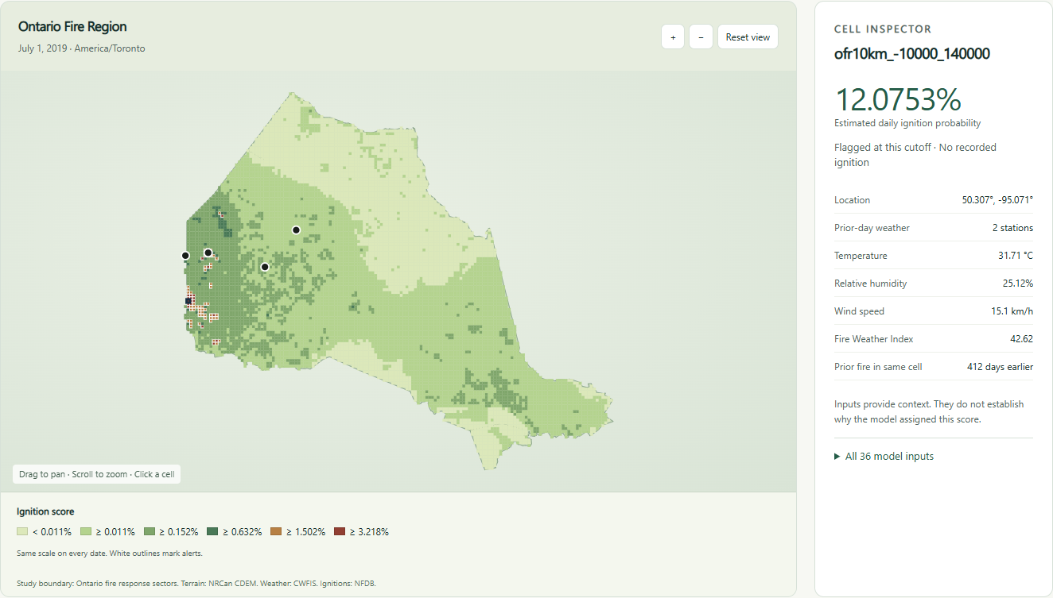
COMP 385 ONTARIO IGNITION ATLAS
Exploring one cell and one day
Fixed colours across dates. Recorded ignitions remain separate from inputs.
04
Notes:
Demonstrate date selection, map navigation and inspection. The screenshot uses the fixed July 1 default. Inputs are context rather than causal explanations. The photograph-like asset is an actual screenshot of the local application.
Sources: output/playwright/map-inspector.png; scripts/ignition_demo/server.py

Slide 5
COMP 385 ONTARIO IGNITION ATLAS
Ranking improves over prevalence
0.007275
Average precision
0.8892
ROC-AUC
Absolute alert precision remains low despite better ranking.
05
Notes:
The plotted values are average precision and the natural-prevalence reference, expressed as fractions. The reconstructed and published metrics match exactly. ROC-AUC is not alert accuracy.
Sources: docs/modeling/final_test.json; docs/ignition_demo/reconstruction_evidence.json

Slide 6
COMP 385 ONTARIO IGNITION ATLAS
Default alert performance
Cutoff 1.5024%, chosen using 2018 validation F2
2019 outcome | Cell-days
Correct alerts | 15
False alerts | 1,871
Missed ignitions | 494
Correct non-alerts | 1,777,452
Precision 0.80% Recall 2.95% Alerts/day 10.25
06
Notes:
F2 chooses the best of eight frozen cutoffs using 2018 only. The full-precision cutoff is 0.01502367973189238. Inclusive comparisons flag scores equal to the cutoff. Operational costs and capacity are unspecified.
Sources: docs/ignition_demo/reconstruction_evidence.json; docs/modeling/threshold_tradeoffs_2018.csv

Slide 7
COMP 385 ONTARIO IGNITION ATLAS
A historical demonstration with clear limits
Available now
Verified reconstructed model, local prediction service, interactive risk map,
alert comparisons, full-day exports and a learning walkthrough
Claims remain bounded by the data
Historical archive availability is unknown. The frozen grid uses event-informed
edge selection. False alerts and missed ignitions remain substantial.
Live forecasting needs a current pipeline and additional validation.
Demo: choose a date, inspect a cell, compare cutoffs, download predictions
07
Notes:
Launch Start-IgnitionDemo.cmd, inspect one cell, compare cutoffs and export a date. Future live forecasting requires issue-time data, current validation, coverage/drift monitoring and an alert policy based on response costs and capacity.
Sources: docs/ignition_demo/report.md; docs/ignition_demo/demo_script.md

