Slide 1
Generative AI-Based Kitting System
Cad-Based Collision aware robotic kitting with open-source vision-language models, large-language model and Lula inverse kinematic motion planning
Parth Kadiya · Chalmers Industriteknik
Notes:
Progress review covering three architectural phases since July: perception rearchitecture onto an open-source VLM served by vLLM, migration of motion planning to cuMotion with a point-cloud collision world, and the decision to move to cuRobo plus nvblox for real-hardware deployment.

Slide 2
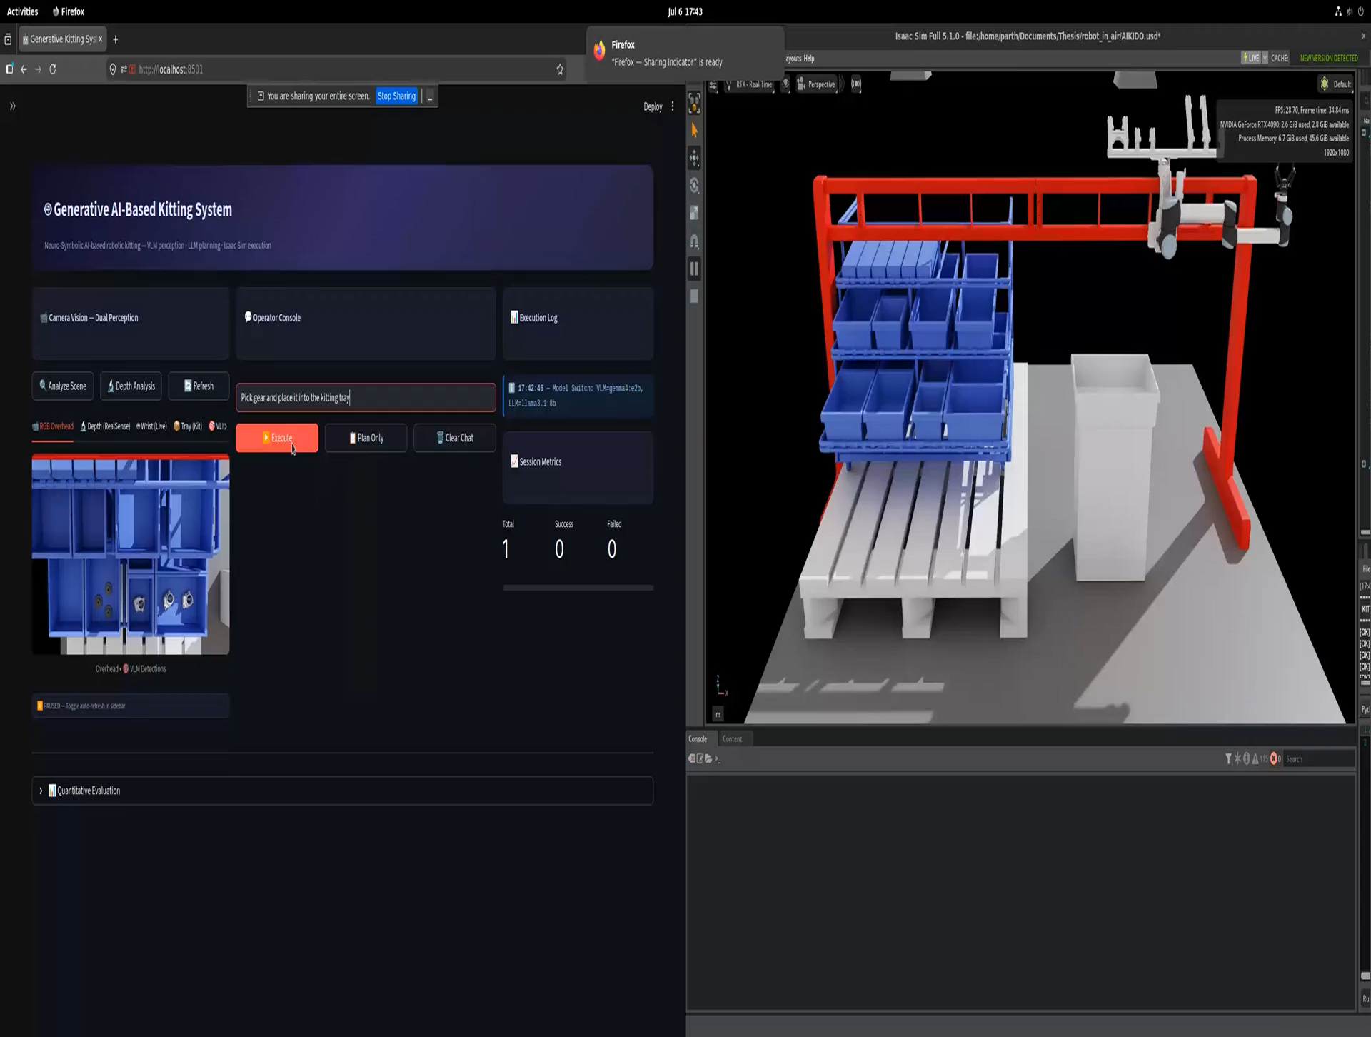

Slide 3
PROGRESS REVIEW · JULY – SEPTEMBER 2026
From Point Clouds to
Depth-Native Planning
Collision-aware robotic kitting with open-source vision-language models and GPU motion planning
Notes:
Progress review covering three architectural phases since July: perception rearchitecture onto an open-source VLM served by vLLM, migration of motion planning to cuMotion with a point-cloud collision world, and the decision to move to cuRobo plus nvblox for real-hardware deployment.

Slide 4
CONTEXT
What the system does
A natural-language instruction becomes collision-free robot motion, with no hand-coded part positions anywhere in the pipeline.
Perception
THE CELL
1
Open-source VLM grounds parts in the image; depth projection lifts them to 3D world coordinates.
Robot
UR10, ceiling-mounted
Extra axis
1-DOF gantry rail
Orchestration
Total planned
2
VLM turns the command plus the grounded scene into a validated sequence of atomic robot skills.
7 DOF
Gripper
Robotiq 2F-140
Wrist sensor
RealSense depth
Execution
Scene cameras
3
GPU motion planning produces collision-free trajectories; the arm executes them under sensor feedback.
4 corner + 2 overhead
Simulator
Isaac Sim 6.0.1
Notes:
The cell is a ceiling-mounted UR10 on a gantry rail, giving seven planned degrees of freedom. Rule one in the architecture: object positions come from camera projection only, never from reading the simulator's internal scene graph, because that has no equivalent on real hardware.

Slide 5
Three architectural phases
JUL
AUG
AUG
SEP
Platform upgrade
Perception rearchitecture
Motion rearchitecture
Architectural limit found
Isaac Sim 6.0.1, v2.0.1 pipeline, edge-AI optimisation of the perception stack.
A unified open-source VLM served by vLLM replaces the two-stage detector pipeline.
Per-tick inverse kinematics replaced by cuMotion trajectory planning with a point-cloud collision world.
cuMotion cannot ingest depth. Decision: move to cuRobo and nvblox.
Notes:
The important point for examiners: each move was forced by a measured limitation in what came before, and each limitation was demonstrated before the change was made.

Slide 6
PHASE 1 · PERCEPTION
Why an open-source VLM, self-hosted
BEFORE
NOW
Two stages: a VLM for labels, a separate OWL-V2 / Grounding-DINO detector for boxes
Two models to serve, tune and fail independently
A detector confidence threshold as one more tuned parameter
One pass: Qwen3-VL produces labels and grounded boxes together
Native visual grounding — the detector stage is switched off entirely
Served through vLLM on an OpenAI-compatible endpoint
The case does not rest on benchmark scores
✓
Deployment control
✓
Fewer moving parts
✓
Reproducibility
Open weights, self-hosted. No external API, no per-call cost, and no image leaves the site.
One model instead of two removes a whole class of stage-mismatch failures.
Pinned open weights keep the result re-runnable.
Notes:
Be explicit that this decision is architectural rather than accuracy-driven. Self-hosting, removing a pipeline stage, and reproducibility are the defensible reasons. The accuracy comparison comes later and is currently confounded.

Slide 7
PHASE 1 · METHOD
A diagnosis worth showing
Detected boxes were offset from the parts they named. The model was not at fault.
SYMPTOM | Bounding boxes visibly fits from parts in the overhead view, but during normalisation it offsets by 66mm, and grasps missing in some cases.
MECHANISM | The pipeline re-queried the model on a small cropped region to refine each box.
ROOT CAUSE | A coordinate in absolute pixels and one on the normalised 0–1000 grid span the same numeric range. The two conventions become indistinguishable, and the wrong one was decoded.
FIX | One full-frame pass with calibrated camera, one unambiguous coordinate convention.
TAKEAWAY
The failure was an ambiguity created by own pre-processing, not a limitation of the model.
Removing a stage fixed it. More tuning would not have.
Notes:
This slide shows diagnostic method rather than a result. The lesson generalises: when a model appears wrong, check first whether the surrounding code made the answer ambiguous.

Slide 8
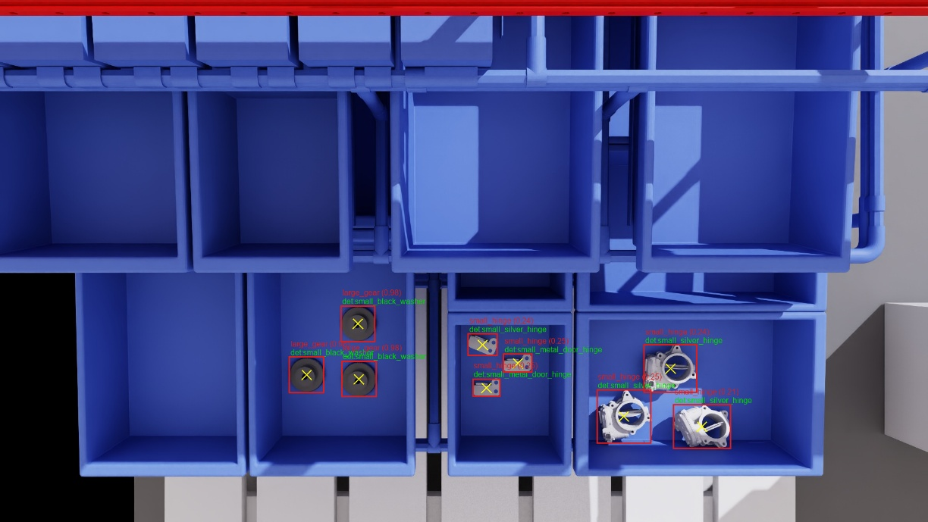
Notes:
This slide shows diagnostic method rather than a result. The lesson generalises: when a model appears wrong, check first whether the surrounding code made the answer ambiguous.

Slide 9
PHASE 2 · MOTION
Motion planning becomes collision-aware
BEFORE · Lula inverse kinematics
AFTER · cuMotion trajectory planning
One joint target solved per simulation tick, with knowledge of obstacles from usd files instead of camera vision. The arm moves straight at its goal and but in real world deployment vision based obstacle awareness is more realistic.
A complete collision-free trajectory planned in one call against a world model, then executed across many ticks. The robot moved in logs but not in simulation.
How the collision world was built
6 cameras
›
3D point cloud
›
voxel grid
›
sphere obstacles
›
planner
1,066,741
6,000
93.8%
raw 3D points captured per scan cycle
sphere obstacles the planner actually received
of the voxel map discarded to fit that budget
Notes:
The sphere budget is the key number here. The collision world had to be squeezed into six thousand primitives, and the method used to squeeze it turned out to be the problem.

Slide 10
PHASE 2 · FINDINGS
Where the point-cloud approach broke
The robot became its own obstacle
✕
Every camera sees the arm, so its own surface entered the obstacle map. The planner judged the starting position to be already inside something and refused to plan at all.
Moves normally with the collision world off. Frozen with it on.
Obstacles were thinned at random
✕
96,962 voxels had to fit a 6,000-sphere budget. The surplus was dropped by random sampling, which punches holes straight through real surfaces.
A hole in a bin wall reads to the planner as free space.
The self-filter under-covered the arm
✕
The robot was masked using a single fixed 18 cm sphere at each of twelve link origins — far smaller than links such as the forearm.
Unmasked robot surface survived as phantom obstacles.
All three are properties of squeezing a sensed world into a fixed budget of primitives. None is a tuning problem.
Notes:
Stress that none of these three is fixable by parameter tuning. They follow from the representation itself.

Slide 11
THE DECIDING EVIDENCE
cuMotion cannot represent a sensed world
Measured directly against the live planning interface, not inferred from documentation.
WHAT IT ACCEPTS
WHAT IT HAS NO NOTION OF
Spheres, cubes, capsules, cones, cylinders, planes, oriented boxes and meshes
Signed distance field
Voxel or occupancy grid
Depth-image ingestion
Robot self-segmentation
Geometric primitives, placed one at a time.
A depth image has no way in.
Tested live on the running planner
Resize an obstacle
Move an obstacle
Enable or disable
Replace or delete
not implemented
works
works
rejected
Obstacles can be created once, then only moved or switched off. A scene that changes shape cannot be expressed — which is precisely what a depth sensor delivers.
Notes:
This is the slide the architecture decision rests on. These results come from calling the interface directly on the running system. The conclusion is not that cuMotion is poor software, but that its world model is built for authored geometry while ours is sensed.

Slide 12
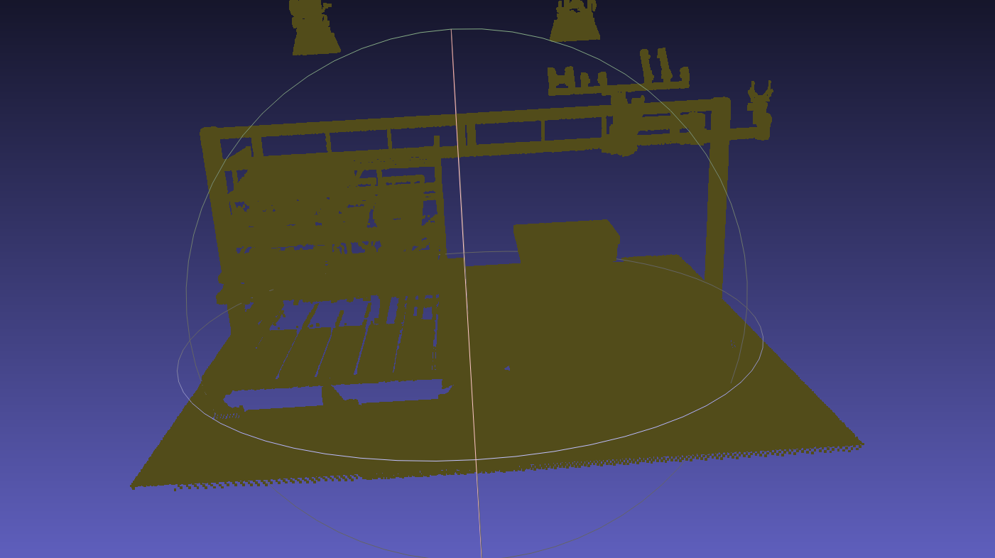

Slide 13
THE REPLACEMENT
What cuRobo and nvblox provide instead
Robot self-segmentation
ALREADY VERIFIED
✓
The robot's own pixels are erased from every depth image using its live joint angles, before they can become obstacles.
Container
✓
Solves the blocking failure directly.
nvblox, cuRobo and PyTorch built on the Isaac Sim 6.0.1 base image
nvblox distance field
✓
Robot model
✓
Depth images fuse into a signed distance field with temporal decay, at 5 mm resolution, across all six cameras.
Loads with all seven planned joints in the correct order
Continuous distance and gradient, not a binary in-or-out test.
✓
Collision model
GPU motion planning
42 of 42 spheres bound to real robot links
✓
Pose and joint-space planning against that field, including handling of a grasped part's volume.
The optimiser can descend a gradient out of collision.
Notes:
Emphasise that these are verified, not planned. The container is built and the robot model loads with every collision sphere bound, which was itself a trap that had to be found and fixed.

Slide 14
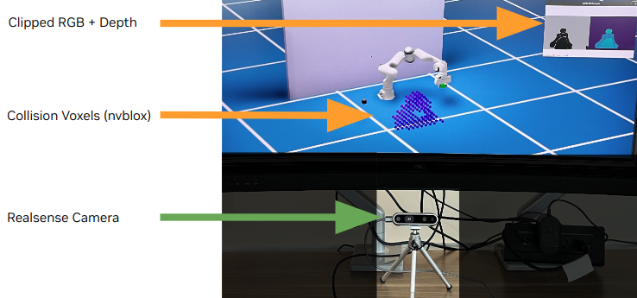
Source: https://curobo.org/get_started/2d_nvblox_demo.html

Slide 15
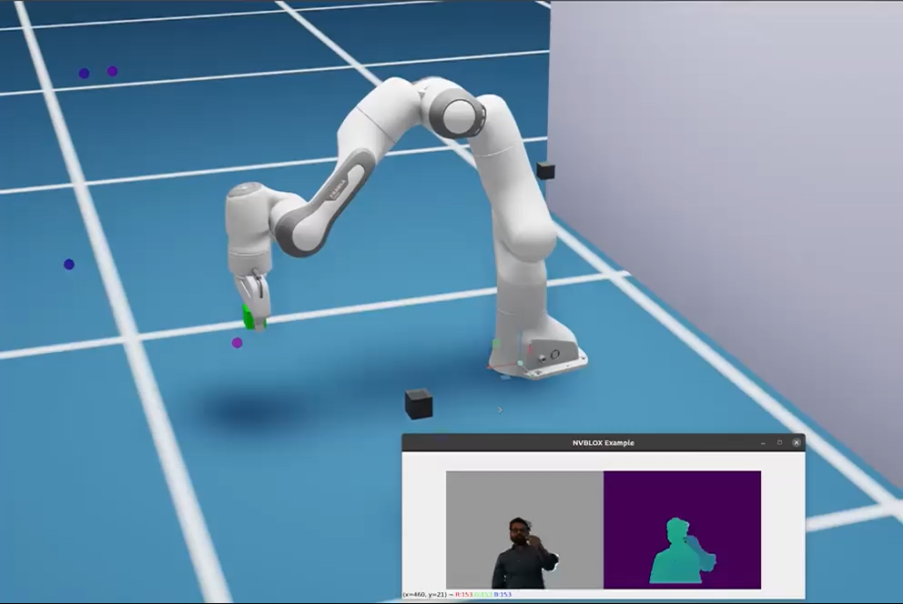
Source: https://curobo.org/get_started/2d_nvblox_demo.html

Slide 16
THE DEPLOYMENT ARGUMENT
Why this is the right interface for real hardware
A real depth camera outputs a depth image and a pose. It does not output a point cloud, and it certainly does not output spheres.
Identical input on both sides
No simulation-only shortcut
nvblox consumes exactly what a RealSense or Photoneo produces. Swapping the simulator's depth output for a camera driver becomes the only change needed.
Turning clouds into sphere primitives had no counterpart on hardware. It was a convenience that would have been thrown away at deployment.
Self-filtering transfers unchanged
Deployment operating system
Masking the robot is driven by its own joint encoders and kinematic model, both available identically on the real cell.
The planning stack runs in a Linux container, which is the target environment. Simulation and hardware share one stack.
Notes:
If asked for the single strongest reason: the interface between perception and planning becomes identical in simulation and on hardware. Everything between the camera driver and the robot driver stays the same.

Slide 17
HONEST ASSESSMENT
What the evaluation data can and cannot show
WHY THIS COMPARISON DOES NOT HOLD
27 of the 30 zero-success runs recorded a camera-capture timeout or an unreachable bridge.
Those runs took place while the motion stack was being rebuilt and the bridge restarted repeatedly. The failures are infrastructure, recorded as such in the logs. The perception stage never received its image.
Claimed
The architectural case for self-hosted open-weight perception: control, one fewer stage, reproducibility.
Not claimed
That Qwen3-VL outperforms the previous model. This data cannot support that in either direction.
Next
Re-run the perception benchmark on a frozen pipeline, with the motion stack held still, before drawing any conclusion about models.
Notes:
Raise this before anyone else does. The honest position is that the comparison is confounded, the confound is identified and evidenced in the logs, and a clean benchmark is scheduled. That is a stronger position than a favourable number nobody trusts.

