Slide 1




MACHINE LEARNING &
ARTIFICIAL INTELLIGENCE
IN AGRICULTURE
COLLEGE OF AGRICULTURAL ENGINEERING AND TECHNOLOGY

Slide 2
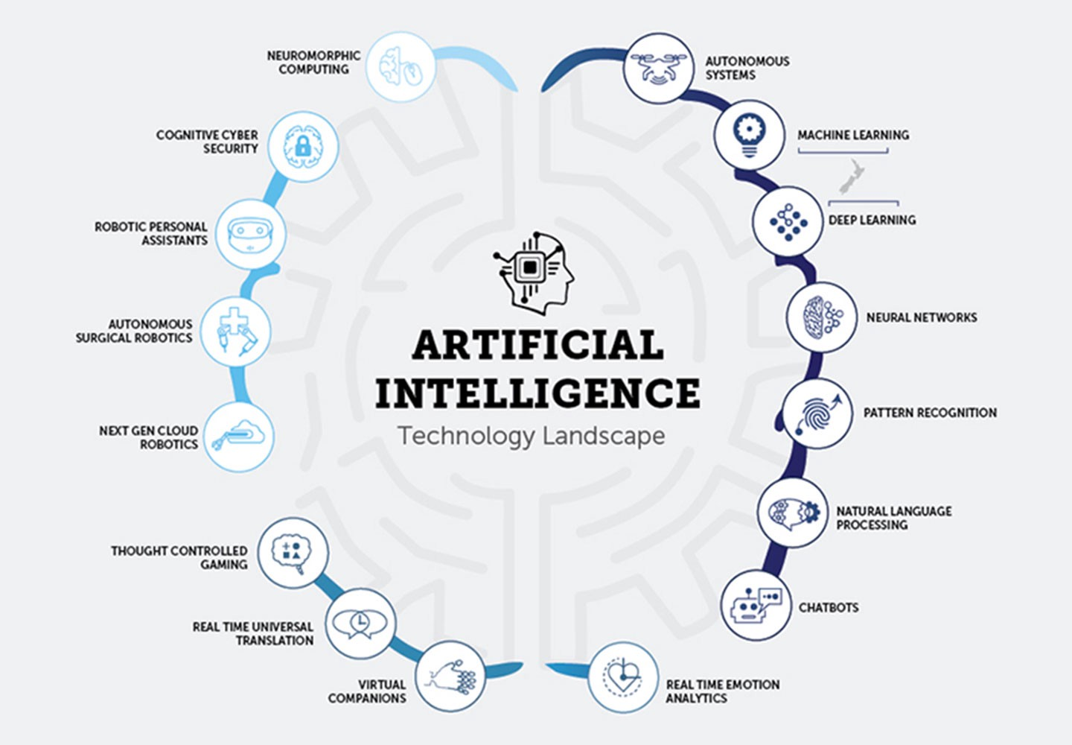

Slide 3






TECH CONSIDERATIONS
The Python Libraries we considered using
01
03
Tensor Flow
Keras
05
MatplotLib
04
06
SciKit Learn
OpenCV
02
Pandas and Numpy

Slide 4
Application
Suggestion for crop selection.
Detect problem, with land and plants.
Suggestion for need of fertilizer, proper watering system.
Location tracing and provide weather forecasting for particular area.
Identify the various bacteria's ,bugs and vermin's.
Monitoring crop and soil health.
Precise amount of spraying.
Analysis of different agricultural sensor data.

Slide 5
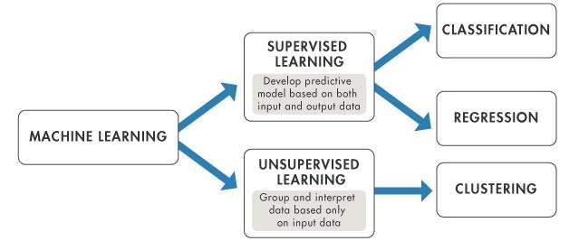
Algorithms of AI

Slide 6
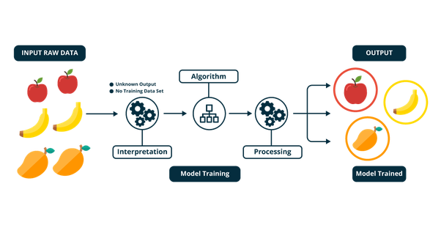
Supervised Learning

Slide 7
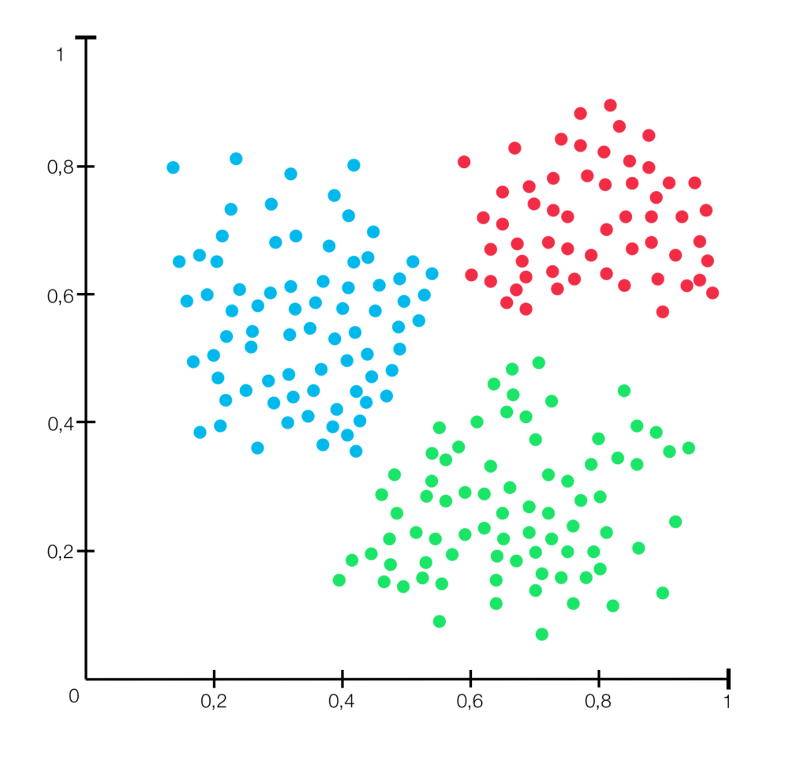
Unsupervised Learning
Clustering

Slide 8
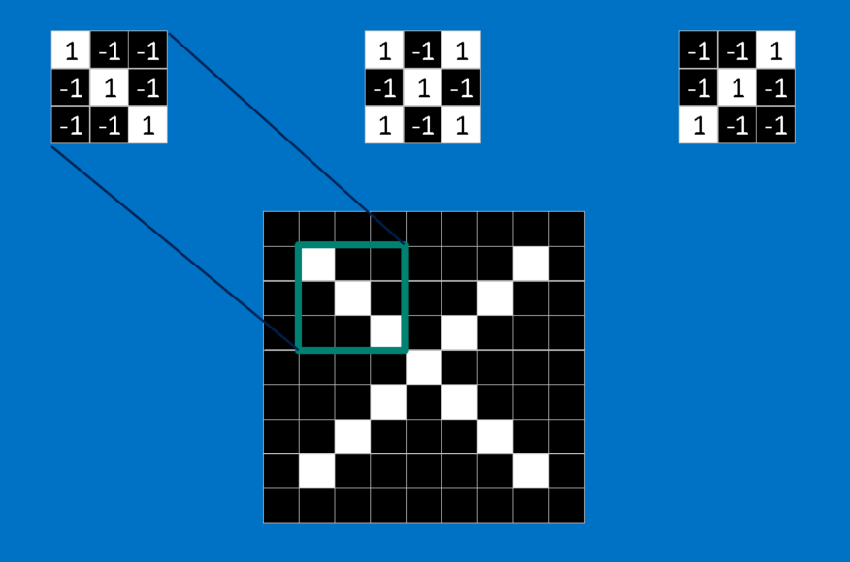
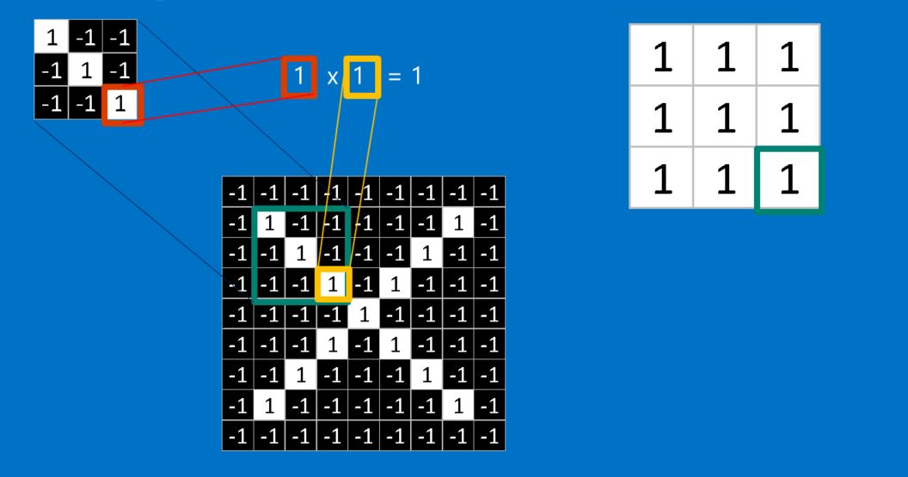
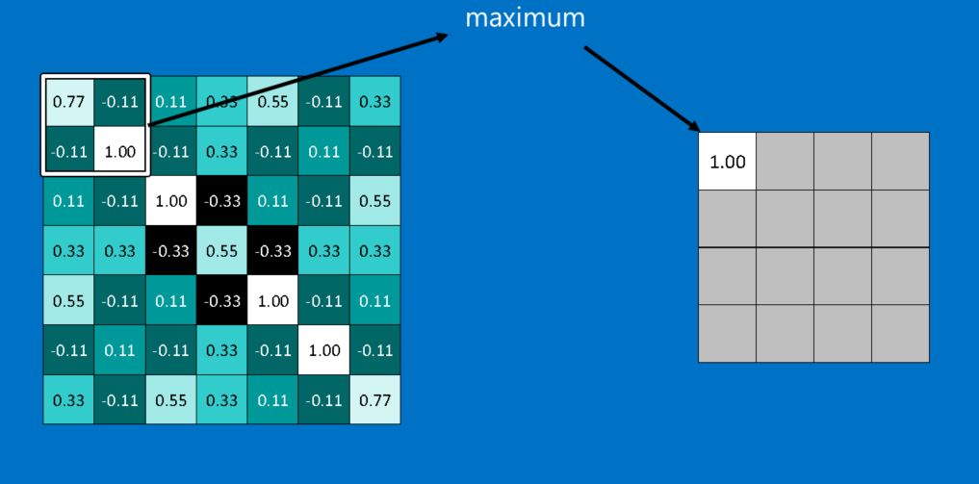
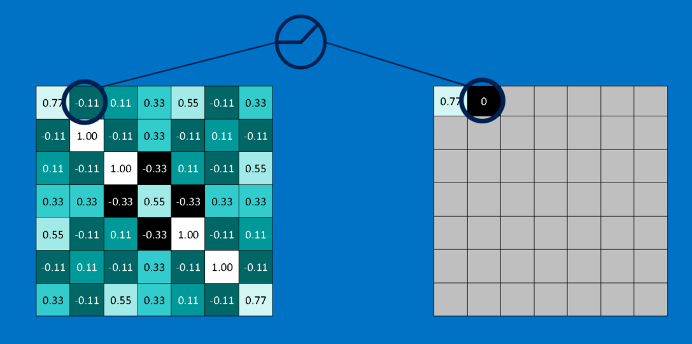
Image Classification

Slide 9
Practical projects based on Artificial Intelligence which are made by students of
COLLEGE OF AGRICULTURAL ENGINEERING AND TECHNOLOGY

Slide 10
THE WAY THINGS WORKED
A Project Pipeline
DATA COLLECTION
AND LABELING
MODEL REFINEMENT
TESTING
THE MODEL
PLANNING
AND SETTING UP
OF PROJECT
6
4
TRAINING
THE MODEL
2
MODEL
EXPLORATION
5
1
3

Slide 11
Assessment of crop condition by NDVI of satellite image
Objective
Determine the NDVI image value from satellite image.
Classify the NDVI image in different class
Determine and assess the crop condition
Determine the area covered by each crop condition.

Slide 12
Methodology
1) Calculate NDVI from Satellite image
2) Classify crop condition by Try and error method on basis of NDVI value
3) Calculate area under each crop condition
(Area = No of pixel * pixel resolution)

Slide 13
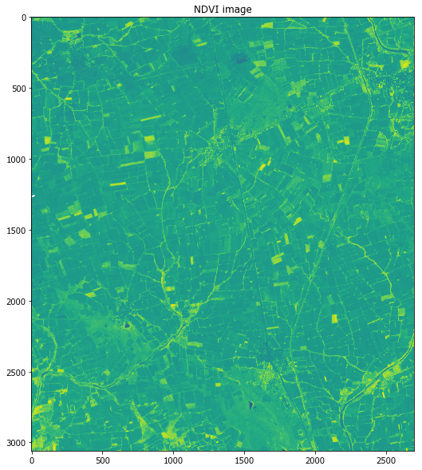
Results
NDVI image
Each pixel having a value in range of
-1 to 1

Slide 14
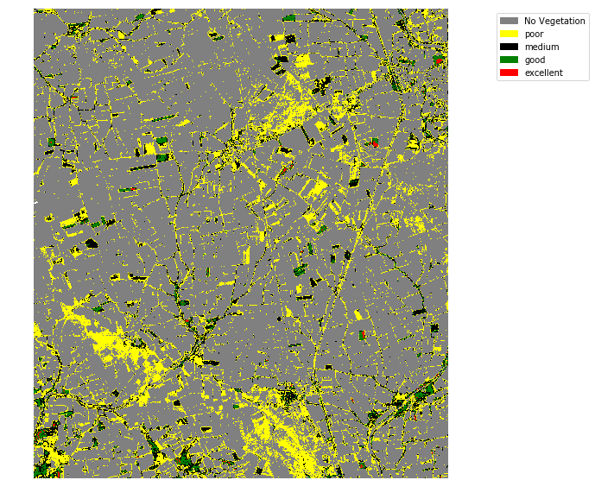
Map Representing the crop condition

Slide 15

Area covered by each crop condition

Slide 16
Future work
In case of any natural calamities, farmers can be reimbursement with actual amount/proportion of damage.
Fast and transparency in farmer’s claim reimbursement.
Projection of Crop yield and loss assessment.

Slide 17
Development of Neural network model to Predict EC of soil
Objective
Prediction of EC(Electrical conductivity) using Soil health card.
Developing of Neural Network.

Slide 18
Methodology
1) Extraction data from geo tiff image.
2) Splitting of 90% of data for training and 10% for testing.
3) Generation of Slope from DEM using QGIS.
4) Neural network model has been developed.
5) With different activation function model give different accuracy.

Slide 19
Result
By using Relu and Sigmoid as activation function we get 0.05 MSE.
By using Sigmoid as activation function we get 0.0493 MSE.

Slide 20
Future scope
The weights of respective independent variables generated by program can be used to predict the EC of unknown location.
The EC prediction will help to decide which type of crop can be sown and how much irrigation it would require.

Slide 21
Soil class classification using different soil properties
Objective
we want to classify the soil classes and compare results with different supervised classification techniques.
By classifying the soil we can know which crops can be sown according to it.

Slide 22
Methodology
1) Data extraction by using python code from shape file.
2) Splitting 35% data for training and 65% data for testing purpose.
3) Applying different supervised classification techniques SVM, NN, KNN, Random forest and Decision tree.
4) Accuracy analysis with confusion matrix for different supervised classification techniques.

Slide 23
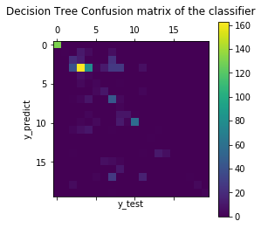
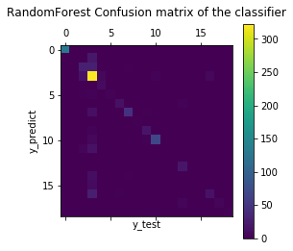
Result
Decision Tree :
Accuracy : 51.56%
Random Forest:
Accuracy : 77.13%
SVM:
Accuracy : 72.47%
Neural Network:
Accuracy - 70.14%

Slide 24
Future Scope
We can determine the soil classes using different soil properties.
We can plan about different plants, trees which can be sown on the particular area according to soil classes.

Slide 25
Development of python code for
Yield Predection
Objective
We have dataset of different weather parameters of past 27 years and meteorological week 44-52 to next year meteorological week 1-11(Rabi season).
By using this dataset we want to build a multiple linear regression model which can predict crop yield.

Slide 26
Methodology
1) We find 56 features by statistical approach
2) we used top correlated features in multiple linear regression to build yield prediction model.
3) By, Multiple linear regression we find coefficient and intercept of equation which can predict crop yield.
4) With help of equation we passed current weather parameter and we predicted crop yield.

Slide 27
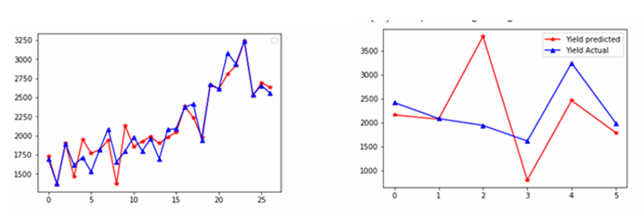
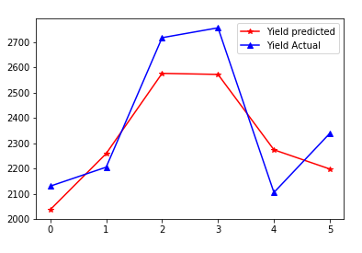
Results
Train data regression result
Test data regression result

Slide 28

THANK YOU

