Slide 1
LLM-Driven Adaptive Authentication and Access Control in Zero Trust Systems Using Blockchain
Submitted in the partial fulfillment for the award of the degree of
BACHELOR OF ENGINEERING
IN
Computer Science Engineering
Specialization in Information Security (IBM)
Submitted by:
Parth Kansal - 23BIS70035
Anshul Sharma - 23BIS70073
Vireshwar Singh Tomar - 23BIS70081
Under the Supervision of:
Ms. Sidrah Fayaz Wani
Department of AIT-CSE
DISCOVER . LEARN . EMPOWER

Slide 2
Outline
Introduction
Problem Formulation & Motivation
Objectives of the Work
System Overview & Architecture
Methodology & Workflow
Risk Assessment & Blockchain Integration
Results & System Output
Advantages of the Proposed System
Conclusion
Future Scope
References

Slide 3

Introduction to Project
Rapid rise in cyber threats and sophisticated attacks demands advanced security models
Traditional authentication mechanisms are static, rule-based, and easily exploitable
Organizations require a dynamic, context-aware security framework
Adoption of Zero Trust Architecture (ZTA) ensures continuous verification
No user or device is inherently trusted, regardless of network location

Slide 4
Core Concept
Integration of Large Language Models (LLMs), Blockchain, and Adaptive Authentication
Enables context aware and risk based access decisions
Continuous real-time evaluation of user behavior and system context
Intelligent automation of authentication and authorization processes
Ensures a balance between strong security and seamless user experience.

Slide 5
Why This Approach
Traditional MFA mechanisms are static and context-unaware
Manual approval processes introduce delays and inefficiencies
Limited visibility leads to poor transparency in access control logs
Centralized systems are prone to security vulnerabilities and manipulation
Need for:
Automation - Faster, real-time access decisions
Intelligence - Context-aware, risk-based authentication
Tamper Proof auditing - Secure and transparent activity tracking

Slide 6
Existing Problems
Authentication mechanisms are static and uniform, ignoring user context
Absence of real-time risk assessment leads to ineffective security decisions
Centralized identity management creates a single point of failure
Limited audit mechanisms result in poor traceability and accountability

Slide 7
Problem Statement
Designing a secure and efficient access control system remains a significant challenge due to the limitations of traditional approaches. There is a need to develop a dynamic, context-aware authentication mechanism that can adapt to user behavior and risk levels in real time. Additionally, enabling intelligent and automated decision making, ensuring secure and tamper-proof logging, and eliminating centralized vulnerabilities are critical requirements. The key challenge is to achieve all of this while maintaining a seamless and user-friendly experience.

Slide 8
Objectives of the Work
Design a risk-based adaptive authentication system for dynamic security
Leverage Large Language Models (LLMs) for intelligent access decision-making
Implement dynamic Multi-Factor Authentication (MFA) based on real-time risk levels
Integrate blockchain technology for secure and decentralized identity management
Ensure:
Transparency in access control and auditing
Robust security against evolving threats
Scalability for large-scale deployment

Slide 9
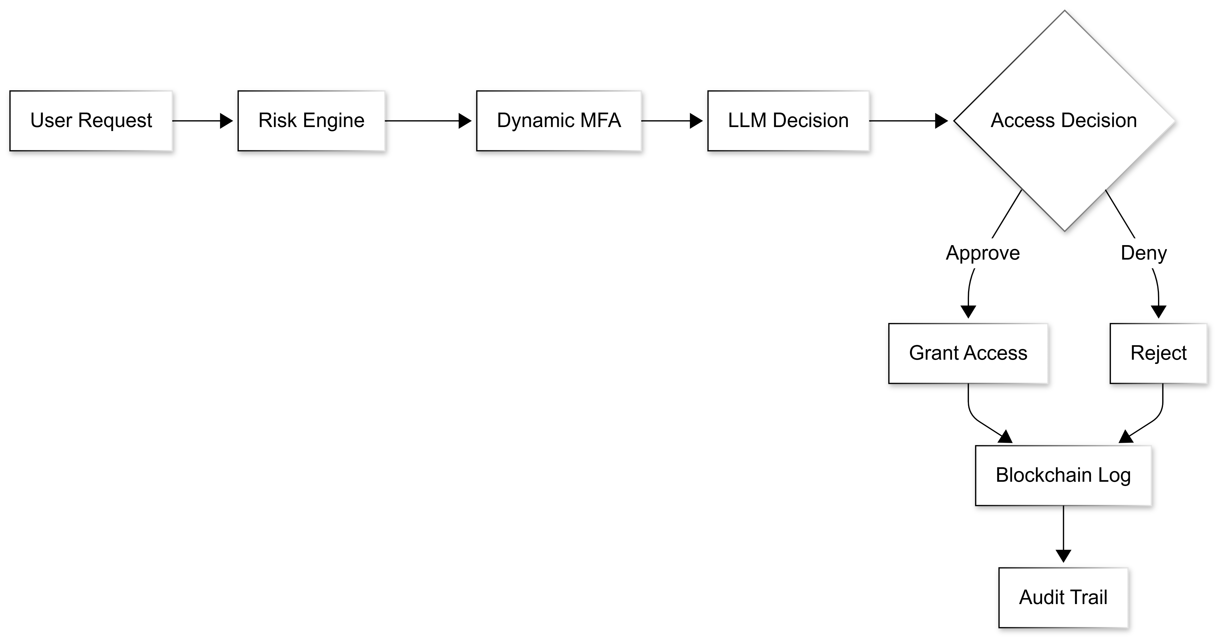
System Overview
User initiates an access request
Risk Assessment Engine evaluates contextual and behavioral parameters
Dynamic MFA is applied based on computed risk level
LLM Module performs intelligent access decision-making
Blockchain Layer securely records all identity and access events

Slide 10
Key Components
User Identity Module: User registration/Login and digital identity creation
Risk Assessment Engine: Evaluates parameters to compute risk
Adaptive MFA System: Dynamically adjusts authentication factors based on risk level
LLM Decision Module: Performs intelligent analysis for access control decisions
Blockchain Ledger: Stores identity and access logs in a secure, immutable manner

Slide 11
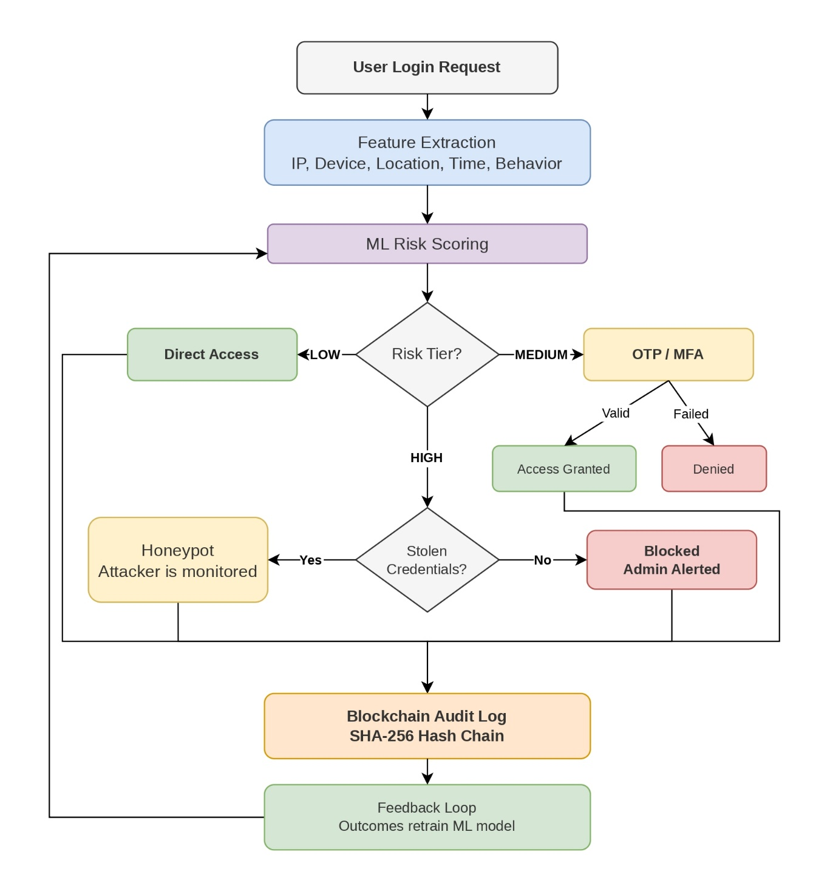
Authentication Workflow
User initiates a login or access request
System collects contextual data, including:
  Device information
  Geographical location
  Time of access
Risk Assessment Engine computes a real-time risk score
Adaptive MFA is applied based on the calculated risk level

Slide 12
Risk Assessment Parameters
Parameter | Description
User Behavior | Login frequency, usage patterns, anomalies
Device Information | Device type, fingerprint, trust level
Location & Time | Geographic location and access timing
Historical Activity | Past access records and suspicious behavior
Resource Sensitivity | Importance and classification of requested data

Slide 13
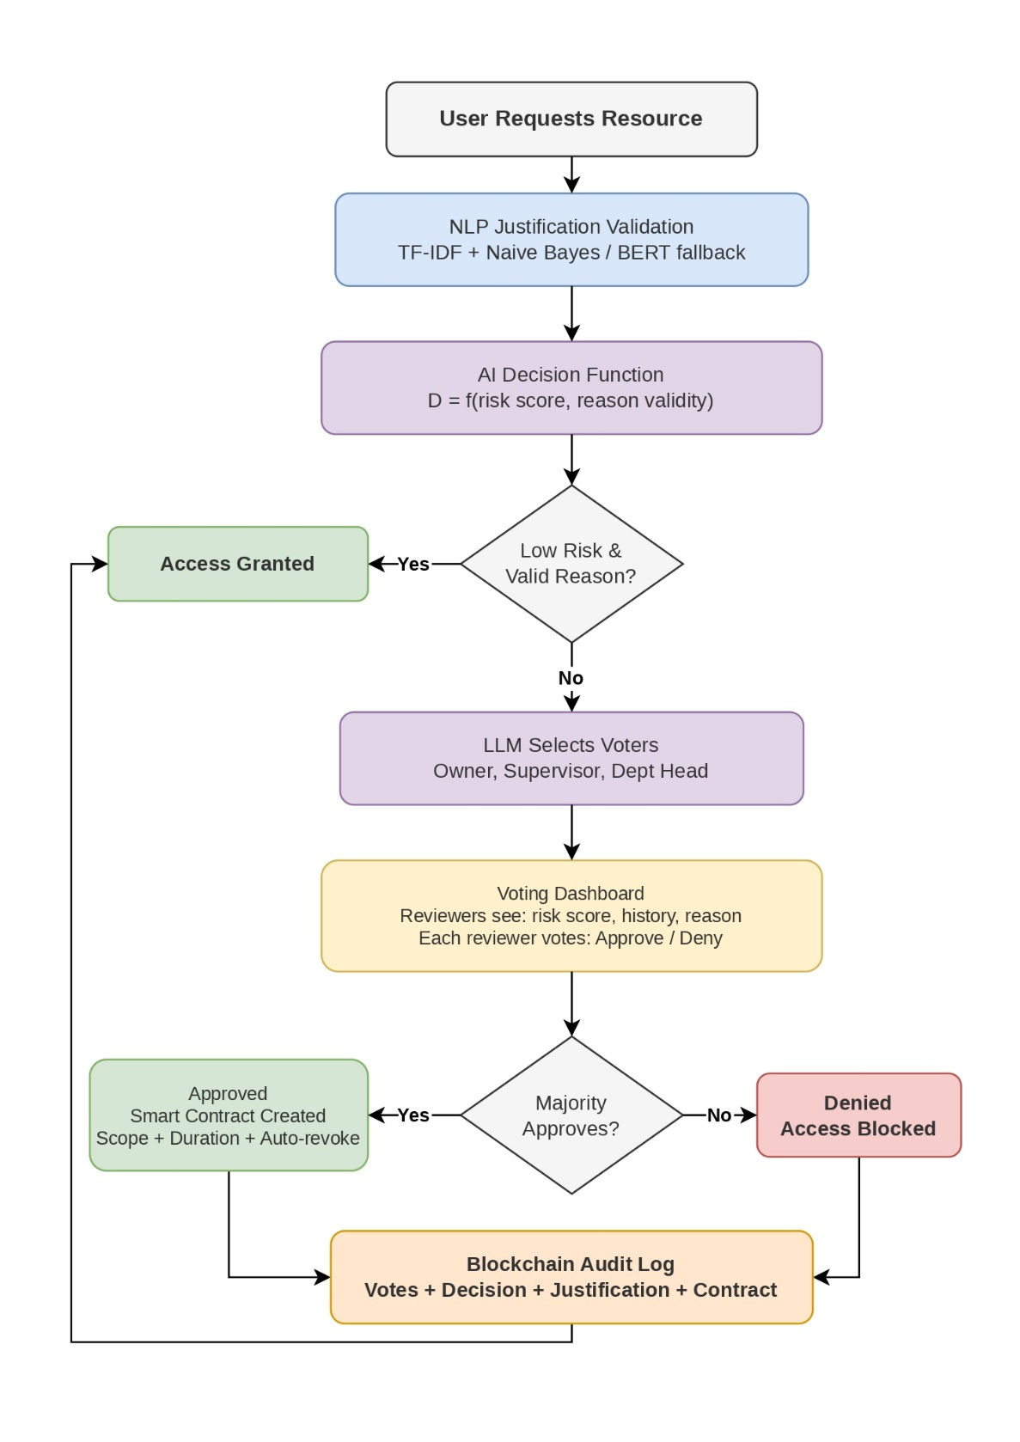
Authorization Workflow
User submits access request with justification
System performs AI-based validation (risk + reason)
Decision:
  Low risk → Direct access
  High risk → Reviewer approval (LLM-assisted)
Final outcome: Approve / Deny
All actions recorded on blockchain for audit

Slide 14
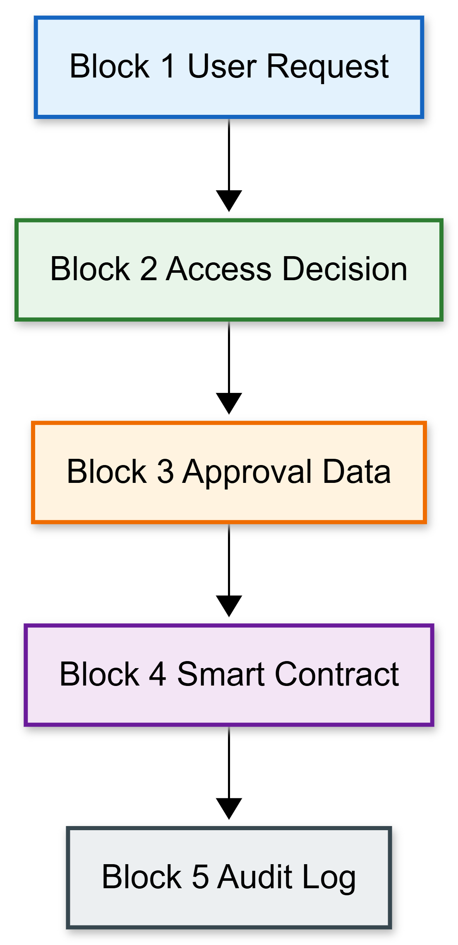
Blockchain Integration
Ensures immutable and tamper-proof storage of access records
Provides decentralized identity management (no single point of failure)
Maintains transparent audit logs for all access activities
Enables non-repudiation (users cannot deny actions)
Uses smart contracts for automated access control (scope & duration)

Slide 15
Expected Results
Traditional | Proposed System
Static, one-size-fits-all security approach | Adaptive, context-aware security that adjusts based on risk
Slow and manual decision-making processes | Real-time, AI-driven intelligent decision making
Limited and insecure logging mechanisms | Secure, transparent, and tamper-proof blockchain audit logs
Centralized systems with single point of failure | Decentralized architecture ensuring higher reliability
Fixed authentication methods (basic MFA) | Dynamic, risk-based multi-factor authentication
Enhanced system security through risk-based authentication
Significant reduction in unauthorized access attempts
Faster and more efficient decision-making process
Improved user experience with adaptive authentication
Increased transparency and trust via blockchain-based logging

Slide 16
System Output
Risk-based authentication flow with dynamic security levels
Intelligent access approvals using AI-driven decision-making
Secure and immutable audit trail via blockchain integration
Real-time monitoring and response to access requests
Enhanced visibility and control over system access activities

Slide 17
Advantages
Adaptive security system with context-aware authentication
Scalable architecture suitable for large and dynamic environments
Transparent and tamper-proof logging using blockchain
Reduced human intervention through AI-driven automation

Slide 18
Conclusion
The proposed system enhances Zero Trust security through continuous verification
Integrates AI-driven intelligence (LLMs) with blockchain-based trust
Enables dynamic, risk-based authentication for stronger protection
Ensures transparent and tamper-proof auditing of all access activities
Achieves a balance between high security and seamless user experience

Slide 19
Future Scope
Implementation and real-world deployment of the proposed system
Integration with enterprise IAM solutions for practical validation
Use of advanced LLMs to enhance decision-making accuracy
Development of AI-driven anomaly detection for proactive security
Support for cross-platform identity federation
Exploration of quantum-resistant blockchain mechanisms

Slide 20
References
[1] R. S. Sandhu, E. J. Coyne, H. L. Feinstein, and C. E. Youman, “Role-based access control models,” IEEE Computer, vol. 29, no. 2, pp. 38–47, 1996.
[2] V. C. Hu, D. Ferraiolo, and D. Kuhn, “Assessment of access control systems,” NIST Interagency Report 7316, 2017.
[3] S. Wiefling, M. Dürmuth, and L. Lo Iacono, “Pump up password security! Evaluating and enhancing risk-based authentication on a real-world large-scale online service,” ACM Trans. Privacy Security, 2022.
[4] M. Zyskind, O. Nathan, and A. Pentland, “Decentralizing privacy: Using blockchain to protect personal data,” in Proc. IEEE S&P Workshops, 2015, pp. 180–184.
[5] Y. Liu, K. Wang, Y. Lin, and W. Xu, “Blockchain-based identity management systems: A survey,” J. Network Comput. Appl., vol. 166, 2020.
[6] K. Sharma and R. Gupta, “Adaptive multi-factor authentication for secure systems,” Comput. Security, vol. 108, 2022.
[7] S. Rose, O. Borchert, S. Mitchell, and S. Connelly, “Zero trust architecture,” NIST SP 800-207, 2020.
[8] S. Wiefling et al., “RBA login dataset,” GitHub, 2022. [Online]. Available: https://github.com/das-group/rba-dataset
[9] G. Picard and S. Pierre, “RLAuth: A risk-based authentication system using reinforcement learning,” IEEE Access, 2023.

Slide 21
References
[10] H. Fereidouni et al., “F-RBA: A federated learning-based framework for risk-based authentication,” arXiv preprint arXiv:2412.12324, 2024.
[11] A. F. Baig and S. Eskeland, “Security, privacy, and usability in continuous authentication: A survey,” Sensors, vol. 21, no. 17, 2021.
[12] M. Frank, R. Biedert, E. Ma, I. Martinovic, and D. Song, “Touchalytics: On the applicability of touchscreen input as a behavioral biometric,” IEEE Trans. Inf. Forensics Security, vol. 8, no. 1, 2013.
[13] J. Kindervag, “Build security into your network’s DNA: The zero trust network architecture,” Forrester Research, 2010.
[14] Y. Wang et al., “AU-ZTAC: Attribute and user trust score-based zero trust access control in IoV,” Electronics, vol. 12, no. 23, 2023.
[15] Google, “BeyondCorp: A new approach to enterprise security,” Google Whitepaper, 2014.
[16] X. Hu et al., “N-Accesses: A blockchain-based access control framework for IoT,” Sensors, vol. 23, no. 20, 2023.
[17] R. Patel, S. Mehta, and A. Verma, “Context-aware security decision making using large language models,” in Proc. IEEE Int. Conf. Artificial Intelligence Security, 2023.
[18] H. Tawfik et al., “ACHealthChain: A blockchain-based access control framework for healthcare data,” Scientific Reports, vol. 15, 2025.
[19] S. N. Zisad, “LLMAC: A global and explainable access control framework with LLM,” arXiv preprint arXiv:2602.09392, 2026.

