Slide 1
CAPSTONE PROJECT 2-PPT FOR ENDSEMESTER ASSESSMENT-JULY
CP1_TITLE:- HIFI MOUSE
CAPSTONE PROJECT 2- PPT FOR ENDSEMESTER ASSESSMENT – JULY
Div :- I CP1_GROUP No. 10 Day:- Saturday Date:-02/07/2022
Presented by Project Guide
DEPARTMENT OF ENGINEERING SCIENCE AND HUMANITIES(DESH)
VISHWAKARMA INSTITUTE OF TECHNOLOGY , PUNE
Dipkul Khandelwal 12111226
Arya Khandetod 12110563
Siddesh Khaple 12110054
Aishwarya Kharade 12110040
Parth Kharade 12110130
Yogita Narule Ma’am

Slide 2
Contents
Introduction
Problem statement
Objectives
Methodology
Literature review
Work done
Conclusion
References

Slide 3
INTRODUCTION
Hifi MOUSE
The devices are becoming more compact in the form of Bluetooth or wireless technologies.
Uses hand gestures and fingertips for performing mouse functions
Hand gesture and fingertip detection by using computer vision.
By using a built-in-camera or web camera and perform the mouse cursor operations and scrolling functions and also move the cursor with it.

Slide 4
Problem Statement
The AI virtual mouse system can be used to overcome the problem in the real world where there is no space to use a physical mouse.
As we have seen in the COVID-19 situation, it is not safe to use devices by touching them as it increases the spread of viruses.
Since hand gestures and figure tip detection are used to control PC mouse functions by using a web-cam or built-in camera, an AI virtual mouse can be used to overcome these problems.

Slide 5
Methodology
We have used VS Code for developing our projects.
Different Modules are installed. It includes
OpenCV
Mediapipe
Autopy
Time
We have divided the given software system into 4 parts:
Hand Tracking Module
Mouse Control
Sound control
Virtual painter

Slide 6
Literature Review
Title of paper | Author | Publishing year | Features
Virtual Mouse Using a Webcam Virtual Mouse Control Using Hand Class Gesture | Kazim Sekeroglu Vijay Kumar Sharma | 2017 2020 | In the object tracking application one of the main problems is object detection. Instead of finger tips, a colour pointer has been used to make the object detection easy and fast. A circle blue sticker is used as a colour pointer in this study. To simulate the click events of the mouse three fingers with three colour pointers has been used. (i) The first step is to capture the image using the camera. (ii) The camera then extracts and recognizes the human hand from the input image. (iii) Then the position of the human hand is stored in the system using the regular coordinate-system. (iv) Then when the second frame is captured. The position of the hand from the second frame is captured and is stored in the system. (v) Then the position of both hands is compared and then the cursor moves accordingly.

Slide 7
Title of paper | Author | Publishing year | Features
Deep Learning-Based Real-Time AI Virtual Mouse System Using Computer Vision to Avoid COVID-19 Spread Virtual Mouse Using Hand Gesture | S. Shriram , B. Nagaraj , J. Jaya , S. Shankar , P. Ajay Saniya Khan, Dnyaneshwari Bagekar, Abhishek Chauhan, Prof.Deveshree Wankhede. | 25 October 2021 5 May 2021 | There are some related works carried out on virtual mouse using hand gesture detection by wearing a glove in the hand and also using color tips in the hands for gesture recognition, but they are no more accurate in mouse functions. the recognition is not so accurate because of wearing gloves; also, the gloves are also not suited for some users, and in some cases, the recognition is not so accurate because of the failure of detection of color tips. The flow model shows the working of the system with different functions. The system will first take the input of image from the web camera. It will also convert the video captured from the web camera and convert them into image. It will then resize the input image so that the segmentation can take place to calibrate the points on the image.

Slide 8
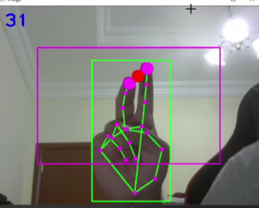
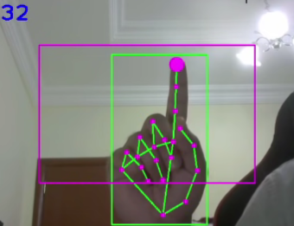
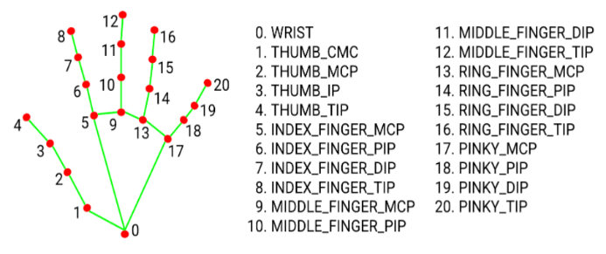
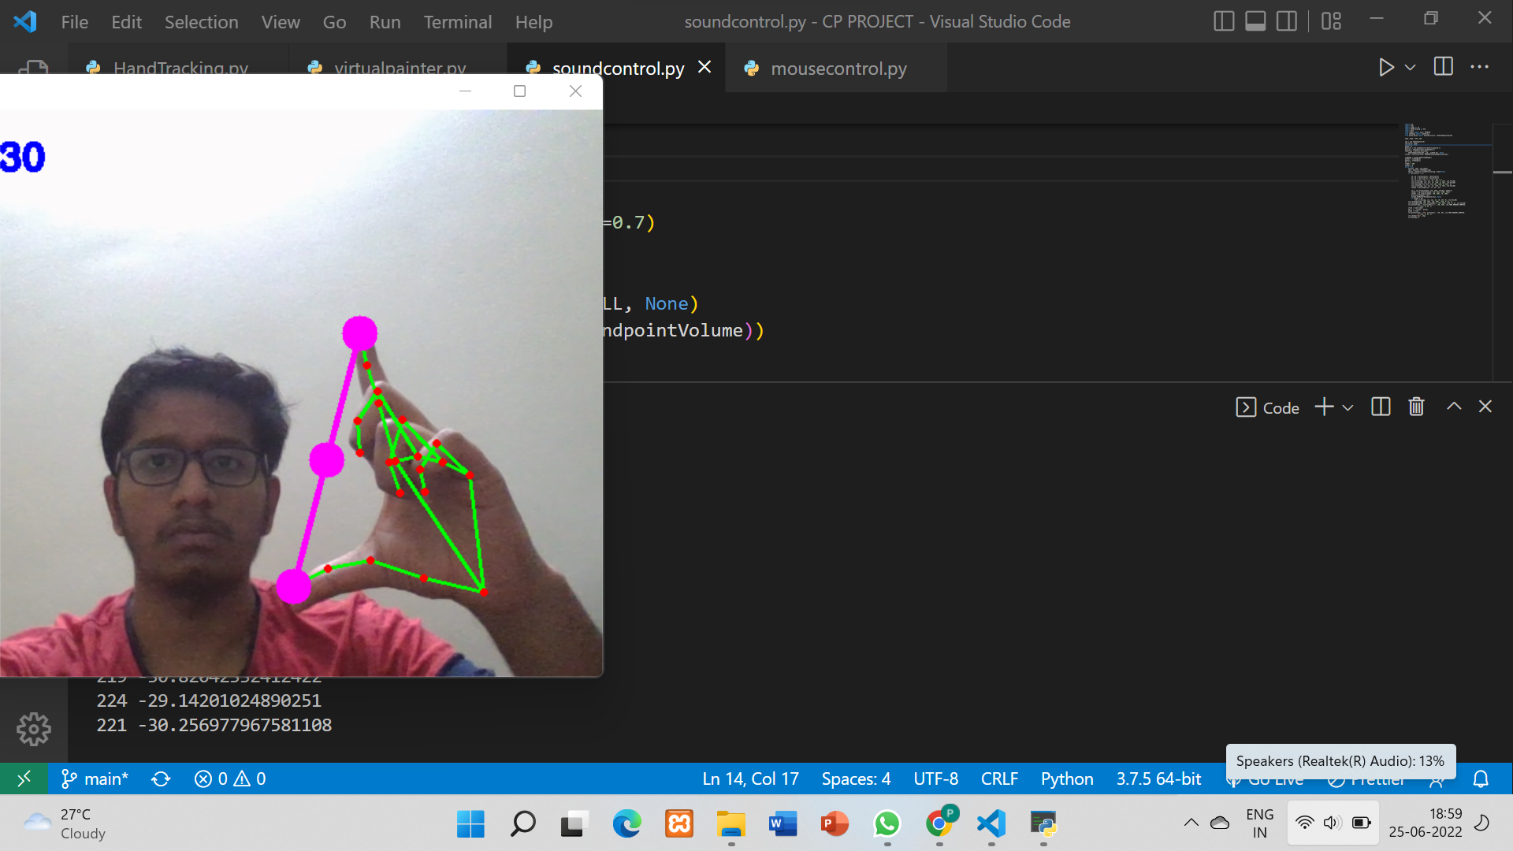

Working
Recognition of hand.
Hand tracking with the help hand landmarks.
Characterisation of landmarks into
Mouse control
Volume mode
Character tracking
Cursor
Cursor positioning
Clicking
Distance tracking.
Volume
Distance tracking.

Slide 9
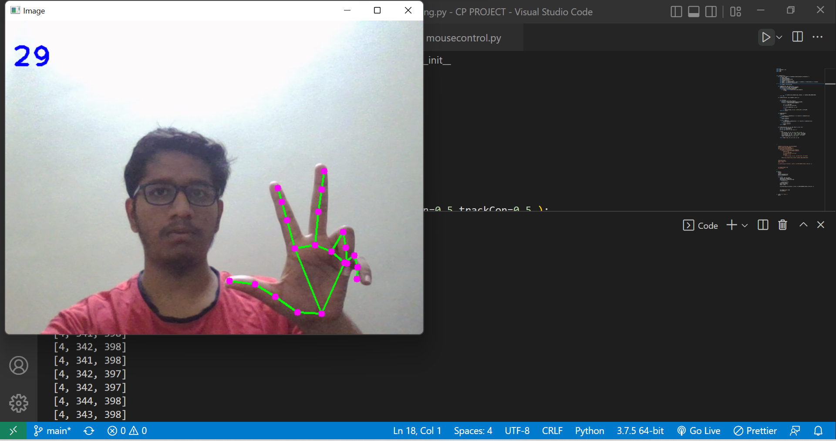
RESULTS
Fig 3. Gesture used for mouse control
Fig 4. Gesture for sound control

Slide 10
References
[1] S. Shriram , 1 B. Nagaraj , 2 J. Jaya , 3 S. Shankar , 4 and P. Ajay 5 Deep Learning-Based Real-Time AI Virtual Mouse System Using Computer Vision to Avoid COVID- 19 spreads
[2] Saniya Khan, Dnyaneshwari Bagekar, Abhishek Chauhan, Prof.Deveshree Wankhede. Virtual Mouse Using Hand Gesture
[3] Chien-Cheng Lee, Cheng-Yuan Shih, and BorShennJeng,“Fingertip-writing alphanumeric Character Recognition for Vision-based Human Computer Interaction” ,International Conference on Broadband, Wireless Computing, Communication and Applications 978-0-7695- 4,2010
[4] T. Suganya Thevi , C. Chitra, “Cursor Movement in Real Time using Hand Gesture Recognition”, International Journal of Engineering Sciences& ResearchTechnology,ISSN:2277-9655,March 2014.
[5] Shany Jophin, Sheethal M.S, Priya Philip, T M Bhruguram, “Gesture Based Interface Using Motion and Image Comparison”, InternationalJournal of Advanced InformationTechnology (IJAIT) Vol. 2, No.3,June 2012.
[6] Ravikumar Javali Virtual Mouse

Slide 11
Conclusion
Python programming language is used for developing the AI virtual mouse system.
OpenCV
MediaPipe
Autopy
The results of the proposed model showed a good accuracy level.

