Slide 1
CAPSTONE PROJECT 2- PPT FOR MEDSEMESTER ASSESSMENT -MAY
CP1_TITLE:- HIFI MOUSE
Div :- I CP1_GROUP No. 10 Day:- Monday Date:-30/05/2022
Presented by Project Guide
DEPARTMENT OF ENGINEERING SCIENCE AND HUMANITIES(DESH)
VISHWAKARMA INSTITUTE OF TECHNOLOGY , PUNE
Yogita Narule Mam
Dipkul Khandelwal 12111226
Arya Khandetod 12110563
Siddesh Khaple 12110054
Aishwarya Kharade 12110040
Parth Kharade 12110130

Slide 2
Contents
Introduction
Problem statement
Objectives
Literature review
Methodology
Work done till now
Action plan for future
Conclusion
References

Slide 3
Introduction
With the development in technologies the devices that we use in daily life are becoming compact in form of Bluetooth or wireless technologies
The mouse system that we are going to develop is makes use of hand gestures and fingertips for performing mouse functions
Hand gesture and hand tip hand tip detection by using computer vision is used in HCL with the computer
By using a built-in-camera or web camera and perform the mouse cursor operations and scrolling functions and also move the cursor with it

Slide 4
Problem Statement
The AI virtual mouse system can be used to overcome the problem in real world where there is no space to use a physical mouse and also for the people who have any physical problem and can’t operate the mouse
As we have seen in COVID-19 situation it is not safe to use devices by touching them as it increase the spread of virus
AI virtual mouse can be used to overcome these problems since hand gestures and hand tip detection is used to control PC mouse functions by using a web-cam or built-in camera.

Slide 5
Objectives
To develop alternative to regular and traditional mouse system to perform and control mouse functions
This can be achieved with the help of web camera that captures the hand gestures and hand tip
Then processes these work frames to perform the particular mouse function such as left click, right click and scrolling functions

Slide 6
Methodology
OpenCV is a computer vision library which contains image-processing algorithms for object detection
OpenCV is a library of python programming language and the real time computer vision application can be developed by using the computer vision library.
The OpenCV library used in image and video processing and also analysis such as face detection and object detection
Mediapipe is a framework which is used for applying in a machine learning pipeline and it is an opensource framework of google
Mediapipe frame is multimodal where this framework can be applied to various audios and videos.

Slide 7



Slide 8
Literature review
Title of paper | Author | Publishing year | Features
Virtual Mouse Using a Webcam Virtual Mouse Control Using Hand Class Gesture | Kazim Sekeroglu Vijay Kumar Sharma | 2017 2020 | In the object tracking application one of the main problems is object detection. Instead of finger tips, a color pointer has been used to make the object detection easy and fast. A circle blue sticker is used as a color pointer in this study. To simulate the click events of the mouse three fingers with three color pointers has been used. (i) The first step is to capture the image using the camera. (ii) The camera then extracts and recognizes the human hand from the input image. (iii) Then the position of the human hand is stored in the system using the regular” coordinate-system”. (iv) Then when the second frame is captured. The position of the hand from the second frame is captured and is stored in the system. (v) Then the position of both hands is compared and then the cursor moves accordingly.

Slide 9
Title of paper | Author | Publishing year | Features
Deep Learning-Based Real-Time AI Virtual Mouse System Using Computer Vision to Avoid COVID-19 Spread Virtual Mouse Using Hand Gesture | S. Shriram , B. Nagaraj , J. Jaya , S. Shankar , P. Ajay Saniya Khan, Dnyaneshwari Bagekar, Abhishek Chauhan, Prof.Deveshree Wankhede. | 25 October 2021 5 May 2021 | There are some related works carried out on virtual mouse using hand gesture detection by wearing a glove in the hand and also using color tips in the hands for gesture recognition, but they are no more accurate in mouse functions. the recognition is not so accurate because of wearing gloves; also, the gloves are also not suited for some users, and in some cases, the recognition is not so accurate because of the failure of detection of color tips. The flow model shows the working of the system with different functions. The system will first take the input of image from the web camera. It will also convert the video captured from the web camera and convert them into image. It will then resize the input image so that the segmentation can take place to calibrate the points on the image.

Slide 10
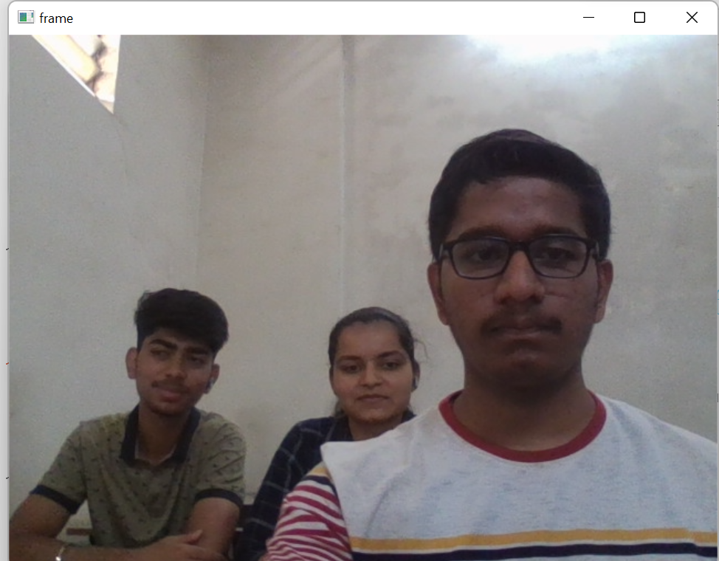
Work done till now
InstaWorking on Hand-Tracking Module: It consists of code required to track our hand.

Slide 11
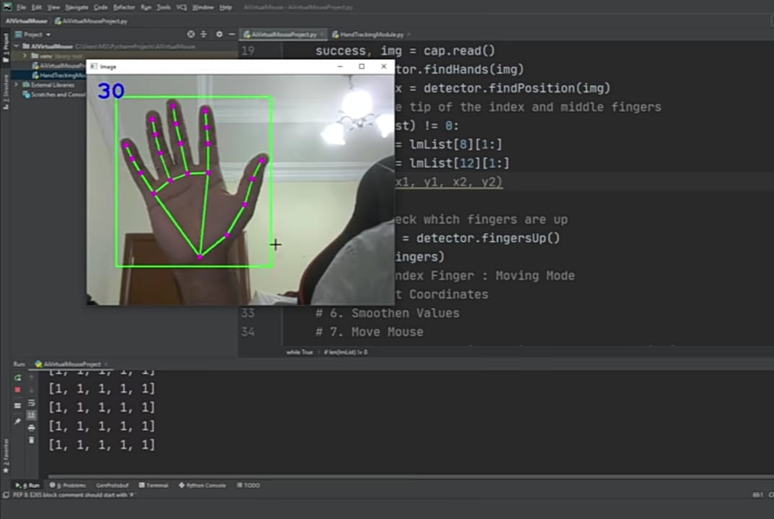

Slide 12
Action Plan for future
Going to work on the Mouse control

Slide 13
Conclusion
Python programming language is used for developing the AI virtual mouse system, and also, OpenCV which is the library for computer vision is used in the AI virtual mouse system. In the proposed AI virtual mouse system, the model makes use of the MediaPipe package for the tracking of the hands and for tracking of the tip of the hands, and also, Pynput, Autopy, and PyAutoGUI packages were used for moving around the window screen of the computer for performing functions such as left click, right click, and scrolling functions. The results of the proposed model showed very high accuracy level, and the proposed model can work very well in real-world application with the use of a CPU without the use of a GPU.

Slide 14
References
http://www.ece.lsu.edu/ipl/SampleStudentProjects/ProjectKazim/Virtual%20Mouse%20Using%20a%20Webcam_Kazim_Sekeroglu.pdf
https://www.researchgate.net/publication/347983092_Virtual_Mouse_Control_Using_Hand_Class_Gesture
Deep Learning-Based Real-Time AI Virtual Mouse System Using Computer Vision to Avoid COVID-19 Spread
Virtual Mouse Using Hand Gesture 1Saniya Khan,2Dnyaneshwari Bagekar,3Abhishek Chauhan,4Prof.Deveshree Wankhede. 1Student, 2Student, 3Stuent, 4Assistant Professor 1Computer Engineering Department, 1Shivajirao S. Jondhale College Of Engineering, Dombivli(E), India
Virtual Mouse Proceedings of International Conference on Circuits, Communication, Control and Com

