Slide 1
Apartment Reviews Database Management
By Data WhereHouse
Group number: 11 Member: Andy Mao, Zhaoyi Li, Parth Kodnani, Heng Zhuang
Date: 12/6/2021

Slide 2
Background
Project Goal:
Display all the reviews of apartments around College Park in a consolidated manner
Users:
Anyone willing to live around College Park Campus
Data source:
Google Reviews
Apartments.com
Official website

Slide 3
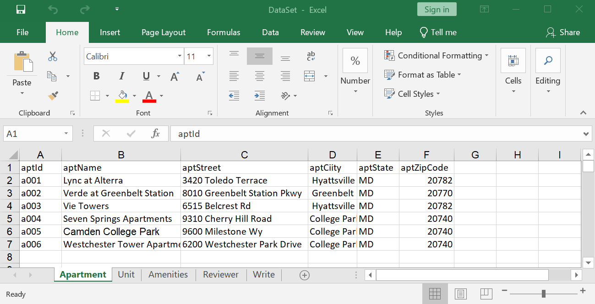
Data Information
Apartment List:
Hyattsville:
Lync at Alterra
Vie Towers
College Park:
Seven Springs Apartments
Camden College Park
Westchester Tower Apartments
Greenbelt:
Verde at Greenbelt Station
Data:
Apartment information:
Room type, rent, amenities informations, address, etc.
Apartment reviews:
Reviewer name, review content, rate and review date

Slide 4
Introduction
Mission Statement:
To provide the future residents with more information
To let the current residents give their feedback about the apartment units
Mission Objective:
Find the apartments with the worst and the best review
Find the apartments with the least and most number of amenities
Find the cheapest and the most expensive apartment units in College Park area
Find the top 5 longest comments

Slide 5
Conceptual Database Design
First Stage of Database design process
Describes the main data entities, attributes, relationships, and constraints of a given problem domain
Design is descriptive and narrative in form. E.g. Entity-Relationship Diagram
"All that is needed is there, and all that is there is needed"
Notes:
"All that is needed is there, and all that is there is needed". Meaning: All data elements required by the database transactions must be defined in the model, and all data elements defined in the model must be used by at least one database transaction.

Slide 6
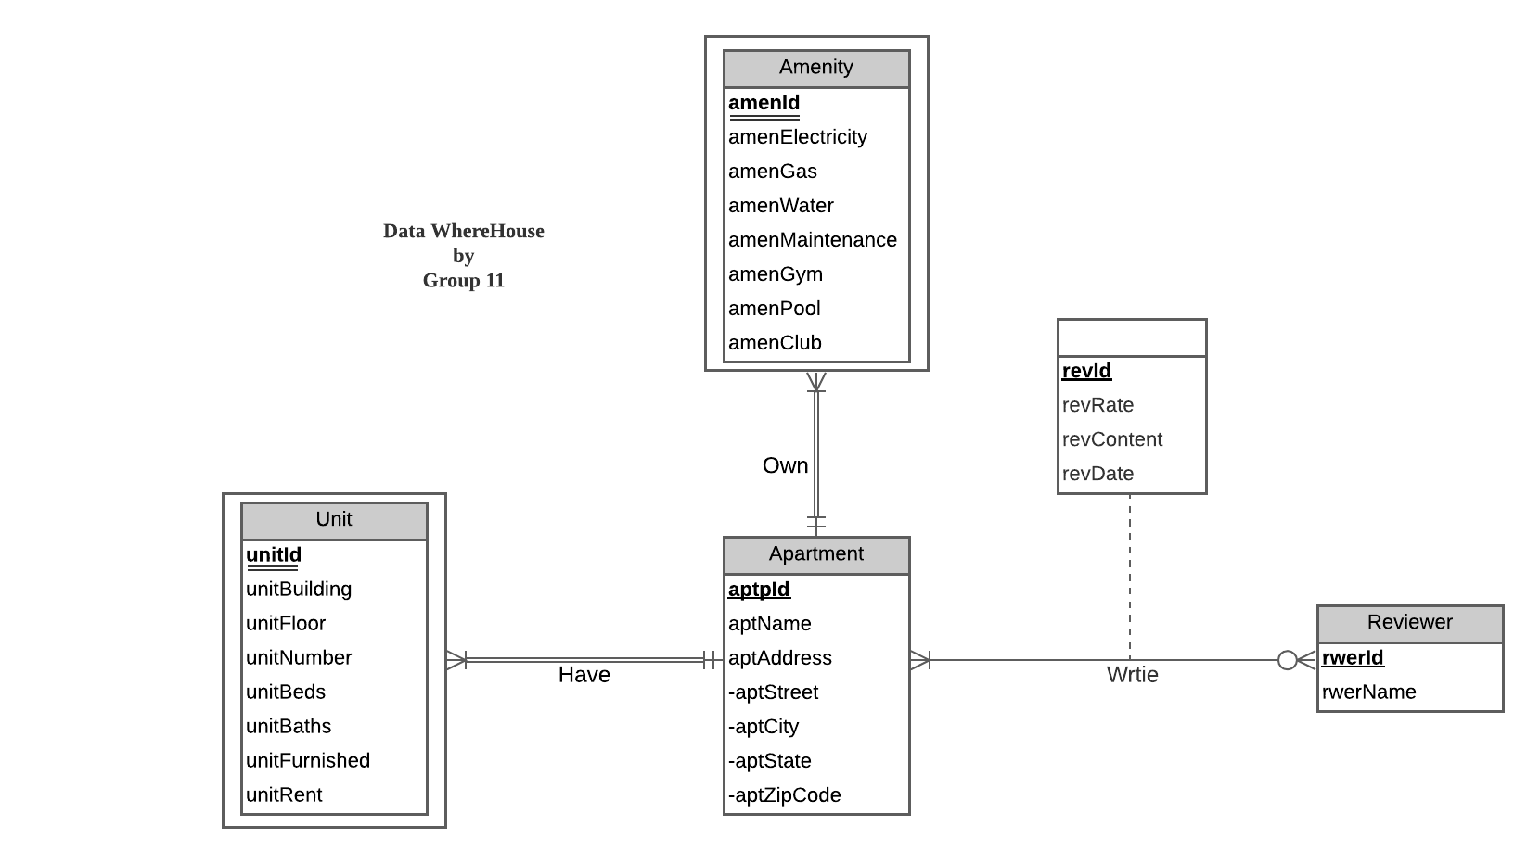
ER Diagram

Slide 7
Logical Database Design
Relational Schema
Apartment (aptId, aptName, aptStreet, aptCity, aptState, aptZipCode)
Unit (unitId, aptId, unitBuilding, unitFloor, unitNumber, unitBeds, unitBaths, unitFurnished, unitRent)
Amenity (amenId, aptId, amenElectricity, amenGas, amenWater, amenMaintenance, amenGym, amenPool, amenClub)
Reviewer (rwerId, rwerName)
Write (revId, aptId, rwerId, revRate, revContent, revDate)
Logical Database Design is the process of transforming (or mapping) a conceptual schema of an application domain into a schema for the data model underlying a particular DBMS, such as the relational data model.
Notes:
Process of transforming a conceptual design of an app into a schema or a logical representation of the system.

Slide 8
Physical Database Design
Process of transforming a logical data model into the physical data structure of a particular database management system (DBMS); in our case, the relational database.
Optimizes performance while ensuring data integrity by avoiding unnecessary data redundancies.
Characteristics:
Describes data requirements for a single project or application.
Specifies all tables and columns.
Contains foreign keys used to identify relationships between tables.
Physical considerations may cause the physical data model to be different from the logical data model.
Notes:
Process of transforming your system’s schema into a tabular, human-readable format.
Ensures data integrity, means data is always consistent throughout the database. Avoids unnecessary redundancies by normalizing the data in rows. This in turn improves efficiency of the system.
Describes data requirements for one and only one system.
As I mentioned, data is present in the form of tables.
Foreign keys are present to connect two tables sharing a relationship.
Physical and Logical designs may vary depending on the type of attributes present.

Slide 9

Query and Output
CREATE TABLE [Review.Unit] (
unitId CHAR(4) NOT NULL,
aptId CHAR(4) NOT NULL,
unitBuilding VARCHAR(10),
unitFloor VARCHAR(2),
unitNumber VARCHAR(8),
unitBeds NUMERIC(2),
unitBaths NUMERIC(2),
unitFurnished VARCHAR(70),
unitRent NUMERIC(6,2),
CONSTRAINT pk_Unit_unitId_aptId PRIMARY KEY (unitId, aptId),
CONSTRAINT fk_Unit_aptId FOREIGN KEY (aptId)
REFERENCES [Review.Apartment] (aptId)
ON DELETE CASCADE ON UPDATE CASCADE
);

Slide 10
Potential used cases
Which apartments have high quality or satisfaction rate?
What are the apartment id, apartment name and apartment address of the apartments with average rating over 4.5?
Which apartment has the worst quality or satisfaction rate?
What is the apartment id, apartment name and apartment address of the apartment with the worst average rating?

Slide 11
What are the apartment id, apartment name and apartment address of the apartments with average rating over 4.5?
GO
CREATE VIEW Q1 AS
SELECT a.aptId, a.aptName, a.aptStreet + ' ' + a.aptCity + ' ' + a.aptState + ' ' + a.aptZipCode as 'aptAddress', AVG(w.revRate) as 'Average Rating'
FROM [Review.Apartment] a, [Review.Write] w
WHERE a.aptId = w.aptId
GROUP BY a.aptId, a.aptName, a.aptStreet, a.aptCity, aptState, aptZipCode
HAVING AVG(w.revRate) > 4.5
WITH CHECK OPTION
SELECT *
FROM Q1

Slide 12
What is the apartment id, apartment name and apartment address of the apartment with the worst average rating?
Solution 1:
GO
CREATE VIEW Q2_1 AS
SELECT TOP 1 a.aptId, a.aptName, a.aptStreet + ' ' + a.aptCity + ' ‘ + a.aptState + ' ' + a.aptZipCode as 'aptAddress', AVG(w.revRate) as 'Average Rating'
FROM [Review.Apartment] a, [Review.Write] w
WHERE a.aptId = w.aptId
GROUP BY a.aptId, a.aptName, a.aptStreet, a.aptCity, aptState, aptZipCode
ORDER BY AVG(w.revRate) ASC
WITH CHECK OPTION
SELECT *
FROM Q2_1

Slide 13
What is the apartment id, apartment name and apartment address of the apartment with the worst average rating?
Solution 2:
GO
CREATE VIEW Q2_2 AS
SELECT a.aptId, a.aptName, a.aptStreet + ' ' + a.aptCity + ' ' + a.aptState + ‘ ‘ + a.aptZipCode as 'aptAddress’, AVG(w.revRate) as 'Average_Rating'
FROM [Review.Apartment] a, [Review.Write] w, (
SELECT aa.aptId, AVG(ww.revRate) as 'AR'
FROM [Review.Apartment] aa, [Review.Write] ww
WHERE aa.aptId=ww.aptId
GROUP BY aa.aptId) av
WHERE a.aptId = w.aptId
GROUP BY a.aptId, a.aptName, a.aptStreet, a.aptCity, aptState, aptZipCode
HAVING AVG(w.revRate) = MIN(av.AR)
WITH CHECK OPTION
SELECT *
FROM Q2_2

Slide 14
Thank You

