Slide 1
Prime Number Detector Using Logisim
Team Members: Pranav Pahwa 01FB16ECS265
Prasad M Kalai 01FB16ECS267
Prithvi RV 01FB16ECS282
Parth Krishna 01FB16ECS248

Slide 2
Introduction
A prime number is a number which is divisible by one and itself.
Here, we have designed a basic combinational circuit to detect if the given 4-bit binary number is prime or not.
The range is from 0000 – 1111.

Slide 3
Truth Table
N3 | N2 | N1 | N0 | Output
0 | 0 | 0 | 0 | 0
0 | 0 | 0 | 1 | 1
0 | 0 | 1 | 0 | 1
0 | 0 | 1 | 1 | 1
0 | 1 | 0 | 0 | 0
0 | 1 | 0 | 1 | 1
0 | 1 | 1 | 0 | 0
0 | 1 | 1 | 1 | 1
1 | 0 | 0 | 0 | 0
1 | 0 | 0 | 1 | 0
1 | 0 | 1 | 0 | 0
1 | 0 | 1 | 1 | 1
1 | 1 | 0 | 0 | 0
1 | 1 | 0 | 1 | 1
1 | 1 | 1 | 0 | 0
1 | 1 | 1 | 1 | 0

Slide 4
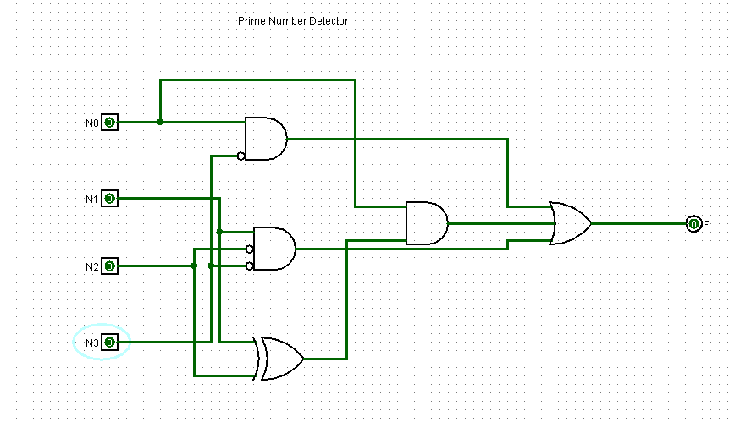

Slide 5
10 sec Countdown Using Logisim

Slide 6
Introduction
It is a simple counter which uses a hex display to count down from 9-1.
Each decrement happens with every passing clock cycle.

Slide 7
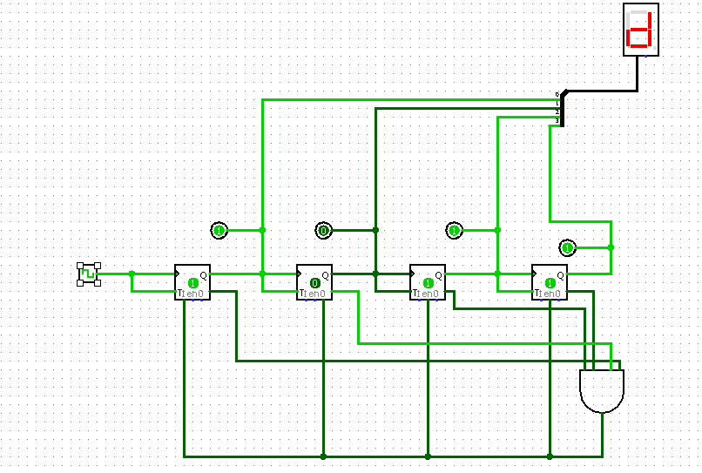

Slide 8
Thank You!

