Slide 1

Happiness vs. Physical Facilities
What really drives well-being — and why the things we assume will make us happy often fall short.

Slide 2
What "Happiness" Means in Science
Happiness isn't just a feeling — it's measurable. Scientists define it as positive emotions plus life satisfaction, where the positive outweighs the negative overall.
Hedonic Happiness
Eudaimonic Happiness
The pursuit of pleasure and comfort — enjoying good food, leisure, and positive experiences.
Deep fulfillment from purpose, growth, and living in alignment with your values.

Slide 3


The Promise of Physical Facilities
We often assume better facilities — gyms, parks, clinics, amenities — will make us healthier and happier. There's truth to this, but the relationship runs both ways.
Emotional Well-Being → Physical Health
Positive emotions are linked to better immunity, lower inflammation, and longer life.
Physical Health → Emotional Well-Being
Good health enables participation in life, reducing suffering and expanding opportunity.

Slide 4

Where Facilities Help — And What They Can't Replace
Active Leisure Supports Happiness
Sports, hobbies, and creative pursuits consistently boost well-being. But passive leisure — binge-watching TV, scrolling — often doesn't.
Spirituality Goes Beyond Amenities
A sense of meaning, hope, and connection to something larger shapes healthier choices and deeper resilience — no facility required.

Slide 5
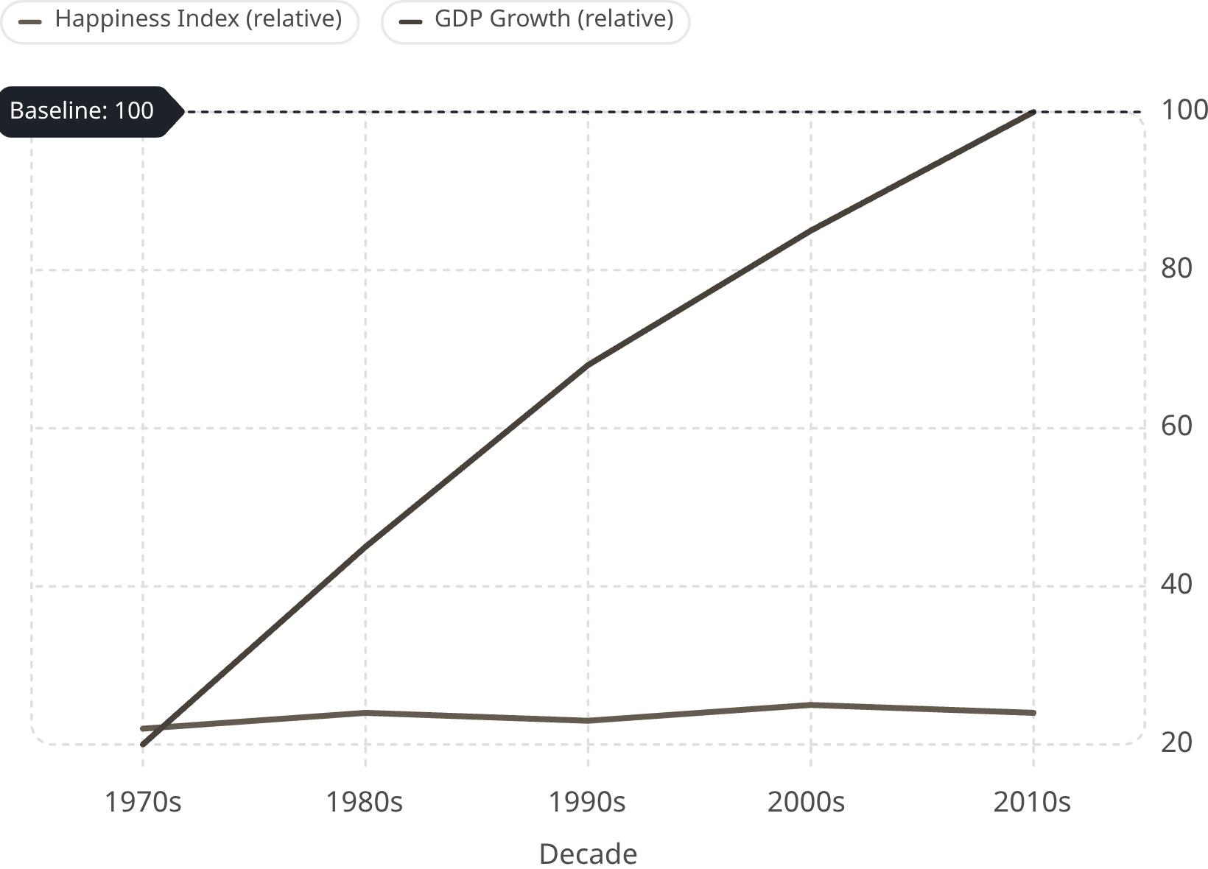

The Money Trap: More Space, More Status ≠ More Happiness
The Easterlin Paradox
Over decades, GDP has risen sharply — yet average happiness has remained nearly flat. More income helps up to a point, but social comparison and rising expectations quickly erode the gains.
Once basic needs are met, relative standing matters more than absolute wealth.

Slide 6





The Strongest Predictors of Happiness
Research consistently points to the same pillars. The PERMA model captures what truly sustains well-being.
Pleasure
Engagement
Relationships
Positive emotions and enjoyable experiences
Flow states and deep involvement
Strong social bonds and community
Meaning
Accomplishment
Purpose beyond oneself
Growth, mastery, and achievement
Perceived lack of control — learned helplessness — is one of the strongest predictors of poor well-being. Autonomy matters.

Slide 7
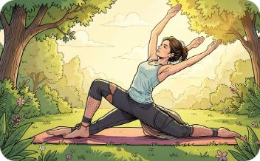



Build for Happiness — Then Measure It
Facilities should enable health, connection, and meaning — not substitute for them. A true happiness strategy is intentional.
Active Leisure
Relationships
Gratitude & Kindness
Stress & Health Habits
Design spaces for movement, sport, and creative engagement.
Prioritize community spaces that bring people together.
Encourage practices that build emotional resilience.
Support sleep, nutrition, and mental health as foundations.

