Slide 1
Analyzing Iterative SVD’s for Large Scale Recommendation Systems
BY
PARTH MAHESHWARI
SAI DIVYA TEJA KONDA

Slide 2
Abstract
Recommender systems are generally used to recommend products to the user based on the previous purchases made. We are trying to forecast the opinion the users will have on the dissimilar substance and be able to recommend the finest product to each user. It is very useful for both the customers and the sellers. For the customers, recommender systems will help them to find the products which they are interested in and for the sellers, recommender systems will improve the loyalty of their customers by enhancing the user experience and further converting more browsers to consumers. By using Singular Value Decomposition (SVD) we discover the relationships between the products which are in turn useful to recommending products to users.
Notes:
Based on the previous purchases made we will give recommendation to the user. we are trying to get opinions from the users to give finest recomm. this is useful for bith users and the sellers. users will get good recom and sellers will get profits

Slide 3
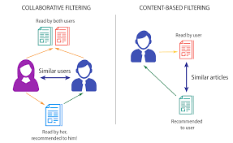
Recommedation Systems
Systems for recommending items (e.g. books, music, movies, CD’s, web pages, newsgroup messages) to users based on previous data of the user.
All the marketing companies use recommendations systems
Recommenders have shown substantial increase of sales at on-line stores.
There are 2 approaches for recommender systems
- Collaborative filtering
- Content Based filtering
In this project we are using collaborative filtering
Notes:
Now-a days all the ecommerce websites are using recomm syst in order to get more profits. there are many kinds of recomm syste which are used for recommending books,movies,music and so on. collo content

Slide 4
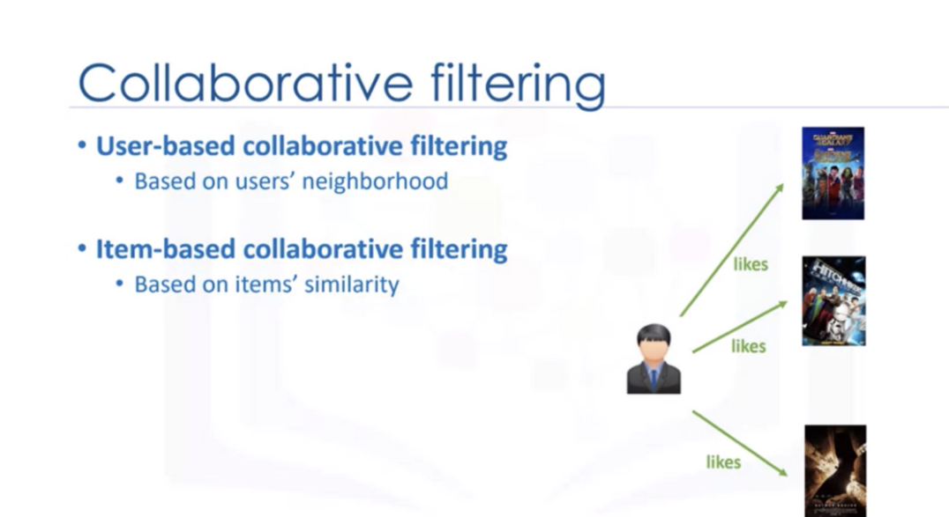
Collaborative Filtering
Maintain a database of many users’ ratings of a variety of items.
For a given user, find other similar users whose ratings strongly correlate with the current user.
Recommend items rated highly by these similar users, but not rated by the current user.
Almost all existing commercial recommenders use this approach (e.g. Amazon).

Slide 5
Work Flow
Data collection and preprocessing
Converting the huge data matrix into smaller matrices using SVD’s
Power Iteration Method will give the largest eigenvalues of the data matrix
Lanczos Bidiagonalization Iteration will give the important eigenvalues of the data matrix
Building a Recommendation model using the important data
Giving recommendations to the user
Notes:
first we collect the data from various places then filter out all the unwanted data using preprocessors, then we use singular value decomposition to convert the huge datamatrix into smaller sub matrices. In this project we are using 2 different eigen value decomposition methods . power iteration and lanczos bidiagonalization iteration. these algorithms will give the most useful singular values of the dataset. Later we built a recommendation systems which uses the above generated singular values and at the end we will gives recommendations to the user

Slide 6
Singular Value Decomposition
In machine learning, the Singular Value Decomposition (SVD), a technique from linear algebra, has typically been utilized as a dimensionality reduction method.
By lowering the spatial dimension, the SVD matrix factorization approach lowers the number of features in a dataset.
It is utilized as a collaborative filtering method within the context of the recommender system.
It makes use of a matrix structure, where each row stands in for a user and each column for an object.
The ratings that people assign to items make up the constituents of this matrix.
Let A be a data matrix then after applying Singular value decomposition it will be converted into 3 sub matrices U, Σ, V(transpose)
A=UΣVᵗ
Where Σ is the singular value diagonal matrix
Notes:
SVD is generally used in linear algebra to decompose a matrix into sub matrices where we get 2 unitary matrices u and vt and 1 diagonal singular matrix. In machine learning it is used in a similar way. here we use svd to reduce the dimensions of a datamatrix. this approach lowers the features in the dataset. we are using it as a collaborative filtering technique. the dataset contains the ratings given by the users.

Slide 7
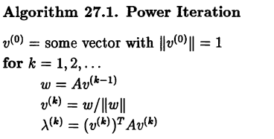
Power Iteration
When given a diagonalizable matrix A, the eigenvalue method power iteration will generate a number λ, the largest eigenvalue of A, and a nonzero vector v, associated eigenvector of λ, such that Av=λv.
Notes:
The first SVD implementation we used was power iteration, which is an algorithm that is typically used to compute the most dominant eigenvalue-eigenvector pair. We used Power iteration to compute the most significant eigenvalues of A*A, which is the most significant singular value-vector pair for our original matrix A. After computing the second unitary matrix U, once we have our first singular triplet, we iteratively subtract these singular components from the original matrix and run the power iteration on resultant matrix again till we get all our k most significant singular components. The algorithm has a complexity of O(mn2) but it typically takes much longer due to its slow rate of convergence.

Slide 8
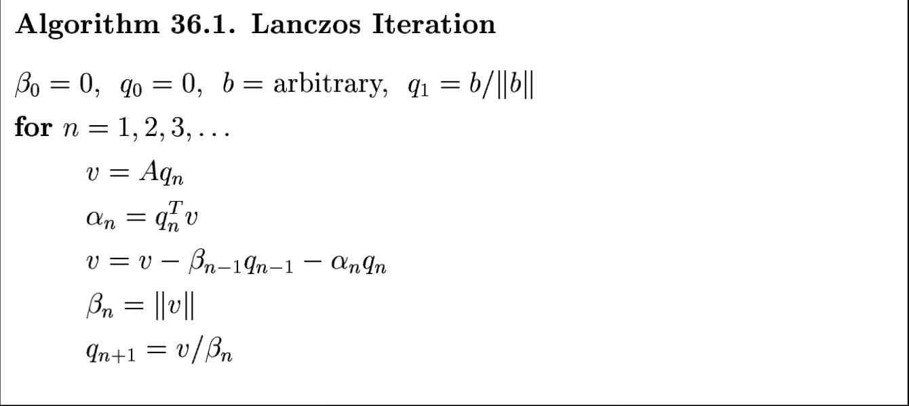
Lanczos Bidiagonalization Iteration
The Lanczos algorithm, developed by Cornelius Lanczos, is an iterative technique that adapts power methods to identify the m most useful eigenvalues and eigenvectors of an n x n Hermitian matrix, where m is much less than n.
Notes:
The second algorithm that we used was Lanczos Iteration. This is a widely used iterative algorithm for computing the extremal eigenvalues and corresponding eigenvectors of a large, sparse, symmetric matrice. This algorithm converts the input matrix to a bidiagonal matrix by creating a Kyrov subspace and then restricting and projecting A onto it. Once, we have our bidiagonal matrix, we can then pass that as an input to a regular SVD implementation (in our case we used numpy), to get first k singular values, using which we computed first k singular triplets. With bidiagonalization, we should have a faster SVD implementation and lesser round-off errors due to fewer non zero components and orthogonalization of residuals respectively.

Slide 9
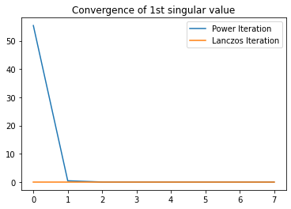
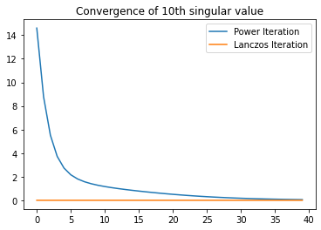
Results
While both algorithms were numerically stable (for top k singular values), Lanczos Iteration converged within 2 iterations as compared to over 40 iterations required by Power Iteration, for 10th singular value. We also observed that Lanczos algorithm was converging equally fast for all singular values, whereas Power iteration convergence rate increases for singular values.

Slide 10
Results
2.We found that the Lanczos Algorithm finished much faster than our Benchmark as well as the Power Iteration for calculating top 10 singular pairs in a 360 x 3794 matrix.
Algorithm | Time taken(seconds)
Scikit-learn’s TruncatedSVD (ARPACK) | 0.57
Power Iteration | 0.85
Lanczos Iteration | 0.31
Notes:
3. Memory comparison, creation of matrices such as Qk and Bk made Lanczos more memory consuming.

Slide 11
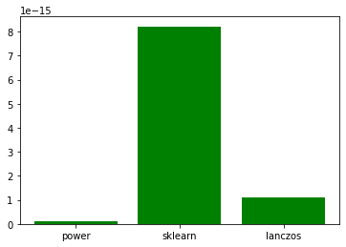
Results
3. Orthogonality - We found that all algorithms returned slightly perturbed orthonormal matrices (∈<∈_{m}), however, sklearn’s implementation seems to be the most perturbed, and slightly more than the machine epsilon.
Notes:
4. All matrices were orthogonal but the scikit learn implementation output was slightly perturbed, however the perturbations in power iteration and Lanczos iteration were less than machine epsilon and therefore can be ignored.
5. Finally, we were able to generate recommendations using all the three implementations. However, we concluded that Lanczos iteration outperformed all the other implementations, and we think it is the most suitable implementation for recommender systems that are usually built up on large, sparse, symmetric matrices.

Slide 12
Thank you

