Slide 1




SMART INDIA HACKATHON 2026
TITLE PAGE
Problem Statement ID – SIH 26009
Problem Statement Title- Using AI/ML and Space Technology to Identify Manganese Reserves and Overcome Production Shortfalls (Ministry of Steel / MOIL)
Theme- Space Technology
PS Category- Software
Team ID-
Team Name (Registered on portal) - ATOMIC-25

Slide 2
IDEA TITLE
ATOMIC-25
MYVISIONAI
Manganese Reserve & Production Intelligence Using Space Technology
DATA SOURCES • Geological + Satellite + Historical Mining​
01
Fuses satellite spectral bands (NDVI, NDWI, BSI), geology & mining history using ML
PROPOSED
SOLUTION
Two ML engines: Reserve Prediction (“Where is the ore?”) + Production Forecast (“How much?”)
RESERVE PREDICTION​
Where is the ore?​
PRODUCTION FORECAST​
How much ore?​
02
03
Predict (ML and Space Technology) → Explain → Recommend corrective actions
RISK / DECISION ENGINE​
04
Unified dashboard delivered to MOIL decision-makers
“A decision-support system that predicts manganese potential, forecasts production shortfalls, explains their causes and recommends corrective actions.”
To learn more about our idea via video :
RECOMMENDED ACTIONS​
https://drive.google.com/file/d/1XKI97vILhN0H1dSLQsx52TQUGCgJS5Bx/view?usp=sharing
2
Notes:
2

Slide 3
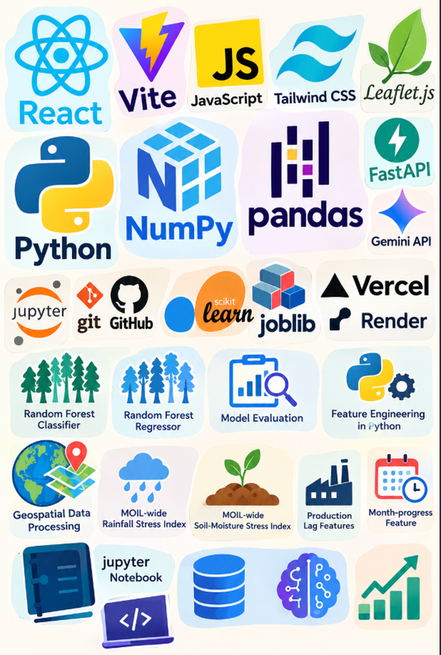
TECHNICAL APPROACH
ATOMIC-25
IMPLEMENTATION FLOWCHART
TECHNOLOGY STACK
METHODOLOGY — END-TO-END PIPELINE
1. DATA INGESTION
Sentinel-2 Imagery (B02-B12, NDVI, BSI) + SRTM DEM (Elevation, Slope)
+ Historical Mine Yield Logs + Real-Time Rain & Weather
1. Data Ingestion & Cleaning
2. ETL & FEATURE ENGINEERING
Historical Production + Lag Features + Rolling Statistics + Month/Trend Feature
2. Feature Engineering (Geological + Satellite + Historical Mining)
3. PROSPECTIVITY PREDICTION ENGINE
HistGradientBoosting + LightGBM + XGBoost
4. PRODUCTION FORECAST ENGINE
Random Forest Classifier + Monthly Production Forecast + ⁠Predicts Next-Month Output + Production Trend Estimation
3. Reserve Model & Production Model (XGBoost)
5. AI RECOMMENDATION
Google Gemini Chatbot + Production Target Recommendations + Operational Alerts
4. PREDICTION OF PROSPECTIVITY AND PRODUCTION
6. FASTAPI REST BACKEND
⁠FastAPI REST APIs + Pydantic Validation + ML Model Inference + ⁠JSON Response Handling
7. REACT COMMAND DASHBOARD (FRONTEND)
• Interactive GIS Layer Overlay • Live Recommendation Action Cards • API Flow Verification
5. Recommendation Engine
IMPLEMENTATION PROTOTYPE
6. FastAPI Backend → React Dashboard
Demonstrates the complete intelligence pipeline for manganese prospectivity, production and prediction using representative/public mining data, with an architecture designed to seamlessly integrate MOIL's real data.
Notes:
3

Slide 4
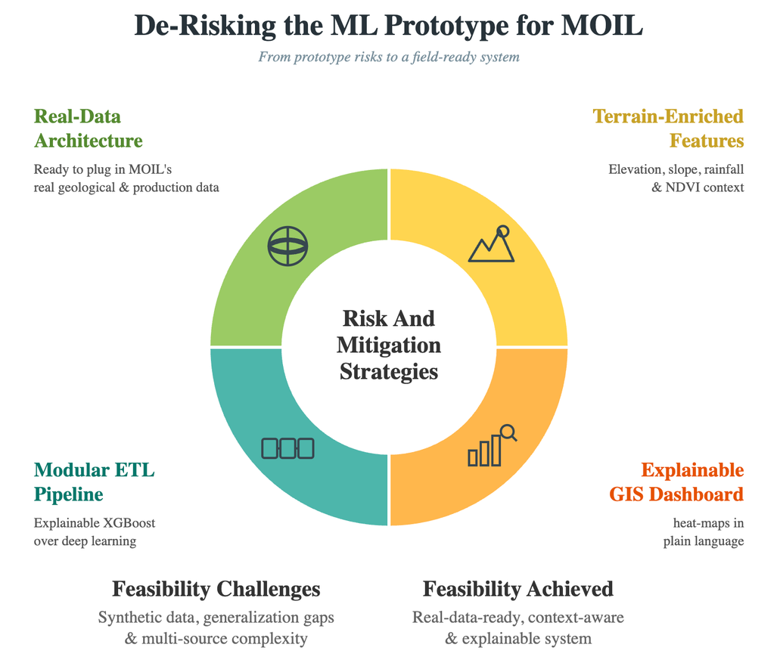
FEASIBILITY AND VIABILITY
ATOMIC-25
FEASIBILITY CHALENGES
CHALLENGES & MITIGATION
Confidentiality & Data Sparsity Limits: Live corporate mining telemetry (equipment SCADA logs, actual daily yields, blasting records) is proprietary, highly sensitive, and inaccessible during the hackathon environment.
Spectral Ambiguity & Terrain-Based False Positives: Relying solely on optical and multi-spectral surface satellite signatures (Sentinel-2) leads to false positive mineral predictions across varying landforms and soil conditions.
Complex Interdependent Operational Bottlenecks: Mining shortfalls stem from chaotic, non-linear variables—heavy rainfall, equipment mechanical failure—making standard linear predictions inaccurate and black-box AI untrusted by mine managers.
Engineering Mitigations--Open Spatial Baseline with Plug-and-Play Architecture: The prototype is trained and validated on open-access Sentinel-2 multi-spectral imagery and USGS/GSI geological survey datasets. The backend provides standardized REST API ETL endpoints so MOIL’s live confidential enterprise feeds plug directly into the model post-hackathon without architectural changes.
Multi-Modal Spatial Feature Enrichment: Combines Sentinel-2 spectral indices (NDVI, NDWI, BSI) with SRTM elevation, slope, and terrain relief data. Fusing physical topographic context with surface signatures eliminates generalization gaps and removes terrain-driven false positives.
Challenge | Mitigation
Reliance on synthetic / public data for the prototype | Architecture built to plug in MOIL's real geological & production data later
Generalization gap — strong validation, weaker independent performance | Enrich spectral features with terrain & environmental context (elevation, slope, rainfall, NDVI)
Multi-source data complexity (geology + satellite + equipment + weather) | Modular ETL + feature-engineering pipeline; explainable models (XGBoost) over deep learning
Complex geospatial output hard for mine managers to interpret | GIS heat-map dashboard
FEASIBILITY CHECK
Factor | Status
Satellite Data (Sentinel-2) | ✓ Available
Geological & Production Data | ✓ Prototype-ready
ML Integration (XGBoost + SHAP) | ✓ Scalable
Dashboard (React) | ✓ Working Prototype
GIS Heatmap Layer | ✓ Integratable
Notes:
4

Slide 5


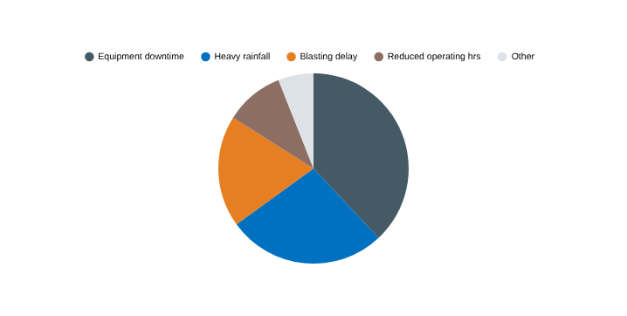
IMPACT AND BENEFITS
ATOMIC-25
National Vision & Aatmanirbhar Bharat Alignment
Strategic Mineral Security: Reduces national reliance on manganese ore imports by optimizing domestic reserve extraction.
Leveraging Space Assets: Maximizes the utility of open space technology (Sentinel-2) for national industrial development.
Scalable National Framework: Creates a deployable AI template adaptable to other critical minerals (Iron Ore, Bauxite, Chromite).
ECONOMIC
Secures Raw Material Supply: Stabilizes domestic manganese availability to support national steel production mandates.
Fleet & Machinery Optimization: Increases heavy machinery operating efficiency across open-cast and underground mines.
Prescriptive Workflows: Transforms passive mining telemetry logs into automated, actionable operational decisions.
ENVIRONMENTAL
Reduced Ecological Footprint: Minimizes unnecessary ground clearing and exploratory drilling in forested mineral zones.
Targeted Surface Extraction: Focuses mining operations strictly on high-probability, high-grade ore bodies.
Lower Carbon Intensity: Optimizes haul truck routes and equipment runtime, directly reducing diesel fuel consumption.
SHORTFALL RISK CLASSIFICATION
Shortfall vs Plan | Risk Level
0 – 5% | LOW
5 – 15% | MEDIUM
15 – 25% | HIGH
> 25% | CRITICAL
SOCIAL
• Faster, transparent decisions for MOIL managers
• Less reliance on manual survey interpretation
SAMPLE SHORTFALL ROOT-CAUSE BREAKDOWN
Notes:
5

Slide 6
RESEARCH AND REFERENCES
ATOMIC-25
Technology | System Usage | Reference | Description
Sentinel-2 Multi-Spectral Imagery (MSI) | Used to construct spectral signatures (NDVI, NDWI, BSI) for identifying surface environmental indicators associated with manganese deposits. | ESA Sentinel-2 User Handbook: Validated band configurations for geological surface characterization and mineral mapping. | Optical and Short-Wave Infrared (SWIR) satellite bands (B02–B12) capturing surface reflectance, vegetation, and soil moisture indices.
SRTM Digital Elevation Model (DEM) | Enriches spatial feature vectors with physical terrain context to eliminate spectral ambiguity across diverse landforms. | NASA SRTM Global Data v3: Validated 30m spatial resolution terrain parameters for geo-spatial modeling. | Space Shuttle Radar Topography Mission high-resolution topographic raster layers (Elevation, Slope, Aspect, Relief).
Random Forest Predictive Modeling | Powers the "Reserve Engine" (mapping ore probability) and "Production Engine" (forecasting 7/30/90-day yield shortfalls). | Breiman, L. "Random Forests," Machine Learning, 45(1), 5-32, 2001. (Achieves robust performance against overfitting on tabular mining logs). | Non-parametric ensemble learning algorithm operating via multi-tree decision aggregation for classification and regression tasks.
Gini Impurity & MDI Feature Importance | Serves as the explainability engine to identify primary shortfall root causes (e.g., ranking Equipment Downtime vs. Rainfall impact). | Hastie, T., et al. "The Elements of Statistical Learning," Springer, 2009. (Standard method for feature attribution in tree ensembles). | Mean Decrease in Impurity (MDI) analysis derived from Random Forest tree splits to quantify relative variable contributions.
PostGIS & Cloud Optimized GeoTIFFs (COGs) | Enables rapid spatial querying and rendering of GIS prospectivity heatmaps and historical mine layers on the dashboard. | Open Geospatial Consortium (OGC) Standards: Validated framework for high-throughput spatial vector and raster data serving. | Spatial database extension and cloud-native raster formats for high-speed spatial indexing and multidimensional querying.
XGBoost Predictive Modeling | Used as a benchmark ensemble classifier to validate feature interactions and compare baseline precision against the primary Random Forest models. | Chen, T., & Guestrin, C. "XGBoost: A Scalable Tree Boosting System," ACM KDD, 785-794, 2016. (Validated framework for high-dimensional tabular classification). | Optimized gradient boosted decision tree framework designed for efficient, parallelized tree boosting on structured and tabular data.
@SIH Idea submission- Template
6
Notes:
6

