Slide 1

Evaluating the Performance of Faster-RCNN and its Variants for Small Object Detection
Course Name:- Computer Vision
Group name:- Tech Trio
Name | Enrollment no
Kaushik Gohil | AU2444022
Parth Mevada | AU2240172
Richa Saraiya | AU2444002

Slide 2

Problem Statement
Faster R-CNN struggles with small object detection due to poor RPN proposals, low-resolution features, and loss of fine details in deeper layers. This often leads to missed or incorrect detections. To address this, FPN uses multi-scale features to retain detail, M2F2-RCNN improves feature fusion and proposal quality, Libra R-CNN balances feature representation, and Cascade RPN refines proposals in multiple stages for better accuracy.
1

Slide 3
Instructor’s Feedback
Model Selection for Small Object Detection To perform small object detection effectively, it's important to evaluate multiple models. FPN uses multi-scale features, while M2F2-RCNN, Libra R-CNN, and Cascade RPN enhance detection through better fusion, balanced features, and refined proposals.
Performance Evaluation Metrics These models should be compared using evaluation metrics like mAP, precision, and recall to determine which performs best for small object detection.
2

Slide 4
Approach
Approach for FPN:-
The pre-trained Faster R-CNN model with ResNet50-FPN was loaded and set to evaluation mode on the available device (GPU or CPU).
Images were read from a specified folder, transformed to tensors, and prepared for inference.
Inference was performed on each image, generating predictions including bounding boxes, labels, and scores.
Bounding boxes with scores above 0.5 were drawn on the images, along with their corresponding class labels from the COCO dataset.
The processed images, with detected objects and annotations, were displayed using OpenCV.
Approach for M2F2-RCNN:-
A pre-trained Faster R-CNN with ResNet50-FPN was used for object detection.
Input images were converted to tensors using torch vision transforms.
The model generated predictions, and Non-Maximum Suppression (NMS) was applied to filter overlapping boxes.
Bounding boxes were shrunk using a custom method to better capture small objects. Final detections were drawn on the images and labels and confidence scores.
3

Slide 5
Approach [cont..]
Approach for Cascade RPN:-
Load Model – Initialized a pre-trained Cascade RPN detector with config and weights.
Read Images – Fetched images from the input folder.
Run Detection – Applied the model to detect objects in each image.
Draw Boxes – Marked objects with bounding boxes and labels if score > 0.3.
Save Output – Saved and displayed the processed images with detections.
Approach for Libra-RCNN:-
Initialized Libra R-CNN – Loaded the Libra R-CNN model using its specific config and weights.
Loaded Input Images – Read images from the dataset folder (e.g., VisDrone).
Performed Inference – Ran object detection using Libra R-CNN on each image.
Filtered & Annotated – Filtered out low-confidence detections (score < 0.3) and added bounding boxes with class names.
Saved Results – Saved the detected images to an output folder and displayed them.
4

Slide 6
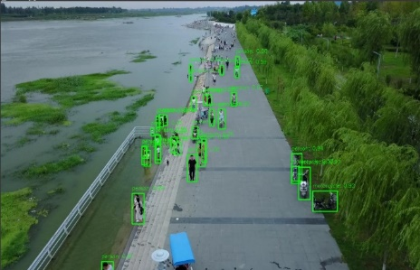
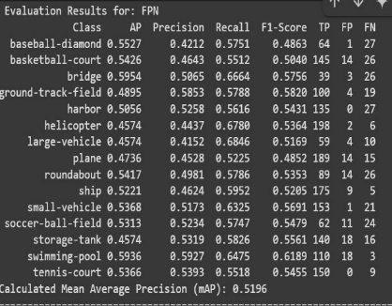
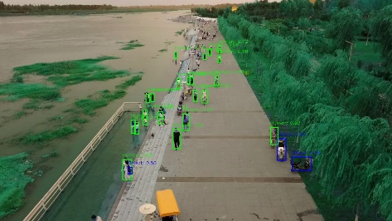
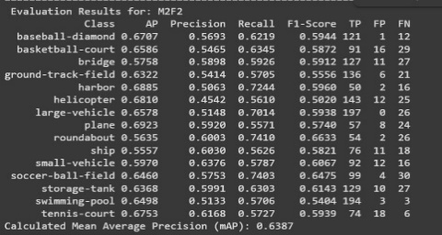
Results and Analysis
Fig-1 Output of FPN
Fig-3 Metrics of FPN
Fig-2 Output of M2f2-RCNN
Fig-4 Metrics of M2F2-RCNN
5

Slide 7
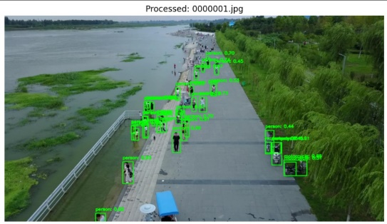
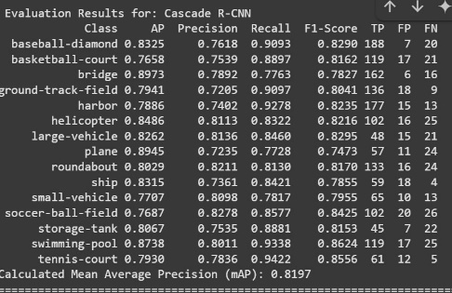
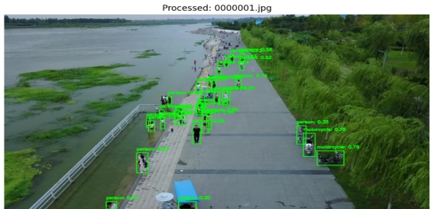
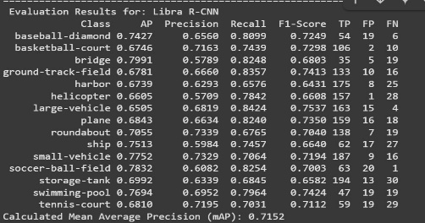
Results and Analysis [cont..]
Fig-5 Output of Cascade RPN
Fig-7 Metrics of Cascade RPN
Fig-6 Output of Libra RCNN
Fig-8 Metrics of Libra RCNN
6

Slide 8
Future Scope
This project can be extended by integrating deep learning-based object tracking models along with the current detection frameworks like Libra R-CNN and Cascade RPN. Tracking models such as STC-MOT or Deep SORT can help maintain the identity of small objects across multiple frames, especially in UAV videos where motion is fast and objects often get occluded.
Another future direction is to optimize the system for real-time performance and reduce false positives to improve accuracy in dynamic environments. The approach can also be expanded to work with multi-camera setups or 3D tracking, enhancing the reliability of detection and tracking in complex, real-world scenarios like traffic monitoring, aerial surveillance, or public safety systems.
7

Slide 9
References
Lin et al. (2017) introduced Feature Pyramid Networks (FPN) to improve small object detection using a top-down feature pyramid, enhancing multiscale feature representation.
Yin et al. (2022) proposed M2F2-RCNN, which combines deep and shallow feature fusion with CBAM attention to improve small object detection but requires high computational power.
Cai, Z., & Vasconcelos, N. (2018). Cascade RCNN: Delving into high quality object detection. CVPR. Cascade R-CNN improves detection by using a multi-stage refinement process to enhance predictions, especially for small or densely packed objects.
Qi, X., Wang, P., & Gao, H. (2019). Libra R-CNN: Towards balanced learning for object detection. ICCV. Libra R-CNN balances feature learning and introduces balanced feature pyramids to improve small object detection.

