Slide 1
Book-Bot
The digital library

Slide 2
Abstract
The project is to create a library management system for book browsing, borrowing, and purchasing. It contains book tracking, user account, and order management for renting and purchasing. Features include recommendations, search filters, reminders, and reviews. Users can browse through the available books, add to cart, and order for purchasing or renting. The project supports easy library and bookstore management, improving efficiency and user satisfaction by eliminating manual processes.

Slide 3
Introduction
Libraries and bookstores require effective systems for handling books and user access. Our project, "BookBot: Library Management System for Book Rentals," will automate all these, and it must be easy to look for the books, borrow them, and buy them. It will handle user accounts, book details, orders, reviews, and notifications and effectively handle stock.

Slide 4
Problem Statement
Libraries and bookstores are confronted with the issue of manually maintaining book inventories, user information, and transactions.
There is a shortage of an integrated system that offers a seamless transition between renting, buying, and browsing.
Lack of feedback systems for the users and recommendation systems de-personalizes the process.
Handling overdue books, payments, and orders involves significant administrative work.

Slide 5
Existing system
Most libraries continue to use manual systems to lend books and manage inventory.
There are bookstores employing simple catalog systems but without sophisticated user interfaces or integrated rental systems.
Customers are now facing issues with availability checks, notifications, and order management.
Other systems limit users to leasing or purchasing, but not both.

Slide 6
Features
User Features
Author Features
Avatar Selection
Category Selection
Audio Books
Book Search
Purchase or Rent Books
Reading Summary Option
Extend Book Issue Period
Predefined Book Recommendations (Chatbot)
Add book details
Manage book details
Track book performance

Slide 7
Proposed System
The system to be proposed is an effective library management system, allowing users to: Search books by title, author, or category.
Order tracking books available for rent or buy.
They could see and control their reading history, reviews, and notifications.
Receive reminders for due books or order status.
Administrators are able to edit book details, process orders, and produce reports.

Slide 8




Tech Stacks Used
Frontend
Backend
ReactJS(For adding frontend functionalities)
Tailwind CSS(For providing styling)
React-Router(For redirecting pages)
NodeJS(For API communication)
ExpressJS(For API communication)
MySQL(For database)
Firebase Cloud(For authentication)

Slide 9
System requirements
Hardware Requirements:
Processor: Intel Core i3 (or equivalent)
RAM: 4GB
Storage: 10GB free space
GPU: Integrated Graphics
Internet: Required for dependencies and API calls
Software Requirements:
Operating System: Windows 10/11, macOS 10+, Linux (Ubuntu 20.04+)
Node.js: v18+ (LTS recommended)
React: v18+
Database (if used): Firebase / MongoDB
Code Editor: VS Code (recommended)

Slide 10
Product backlogs(epics)

Slide 11
Sprint
Sprint 1: Register and Login
Objective: Incorporate sign-up, sign-in, and user profile management.
Duration: 3 weeks
Deliverables: User sign-up page, login feature, user profile dashboard.
Sprint 2: Seeking and Looking for Books
Objective: Add a feature that allows users to search and filter books.
Time: 2 weeks
Deliverables: Book search bar, category filters, book details page.
Sprint 3: Order Management
Objective: Utilize an option to order books for rental and buying.
Timeline: 2 weeks
Deliverables: Cart functionality, order summary, checkout page.

Slide 12
Sprint
Sprint 4: Rating System and Evaluation
Objective: Allow users to read and rate books.
Duration: 2 weeks
Deliverables: Book review page, rating system.
Sprint 5: Messages and Alerts
Objective: Develop a overdue book and order status notification system.
Time: 2 weeks
Deliverables: A user notification system.

Slide 13
Sprint explanation with process
Sprint 1: User Registration and Login (Completed)
Objective:
Add user registration and login to the site.
Enable users to securely register accounts, log in, and control profiles.
Distinctive Features:
User registration form with required fields (e.g., name, email, password).
User authentication mechanism to authenticate credentials and offer secure access.
Password reset feature for individuals who cannot remember their log-in credentials.
Outcome:
Finished successfully. Now, users can register, log in, and edit their profile information.

Slide 14
Sprint explanation with process
Sprint 2: Book Browsing & Search (Ongoing)
Objective:
Allow users to navigate and search for books throughout the site.
Apply filtering and sorting features to enable users to easily locate books.
Book List:
Display books with necessary information such as the title, author, and their current availability status.
Include a search field where users can search for books using either title or author.
Filters and sorting options should enable users to sort books by category or sort them based on popularity, rating, or author.
Status:
Ongoing: Under development and testing now.

Slide 15
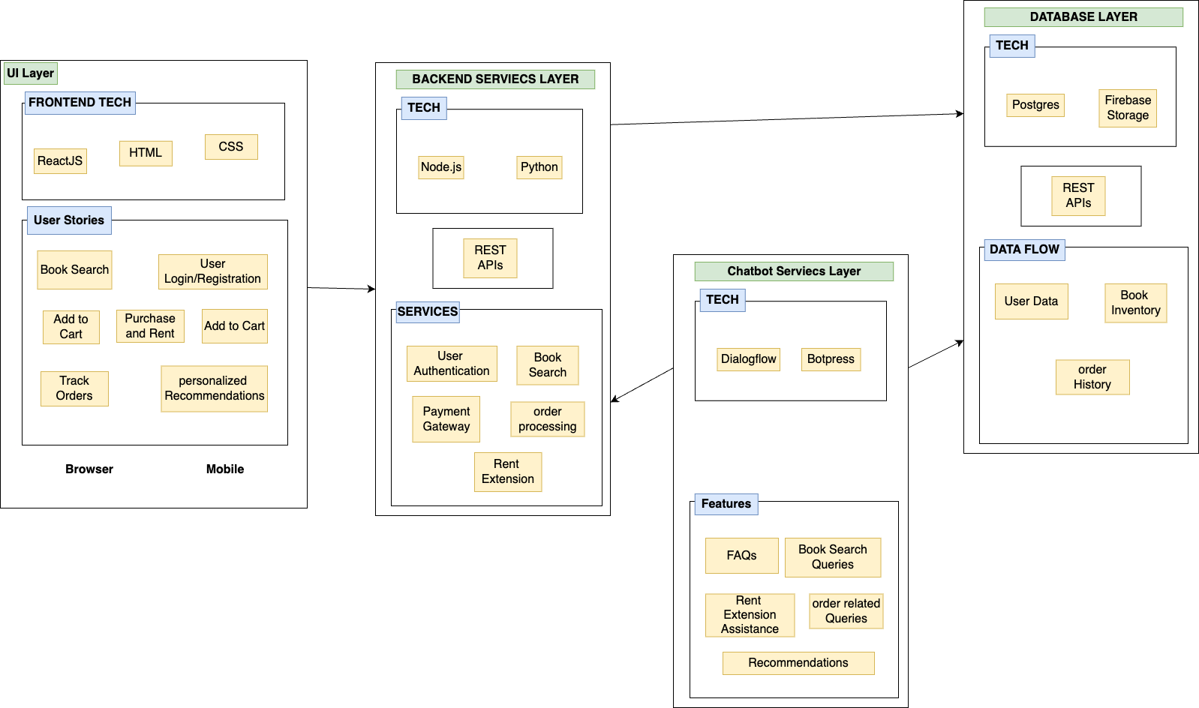
Architecture Diagram

Slide 16
Architecture Diagram
Frontend (UI & Chatbot Services Layer)
Users access BookBot via browser or mobile
.Perform actions like book search, login, cart management, purchase, rent, and order tracking.
Chatbot assists with FAQs, book search, rent extensions, and order queries using Dialogflow & Botpress.Requests are sent to the backend via REST APIs.
Backend (Backend Services & Database Layer)
Backend handles user authentication, book search, order processing, and payments using Node.js & Python.
Data is retrieved/stored in PostgreSQL & Firebase Storage.
Processed responses are sent back to the frontend for real-time updates.

Slide 17
Advantages and Disadvantage
Advantages:
Seamless user experience to search, rent, and purchase books.
Real-time alerts on overdue books and order status.
User ratings and reviews assist potential buyers in making purchasing decisions.
Disadvantages:
Initial installation charges for server and database.
Risk of system crash or malfunctions if not well maintained.

Slide 18
Future Work
Recommendation System: Use machine learning algorithms to recommend books based on user interest.
Mobile App: Create a mobile app for easy use while on the move.
Integration with Payment Gateways: Enable customers to pay for orders online.

Slide 19
Conclusion
The system suggested solves most of the problems that bookstores and libraries encounter at present. With the automation of order management, user account management, and book management, it significantly enhances efficiency and user experience. The inclusion of the rental and purchasing features, along with review systems and notifications, further improves the overall process of the platform.

Slide 20
References
[1] Highsmith, J., Agile Software Development Ecosystems, Addison-Wesley Professional, 2002.
[2] Schwaber, K., & Beedle, M., Agile Software Development with Scrum, Pearson Education, 2002.
[3] Cohn, M., Agile Estimating and Planning, Prentice Hall, 2005.
[4] Sutherland, J., & Schwaber, K., The Scrum Guide: The Definitive Guide to Scrum: The Rules of the Game, available at: https://www.scrumguides.org, 2017.
[5] Poppendieck, M., & Poppendieck, T., Lean Software Development: An Agile Toolkit, Addison-Wesley Professional, 2003.
[6] Benediktsson, S., & Kristjansson, S., Agile Methods in Software Development, Wiley, 2011.
[7] Sinha, S., & Chauhan, A., "Development of Digital Library Systems with Agile Methodologies," International Journal of Computer Science and Information Security, vol. 18, no. 3, pp. 109-115, 2020.
[8] Iqbal, S., & Alam, S., "Agile Development for Library Systems: A Case Study," Journal of Library Automation, vol. 52, no. 5, pp. 453-462, 2019.
[9] Taylor, A. J., & Grant, T., "Agile Practices for Developing Digital Libraries," Library Technology Reports, vol. 54, no. 7, pp. 20-26, 2018.
[10] Liao, X., & Zeng, X., "Adoption of Agile Methodology in Library Management Systems," Journal of Digital Information Management, vol. 14, no. 6, pp. 342-350, 2016.

