Slide 1
Stock Catcher - CS5841
By-
Ali Moazzam Parth Mishra Aaron Filip

Slide 2
Background
Data collection increasing Exponentially.
Markets are hard to predict and there has been a lot of research in this space.
Efficient market hypothesis states that stock price includes every information.
We try to recommend stocks based on the profit and risk associated with them
We do this by using different machine learning models like: ARIMA, LSTM, K-Means

Slide 3

Motivation
Financial Companies investing billions into modelling and technology
Hard to model, like predicting the future with the high volatility
Combines the Stock Market + Machine Learning Concepts

Slide 4
Existing Solutions
Fundamental Analysis:
Based on the financial statements of the company
Calculate and compare different ratios and compare with peers
Technical Analysis:
Look at different graphs to analyze trends and patterns and make different indicators that facilitate in predicting the future price of a security.
A more novel approach: iRDPG(imitative recurrent policy gradient):
Defines the stock market as a partially observable MDP and uses the iRDPG model to solve this partially observable MDP.

Slide 5
Problem Review
Recommend stocks based in risk and profit appetite of the user. Problem?
Stock data is extremely volatile, non-seasonal and random but it is still a time series.
We can use time series prediction models to mine information from this data.
We will be using two different approaches to reinforce decision making: ARIMA and LSTM

Slide 6
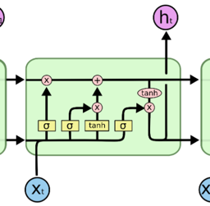
LSTM (Long-Short Term Memory)
Extension of RNNs.
Mitigate the exploding/vanishing gradient problem.
Does this by passing through different gates:
Input Gate
Forget Gate
Output Gate
Example of an LSTM cell

Slide 7
ARIMA Model
ARIMA: Mixture of:
Autoregressive
Integral
Moving Average
Best approach for sequential data sets
Low computational time compared to other conventional models

Slide 8
Risk and Profitability
3 Categories
High Risk
Medium Risk
Low Risk
Risk
Variance between LSTM and ARIMA
Trend Correlation between Model Output
Profitability
Average of models with a generated percent to normalize against other stocks for comparison

Slide 9
Dataset Description
S&P 500 stock data has been used for the purpose of this project.
Dataset sourced from kaggle, includes open, high, low, close and volumes of over five hundred stocks from the S&P 500.
Data set has the information of each stock for five years, from 2013 till 2018.
Conducting analysis for 500 stocks is computationally expensive.
We conduct analysis on the first 25 stocks of the dataset but the results can easily be recreated for a larger dataset.

Slide 10
Overview Architecture
Data Preprocessing for each model.
Generate predictions .csv file from LSTM
Generate predictions .csv file from ARIMA.
Combine the .csv’s and perform risk and profitability analysis.
Output recommendations based on high, medium and low risk.

Slide 11
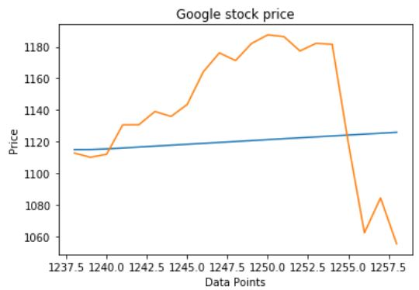
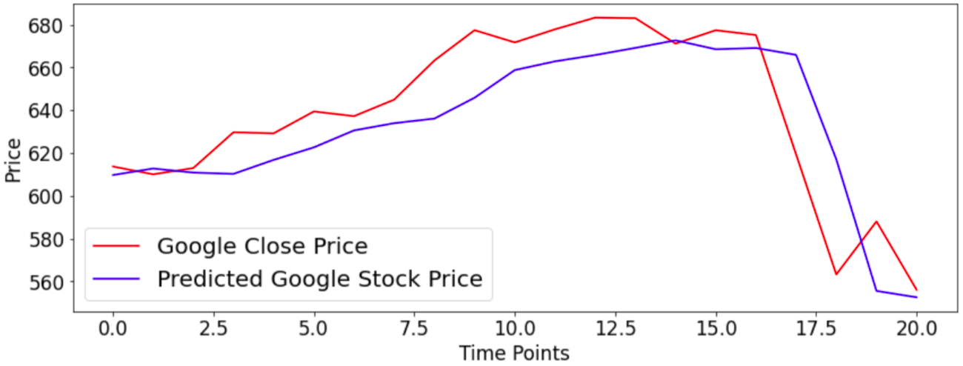
Experimental Results
LSTM and ARIMA model prediction demonstration over “Google stock”
This is extended to all other stocks.

Slide 12
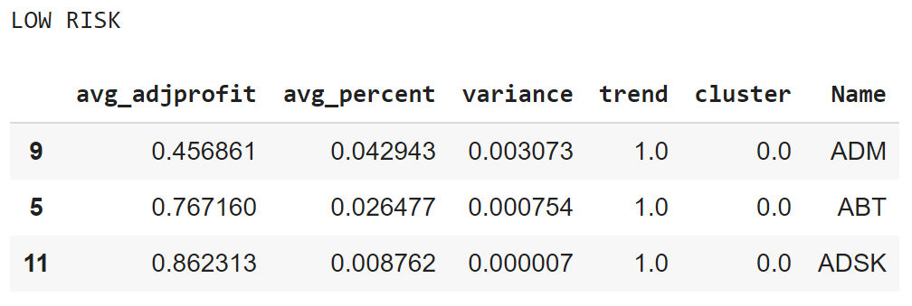
Results Low Risk

Slide 13
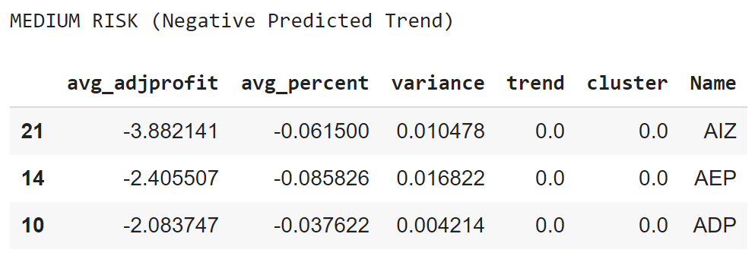
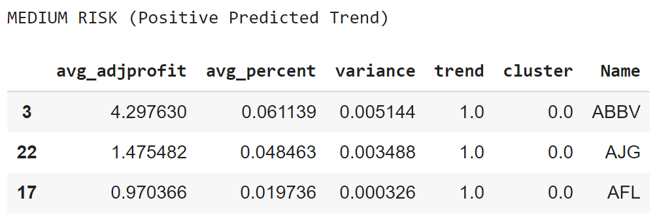
Results Medium Risk

Slide 14
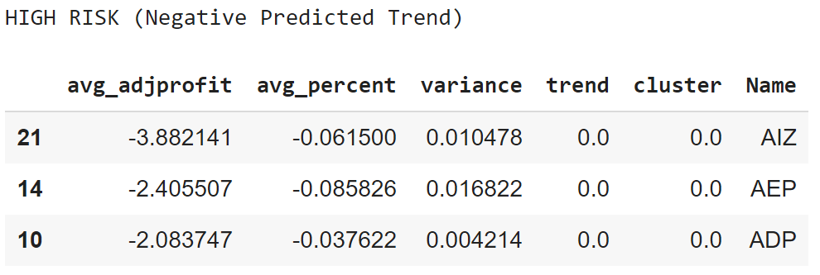
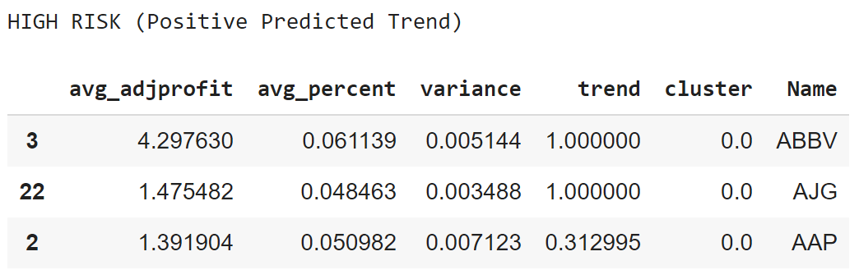
Results High Risk

Slide 15
Conclusion and Future Work
More complex market data, statistics and attempt to measure predictability with external events taken into account
Realtime, connect it up to a live data source from an exchange

Slide 16
Stock Catcher - CS5841
Thank you!
Questions?
By-
Ali Moazzam Parth Mishra Aaron Filip

