Slide 1

B.Tech BCSE497J – Project-I
NeuroScan AI: AI-Powered Brain Tumour Detection, Classification and Segmentation Platform
Team members
Parth Mital (23BCE0842)
Ved Lawand (23BDS0141)
Faculty guide
Dr. Biji C. L.
Associate Professor Grade 2, SCOPE
Based on two research manuscripts: a leakage-controlled benchmark of 2D backbones for detection and subtype classification, and a benchmark of 3D segmentation architectures on BraTS 2020
Notes:
Introduce the team and the guide. The project has two research outputs and one product: a 2D classification benchmark, a 3D segmentation benchmark, and the NeuroScan AI web application that deploys the models those benchmarks selected.

Slide 2

Approval Mail From Guide
All the above aspects are addressed and updated by the project team.
Notes:
Replace the sample image with the guide's approval mail before the review.

Slide 3
Aim
To build and rigorously evaluate an AI system that detects brain tumours in MRI, classifies them as glioma, meningioma or pituitary tumour, and segments the whole tumour, tumour core and enhancing tumour in 3D, selecting every deployed model through a controlled, leakage-aware benchmark.
453,623
26.3%
About 80%
primary brain and other CNS tumours diagnosed in the United States, 2016 to 2020 [1]
of these tumours are gliomas [1]
of malignant brain tumours worldwide are gliomas [2]
1. Detect and classify in 2D
Benchmark nine ImageNet-pretrained CNN, transformer and hybrid backbones for tumour detection and glioma, meningioma or pituitary classification on deduplicated public MRI slices (Paper 1).
2. Segment in 3D
Benchmark six 3D architectures for whole tumour, tumour core and enhancing tumour segmentation on BraTS 2020 under one training budget (Paper 2).
3. Deploy
Serve the most efficient models, EfficientNetB0 and VNet, in a secure web application with a linked multi-planar and 3D viewer and PDF and CSV reports.
Motivation. MRI is the main non-invasive modality for characterising brain tumours [3], which are classified by cell of origin and molecular features [4]. Manual reading is slow and varies between and within readers [5], and reliable automation can support faster, more consistent assessment [6, 7].
Notes:
The aim has three parts that map to the two papers and the application. The statistics motivate the problem: brain tumours are common, and gliomas dominate the malignant group.

Slide 4
Abstract
Problem. Published brain tumour MRI results cannot be compared directly: studies differ in data, splits, training budgets and metrics, and near-duplicate images leak between training and test partitions [8, 9].
Paper 1: 2D detection and subtype classification
Paper 2: 3D segmentation on BraTS 2020
Nine backbones (six CNNs, two transformers, one hybrid), one code path and an equal number of optimiser steps
Label-aware perceptual-hash deduplication: 3,253 to 1,185 detection images and 5,828 to 4,730 subtype images; group-aware five-fold split with a held-out test set
Fold ensembles, bootstrap 95% CIs, exact McNemar tests with Holm correction, calibration, Grad-CAM and background-only shortcut audits
Six networks implemented from scratch: UNet, nnU-Net-style, VNet, UNETR, Swin UNETR and TransBTS
369 cases in a grade-stratified 257 / 56 / 56 split; 50 epochs and 3,250 optimiser steps per model
Native-resolution evaluation with eight-flip test-time augmentation, bootstrap CIs, Wilcoxon tests with Holm correction and results by tumour grade
99.42%
detection accuracy of CoAtNet-0, EfficientNetB0 and ViT‑B/16 on 171 test images (95% CI 98.25 to 100%); no pair of models differs significantly; background-only models beat the majority-class rate for 7 of 9 detection and 9 of 9 subtype backbones
0.8199
mean Dice of UNet (95% CI 0.7826 to 0.8533); VNet 0.7965 with 1.40 M parameters; transformer-based models 0.7056 to 0.7462; every pairwise difference significant
Deployment. EfficientNetB0 (detection and classification) and VNet (segmentation) run in a FastAPI and React application; 61 backend and 39 frontend automated tests pass.
Notes:
One problem, two controlled benchmarks, one deployed system. The headline accuracy is measured after deduplication, and the shortcut audit qualifies it.

Slide 5


Literature Review
Study | Task and data | Method | Reported result | Limitation addressed here
Zacharaki et al., 2009 [10] | Glioma vs metastasis, glioma grade; 102 tumours | Shape, intensity and texture features; SVM with feature elimination | 85% and 88% (leave-one-out) | Hand-crafted features transfer poorly [11, 12]
Cheng et al., 2015 [13] | Three-class subtype; 3,064 T1CE slices, 233 patients | Augmented tumour ROI, ring partition; intensity, GLCM, bag-of-words + SVM | Up to 91.28% | Needs a tumour ROI; features redesigned per task
Seetha and Raja, 2018 [14] | Tumour vs non-tumour; Radiopaedia, BRATS 2015 | ImageNet-pretrained CNN, last layer trained | 97.5% (training) | No held-out estimate
Talo et al., 2019 [15] | Normal vs abnormal; 613 MR images | ResNet34 transfer learning [16, 17] | 100% (five-fold) | One small collection
Deepak and Ameer, 2019 [18]; Ghassemi et al., 2020 [19] | Three-class subtype; figshare 3,064 slices | GoogLeNet features + classifiers; CNN pretrained as a GAN discriminator | 98% mean (Deepak) | One architecture each
Rehman et al., 2020 [20]; Noreen et al., 2020 [21] | Three-class subtype; figshare 3,064 slices | Fine-tuned VGG16 [22]; Inception-v3 [23] and DenseNet201 [24] features | 98.69%; 99.34% and 99.51% | No deduplication, CIs or tests
Khan et al., 2020 [25] | Tumour classification; BraTS 2015, 2017, 2018 | VGG16 and VGG19 features, ELM-based selection | 97.8%, 96.9%, 92.5% | Multi-stage tuned pipeline
Tummala et al., 2022 [26]; Asiri et al., 2024 [27] | Three-class (3,064); four-class (2,870) | ViT ensemble [28]; Swin Transformer [29] | 98.7%; 97% | No CNN baseline under one protocol
3D CNNs [30–33] | 3D medical segmentation | U-Net, 3D U-Net, V-Net, self-configuring nnU-Net | Strong CNN baselines | Compared under different pipelines
3D transformers [34–37] | 3D brain tumour segmentation | UNETR, Swin UNETR, TransBTS, TransUNet | Long-range context | Data-hungry from scratch [38]
Kapoor and Narayanan, 2023 [8]; Fateh et al., 2026 [39] | Reliability of ML results; BRISC curation | Leakage audit across 17 fields; duplicates removed before splitting | Leakage inflates scores | No architecture benchmark
Notes:
Early work used hand-crafted features; transfer learning pushed reported accuracy to 97 to 100%, but each study uses its own data, split and single model. Figures are as reported by each study; the figshare three-class studies are subtype classification, not detection.

Slide 6
Research Gap
Gap in the literature
How this project addresses it
1
No controlled comparison. Most studies test two or three models with their own data, splits and budgets [40, 41].
Nine backbones and six 3D networks, one code path, identical splits, equal optimiser steps
2
Data leakage. Combined public collections hold exact and near-duplicate images that are rarely removed before splitting [8, 9, 39].
Label-aware perceptual-hash deduplication, similarity groups, group-aware split and a leakage audit
3
Single-run leaderboards. Results are quoted from one run, without confidence intervals, tests, per-class metrics or calibration.
Five-fold CV, fold ensembles, bootstrap CIs, McNemar and Wilcoxon tests with Holm correction, ECE, per-grade results
4
Shortcuts unchecked. Models can exploit borders, hospital markers or scanner cues instead of pathology [42–44].
Grad-CAM, occlusion, head and background masking, and background-only retraining
5
Transformer cost in 3D. Transformers need large data, distillation or modified attention [38, 45, 46], and their cost is rarely reported.
Parameters, GFLOPs, latency, training time and memory measured for every model
6
No path to use. Benchmarked models are rarely turned into tools that accept MRI volumes and protect patient data.
A secure web application with a multi-planar and 3D viewer and reports
Notes:
Each gap on the left is answered by a specific design decision on the right; these decisions are the contributions of the two papers.

Slide 7


Objectives
1
Benchmark nine 2D backbones for tumour detection and subtype classification with identical splits and an equal number of optimiser steps.
Sustainable Development Goals and Technology Readiness Level
2
Remove leakage before splitting through label-aware perceptual-hash deduplication, similarity grouping and a group-aware split, verified by a leakage audit.
3
Evaluate with five-fold cross-validation, fold ensembles, bootstrap CIs, Holm-corrected McNemar tests, calibration, efficiency and shortcut audits.
4
Implement six 3D segmentation networks from scratch and compare them on BraTS 2020 per case, region, tumour grade and computational cost.
SDG 3: Good Health and Well-being; SDG 9: Industry, Innovation and Infrastructure
TRL 4: technology validated in the laboratory
Outcomes: two journal manuscripts (Scopus) prepared for Engineering Applications of Artificial Intelligence (Elsevier); an open-source web application
5
Deploy the most efficient models in a secure, tested web application with a multi-planar and 3D viewer and reports.
Notes:
Objectives 1 to 3 belong to Paper 1, objective 4 to Paper 2 and objective 5 to the application.

Slide 8
Framework/Architecture/Block Diagram
Research pipelines (Kaggle, two Tesla T4 GPUs)
2D MRI collections
Br35H, Chakrabarty; Bhuvaji, Cheng
Curation
brain crop, perceptual-hash deduplication
Group-aware split
five folds, held-out test, leakage audit
9 backbones × 5 folds
two tasks, equal optimiser steps
Evaluation
ensembles, CIs, McNemar, shortcut audit
Checkpoints
EfficientNetB0 for detection and classification; VNet for segmentation
BraTS 2020
369 cases, four sequences
Preprocessing
foreground z-score, 128³ resampling
Stratified split
257 / 56 / 56 by grade
6 3D networks
3,250 optimiser steps each
Evaluation
native grid, eight-flip TTA, Wilcoxon
NeuroScan AI application
Browser
React, vtk.js viewer
Reverse proxy
same origin, HttpOnly session cookie
FastAPI backend
23 routes: authentication, scans, slices, reports, health
PipelineRunner
one background worker; re-queues unfinished scans
BrainProcessor
Detection
EfficientNetB0 on the middle axial slice, 224² crop
Outputs to the user
class probabilities, WT, TC and ET volumes, linked multi-planar and 3D views, PDF and CSV reports
SQLite and Alembic
users and scans; WAL mode; migrations
Upload store
per-scan volumes and segmentation mask
Classification
EfficientNetB0: glioma, meningioma, pituitary
Segmentation
VNet on FLAIR, T1, T1CE, T2 at 128³: WT, TC, ET
Notes:
Top: the two research pipelines that produced the checkpoints. Bottom: the application that loads them. The application only reads the exported checkpoints; training stays in the notebooks.

Slide 9
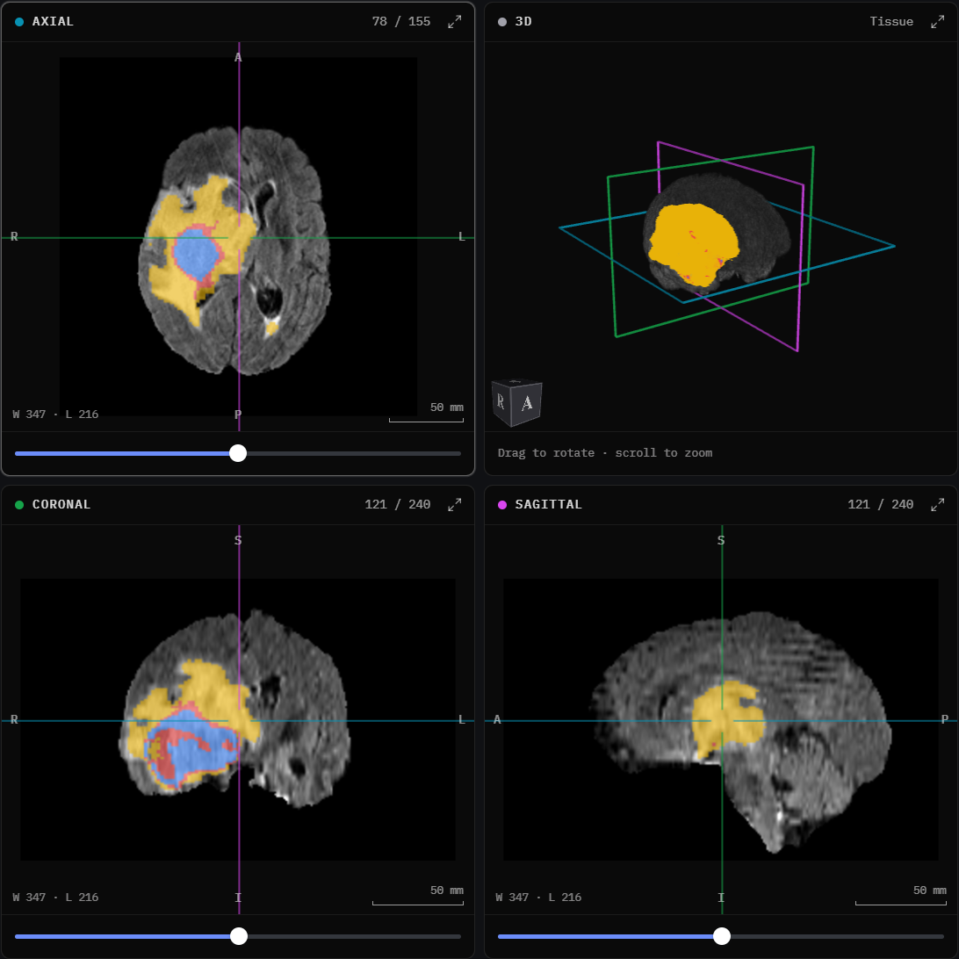
Functional Requirements and Modules
Functional requirements
Modules
Register, sign in and out, change the password; optional TOTP two-factor authentication
Upload one to four NIfTI volumes (FLAIR, T1, T1CE, T2) per case; modality detected from the file name
Process each scan in the background with live status, step and progress; retry on failure
Detect a tumour, classify its type with class probabilities, and segment WT, TC and ET with volumes
View linked axial, coronal, sagittal and 3D panes with overlay, contrast, zoom and ruler
Search, rename and delete scans; dashboard with counts, recent scans and a volume chart
PDF and CSV report per scan; CSV export of all scans
Operator account recovery from the command line
Data curation: brain crop, perceptual-hash deduplication, label-noise exclusion, group split
2D benchmark: 9 backbones × 5 folds plus a background-only run; 54 runs per task
3D benchmark: six networks, 3,250 steps each, eight-flip TTA, Dice, HD95, Wilcoxon
Inference engine: BrainProcessor with safe weight loading, the training crop and the mask in FLAIR space
Backend and pipeline: FastAPI (23 routes), one worker, SQLite in WAL mode, Alembic
Security: bcrypt, revocable JWT cookies, CSRF header, lockout, rate limits, TOTP
Viewer: React and vtk.js; linked multi-planar and 3D views, slab modes, ruler
Reports: PDF MRI report with key images; CSV export with formula escaping
NeuroScan AI viewer: linked axial, 3D, coronal and sagittal panes with the WT, TC and ET overlay on a BraTS case
Notes:
Requirements are what the user can do; modules are how the project is built. The first three modules are the research notebooks; the rest form the application.

Slide 10
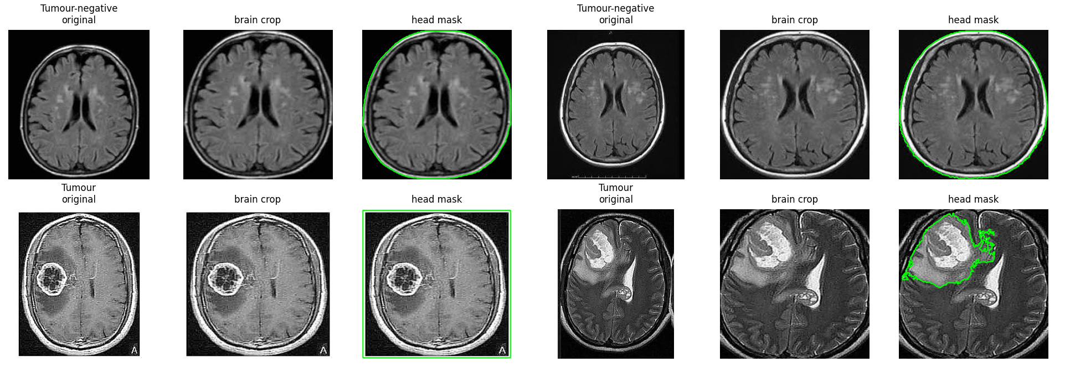
Data Curation and Leakage Control
Experiments and Results: Paper 1 (2D)
1. Brain crop
greyscale, 5×5 Gaussian, threshold 45, largest contour [47]
2. Perceptual hash
64-bit pHash [48] and a 64×64 thumbnail per image
3. Deduplicate
same label, Hamming ≤ 5 [49]: keep one; cross-label NCC ≥ 0.98 [50]: drop both
4. Group
Hamming ≤ 8 or NCC ≥ 0.98: 821 and 1,867 groups as a patient proxy
5. Split and audit
stratified group k-fold [51, 52]: 15% test, five folds; no test image near development
Task | Sources | Images | After deduplication | Dev. | Test
Detection | Br35H [53], Chakrabarty [54] | 3,000 + 253 | 1,185 (−63.57%) | 1,014 | 171
Subtype | Bhuvaji [55], Cheng [13, 56, 57] | 2,764 + 3,064 | 4,730 (−18.84%) | 4,685 | 45
Eight of 31 cross-label pairs in the subtype pool were label noise; the detection pool had none.
One subtype group held 1,431 images, so the subtype test set has only 45 images (1 glioma, 13 meningioma, 31 pituitary).
Original image, brain crop used for training, and head mask used by the attention audit
Notes:
Deduplication removed 63.57% of the detection pool, mostly Br35H copies, and 18.84% of the subtype pool. The brain crop is the same one the application applies. Grouping by similarity is a proxy for patient-level splitting because no source records patient identifiers.

Slide 11
Backbones, Training and Evaluation
Experiments and Results: Paper 1 (2D)
Backbone | Family | Params (M) | GFLOPs | Latency (ms) | Images/s
ResNet50 [16] | CNN | 23.51 | 8.17 | 9.57 | 777
VGG16 [22] | CNN | 134.26 | 30.93 | 7.72 | 387
DenseNet121 [24] | CNN | 6.95 | 5.67 | 23.58 | 657
EfficientNetB0 [58] | CNN | 4.01 | 0.77 | 13.13 | 1,393
MobileNetV3-Large [59, 60] | CNN | 4.20 | 0.43 | 10.55 | 2,301
InceptionV3 [23] | CNN | 21.79 | 11.42 | 17.63 | 512
ViT-B/16 [28, 61] | Transformer | 85.80 | 22.54 | 10.95 | 272
Swin-Base [29] | Transformer | 86.74 | 30.86 | 36.29 | 198
CoAtNet-0 [62] | Hybrid | 26.67 | 8.42 | 16.53 | 513
Identical training: 54 runs per task
AdamW [68], learning rate 3×10⁻⁴, weight decay 0.01
20 epochs; effective batch 64 by gradient accumulation, so every model takes the same optimiser steps
One-epoch warm-up and cosine decay [69]; half precision [70]; gradient clipping at 1.0 [71]
Flip, ±10° rotation, ±20% brightness and contrast; checkpoint at the lowest validation log-loss [72]
Evaluation protocol
Temperature scaling [73] and Youden threshold [74] fitted on each validation fold
Five fold models averaged into one fold-ensemble prediction per test image
Accuracy, macro F1, AUC [75, 76], MCC [77, 78] and ECE with 15 bins [79]
Bootstrap 95% CIs from 2,000 resamples [80]; exact McNemar tests [81], Holm-corrected over 36 pairs [82]
CNNs stack learned convolutional filters [63, 64]; transformers relate all image patches through self-attention. All models are ImageNet-pretrained [65, 66] torchvision or timm models in PyTorch [67], with a one-output (detection) or three-output (subtype) head.
Cost was measured on one Tesla T4 in half precision: latency at batch size 1, throughput at batch size 32. It spans two orders of magnitude (0.43 to 30.93 GFLOPs) while detection accuracy spans 2.34 points, and latency does not follow size: VGG16 (134 M parameters) takes 7.7 ms, DenseNet121 (6.95 M) 23.6 ms.
Notes:
Every row of every results table differs only in the architecture. Two Tesla T4 GPUs on Kaggle, PyTorch 2.11.0. Each backbone was also trained once on fold 0 with the head set to zero for the shortcut test, giving 54 runs per task, all completed. EfficientNetB0, shaded, is the deployed model.

Slide 12
Detection and Subtype Results
Experiments and Results: Paper 1 (2D)
99.42%
0 of 36
4.01 M
best accuracy, 95% CI 98.25 to 100%
model pairs significant after Holm
parameters in EfficientNetB0
Subtype (45 test images) | Accuracy [95% CI] | Macro F1 | MCC
ResNet50, DenseNet121, InceptionV3, ViT-B/16, Swin-Base, CoAtNet-0 | 100 [100, 100] | 100 | 1.0000
VGG16, EfficientNetB0, MobileNetV3-Large | 97.78 [93.33, 100] | 87.56 | 0.9515
The single subtype error is a meningioma predicted as glioma; with one glioma among 45 test images, this test set cannot rank the models.
CNN
Transformer
Hybrid
Calibration
ECE is 0.0146 to 0.0326 (detection) and 0.0044 to 0.0371 (subtype).
Temperature scaling lowered ECE only for ResNet50 and ViT-B/16 (detection) and CoAtNet-0 (subtype).
Near-separable validation folds push the fitted temperature to its lower bound, e⁻³ ≈ 0.0498, which sharpens the test probabilities.
CoAtNet-0 missed one tumour; EfficientNetB0 and ViT-B/16 detected all 107 tumours and raised one false alarm.
Every AUC lies between 0.9974 and 0.9997; the fold-to-fold standard deviation of accuracy, 0.32 to 2.20 points, matches the gaps between backbones.
On the test images furthest from development (Hamming 17 to 20), every model is correct.
Notes:
No pair of models differs significantly (all Holm-adjusted p = 1.0), so the ordering on the left is not a ranking of architectures. The bootstrap gap to CoAtNet-0 excludes zero only for VGG16 and MobileNetV3-Large, both 2.34 points behind (0.58 to 4.68).

Slide 13
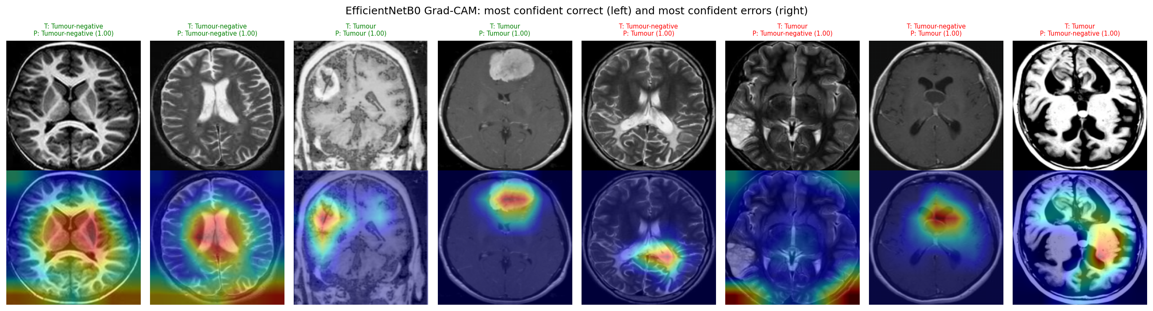
Interpretability and Shortcut Audit
Experiments and Results: Paper 1 (2D)
Where the models look
Grad-CAM [83]: correct tumour predictions peak on the lesion; a missed temporal lesion peaks at the lower border
ViT-B/16 attention rollout [84] puts 42.1% of its weight outside the head on tumour-negative images
Occlusion sensitivity [85] outside the head: 0.7% to 19.4% (detection)
Masking and shortcut findings
Head-only inputs (Otsu head mask [86]) keep 93.7% to 96.8% (detection) and 94.2% to 99.6% (subtype) accuracy
Without the head: 44.4% to 53.3% (detection; InceptionV3 65.7%) and 11.6% to 33.8% (subtype)
Retrained on background only, 7 of 9 detection and 9 of 9 subtype backbones beat the majority-class rate (binomial test, Holm) [42]; grey bars are not significant
Borders and framing carry label information, so high accuracy on these collections does not prove that pathology was learned.
Notes:
Models trained on full images depend on the head, but the data do not stop them from using the background. Swin-Base reaches 83.0% detection accuracy without seeing any brain; subtype background-only models reach up to 97.8%.

Slide 14
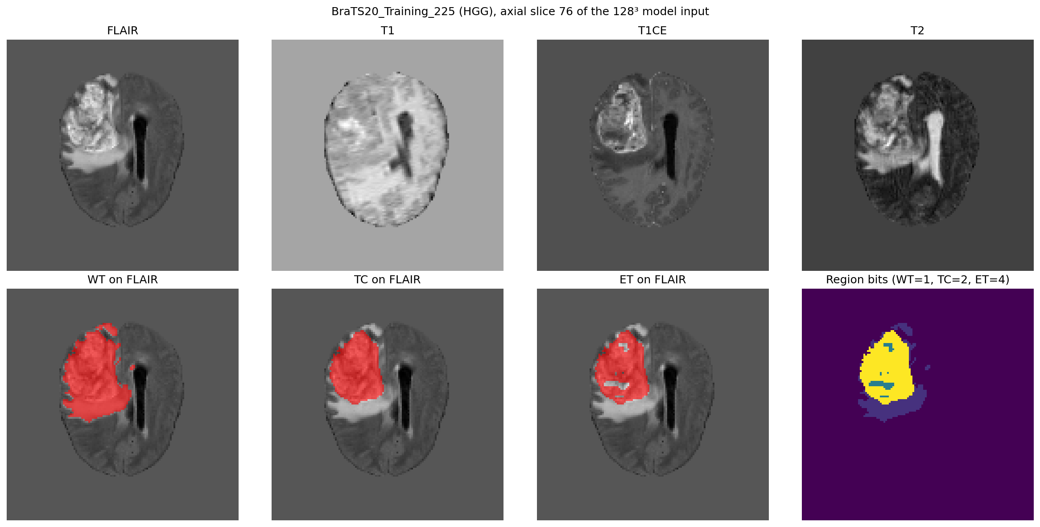
BraTS 2020 Data and 3D Architectures
Experiments and Results: Paper 2 (3D)
Model | Type | Design | Params (M) | GFLOPs
UNet [30, 31] | CNN | Four levels, 32 to 256 channels, LeakyReLU | 5.60 | 907.0
nnU-Net-style [33] | CNN | Five stages, 32 to 320 channels | 16.55 | 956.3
VNet [32] | CNN | Residual blocks, 16 to 128 channels, PReLU | 1.40 | 149.9
UNETR [34] | Transformer | ViT-Base on 16³ patches: 512 tokens | 137.60 | 1,761.7
Swin UNETR [35] | Transformer | Swin encoder, 2³ patches, 7³ windows | 10.52 | 797.1
TransBTS [36] | Hybrid | CNN encoder, 4 transformer layers on 8³ tokens | 35.81 | 996.2
BraTS 2020 [2, 87, 88]: 369 cases (293 HGG, 76 LGG) with FLAIR, T1, T1CE and T2
Labels 1, 2 and 4 give nested regions: WT (all labels), TC (1 and 4), ET (4)
Median ET volume 0.82 cm³ in LGG vs 19.46 cm³ in HGG; 27 of 76 LGG cases have no ET
Foreground z-score per sequence; 240×240×155 resampled to 128³ (trilinear; masks nearest); flips, intensity scale 0.9 to 1.1 and shift ±0.1
Grade-stratified split with seed 42: 257 training, 56 validation, 56 test (44 HGG, 12 LGG)
Identical budget: 50 epochs, effective batch 4, 3,250 optimiser steps
Loss per region: soft Dice plus binary cross-entropy, with deep supervision in UNet, nnU-Net-style, VNet and TransBTS
CNNs: SGD with Nesterov momentum 0.99, learning rate 0.01, polynomial decay (power 0.9)
Transformer-based models: AdamW, learning rate 10⁻⁴, three-epoch warm-up, cosine decay
Half precision, clipping at 1.0; gradient checkpointing for UNETR and Swin UNETR
Checkpoint at the best validation mean Dice; 515 minutes of training on two Tesla T4 GPUs
Notes:
All six networks are implemented from scratch in one notebook and take the same four-channel 128³ input. VNet, shaded, is the deployed model; its module names match the application's network class, so its weights load unchanged.

Slide 15
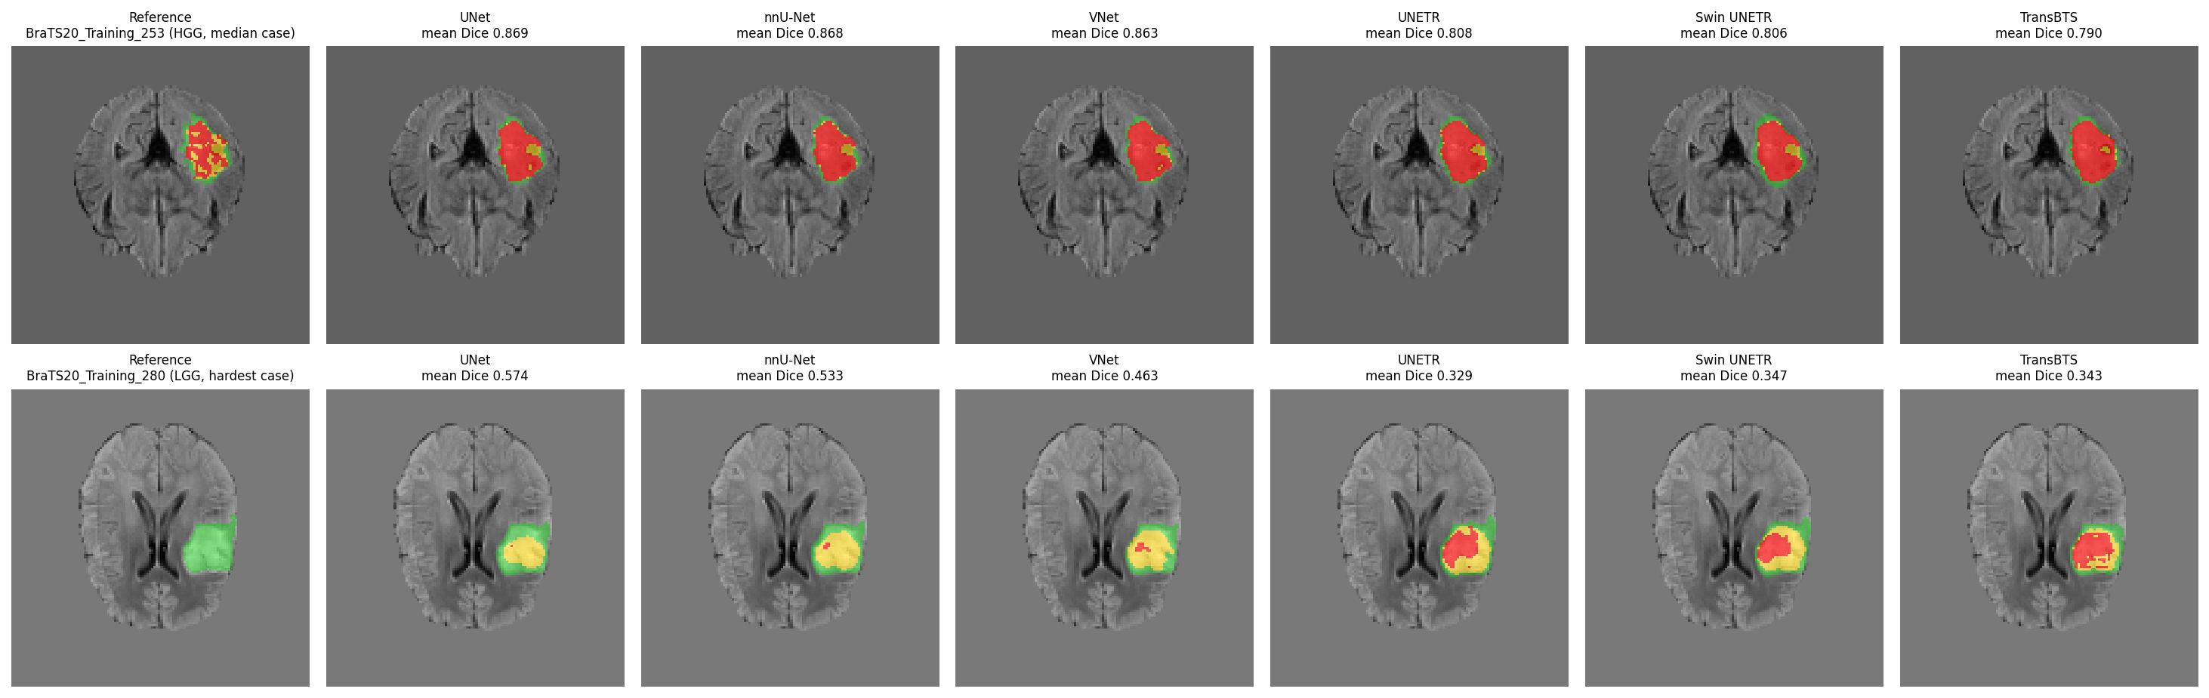
3D Segmentation Test Results
Experiments and Results: Paper 2 (3D)
Model | Type | Mean Dice [95% CI] | WT | TC | ET | HD95 TC (mm) | ET sens.
UNet | CNN | 0.8199 [0.7826, 0.8533] | 0.9012 | 0.8300 | 0.7286 | 3.24 | 0.8486
nnU-Net-style | CNN | 0.8192 [0.7837, 0.8511] | 0.9002 | 0.8309 | 0.7264 | 3.46 | 0.8538
VNet | CNN | 0.7965 [0.7497, 0.8340] | 0.8865 | 0.7972 | 0.7058 | 4.18 | 0.8278
Swin UNETR | Transformer | 0.7462 [0.7134, 0.7772] | 0.8714 | 0.7495 | 0.6176 | 6.70 | 0.9407
TransBTS | Hybrid | 0.7291 [0.6876, 0.7661] | 0.8743 | 0.7488 | 0.5642 | 6.58 | 0.9475
UNETR | Transformer | 0.7056 [0.6700, 0.7384] | 0.8758 | 0.6692 | 0.5720 | 11.29 | 0.9520
What decides the ranking
WT is easy for every model (Dice 0.8714 to 0.9012); TC and ET separate them
Transformer-based models are more sensitive but over-segment; specificity exceeds 0.997 for all
All 15 Wilcoxon pairs are significant after Holm; UNet and nnU-Net-style differ by a median 0.0023 (p = 0.042)
56 test cases at native resolution with eight-flip TTA and validation-tuned ET filtering; HD95 is the median over cases.
Qualitative comparison
Top: median HGG case; every model recovers the tumour (mean Dice 0.790 to 0.869)
Bottom: hardest LGG case, whose reference has no enhancing tumour; the transformer-based models add ET and fall to mean Dice 0.329 to 0.347
Overlay: WT green, TC yellow, ET red
Notes:
UNet leads VNet by a median 0.0119 Dice and every transformer-based model by 0.0738 to 0.1139. Best validation Dice: UNet 0.7845 (epoch 45), nnU-Net-style 0.7824 (50), VNet 0.7598 (44), Swin UNETR 0.7235 (33), TransBTS 0.7102 (45), UNETR 0.6960 (39).

Slide 16
Tumour Grade, Ensembles and Efficiency
Experiments and Results: Paper 2 (3D)
Tumour grade
LGG mean Dice 0.5616 to 0.6624 vs HGG 0.7434 to 0.8632; WT Dice is slightly higher on LGG
One false-positive ET voxel on a case without ET gives that case an ET Dice of 0
Ensembles and uncertainty
CNN ensemble 0.8178 and six-model ensemble 0.7991: neither beats UNet alone
TTA uncertainty vs Dice: Spearman −0.30 to −0.40 (p ≤ 0.023) for CNNs; not significant for the transformer-based models
VNet: the efficiency choice
97% of the UNet Dice with 1.40 M parameters, 149.9 GFLOPs and 0.53 training hours
0.0375 s per volume (UNet 0.1076 s) and 0.98 GB at inference; best Dice per parameter (0.5694) and per training hour (1.4939)
Notes:
Swin UNETR is the slowest model (0.4893 s per volume, 5.29 training hours) despite 10.52 M parameters, because its first stage attends over 64³ tokens. TTA multiplies latency by about eight for every model. In the bubble chart, navy marks CNNs, brick transformers and teal the hybrid.

Slide 17
Conclusion and Future Work
1
Cost decides in 2D. All nine backbones reach 97.08% to 99.42% detection accuracy with no significant difference; EfficientNetB0 matches the leaders with 4.01 M parameters and 0.77 GFLOPs.
Future work
Patient-level splits and external, multi-centre validation
Grouping that keeps every subtype in the test set
Standardise image borders, then repeat the shortcut test
3D multi-sequence detection and classification
Several seeds and cross-validation for the 3D benchmark
Pretrained transformer encoders; higher-resolution or patch-based training
Grade-aware ET post-processing for LGG cases
Calibration on larger held-out sets; DICOM input and physical volumes in the application
2
Leakage and shortcuts are real. Deduplication removed 63.57% and 18.84% of the images, and background-only models still beat chance: public 2D collections carry non-anatomical label cues.
3
CNNs lead in 3D. UNet (0.8199) and nnU-Net-style (0.8192) lead, every CNN beats every from-scratch transformer-based model, and VNet gives 97% of the UNet Dice at about a third of its latency.
4
The weak spot is known. Whole-tumour Dice is 0.87 to 0.90 for every model, but LGG enhancing-tumour Dice is 0.16 to 0.42, a bias that must be disclosed to users.
Recommendation
Highest 3D accuracy: UNet; limited compute and deployment: VNet (3D) and EfficientNetB0 (2D)
Revisit transformers with pretraining, larger datasets or higher-resolution training
5
From benchmark to tool. NeuroScan AI deploys EfficientNetB0 and VNet in a secure, tested application; it is a research prototype, not a diagnostic device.
Notes:
Recommendation: UNet for the highest accuracy; VNet and EfficientNetB0 for deployment with limited compute. Transformers should be revisited with pretraining, more data or higher resolution.

Slide 18
Outcome Achieved
Journal publication: two manuscripts prepared for Engineering Applications of Artificial Intelligence (Elsevier, Scopus indexed)
Manuscript 1
“Standardised Comparison of Convolutional and Transformer Backbones for Brain Tumour Magnetic Resonance Image Classification under Perceptual-Hash Deduplication”
P. Mital, V. Lawand, Biji C. L., M. A. Dar and G. P. Doss C.
Status: prepared for submission
Manuscript 2
“A Comprehensive Benchmark of Three-Dimensional Segmentation Architectures for Brain Tumour Segmentation”
P. Mital, V. Lawand and Biji C. L.
Status: prepared for submission
Others
Open-source NeuroScan AI web application (TRL 4) with 61 backend and 39 frontend automated tests
Research notebooks with all outputs: splits, per-run metrics, plots and the trained checkpoints
Repository: https://github.com/parthmital/NeuroScan-AI
Notes:
Update the status before the review and upload the proof to the form given in the template.

Slide 19
References (1/2)
[1] Q. T. Ostrom et al., “CBTRUS statistical report: Primary brain and other central nervous system tumors diagnosed in the United States in 2016–2020,” Neuro-Oncology, vol. 25, suppl. 4, pp. iv1–iv99, 2023.
[2] S. Bakas et al., “Advancing The Cancer Genome Atlas glioma MRI collections with expert segmentation labels and radiomic features,” Scientific Data, vol. 4, Art. no. 170117, 2017.
[3] J. E. Villanueva-Meyer, M. C. Mabray, and S. Cha, “Current clinical brain tumor imaging,” Neurosurgery, vol. 81, no. 3, pp. 397–415, 2017.
[4] D. N. Louis et al., “The 2021 WHO classification of tumors of the central nervous system: A summary,” Neuro-Oncology, vol. 23, no. 8, pp. 1231–1251, 2021.
[5] S. Bauer, R. Wiest, L.-P. Nolte, and M. Reyes, “A survey of MRI-based medical image analysis for brain tumor studies,” Physics in Medicine and Biology, vol. 58, no. 13, pp. R97–R129, 2013.
[6] A. L. Beam and I. S. Kohane, “Big data and machine learning in health care,” JAMA, vol. 319, no. 13, pp. 1317–1318, 2018.
[7] J. De Fauw et al., “Clinically applicable deep learning for diagnosis and referral in retinal disease,” Nature Medicine, vol. 24, no. 9, pp. 1342–1350, 2018.
[8] S. Kapoor and A. Narayanan, “Leakage and the reproducibility crisis in machine-learning-based science,” Patterns, vol. 4, no. 9, Art. no. 100804, 2023.
[9] M. Roberts et al., “Common pitfalls and recommendations for using machine learning to detect and prognosticate for COVID-19 using chest radiographs and CT scans,” Nature Machine Intelligence, vol. 3, no. 3, pp. 199–217, 2021.
[10] E. I. Zacharaki et al., “Classification of brain tumor type and grade using MRI texture and shape in a machine learning scheme,” Magnetic Resonance in Medicine, vol. 62, no. 6, pp. 1609–1618, 2009.
[11] N. Gordillo, E. Montseny, and P. Sobrevilla, “State of the art survey on MRI brain tumor segmentation,” Magnetic Resonance Imaging, vol. 31, no. 8, pp. 1426–1438, 2013.
[12] G. Litjens et al., “A survey on deep learning in medical image analysis,” Medical Image Analysis, vol. 42, pp. 60–88, 2017.
[13] J. Cheng et al., “Enhanced performance of brain tumor classification via tumor region augmentation and partition,” PLoS ONE, vol. 10, no. 10, Art. no. e0140381, 2015.
[14] J. Seetha and S. S. Raja, “Brain tumor classification using convolutional neural networks,” Biomedical and Pharmacology Journal, vol. 11, no. 3, pp. 1457–1461, 2018.
[15] M. Talo, U. B. Baloglu, Ö. Yıldırım, and U. R. Acharya, “Application of deep transfer learning for automated brain abnormality classification using MR images,” Cognitive Systems Research, vol. 54, pp. 176–188, 2019.
[16] K. He, X. Zhang, S. Ren, and J. Sun, “Deep residual learning for image recognition,” in Proc. IEEE Conference on Computer Vision and Pattern Recognition (CVPR), 2016, pp. 770–778.
[17] A. Krizhevsky, I. Sutskever, and G. E. Hinton, “ImageNet classification with deep convolutional neural networks,” Communications of the ACM, vol. 60, no. 6, pp. 84–90, 2017.
[18] S. Deepak and P. M. Ameer, “Brain tumor classification using deep CNN features via transfer learning,” Computers in Biology and Medicine, vol. 111, Art. no. 103345, 2019.
[19] N. Ghassemi, A. Shoeibi, and M. Rouhani, “Deep neural network with generative adversarial networks pre-training for brain tumor classification based on MR images,” Biomedical Signal Processing and Control, vol. 57, Art. no. 101678, 2020.
[20] A. Rehman, S. Naz, M. I. Razzak, F. Akram, and M. Imran, “A deep learning-based framework for automatic brain tumors classification using transfer learning,” Circuits, Systems, and Signal Processing, vol. 39, no. 2, pp. 757–775, 2020.
[21] N. Noreen, S. Palaniappan, A. Qayyum, I. Ahmad, M. Imran, and M. Shoaib, “A deep learning model based on concatenation approach for the diagnosis of brain tumor,” IEEE Access, vol. 8, pp. 55135–55144, 2020.
[22] K. Simonyan and A. Zisserman, “Very deep convolutional networks for large-scale image recognition,” in Proc. International Conference on Learning Representations (ICLR), 2015.
[23] C. Szegedy, V. Vanhoucke, S. Ioffe, J. Shlens, and Z. Wojna, “Rethinking the inception architecture for computer vision,” in Proc. IEEE Conference on Computer Vision and Pattern Recognition (CVPR), 2016, pp. 2818–2826.
[24] G. Huang, Z. Liu, L. van der Maaten, and K. Q. Weinberger, “Densely connected convolutional networks,” in Proc. IEEE Conference on Computer Vision and Pattern Recognition (CVPR), 2017, pp. 2261–2269.
[25] M. A. Khan et al., “Multimodal brain tumor classification using deep learning and robust feature selection: A machine learning application for radiologists,” Diagnostics, vol. 10, no. 8, Art. no. 565, 2020.
[26] S. Tummala, S. Kadry, S. A. C. Bukhari, and H. T. Rauf, “Classification of brain tumor from magnetic resonance imaging using vision transformers ensembling,” Current Oncology, vol. 29, no. 10, pp. 7498–7511, 2022.
[27] A. A. Asiri et al., “Advancing brain tumor detection: Harnessing the Swin Transformer's power for accurate classification and performance analysis,” PeerJ Computer Science, vol. 10, Art. no. e1867, 2024.
[28] A. Dosovitskiy et al., “An image is worth 16x16 words: Transformers for image recognition at scale,” in Proc. International Conference on Learning Representations (ICLR), 2021.
[29] Z. Liu et al., “Swin transformer: Hierarchical vision transformer using shifted windows,” in Proc. IEEE/CVF International Conference on Computer Vision (ICCV), 2021, pp. 9992–10002.
[30] O. Ronneberger, P. Fischer, and T. Brox, “U-Net: Convolutional networks for biomedical image segmentation,” in Medical Image Computing and Computer-Assisted Intervention (MICCAI 2015), 2015, pp. 234–241.
[31] Ö. Çiçek, A. Abdulkadir, S. S. Lienkamp, T. Brox, and O. Ronneberger, “3D U-Net: Learning dense volumetric segmentation from sparse annotation,” in Medical Image Computing and Computer-Assisted Intervention (MICCAI 2016), 2016, pp. 424–432.
[32] F. Milletari, N. Navab, and S.-A. Ahmadi, “V-Net: Fully convolutional neural networks for volumetric medical image segmentation,” in Proc. Fourth International Conference on 3D Vision (3DV), 2016, pp. 565–571.
[33] F. Isensee, P. F. Jaeger, S. A. A. Kohl, J. Petersen, and K. H. Maier-Hein, “nnU-Net: A self-configuring method for deep learning-based biomedical image segmentation,” Nature Methods, vol. 18, no. 2, pp. 203–211, 2021.
[34] A. Hatamizadeh et al., “UNETR: Transformers for 3D medical image segmentation,” in Proc. IEEE/CVF Winter Conference on Applications of Computer Vision (WACV), 2022, pp. 1748–1758.
[35] A. Hatamizadeh, V. Nath, Y. Tang, D. Yang, H. R. Roth, and D. Xu, “Swin UNETR: Swin transformers for semantic segmentation of brain tumors in MRI images,” in Brainlesion: Glioma, Multiple Sclerosis, Stroke and Traumatic Brain Injuries (BrainLes 2021), 2022, pp. 272–284.
[36] W. Wang, C. Chen, M. Ding, H. Yu, S. Zha, and J. Li, “TransBTS: Multimodal brain tumor segmentation using transformer,” in Medical Image Computing and Computer Assisted Intervention (MICCAI 2021), 2021, pp. 109–119.
[37] J. Chen et al., “TransUNet: Rethinking the U-Net architecture design for medical image segmentation through the lens of transformers,” Medical Image Analysis, vol. 97, Art. no. 103280, 2024.
[38] H. Touvron, M. Cord, M. Douze, F. Massa, A. Sablayrolles, and H. Jégou, “Training data-efficient image transformers and distillation through attention,” in Proc. 38th International Conference on Machine Learning (ICML), 2021, pp. 10347–10357.
[39] A. Fateh et al., “BRISC: Annotated dataset for brain tumor segmentation and classification,” Scientific Data, vol. 13, Art. no. 361, 2026.
[40] S. Khan, M. Naseer, M. Hayat, S. W. Zamir, F. S. Khan, and M. Shah, “Transformers in vision: A survey,” ACM Computing Surveys, vol. 54, no. 10s, pp. 1–41, 2022.
[41] F. Shamshad et al., “Transformers in medical imaging: A survey,” Medical Image Analysis, vol. 88, Art. no. 102802, 2023.
[42] R. Geirhos et al., “Shortcut learning in deep neural networks,” Nature Machine Intelligence, vol. 2, no. 11, pp. 665–673, 2020.
Notes:
IEEE-style references, numbered in order of first citation in this deck; all 88 references cited by the two manuscripts are included.

Slide 20
References (2/2)
[43] J. R. Zech, M. A. Badgeley, M. Liu, A. B. Costa, J. J. Titano, and E. K. Oermann, “Variable generalization performance of a deep learning model to detect pneumonia in chest radiographs: A cross-sectional study,” PLOS Medicine, vol. 15, no. 11, Art. no. e1002683, 2018.
[44] A. J. DeGrave, J. D. Janizek, and S.-I. Lee, “AI for radiographic COVID-19 detection selects shortcuts over signal,” Nature Machine Intelligence, vol. 3, no. 7, pp. 610–619, 2021.
[45] J. M. J. Valanarasu, P. Oza, I. Hacihaliloglu, and V. M. Patel, “Medical transformer: Gated axial-attention for medical image segmentation,” in Medical Image Computing and Computer Assisted Intervention (MICCAI 2021), 2021, pp. 36–46.
[46] H. Cao et al., “Swin-Unet: Unet-like pure transformer for medical image segmentation,” in Computer Vision – ECCV 2022 Workshops, 2023, pp. 205–218.
[47] S. Suzuki and K. Abe, “Topological structural analysis of digitized binary images by border following,” Computer Vision, Graphics, and Image Processing, vol. 30, no. 1, pp. 32–46, 1985.
[48] V. Monga and B. L. Evans, “Perceptual image hashing via feature points: Performance evaluation and tradeoffs,” IEEE Transactions on Image Processing, vol. 15, no. 11, pp. 3452–3465, 2006.
[49] R. W. Hamming, “Error detecting and error correcting codes,” Bell System Technical Journal, vol. 29, no. 2, pp. 147–160, 1950.
[50] B. Zitová and J. Flusser, “Image registration methods: A survey,” Image and Vision Computing, vol. 21, no. 11, pp. 977–1000, 2003.
[51] F. Pedregosa et al., “Scikit-learn: Machine learning in Python,” Journal of Machine Learning Research, vol. 12, no. 85, pp. 2825–2830, 2011.
[52] M. Stone, “Cross-validatory choice and assessment of statistical predictions,” Journal of the Royal Statistical Society: Series B (Methodological), vol. 36, no. 2, pp. 111–133, 1974.
[53] A. Hamada, “Br35H :: Brain tumor detection 2020,” IEEE DataPort, 2025.
[54] N. Chakrabarty, “Brain MRI images for brain tumor detection,” Kaggle dataset, version 1, 2019.
[55] S. Bhuvaji, A. Kadam, P. Bhumkar, S. Dedge, and S. Kanchan, “Brain tumor classification (MRI),” Kaggle dataset, 2020.
[56] J. Cheng, “Brain tumor dataset,” figshare, version 5, 2017.
[57] MoundirB, “Jun Cheng brain tumor MRI dataset JPG,” Kaggle dataset, version 1, 2025.
[58] M. Tan and Q. Le, “EfficientNet: Rethinking model scaling for convolutional neural networks,” in Proc. 36th International Conference on Machine Learning (ICML), 2019, pp. 6105–6114.
[59] A. Howard et al., “Searching for MobileNetV3,” in Proc. IEEE/CVF International Conference on Computer Vision (ICCV), 2019, pp. 1314–1324.
[60] M. Sandler, A. Howard, M. Zhu, A. Zhmoginov, and L.-C. Chen, “MobileNetV2: Inverted residuals and linear bottlenecks,” in Proc. IEEE/CVF Conference on Computer Vision and Pattern Recognition (CVPR), 2018, pp. 4510–4520.
[61] A. Vaswani et al., “Attention is all you need,” in Advances in Neural Information Processing Systems (NeurIPS) 30, 2017.
[62] Z. Dai, H. Liu, Q. V. Le, and M. Tan, “CoAtNet: Marrying convolution and attention for all data sizes,” in Advances in Neural Information Processing Systems (NeurIPS), 2021, pp. 3965–3977.
[63] Y. LeCun, L. Bottou, Y. Bengio, and P. Haffner, “Gradient-based learning applied to document recognition,” Proceedings of the IEEE, vol. 86, no. 11, pp. 2278–2324, 1998.
[64] Y. LeCun, Y. Bengio, and G. Hinton, “Deep learning,” Nature, vol. 521, no. 7553, pp. 436–444, 2015.
[65] J. Deng, W. Dong, R. Socher, L.-J. Li, K. Li, and L. Fei-Fei, “ImageNet: A large-scale hierarchical image database,” in Proc. IEEE Conference on Computer Vision and Pattern Recognition (CVPR), 2009, pp. 248–255.
[66] O. Russakovsky et al., “ImageNet large scale visual recognition challenge,” International Journal of Computer Vision, vol. 115, no. 3, pp. 211–252, 2015.
[67] A. Paszke et al., “PyTorch: An imperative style, high-performance deep learning library,” in Advances in Neural Information Processing Systems (NeurIPS) 32, 2019.
[68] I. Loshchilov and F. Hutter, “Decoupled weight decay regularization,” in Proc. International Conference on Learning Representations (ICLR), 2019.
[69] I. Loshchilov and F. Hutter, “SGDR: Stochastic gradient descent with warm restarts,” in Proc. International Conference on Learning Representations (ICLR), 2017.
[70] P. Micikevicius et al., “Mixed precision training,” in Proc. International Conference on Learning Representations (ICLR), 2018.
[71] R. Pascanu, T. Mikolov, and Y. Bengio, “On the difficulty of training recurrent neural networks,” in Proc. 30th International Conference on Machine Learning (ICML), 2013, pp. 1310–1318.
[72] T. Gneiting and A. E. Raftery, “Strictly proper scoring rules, prediction, and estimation,” Journal of the American Statistical Association, vol. 102, no. 477, pp. 359–378, 2007.
[73] C. Guo, G. Pleiss, Y. Sun, and K. Q. Weinberger, “On calibration of modern neural networks,” in Proc. 34th International Conference on Machine Learning (ICML), 2017, pp. 1321–1330.
[74] W. J. Youden, “Index for rating diagnostic tests,” Cancer, vol. 3, no. 1, pp. 32–35, 1950.
[75] J. A. Hanley and B. J. McNeil, “The meaning and use of the area under a receiver operating characteristic (ROC) curve,” Radiology, vol. 143, no. 1, pp. 29–36, 1982.
[76] T. Fawcett, “An introduction to ROC analysis,” Pattern Recognition Letters, vol. 27, no. 8, pp. 861–874, 2006.
[77] B. W. Matthews, “Comparison of the predicted and observed secondary structure of T4 phage lysozyme,” Biochimica et Biophysica Acta (BBA) – Protein Structure, vol. 405, no. 2, pp. 442–451, 1975.
[78] D. Chicco and G. Jurman, “The advantages of the Matthews correlation coefficient (MCC) over F1 score and accuracy in binary classification evaluation,” BMC Genomics, vol. 21, Art. no. 6, 2020.
[79] M. Pakdaman Naeini, G. Cooper, and M. Hauskrecht, “Obtaining well calibrated probabilities using Bayesian binning,” in Proc. AAAI Conference on Artificial Intelligence 29(1), 2015.
[80] B. Efron, “Bootstrap methods: Another look at the jackknife,” The Annals of Statistics, vol. 7, no. 1, pp. 1–26, 1979.
[81] Q. McNemar, “Note on the sampling error of the difference between correlated proportions or percentages,” Psychometrika, vol. 12, no. 2, pp. 153–157, 1947.
[82] S. Holm, “A simple sequentially rejective multiple test procedure,” Scandinavian Journal of Statistics, vol. 6, no. 2, pp. 65–70, 1979.
[83] R. R. Selvaraju, M. Cogswell, A. Das, R. Vedantam, D. Parikh, and D. Batra, “Grad-CAM: Visual explanations from deep networks via gradient-based localization,” in Proc. IEEE International Conference on Computer Vision (ICCV), 2017, pp. 618–626.
[84] S. Abnar and W. Zuidema, “Quantifying attention flow in transformers,” in Proc. 58th Annual Meeting of the Association for Computational Linguistics (ACL), 2020, pp. 4190–4197.
[85] M. D. Zeiler and R. Fergus, “Visualizing and understanding convolutional networks,” in Computer Vision – ECCV 2014, 2014, pp. 818–833.
[86] N. Otsu, “A threshold selection method from gray-level histograms,” IEEE Transactions on Systems, Man, and Cybernetics, vol. 9, no. 1, pp. 62–66, 1979.
[87] B. H. Menze et al., “The multimodal brain tumor image segmentation benchmark (BRATS),” IEEE Transactions on Medical Imaging, vol. 34, no. 10, pp. 1993–2024, 2015.
[88] S. Bakas et al., “Identifying the best machine learning algorithms for brain tumor segmentation, progression assessment, and overall survival prediction in the BRATS challenge,” arXiv:1811.02629, 2018.
Notes:
IEEE-style references, numbered in order of first citation in this deck; all 88 references cited by the two manuscripts are included.

