Slide 1
NLP with DEEp learning

Slide 2
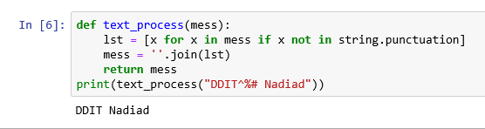
Text Preprocessing
Remove punctuations :-
!"#$%&\'()*+,-./:;<=>?@[\\]^_`{|}~

Slide 3
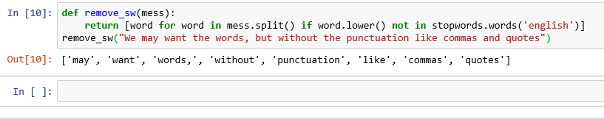
Text Preprocessing
Remove stopwords :=
I , me ,is ,was,why,the no etc.

Slide 4


Text Preprocessing
Lexical Diversity :
Percentage occurrence :

Slide 5
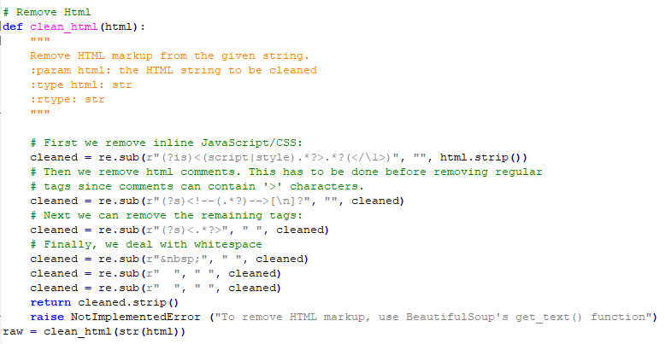
Text Preprocessing
Clean html text :-

Slide 6
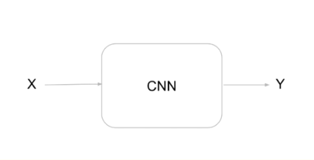
Limitations of CNN
CNN is pretty basic, there is one input x and one output y.
Decision made now is not based on past sequence of inputs .
It does not support feedback loop.
Must have constant input size .

Slide 7
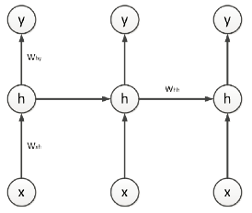
Recurrent Neural Network
Type of Artificial Neural Network
Connections between nodes are directed graph.
Unlike CNN , Recurrent Neural Network use internal state to process Sequence of inputs.

Slide 8
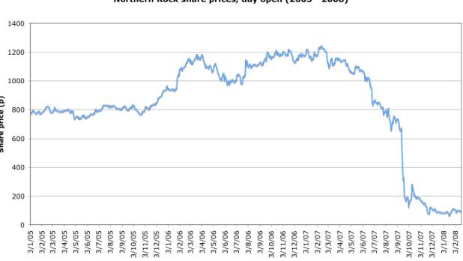
Recurrent Neural Networks
Share price :

Slide 9
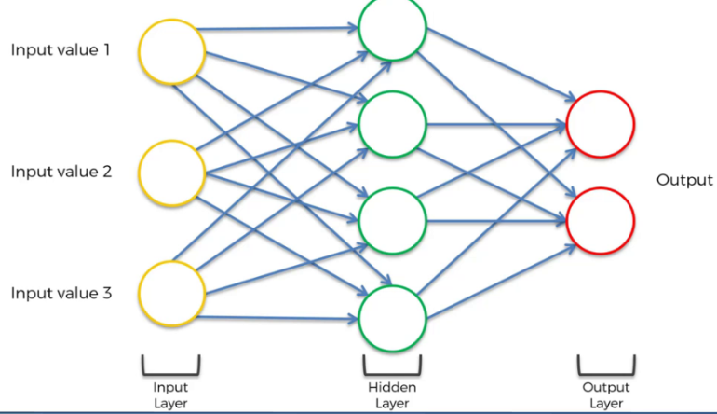
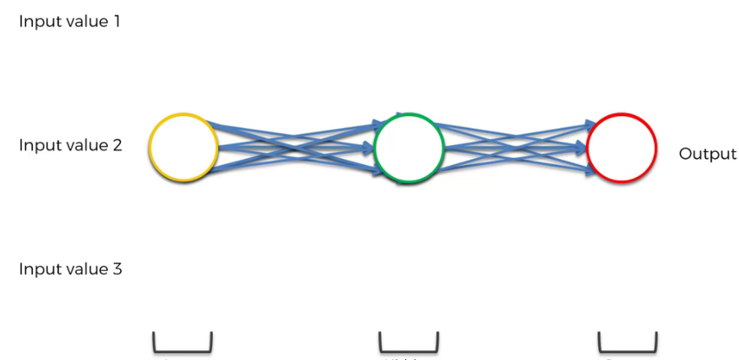
Structure of RNN
1. Consider simple ANN
2.Squash Neurons together

Slide 10
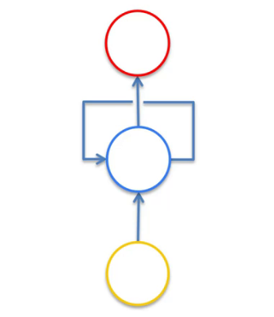
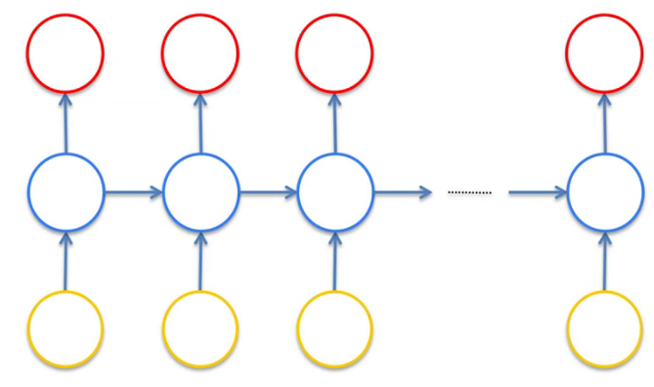
Structure of RNN
3. Add Temporal Loop for Each internal Neuron
that performs feedback process
4.Unroll the loop and add ANN in the
given way.

Slide 11
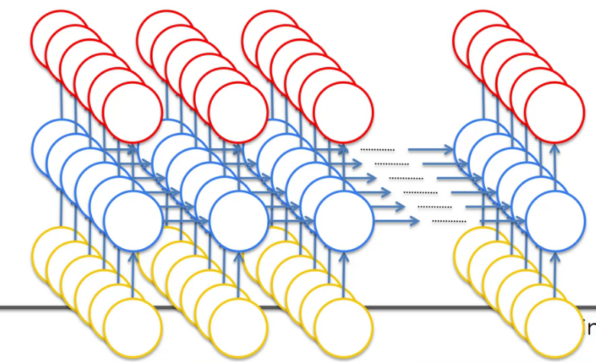
Structure Of RNN
5.Consider In Multiple Dimension way
Finally Neurons get data , Make computations and forward data to next neuron
And Itself too due to self loop.

Slide 12
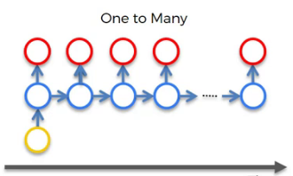
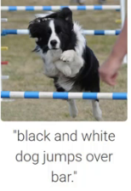
Type of task by RNN
(1)One to many
Get multiple features from single input

Slide 13
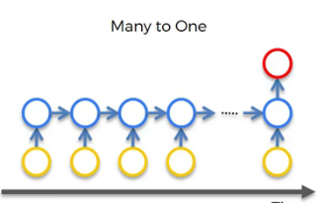
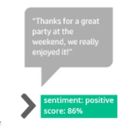
Type of task by RNN
(2)Many to one
Sentiment Analysis

Slide 14
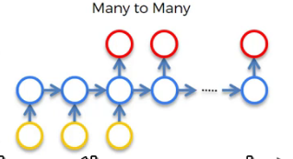
Type of Task
(3) Many to many
Google translator that takes multiple input and generate multiple output

Slide 15
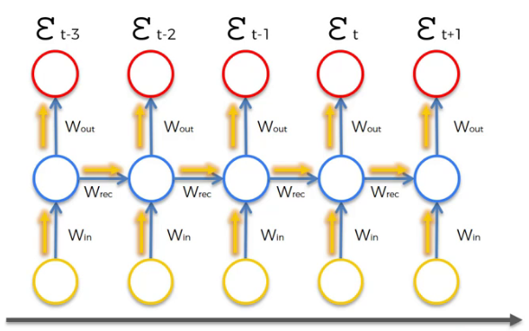
Vanishing Gradient problem
As shown here data is transferred towards neurons and const function is found which should be minimum.

Slide 16
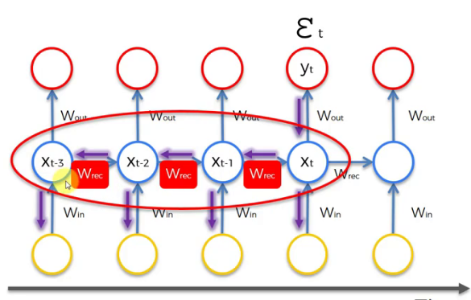
Vanishing Gradient Problem
Due to one cost function , all previous nodes are multiplied by Wrec.So values are decreased.

Slide 17
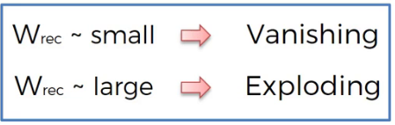
Vanishing Gradient Problem
When we multiply by something small multiple times the value becomes smaller .
Left side neuron gets too much low value.

Slide 18
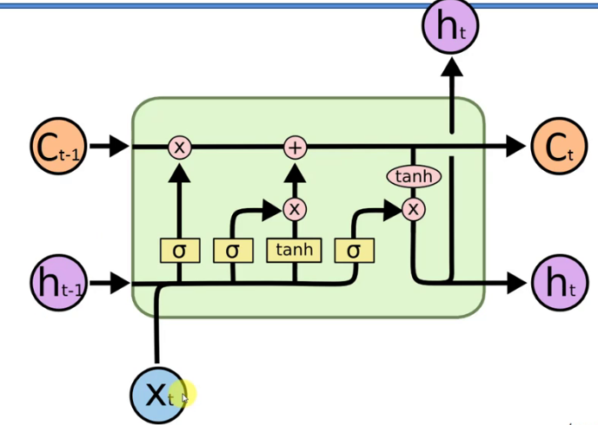
Solution:
(1) LSTM : Long Short term memory.
C : Memory
X : Input
h : Output
Allow hidden layer to remember
Previous inputs.

Slide 19
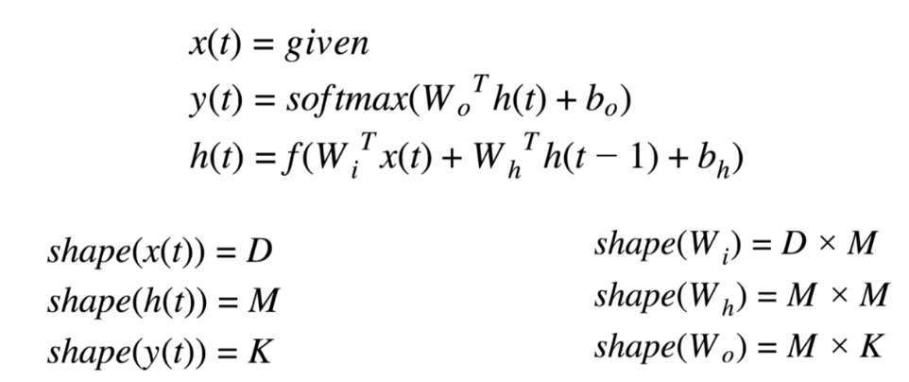
Input , Output and Memory:-

Slide 20
Thank You !

