Slide 1
Assignment 2 Solutions
SQL and NoSQL

Slide 2
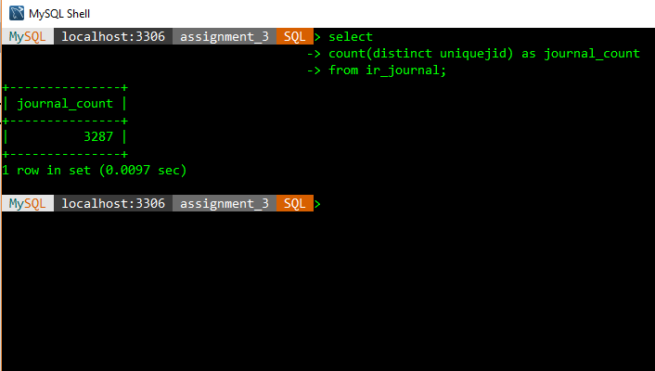
Query 1
Question: Calculate the total number of journals/conferences recorded in the table ir_journal

Slide 3
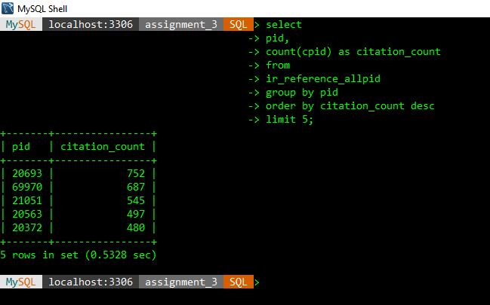
Query 2
Question: Calculate the id of the top 5 papers that received the most number of citations
Hint: You just need to use the table ir_reference_allpid. No need to use ir_paper.

Slide 4
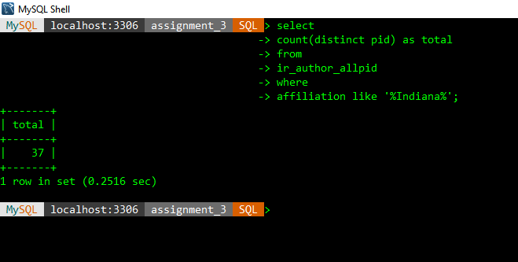
Query 3
Calculate the total number of publications authored or co-authored by authors from affiliations containing “Indiana”
Hint: Use the “affiliation” column in the ir_author_allpid table.

Slide 5
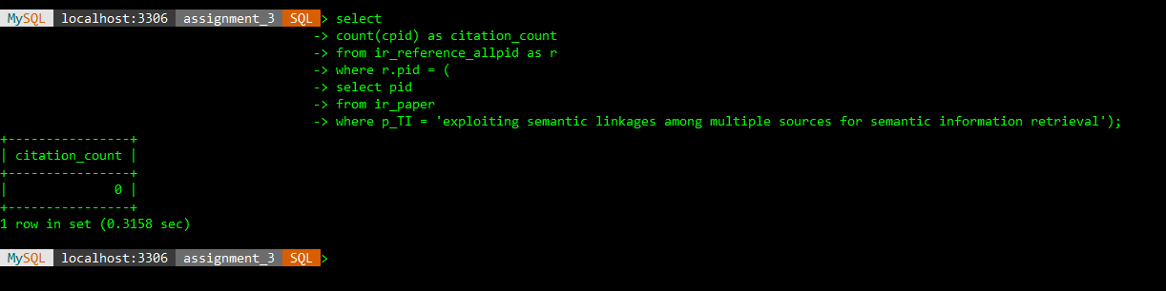
Query 4
Question: Calculate the number of citations of paper titled “exploiting semantic linkages among multiple sources for semantic information retrieval”
Hint: The title of a paper is represented in the column called “p_TI” in ir_paper.

Slide 6
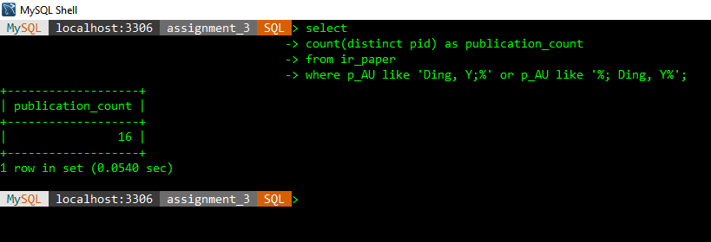
Query 5
Question: Calculate the number of publications authored or co-authored by the person whose name is “Ding, Y”
Hint 1: Do not including publications not recorded in the ir_paper table.
Hint 2: In p_AU in the table of ir_paper, there are all authors’ names separated by “;”. Thus, if an author is the first author of a certain paper, there will be “;” after his/her name; if he/she is not the first author, there will be “;” before his/her name. Taking into consideration of “;” will help you filter those authors such as “Ding, YB”.

Slide 7
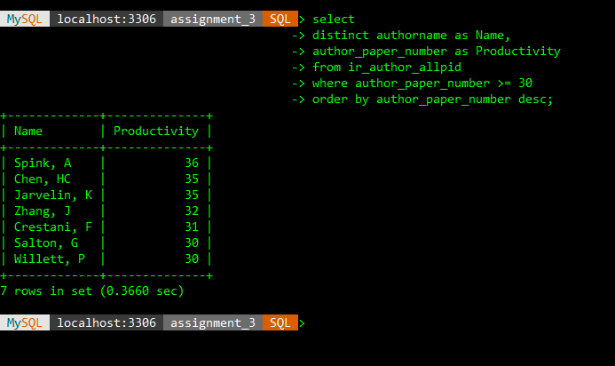
Query 6
Question: Provide the names of the researchers and their number of publications who satisfy the below requirement: Their number of publications is 30 or more recorded in our IR database. Please rename these two columns as “Name” and “Productivity”, respectively in your result.
Explanation: The publication count of an author measures his/her productivity, and is regarded as an important indicator on his/her research performance in the academic communities.
Hint: The author’s number of publications is recorded in the column of author_paper_number in ir_author_allpid. Do not show duplicated names. To rename the column, you can try to use the “as” command.

Slide 8
Query 7
Question: Calculate the number of journals/conferences whose names contain “comput” and start with “a” or “A”. The names of these journals/conferences need to have at least three words.
Hint: Please use the “journalname” field instead of “journalnameshort”.
Answer on next slide.

Slide 9
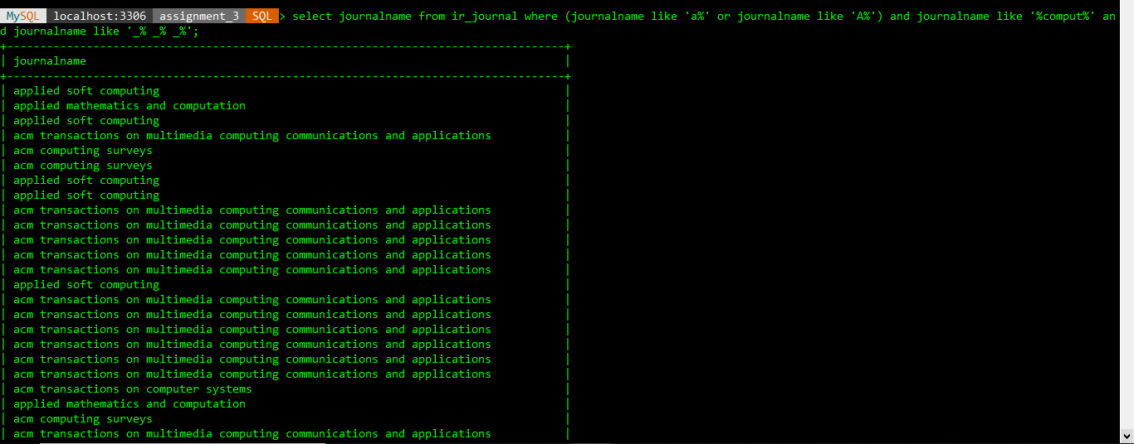

Slide 10
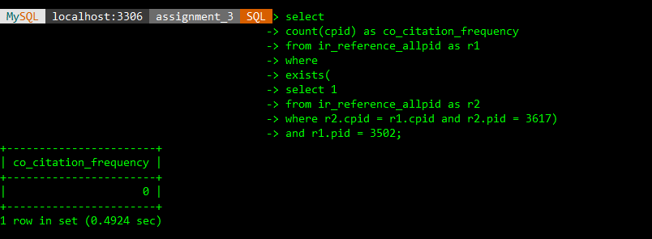
Query 8
Question: Calculate the co-citation frequency between publications 3502 and 3617.
Hint: You just need to use the table ir_reference_allpid to finish this. You can use multiple SQL queries to finish it, as a single query might be complicated. The same for Queries 9 and 10.
Co-citation frequency: If A and B are both cited by another paper C, then A and B are co-cited. The number of papers that co-cite both A and B is called co-citation frequency. Bibliometrically, co-citation has been used to map knowledge domains and depict scientific intellectual structures.

Slide 11
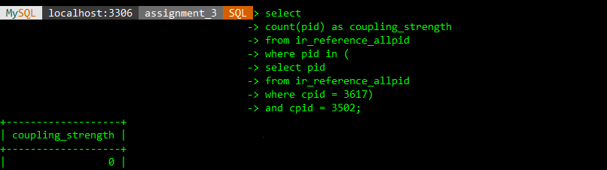
Query 9
Question: Calculate the bibliographic coupling strength between publications 3502 and 3617.
Hint: You just need to use the table ir_reference_allpid to finish this.
Bibliographic coupling strength: If A and B both cite the same paper, A and B are called bibliographic coupled. The number of papers they both cite is equal to their bibliographic coupling strength.

Slide 12
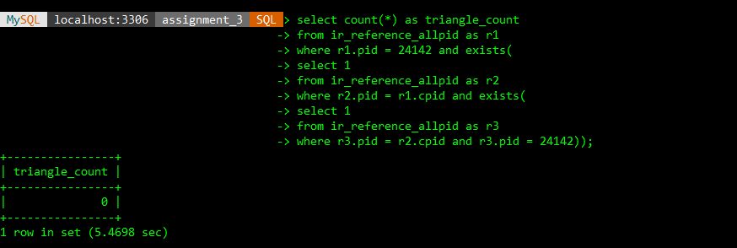
Query 10
Question: Citing cascade of paper A is defined as a network whose nodes include A and all of its citing papers. The edges of citing cascade of A include all of the citation relationship among its nodes. We know that in such as network, there might occur some triangles. For instance, A and B, B and C, and C and A all have citation relationships. Please calculate the number of triangles of the citing cascade of paper 24142.

Slide 13
THANK YOU
Assignment 2, SQL and NoSQL

