Slide 1
Assignment 3

Slide 2
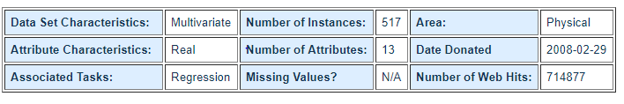
Dataset used - Forest Fires Data
This is a difficult regression task, where the aim is to predict the burned area of forest fires, in the northeast region of Portugal, by using meteorological and other data
Dataset link - https://archive.ics.uci.edu/ml/datasets/Forest+Fires

Slide 3
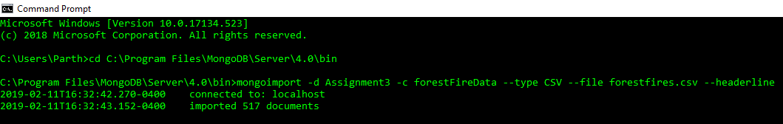
Loading the data in MongoDB
Download the forestfires.csv file from the link in the last slide.
Move this file to the bin directory of the MongoDB installation.
Then execute the command below :

Slide 4
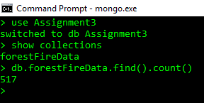
Verify if the data has been correctly loaded
Execute commands:
use Assignment3
show collections
db.forestFireData.find().count()
We should get 517 as the count.

Slide 5

Query 1
Find the number of times that forest fires actually burnt an area (area>0).
MongoDB Query :
db.forestFireData.find({'area':{$gt:0}}).count()
Thus we can see that out of 571 entries, 270 of them have burnt area > 0, this means during predicting burnt area we must take care that our model is not biased due to the imbalance in the data.

Slide 6
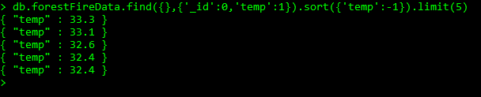
Query 2
Get the top 5 temperatures attained during the fires.
MongoDB query:
db.forestFireData.find({},{'_id':0,'temp':1}).sort({'temp':-1}).limit(5)

Slide 7
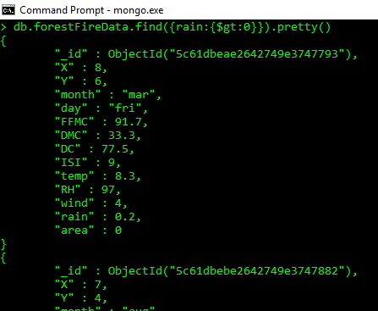
Query 3
Get the records when there was rain (rain>0) during a forest fire. - 8
There are 8 such records when there was rain and most of the times this happened in August.

Slide 8
Query 4
Get the count of the forest fires in each month
Here we use map reduce
var map1 = function() {emit(this.month,1);}
var reduce1 = function(key,values) {return Array.sum(values)}
db.forestFireData.mapReduce(map1,reduce1,{out:'monthly_stats'})
The results are on the next slide.

Slide 9
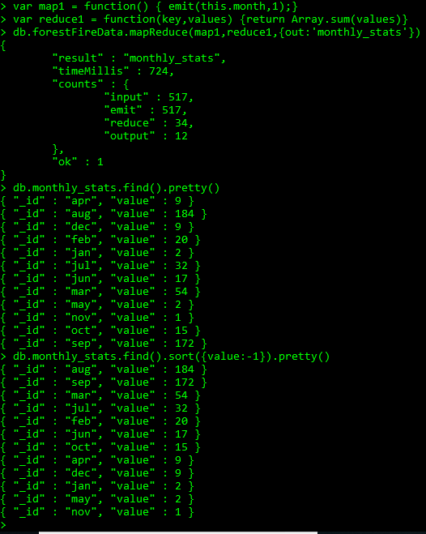
Query 4 results
We can see that the number of forest fires is very high during August and September as peak temperatures are observed in these months in Portugal(Lisbon).

Slide 10
Query 5
Find the total area burnt due to forest fires
MongoDB query:
var map2 = function() {emit(1,this.area);}
var reduce2 = function(key,values){return Array.sum(values)}
db.forestFireData.mapReduce(map2,reduce2,{out:'total_area_burnt'})
Query result on next slide.

Slide 11
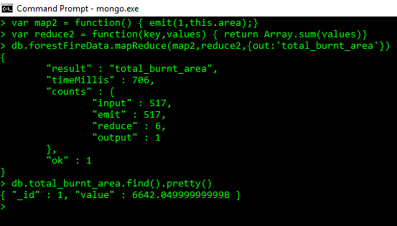
Query 5 result

Slide 12
Query 6
Get how much forest area was burnt for different wind speeds.
MongoDB query
var map3 = function() {
emit(this.wind,1);
}
var reduce3 = function(key,values){
return Array.sum(values)
}
db.forestFireData.mapReduce(map3,reduce3,{out:'windStats'})

Slide 13
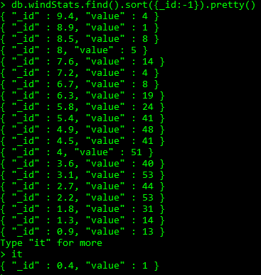
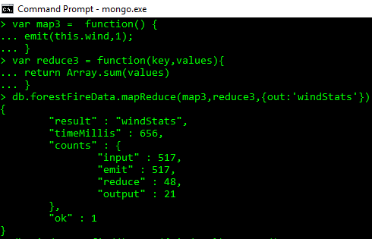
Query 6 results
We can see that the number of forest fire instances are more for the median values of wind than the extreme values, this is as expected as very low winds don't provide as much oxygen and very high winds blow away the fire.

Slide 14
Query 7
Mean areas burnt for each location(X,Y) for the Montesinho park map .
MongoDB query:
var map4 = function(){
emit({X:this.X,Y:this.Y},this.area);
}
var reduce4 = function(key,values){
return Array.avg(values)
}
> db.forestFireData.mapReduce(map4,reduce4,{out:'LocAreaMean'})

Slide 15
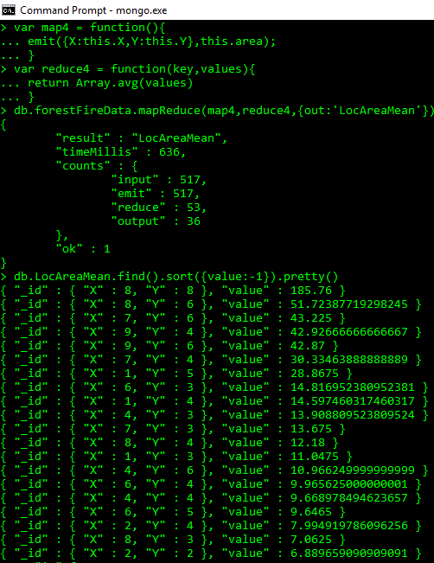
Query 7 results

Slide 16
Query 8
Number of forest fires on each day of the week.
MongoDB query:
var map5 = function(){
emit(this.day,1);
}
var reduce5 = function(key,values){
return Array.sum(values)
}
db.forestFireData.mapReduce(map5,reduce5,{out:'dayStats'})

Slide 17
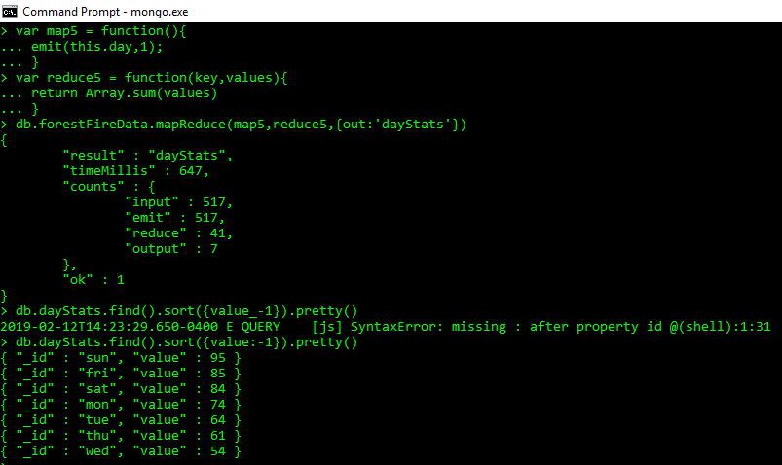
Query 8 results

Slide 18
Query 9
Sort the records according to decreasing area by creating a index first.
MongoDB queries:
db.forestFireData.ensureIndex({area:-1})
db.forestFireData.find().sort({area:-1}).pretty()
Creating a index before sorting greatly increases in performance as by creating an index only a part of the data is stored in the RAM which greatly speeds up performance.

Slide 19
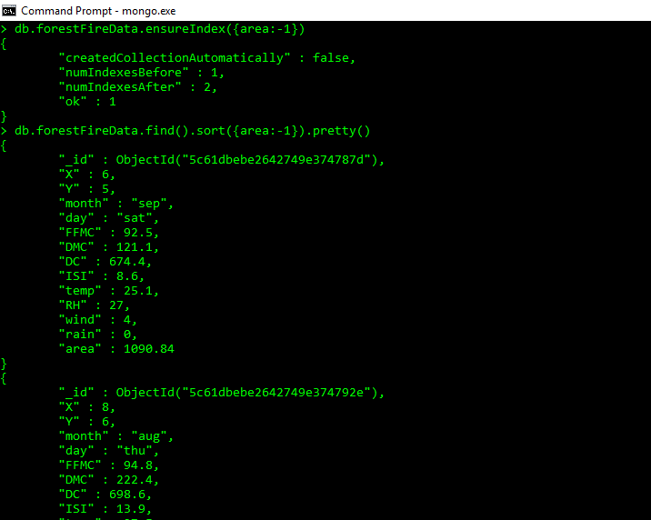
Query 9 results

Slide 20
Query 10
Get the average FFMC score over all the forest fires.
MongoDB query
var map6 = function() {
emit('mean_FFMC',this.FFMC);
}
var reduce6 = function(key,values) {
return Array.avg(values)
}
db.forestFireData.mapReduce(map6,reduce6,{out:'avg_FFMC'}

Slide 21
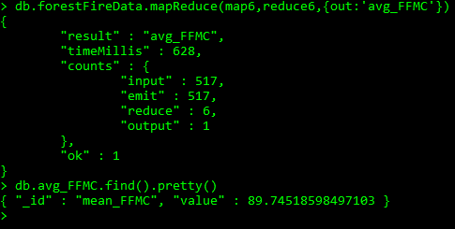
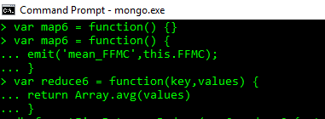
Query 10 results
Fine Fuel Moisture Code is a measure of how easily a fuel source burns, as we can see that over all forest fires the FFMC score is pretty high indicating that the forest area can easily catch fire.

Slide 22
Tableau Visualizations

Slide 23
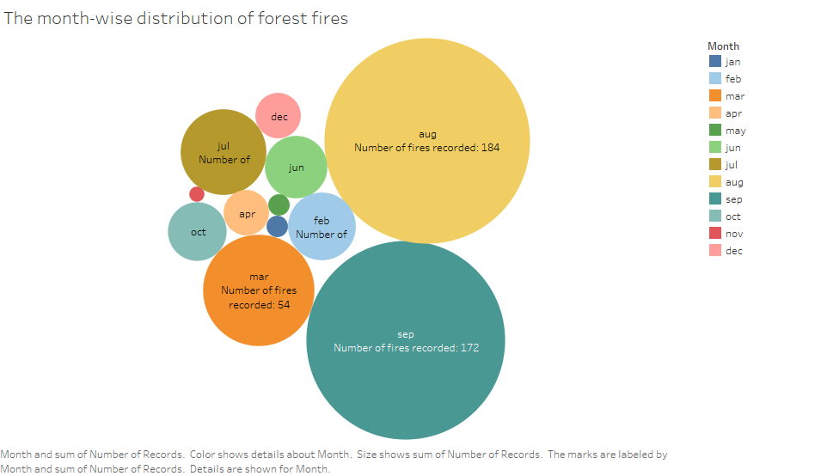
Distribution of forest fires by month

Slide 24
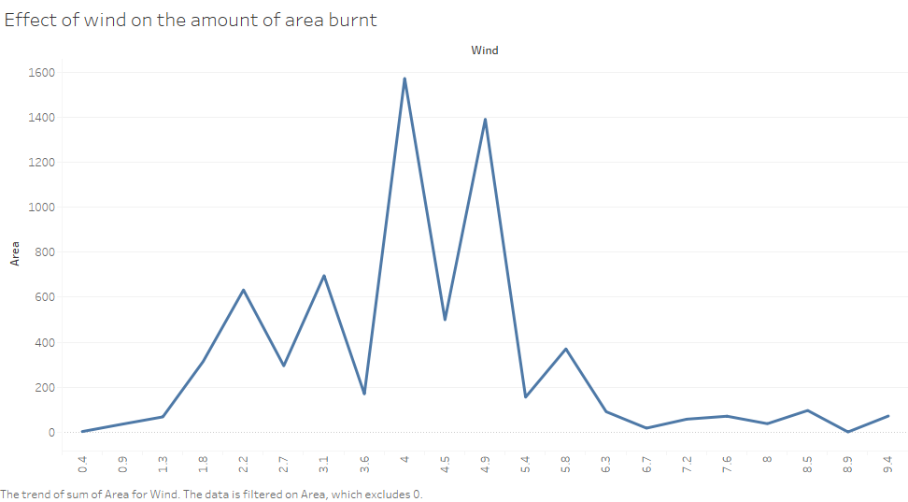
How does burnt area vary by wind speed ?

Slide 25
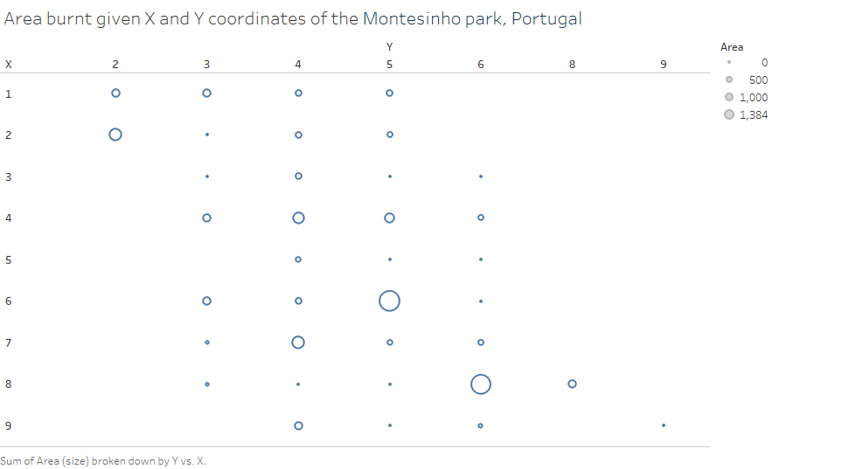
Where was the most area burnt ?

Slide 26
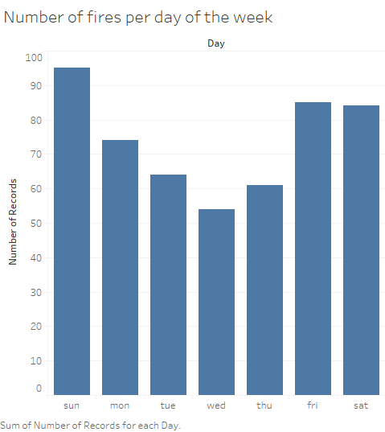
Day of the week distribution of the fires

