Slide 1
Assignment 4

Slide 2
Data
The data was taken from the PubMed website.
The data contains information of the latest 20 papers on panic attacks.

Slide 3
XPath 1
Get all articles of the Medline citation having PMID 30791805
XPath :
/PubmedArticleSet/PubmedArticle/MedlineCitation/Article/Journal/Title[/PubmedArticleSet/PubmedArticle/MedlineCitation/PMID=30791805]
Result on next slide.

Slide 4
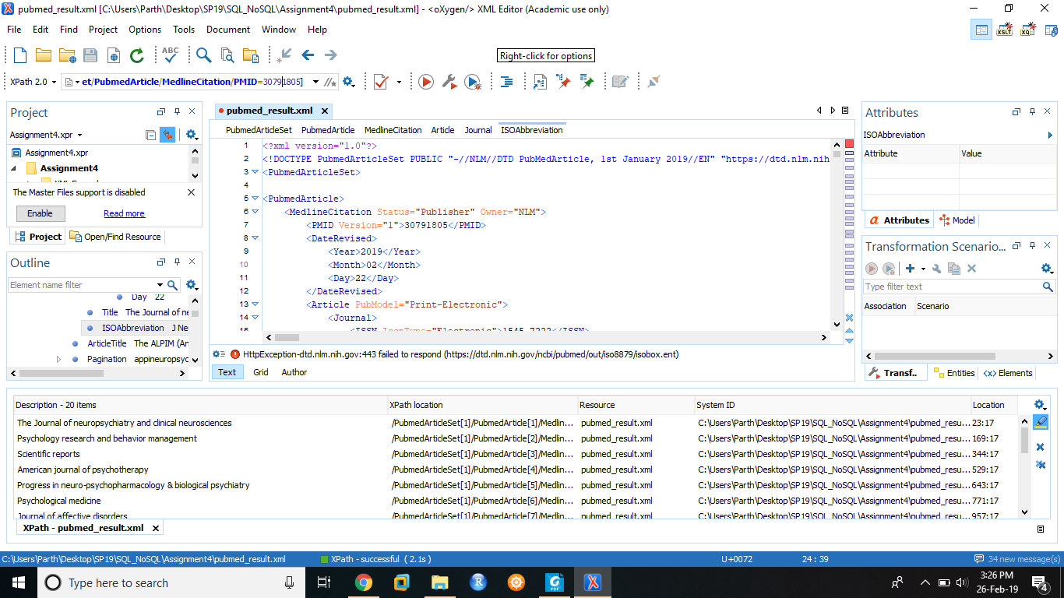

Slide 5
XPath 2
Get all the titles of articles whose PubMode is "Electronic-eCollection".
X Path:
//Article[@PubModel="Electronic-eCollection"]/ArticleTitle
Results on next slide.

Slide 6
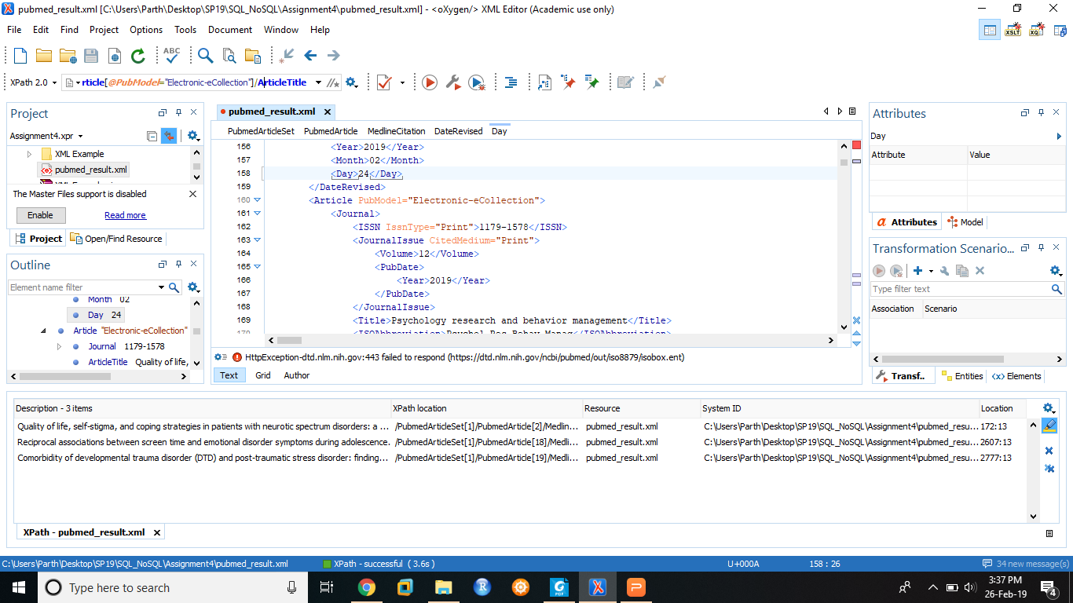

Slide 7
XPath 3
Get the first names of all authors of the third article.
XPath:
/PubmedArticleSet/PubmedArticle[3]/MedlineCitation/Article/AuthorList/Author/ForeName

Slide 8
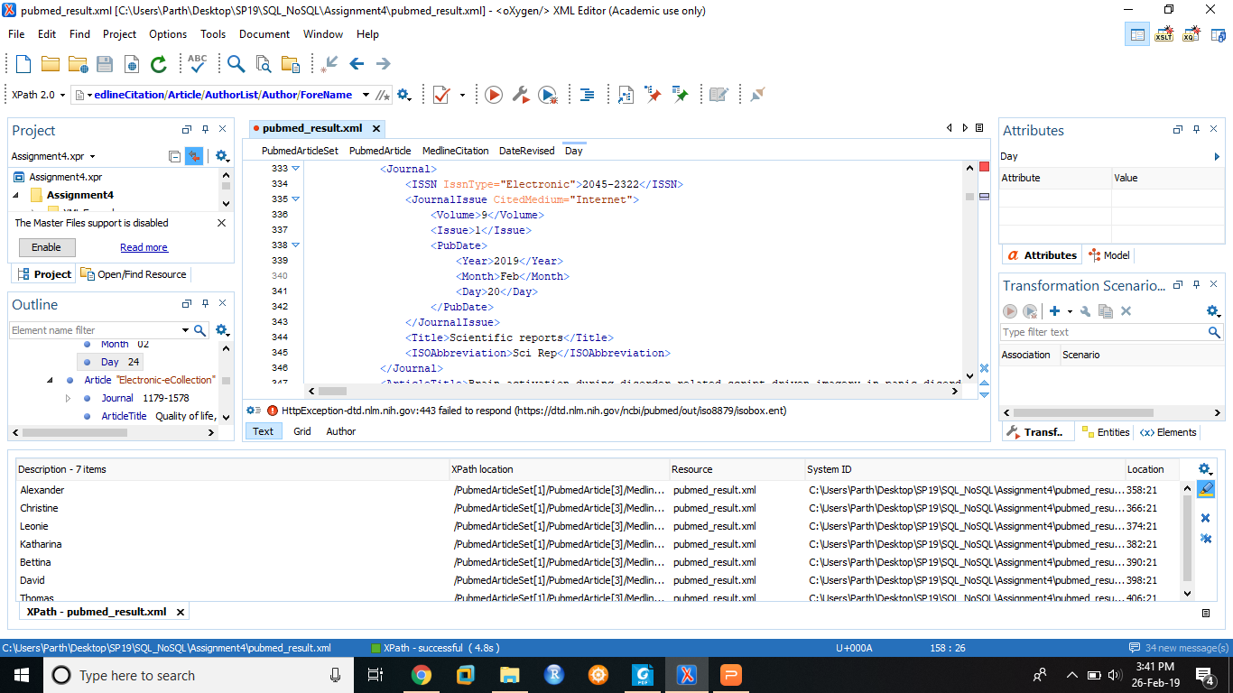

Slide 9
XPath 4
Get the number of PubmedArticles having MedlineCitation status as "In-Data-Review"
XPath:
count(//MedlineCitation[@Status="In-Data-Review"])

Slide 10
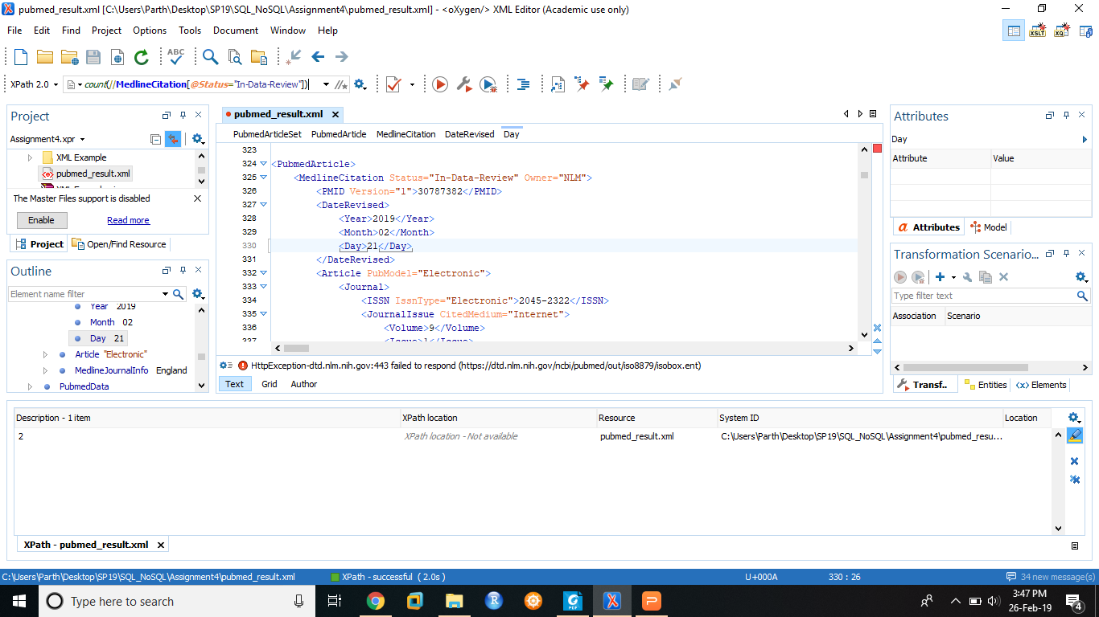

Slide 11
XPath 5
Get the conclusion text of PubMed article having PMID = “30765288”
XPath:
/PubmedArticleSet/PubmedArticle/MedlineCitation[//PMID="30765288"]/Article/Abstract/AbstractText[@Label="CONCLUSION"]

Slide 12
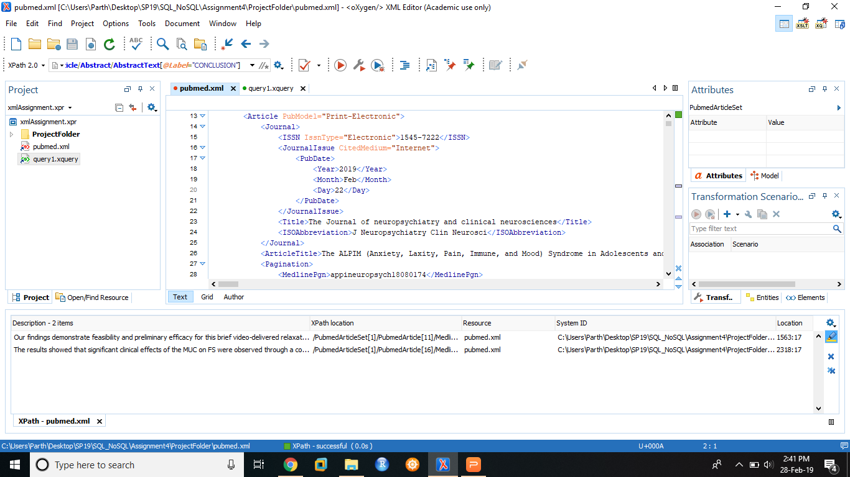

Slide 13
XQuery 1
Get the title of articles having PMID 30791805
XQuery:
<ul type="square">{
for $citation in
doc("pubmed.xml")//MedlineCitation
where $citation/PMID = '30791805'
return <li>{data($citation//Title)}</li>
}</ul>

Slide 14
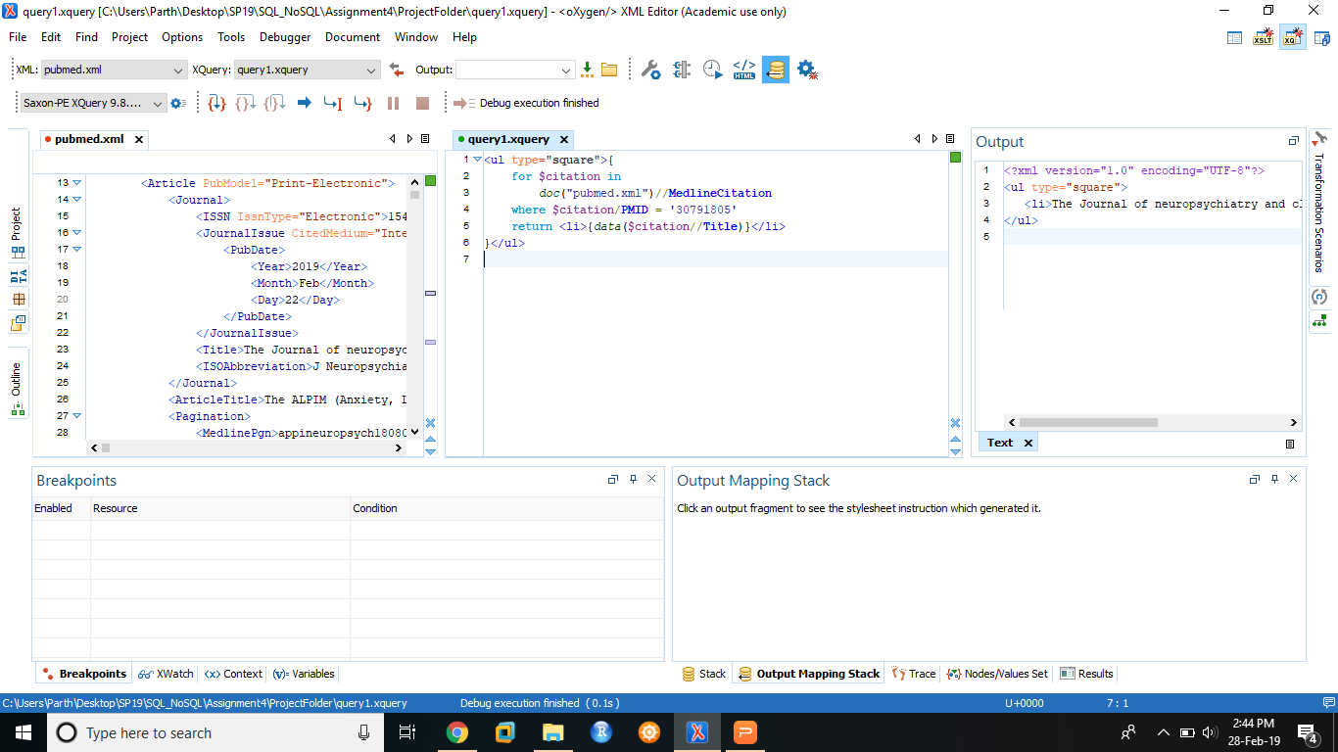

Slide 15
XQuery 2
Get all the distinct ISSNs
XQuery:
<ul>{
for $print_types in
distinct-values(doc("pubmed.xml")//ISSN)
return <li>{data($print_types)}</li>
}</ul>

Slide 16
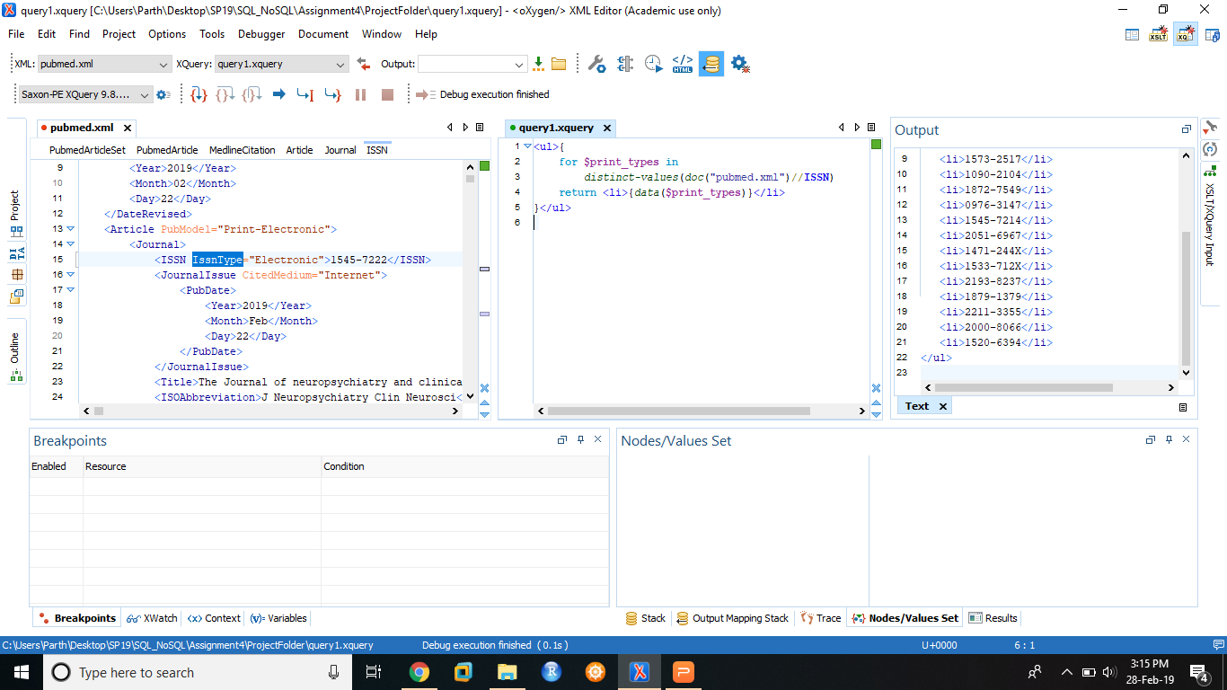

Slide 17
XQuery 3
Get the title of all Medline Citations whose status is “In-Data-Review”
XQuery:
<ul>{
for $document in
doc("pubmed.xml")//MedlineCitation
where $document/@Status = "In-Data-Review"
return <li>{data($document//Title)}</li>
}</ul>

Slide 18
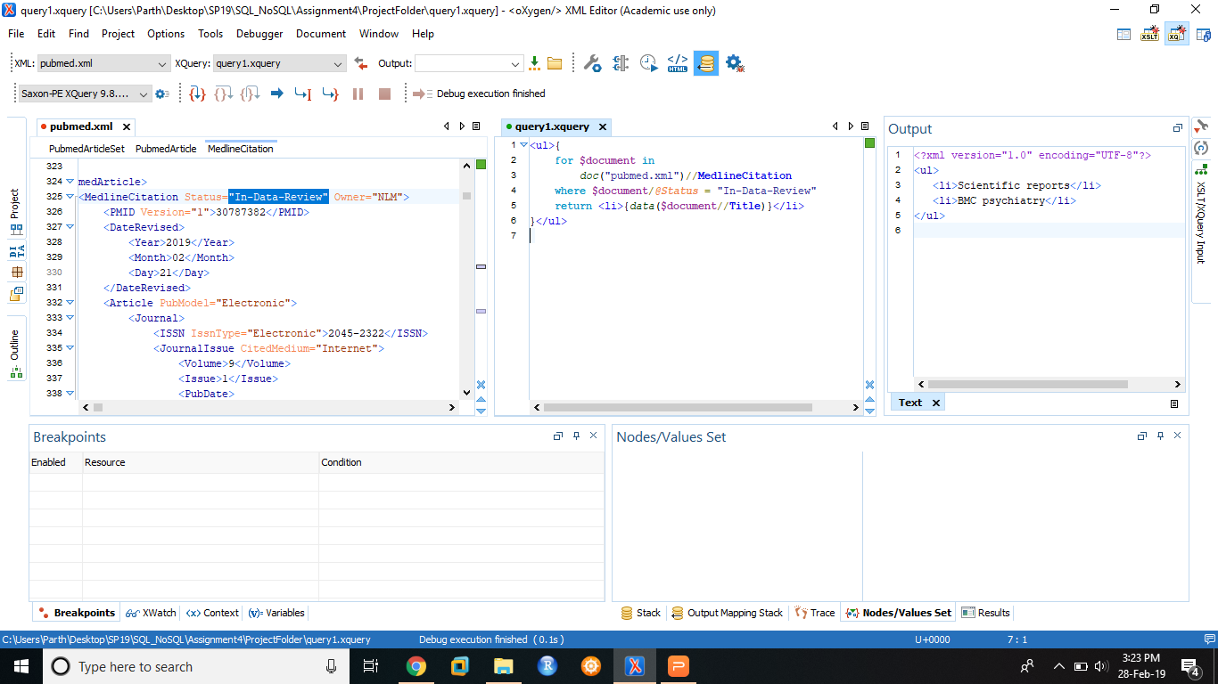

Slide 19
XQuery 4
Get PMIDs in descending order
XQuery:
<ul>{
for $x in
doc("pubmed.xml")//PMID
order by $x
return <li>{data($x)}</li>
}</ul>

Slide 20
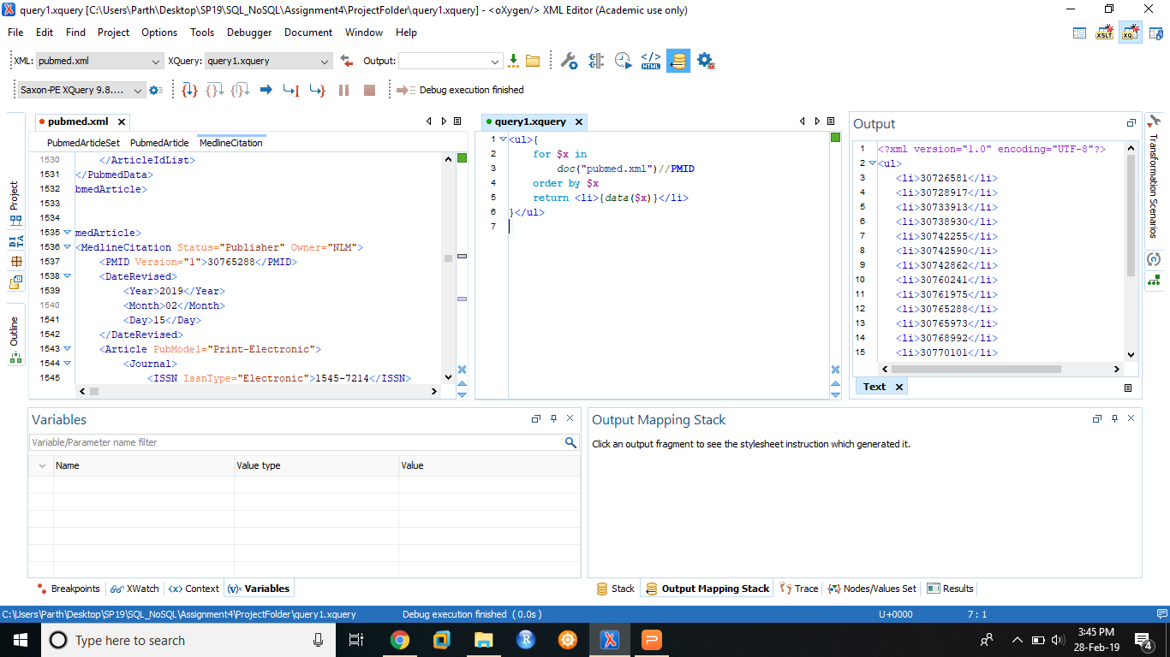

Slide 21
XQuery 5
Get the names of all authors starting from the letter 'P'
XQuery:
<ul type="square">{
for $first_name in
doc("pubmed.xml")//ForeName
where matches($first_name,'^P')
return <li>{data($first_name)}</li>
}</ul>

Slide 22
