Slide 1
Assignment 5
Fraud Detection using Neo4J
Parth Naik

Slide 2
Overview
Load the transaction data of customers to Neo4J as a graph.
The data consists of customers and merchants as the graph nodes.
The transactions are the relationships between these nodes.
A transaction is either Undisputed or Disputed representing genuine and fraudulent transactions.
Reference - https://neo4j.com/graphgist/credit-card-fraud-detection

Slide 3
Generating the data
The graph is generated using a query consisting of CREATE commands given at the reference.
Part of the query(The entire query is very large) :
# Create customer nodes
CREATE (Paul:Person {id:'1', name:'Paul', gender:'man', age:'50'}) CREATE (Jean:Person {id:'2', name:'Jean', gender:'man', age:'48’})
# Create merchant nodes
CREATE (Amazon:Merchant {id:'11', name:'Amazon', street:'2626 Wilkinson Court', address:'San Bernardino, CA 92410'}) CREATE (Abercrombie:Merchant {id:'12', name:'Abercrombie', street:'4355 Walnut Street', age:'San Bernardino, CA 92410’})
# Create transactions
CREATE (Paul)-[:HAS_BOUGHT_AT {amount:'986', time:'4/17/2014', status:'Undisputed'}]->(Just_Brew_It) CREATE (Paul)-[:HAS_BOUGHT_AT {amount:'239', time:'5/15/2014', status:'Undisputed'}]->(Starbucks)

Slide 4
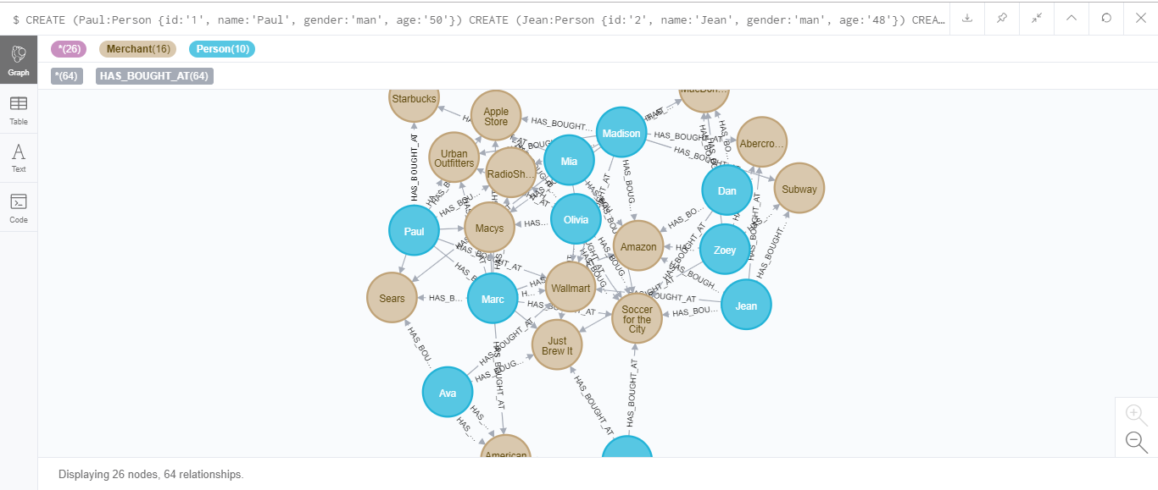
How the graph looks..

Slide 5
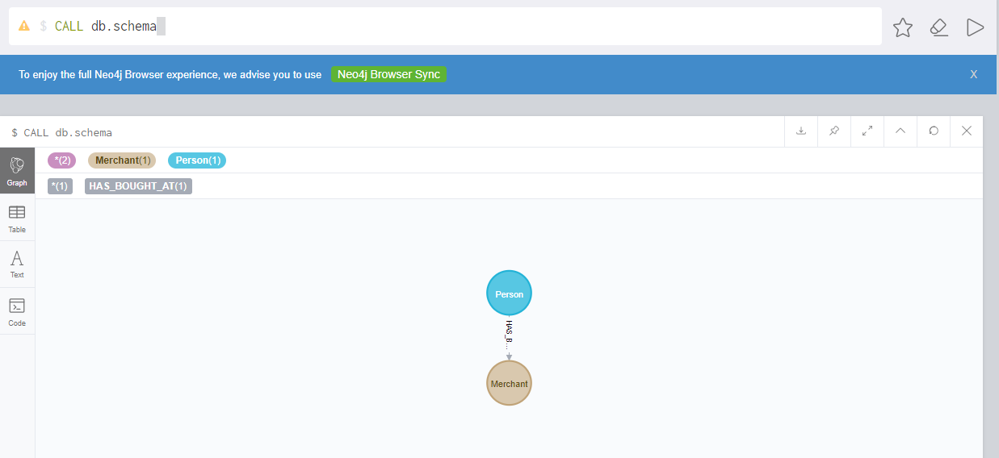
Query 1
Get the basic structure of the graph database.

Slide 6
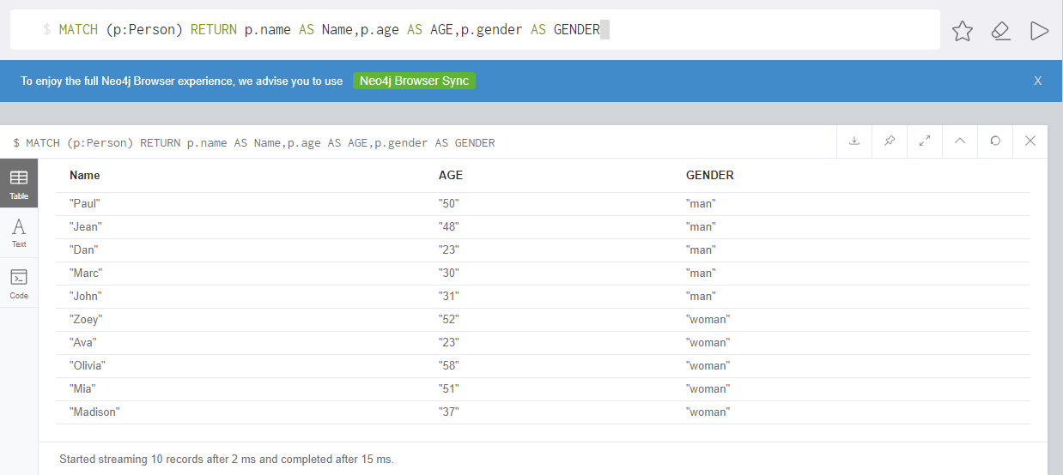
Query 2
Get all the customers and their properties

Slide 7
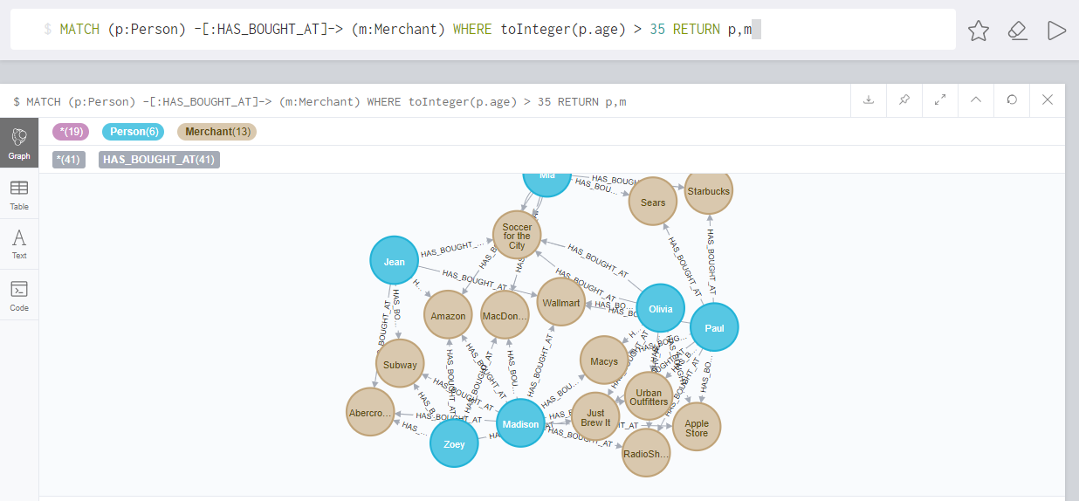
Query 3
Get the graph of transactions of customers above 35 years of age.

Slide 8
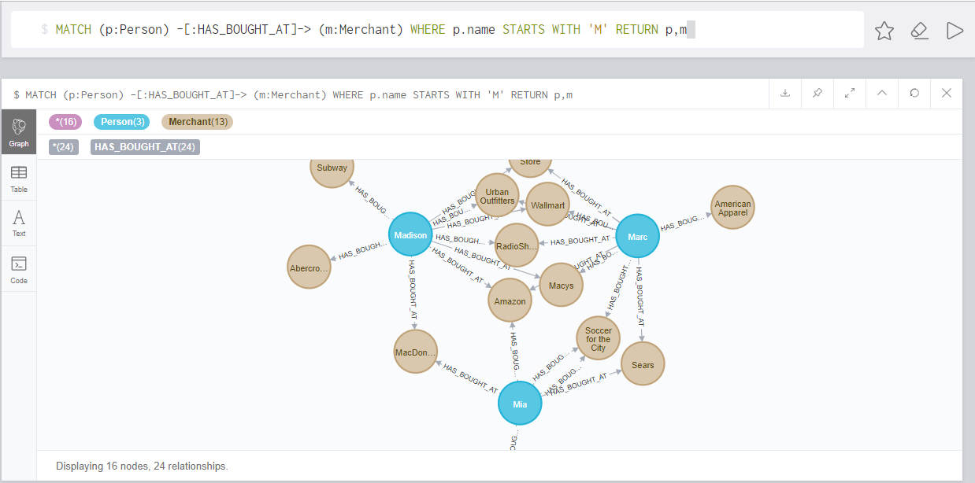
Query 4
Get the transactions of customers whose name starts with ‘M’.

Slide 9
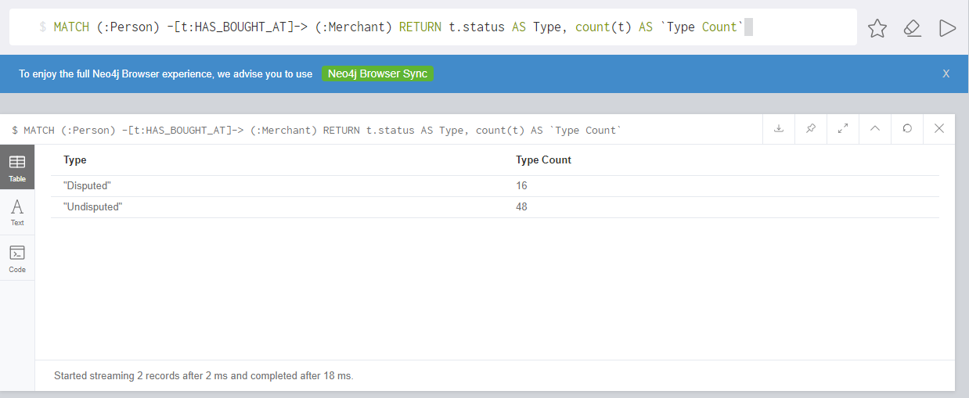
Query 5
Get the number of legitimate and fraudulent transactions.

Slide 10
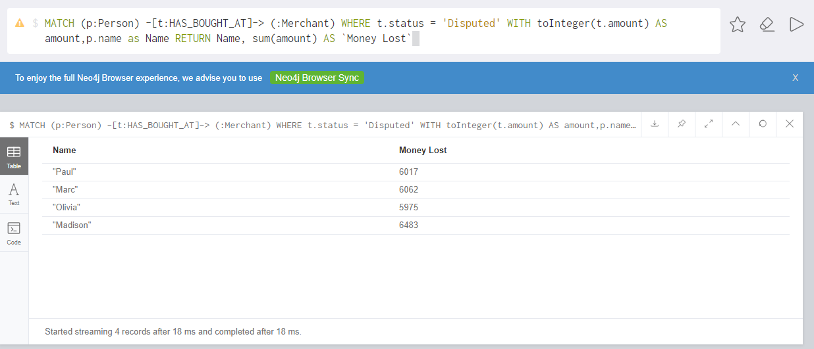
Query 6
Get the total amount the merchants lost due to fraudulent transactions.

Slide 11
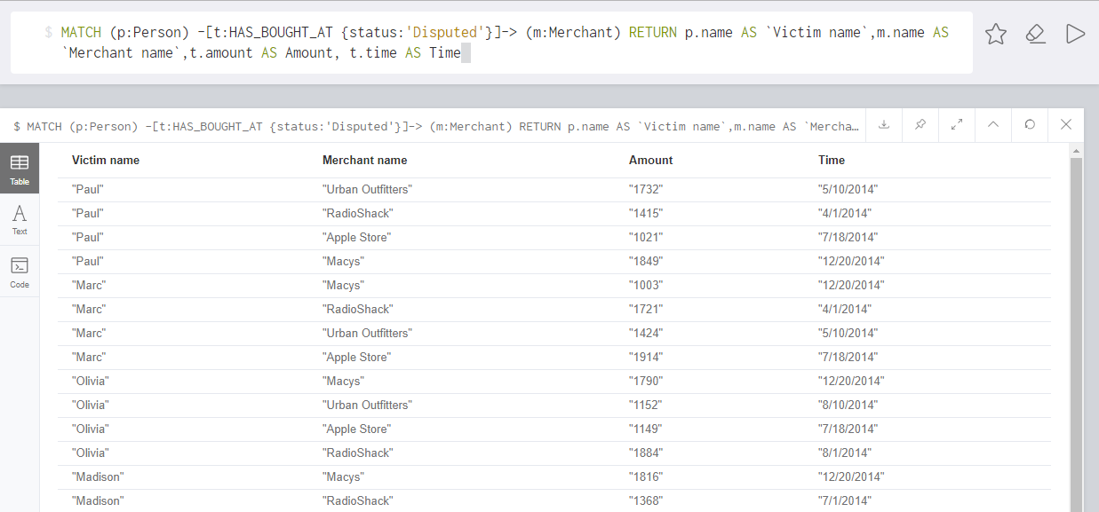
Query 7
Get information of the fraudulent transactions.

Slide 12
Query 8
Identify the point of the fraud
Get the legitimate transactions before the frauds started to take place.
This is because at an earlier legitimate transaction the victim was unknowingly robbed of his/her credit card information.
These past legitimate transactions can possibly give us an idea at which merchant the potential

Slide 13
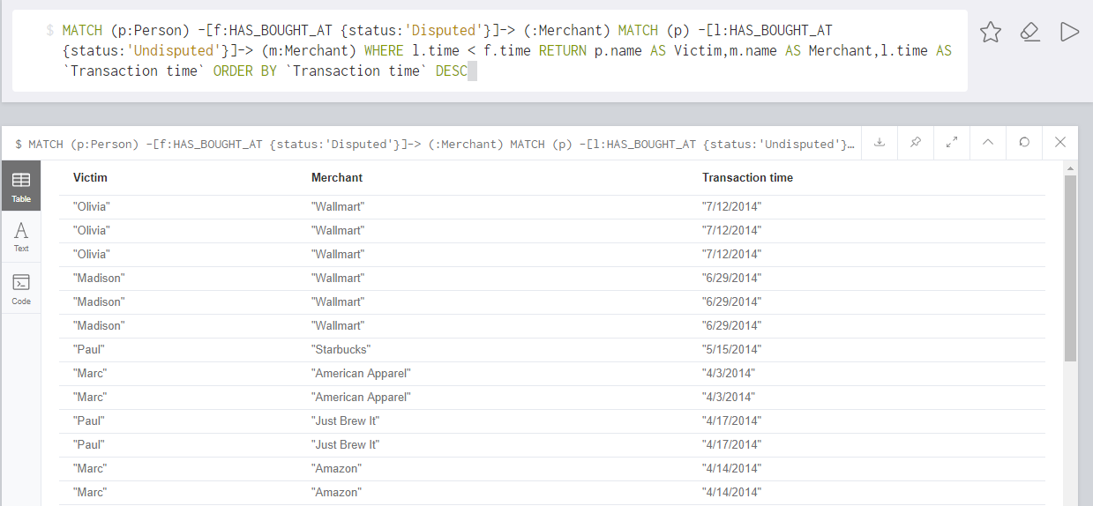

Slide 14
Query 9
Zero in on the store at which the criminal is operating
From the previous query we got a list of all previous transactions the victims did before the fraudulent transactions started.
We count the common stores in these transactions.

Slide 15
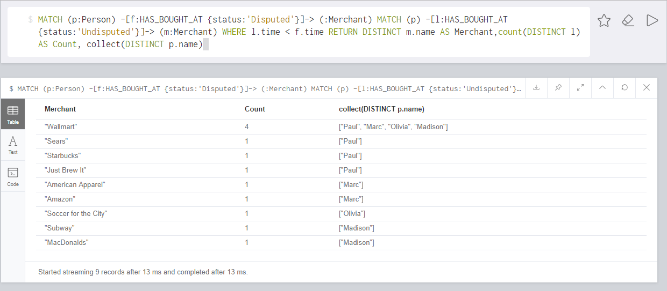

Slide 16
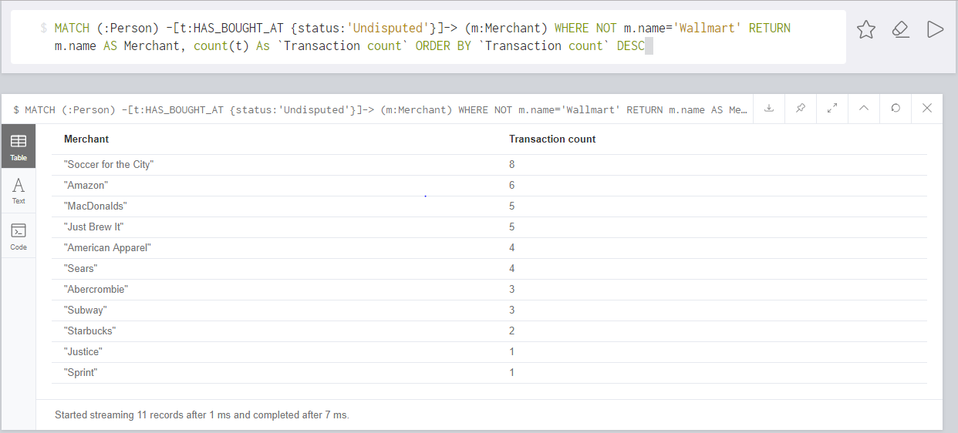
Query 10
The most popular stores apart from our the store from where the criminal is operating.

Slide 17
THANKS

