Slide 1

SMART INDIA HACKATHON 2026
TITLE PAGE
Problem Statement ID – SIH26097
Problem Statement Title - AI-Driven voice Assistant for livelihood Mapping and NSQF-Aligned Skilling Recommendations for SC Communities under GIA component of PM-AJAY
Theme - Agriculture, Food Tech & Rural Development
PS Category - Software
Team ID -
Team Name - Silicon Alley

Slide 2
PM-AJAY Voice Livelihood Helpline
Silicon Alley
Proposed Solution: Working phone-call prototype for PM-AJAY GIA counselling.
Detailed explanation of the proposed solution
Beneficiary taps Call and speaks.
Gemini Live interviews in their language/dialect.
Collects education, family occupation, current work, skills, constraints, wage vs self-employment, district etc.
Recommends 2-3 nearby NSQF courses, jobs, or GIA/NSFDC pathways and saves a counselling record.
How it addresses the problem Form-based GIA intake fails low-literacy SC users; mismatched trades, dropouts, poor placement. Voice interview + district catalog matches aspirations to local NSQF training and livelihood demand.
Innovation and uniqueness of the solution
Native voice-to-voice;
no language picker;
replies in the same dialect, respectfully.
Agent tools search NQR, NCS, NSFDC, SIDH, PM-AJAY catalogs during the call.
Officer desk turns each call into a structured GIA counselling file.

Slide 3
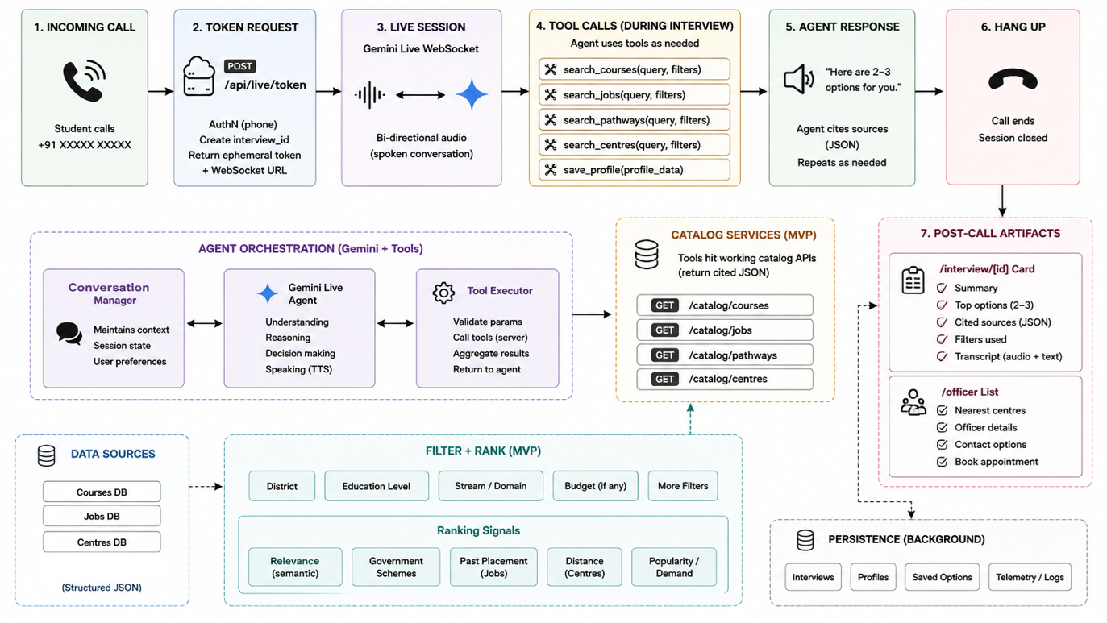
TECHNICAL APPROACH
Silicon Alley
Technologies used
Next.js 16, React 19, TypeScript, Tailwind 4, bun.
Google Gemini Live (gemini-3.1-flash-live-preview) via @google/genai.
Browser mic 16 kHz PCM; speaker 24 kHz.
API key stays on server (ephemeral token).
Hardware now: smartphone / kiosk browser.
Future: IVR feature phone, WhatsApp voice notes.

Slide 4
FEASIBILITY AND VIABILITY
Silicon Alley
Analysis of the feasibility of the idea
Multilingual live voice is Gemini; we did not train a model.
Catalog is official public lists (NQR/NCS/NSFDC/PM-AJAY).
Working prototype with 90% of required functionality.
Fits hackathon resources: one web app, one API key, no new hardware.
Potential challenges and risks
NCS, SIDH, PM-AJAY have no public developer APIs.
Live call needs connectivity and a Gemini key.
Catalog must stay current; must not collect Aadhaar / caste-cert / bank data.
Strategies for overcoming these challenges
Seeded cited catalog now; MoSJE/SIDH DPI APIs when available.
Browser/kiosk for SIH; same script on IVR with a telecom partner.
Privacy rules in the system prompt.
Warn PM-DAKSH vs PM-AJAY double enrolment.

Slide 5
IMPACT AND BENEFITS
Silicon Alley
Potential impact on the target audience
SC beneficiaries under PM-AJAY GIA with low literacy or dialect speech.
District GIA / SC corporation staff who lack ground counselling capacity.
Better matching is the missing step behind GIA's ~70% post-training placement rule.
Benefits of the solution (social, economic, environmental, etc.)
Social: counselling in their language; traditional trades treated as real skills.
Economic: fewer wasted training seats; local wage jobs; NSFDC credit for self-employment.
System: each call becomes structured data for GIA perspective plans.

Slide 6
RESEARCH AND REFERENCES
Silicon Alley
Details / Links of the reference and research work PM-AJAY GIA domains: pmajay.dosje.gov.in/illustrative-list PM-AJAY portal: pmajay.dosje.gov.in NSQF / NQR: nqr.gov.in Kaushalverse: kaushalverse.ncvet.gov.in SIDH: skillindiadigital.gov.in PM-DAKSH: pmdaksh.dosje.gov.in NCS jobs: ncs.gov.in NSFDC: nsfdc.nic.in e-Shram: eshram.gov.in Gemini Live API: ai.google.dev/gemini-api/docs/live PS 26097, MoSJE — Department of Social Justice and Empowerment.

