Slide 1
Welcome to our Presentation
1
Web Programming cse479 Section:01

Slide 2
Topic Name : “A Comparative Study of Laravel and Node.js“.
2
Partho Sarker
ID : 2021 - 3 – 60 – 202
CSE Department East West University
Tonmoy Das
ID : 2022 – 1 – 60 – 004
CSE Department East West University
Tasniya Aziza Tufa
ID : 2022 - 1 – 60 – 163
CSE Department East West University
Zaber Mahmud
ID : 2022 - 3 – 60 – 077
CSE Department East West University
Abrar Bin Habib
ID : 2023 - 3 – 60 – 021
CSE Department East West University
COURSE INSTRUCTOR
Md. Arman Hossain
Lecturer
Department of Computer Science and Engineering , East West University

Slide 3
Table of Contents
3
Introduction
Overview of Laravel
Laravel Architecture (MVC)
Features & Advantages of Laravel
Introduction to Node.js
Features & Advantages of Node.js
Laravel vs Node.js Comparison
Using Laravel and Node.js Together
Applications of Laravel & Node.js
Conclusion

Slide 4
Introduction
4
Web development is the process of creating websites and web applications using different technologies.
Laravel and Node.js are popular backend technologies used for building fast, secure, and scalable applications.
This presentation discusses their features, advantages, differences, and practical uses in modern web development.
These technologies help developers create efficient, dynamic, and user-friendly web applications.
Both Laravel and Node.js are widely used in the software industry for modern web development solutions.

Slide 5
Overview of Laravel
5
Laravel is an open-source PHP web application framework.
It was created by Taylor Otwell in 2011.
Laravel follows the MVC (Model-View-Controller) architecture.
It is used to build secure and scalable web applications.
Laravel provides tools for routing, authentication, and database management.

Slide 6
Laravel Architecture (MVC)
6
Laravel follows the MVC (Model-View-Controller) architecture.
Model: Handles data and database operations.
View: Manages the user interface and displays information.
Controller: Controls user requests and connects Model with View.
MVC makes the application more organized, maintainable, and easier to develop.

Slide 7
Features & Advantages of Laravel
7
MVC Architecture: Provides a clean and organized code structure.
Authentication System: Helps to build secure user login and registration systems.
Eloquent ORM: Makes database operations easier and faster.
Routing System: Provides simple and flexible URL management.
Security Features: Protects applications from common web threats.
Large Community Support: Offers many resources and developer support.

Slide 8
Introduction to Node.js
8
Node.js is an open-source JavaScript runtime environment.
It allows developers to run JavaScript outside the web browser.
Node.js was created by Ryan Dahl in 2009.
It is built on the Google Chrome V8 JavaScript Engine.
Node.js is mainly used for building fast and scalable web applications.
It is popular for developing APIs, real-time applications, and server-side solutions.

Slide 9
Features & Advantages of Node.js
9
Fast Performance: Uses the Chrome V8 JavaScript Engine for high-speed execution.
Non-blocking I/O: Handles multiple requests efficiently without slowing down the system.
NPM (Node Package Manager): Provides thousands of reusable packages and libraries.
Real-time Applications: Supports real-time features like chat apps and live notifications.
Scalability: Can handle large numbers of users and requests.
Single Programming Language: Allows developers to use JavaScript for both frontend and backend.

Slide 10
Laravel vs Node.js Comparison
10
Feature | Laravel | Node.js
Technology | PHP Framework | JavaScript Runtime Environment
Architecture | MVC (Model-View-Controller) | Event-driven Architecture
Performance | Good performance for structured applications. | Very fast for real-time applications.
Database | Uses Eloquent ORM for database management. | Uses MongoDB, MySQL, PostgreSQL etc.
Development Style | Backend development with PHP. | Server-side development with JavaScript.
Best Used For | E-commerce, CMS, Enterprise applications. | Chat apps, APIs, Streaming applications.
Package Manager | Composer. | NPM (Node Package Manager).
Example | Online shopping website, Banking system. | Real-time chat app, Video streaming platform.

Slide 11
Using Laravel and Node.js Together
11
Laravel can be used as the main backend framework for business logic and database management.
Node.js can handle real-time features like chat, notifications, and live updates.
Both technologies can communicate through REST APIs.
Laravel manages user authentication, products, and transactions.
Node.js manages real-time communication and high-speed operations.

Slide 12


Laravel Into Action
12
Laravel routing is clean and readable. One line maps a URL to a controller.
Just adding middleware('auth') protects this route. No extra code needed!
No SQL required. Eloquent makes database queries simple and intuitive

Slide 13


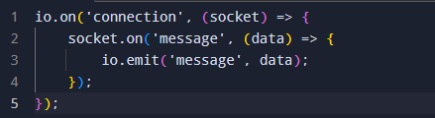

Node js Into Action
13
Environment Variables: Manages configuration securely using .env files
Error Handling: Centralized error handling catches all application errors
Real-Time (Socket.io): Enables real-time bidirectional communication between clients and server
Async Operations: Non-blocking I/O allows multiple database queries to run in parallel.

Slide 14
Applications of Laravel & Node.js
14
Applications of Laravel:
E-commerce Websites – Online shopping platforms and payment systems.
Content Management Systems (CMS) – Blogs, news portals, and websites.
Enterprise Applications – Business management and internal systems.
Banking & Financial Systems – Secure transaction-based applications.
Applications of Node.js:
Real-time Applications – Chat applications and live notifications.
API Development – Building fast and scalable backend APIs.
Streaming Platforms – Video and audio streaming services.
Social Media Applications – Real-time user interaction platforms.

Slide 15
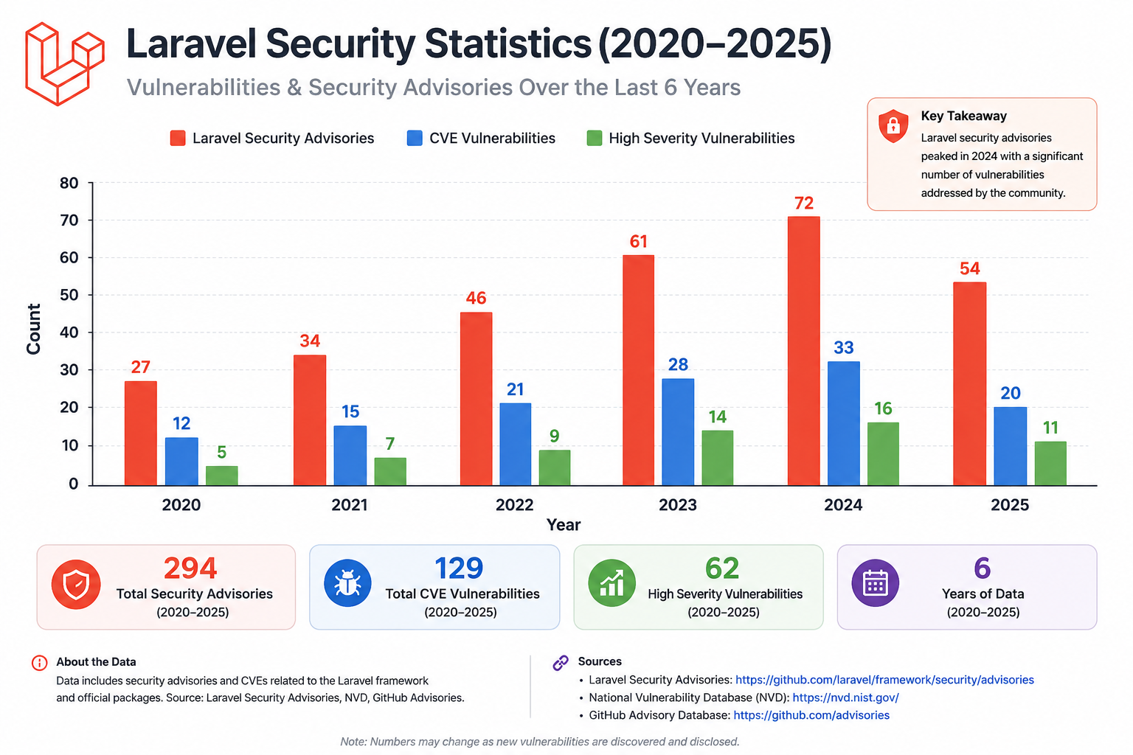
Laravel Security Statistics
15

Slide 16
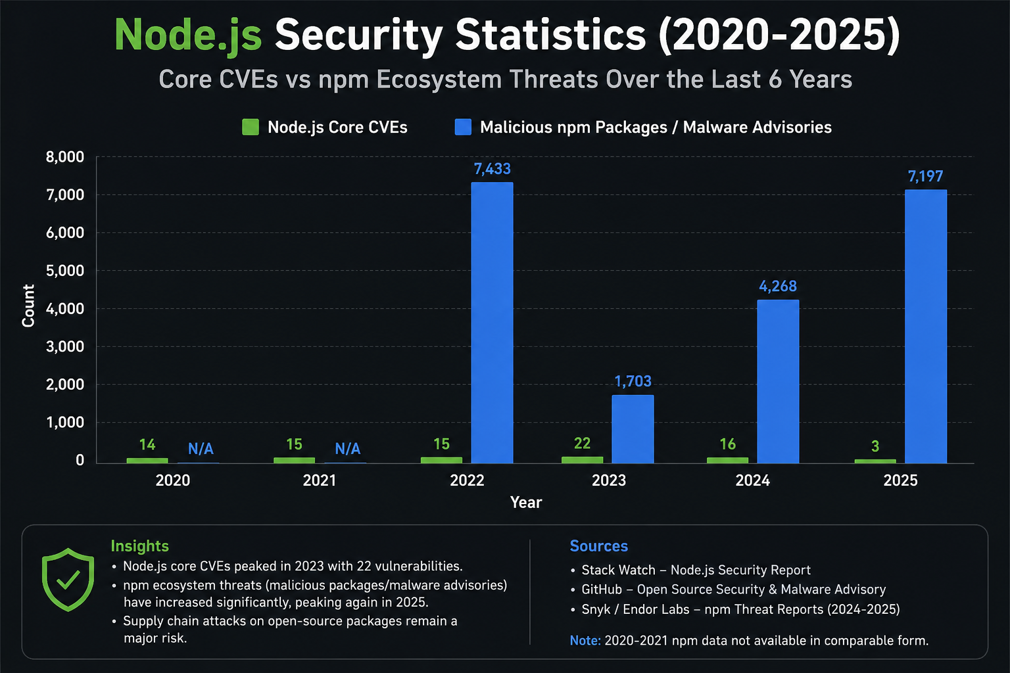
Node JS Security Statistics
16

Slide 17
Conclusion
17
Laravel and Node.js are two powerful technologies used for modern web development.
Laravel provides a secure, structured, and efficient framework for building web applications.
Node.js offers high performance and real-time capabilities for scalable applications.
Both technologies have their own strengths and can be used together to create fast, secure, and powerful solutions.
Understanding these technologies helps developers build modern and user-friendly web applications.

Slide 18
Thank you
18

