Slide 1
Shotgun Data Analysis using MicrobiomeAnalyst
Metabolomics 2019
Jasmine Chong and Jianguo (Jeff) Xia
jasmine.chong@mail.mcgill.ca | www.xialab.ca
McGill University
June 23, 2019

Slide 2
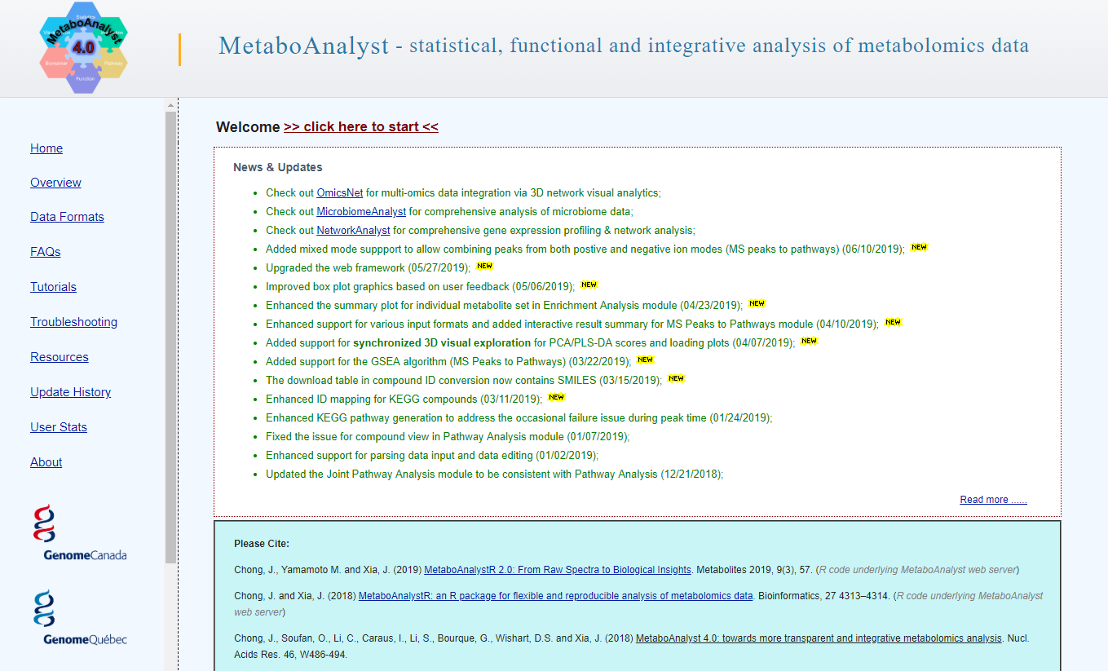
Today’s Tutorial
Use the Shotgun Data Profiling module in MicrobiomeAnalyst to perform statistical and functional analysis on a subset of fecal microbiome samples from colorectal cancer (CRC) patients.
Ultimately a list of the most important features will be used as input for multi-omics integration within MetaboAnalyst.

Slide 3
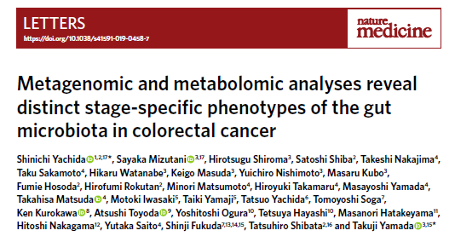
The Data
Subset of samples from a large-scale cohort study of intramucosal carcinoma (Yachida et al. 2019).
Comprehensive metagenomic + metabolomic analysis of fecal samples.
149 healthy and 68 stage 3/4 CRC subjects.
Download the “crc_data_june23.zip” zipped folder from the tutorials page of OmicsNet.

Slide 4
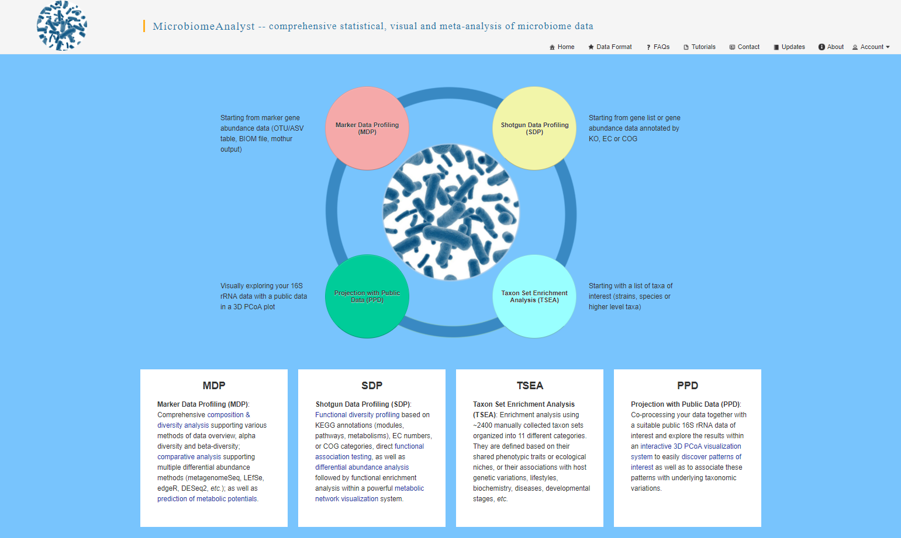
Click here to enter the SDP module

Slide 5
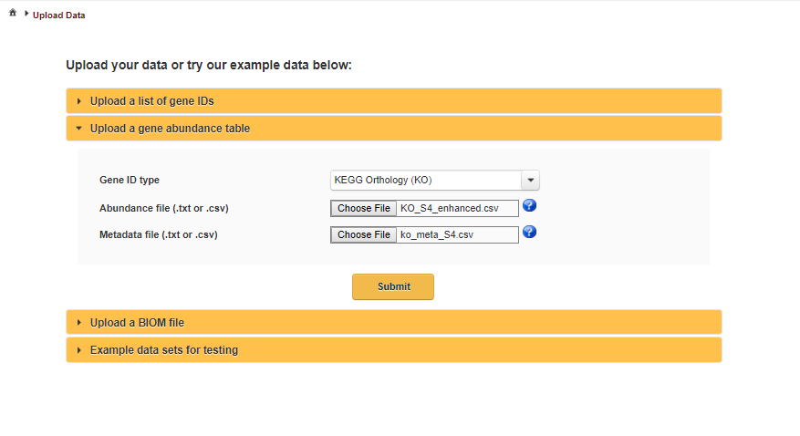
Set the Gene ID type to “KEGG Orthology (KO)”, for the abundance file select the “KO_S4_enhanced.csv” file, and for the metadata file select the “ko_meta_S4.csv” file. Click “Submit” to upload all files.

Slide 6
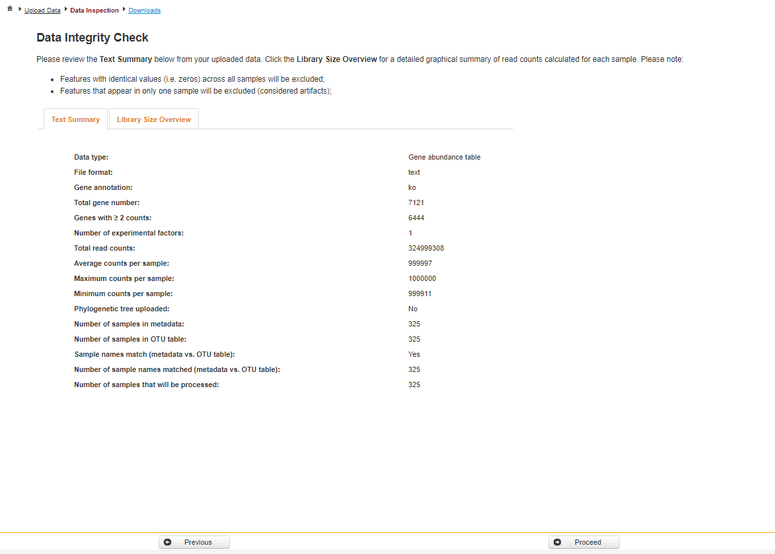
Data Integrity Check. Click “Proceed” to move forward.

Slide 7
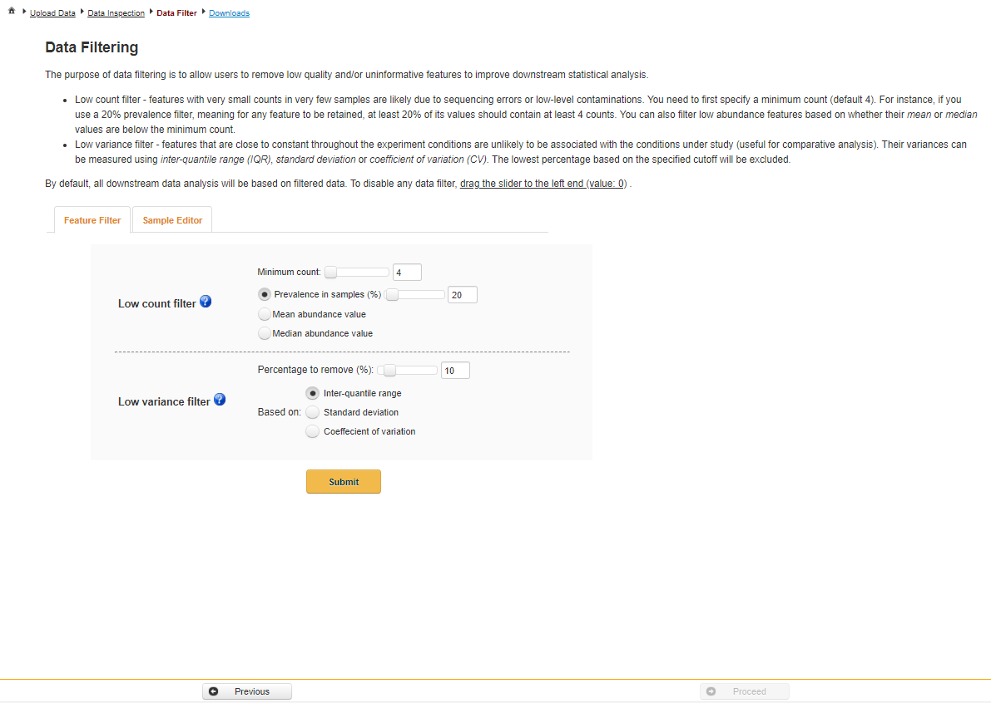
Data filtering page. Keep all parameters set as default and click “Submit”. Next, click “Proceed” to move forward.

Slide 8
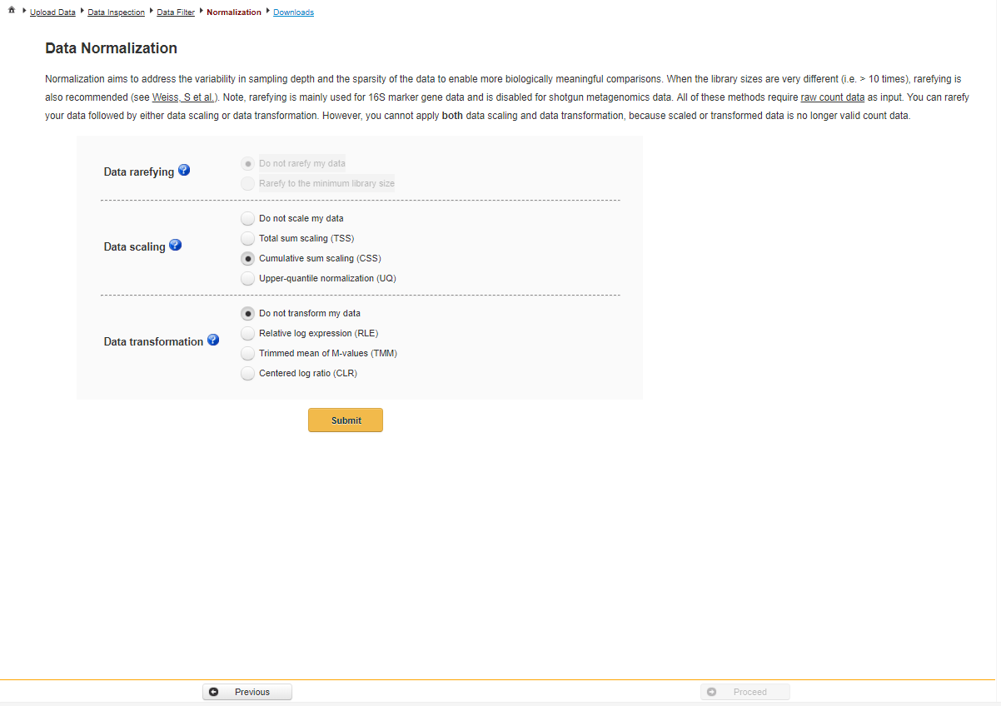
Data Normalization page. The aim of data normalization is to standardize the data to enable accurate comparisons. Keep all parameters set as default and click “Submit”. Click “Proceed” to move forward.

Slide 9
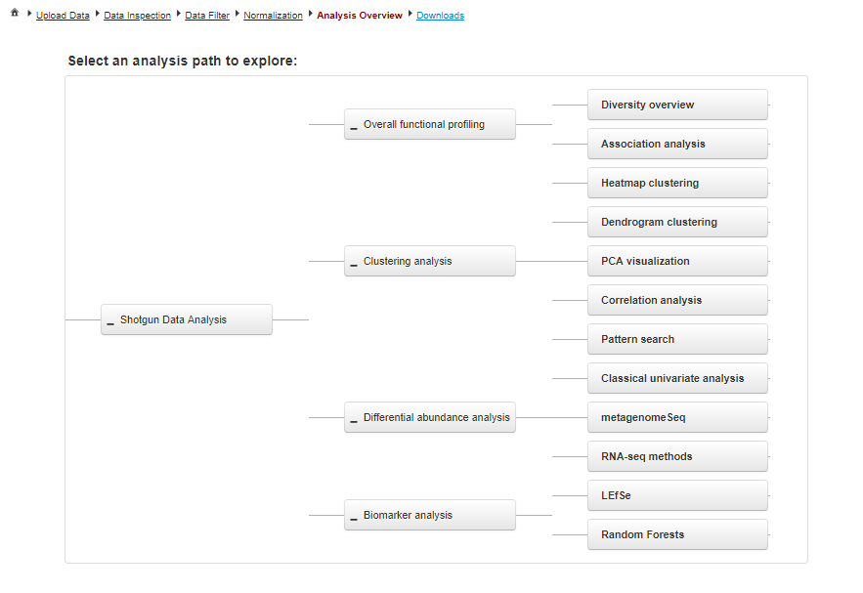
Available analysis options for shotgun metagenomics data. Click “PCA visualization” to first check if there are any patterns within the data.

Slide 10
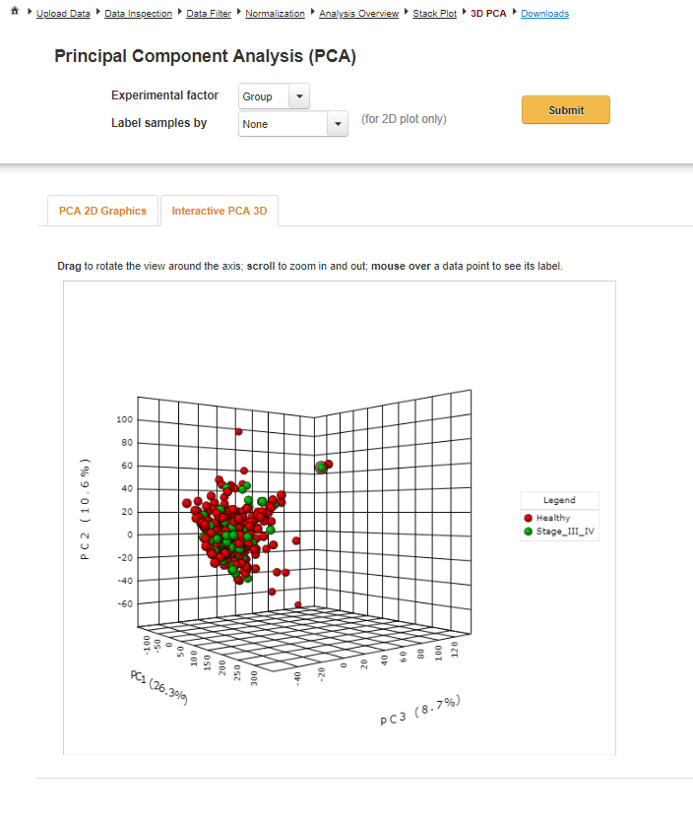
2. Click the Analysis Overview to return to select other analyses.
1. Interactive 3D PCA plot. Use your mouse to rotate the plot and zoom-in and-out. Hover over any sample (circle) to view its label.

Slide 11
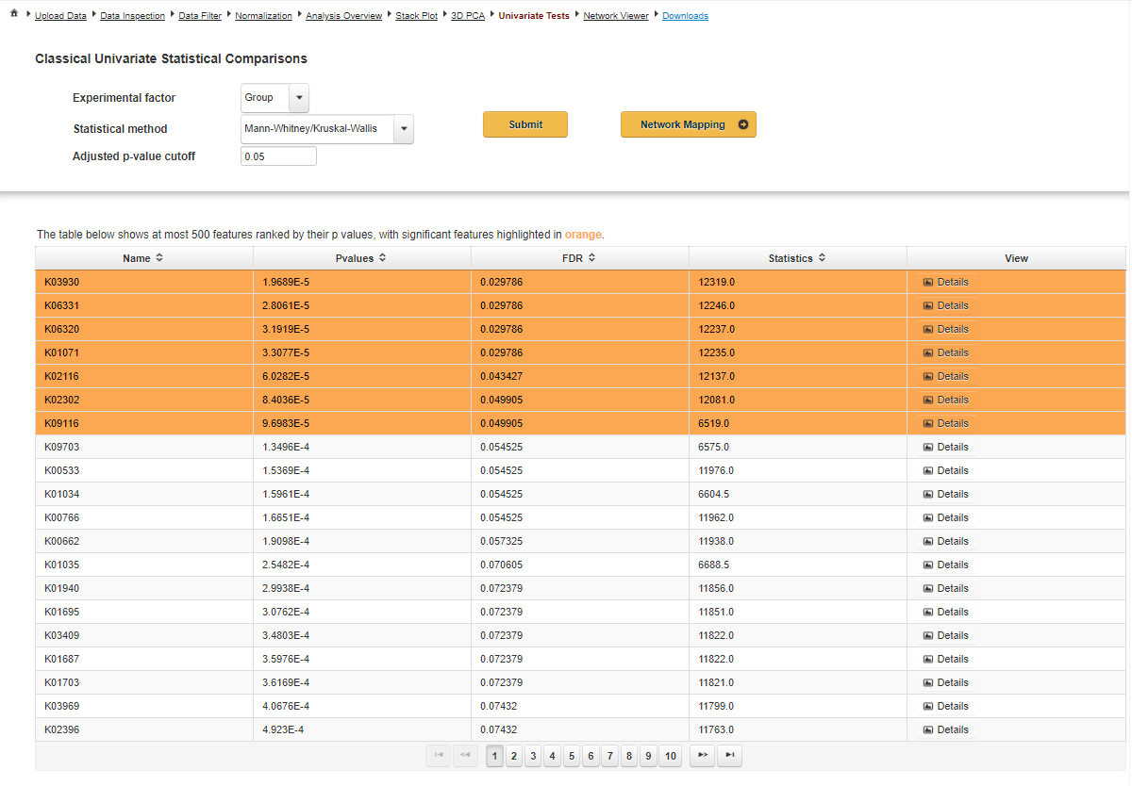
Classical univariate analysis
Using classical univariate analysis (non-parametric Mann-Whitney), only 7 differentially abundant (DA) KOs were identified.

Slide 12
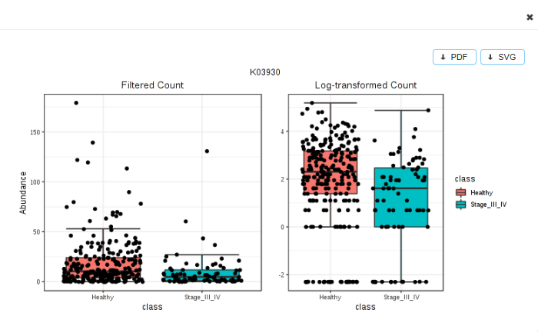
Classical univariate analysis
Click the “Details” link to view a boxplot of the selected KO’s abundance between the CRC patients and healthy controls.

Slide 13
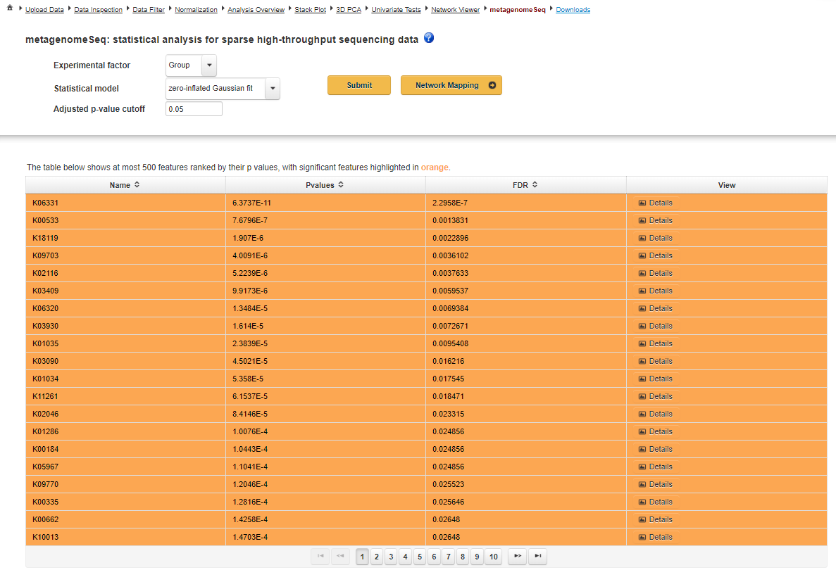
metagenomeseq analysis
Using metagenomeSeq, which was developed for identifying DA features in shotgun data, 37 significant KOs were identified.

Slide 14
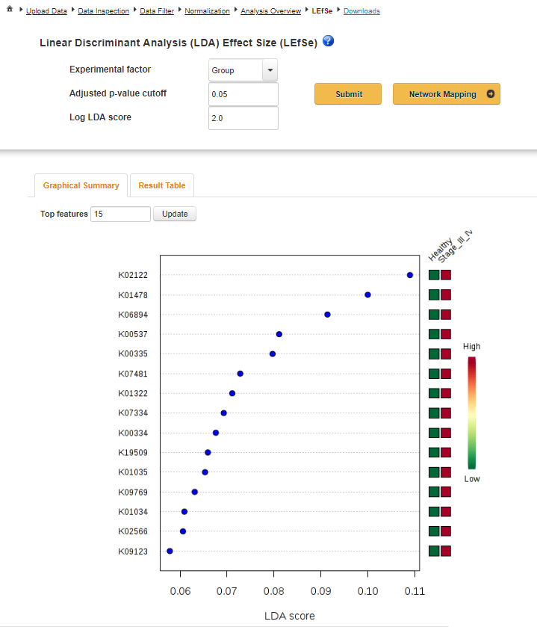
LEfSe
LEfSe is a biomarker discovery method. LEfSe first utilizes the Kruskal-Wallis test to identify features whose relative abundance are significantly different between groups. Linear discriminant analysis (LDA) is then applied to features that meet the significance threshold (i.e. P < 0.05) to estimate their effect size. Using a p-value cutoff of 0.05 and LDA cutoff of 2.0, no features were considered significant.

Slide 15
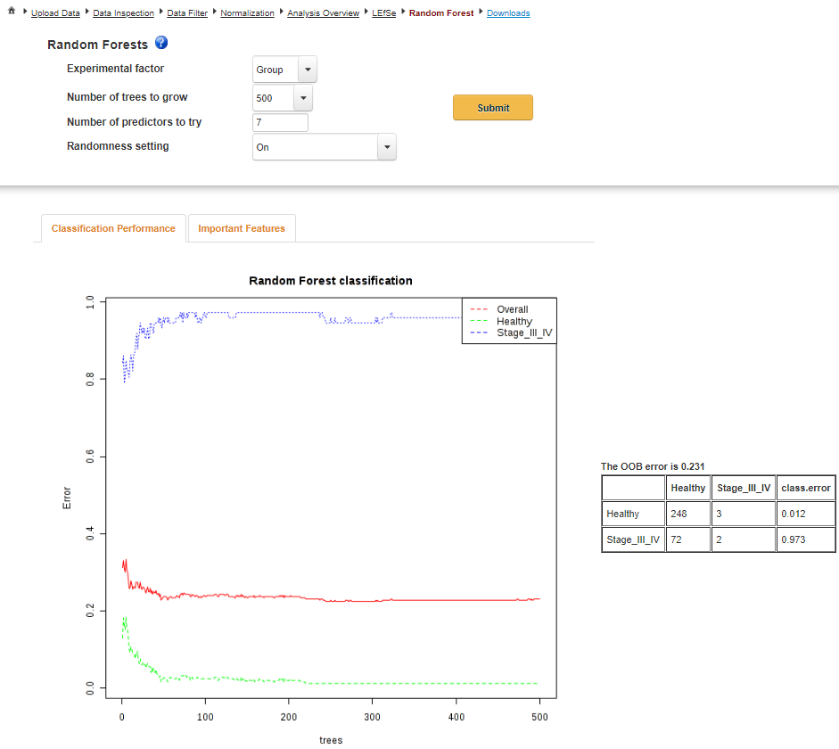
Random forest
Random Forest (RF) is a supervised machine-learning algorithm to identify microbial features that differentiate between phenotypes. The method learns by building and combining decision trees to improve model accuracy and prediction. Change the number of trees built and see if the OOB error changes.

Slide 16
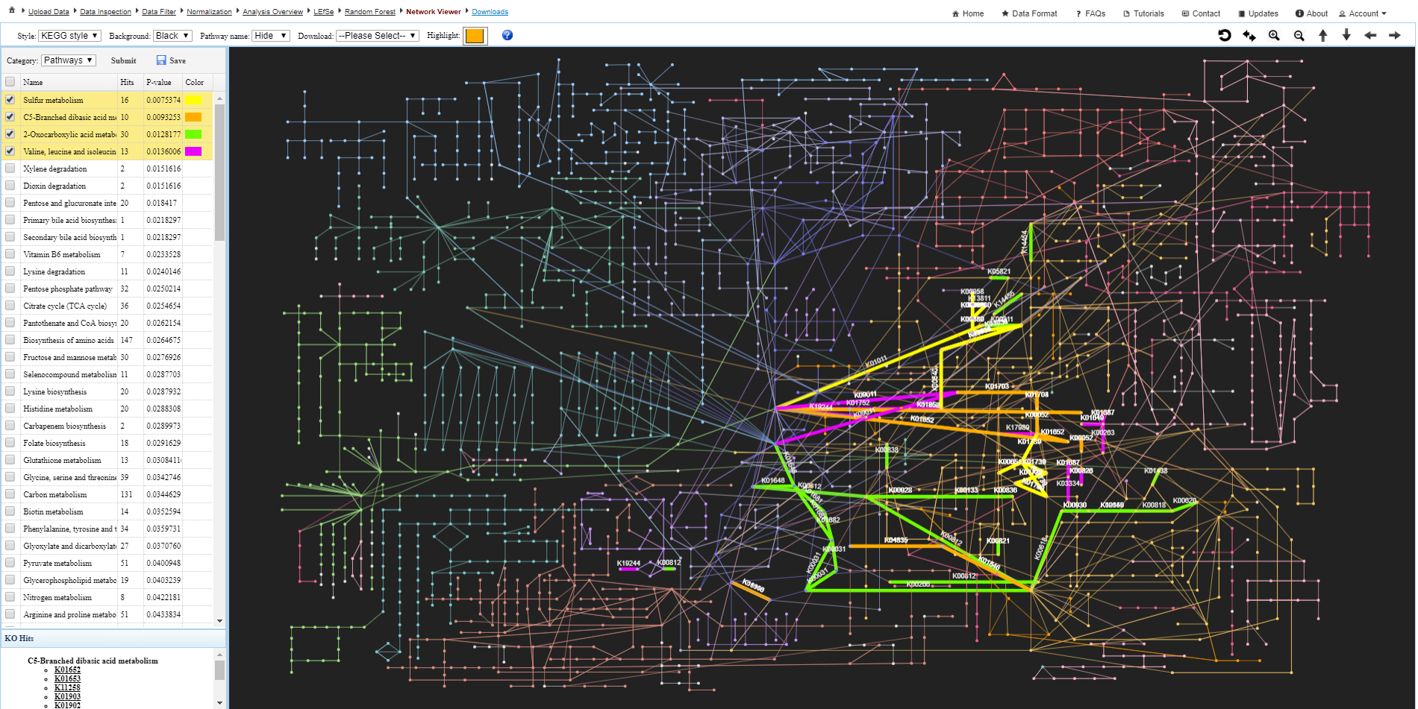
Functional association analysis
Use the top toolbar to customize the network. Click on the colored box to highlight enriched pathways on the KEGG global metabolic network.
The left panel contains the results of KEGG pathway enrichment analysis evaluated using the globaltest algorithm.

Slide 17
Functional association analysis
Click here to download all results generated in the session.
Click here to download the customized network.

Slide 18
Further Exploration
Refer to the FAQs, Tutorials, and Resources page of MicrobiomeAnalyst for more information.
Try out the PPD and TSEA modules to perform meta-analysis by projecting user’s 16S rRNA data with public data, or performing Taxon Set Enrichment Analysis, respectively.
For a detailed step-by-step tutorial, read the “Using MicrobiomeAnalyst for comprehensive statistical, functional and meta-analysis of microbiome data”
Caution! There are 46 pages, covering all four modules within MicrobiomeAnalyst.
https://www.dropbox.com/s/025wp5p1aelc45f/MicrobiomeAnalyst_Nat_Prot_all_in_one.pdf?dl=0

Slide 19
References
Dhariwal A, Chong J, Habib S, King IL, Agellon LB, Xia J. MicrobiomeAnalyst: a web-based tool for comprehensive statistical, visual and meta-analysis of microbiome data. Nucleic acids research. 2017 Jul 3;45(W1):W180-8.
Yachida S, Mizutani S, Shiroma H, Shiba S, Nakajima T, Sakamoto T, Watanabe H, Masuda K, Nishimoto Y, Kubo M, Hosoda F. Metagenomic and metabolomic analyses reveal distinct stage-specific phenotypes of the gut microbiota in colorectal cancer. Nature medicine. 2019 Jun 6:1.

