Slide 1
System Metabolomics Using MetaboAnalyst 4.0
Metabolomics 2019
Jasmine Chong and Jianguo (Jeff) Xia
jasmine.chong@mail.mcgill.ca | www.xialab.ca
McGill University
June 23, 2019

Slide 2
Today’s Workshop
Use the MS Peaks to Pathways module to predict pathway-level activity from a subset of fecal metabolome samples from pediatric Crohn’s Disease (CD) patients.

Slide 3
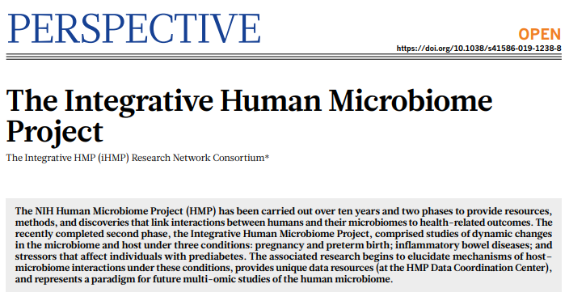
The Data
Subset of samples from a large-scale cohort study of the onset of Inflammatory Bowel Disease (IBD) from the Integrative Human Microbiome Project (https://www.hmpdacc.org/ihmp/) .
Untargeted metabolomics (Q-Exactive Plus Orbitrap MS in negative ion mode) of fecal samples.
24 pediatric CD patients and 24 healthy controls.
Download the “ibd_data_june23.zip” zipped folder from the tutorials page of OmicsNet.

Slide 4
MS Peaks to Pathways
High-resolution LC-MS is the dominant platform for global metabolomics.
Peak annotation requires significant efforts (i.e. compound database and tandem MS experiments) = challenge for functional interpretation.
321.11
Intensity
m/z
LC-MS/MS
Analysis
Data Pre-processing
Feature Selection
Metabolite Identification
Pathway Analysis

Slide 5
MS Peaks to Pathways
SOLUTION: Bypass metabolite identification and directly infer functional activity from MS peaks by leveraging the collective knowledge of metabolic pathways, as implemented in the mummichog algorithm (Li et al. 2013).
This algorithm assumes that if a list of truly significant features reflect biological activity, the representation of these true metabolites would be enriched on functional structures, while false matches would be distributed at random.
vs.
True matches
False matches

Slide 6
MS Peaks to Pathways
The mummichog algorithm also assumes that a certain degree of random errors during individual peak assignment will not change the collective behavior jointly determined by all metabolites involved in the pathways.
This concept has also been adapted to the popular GSEA (Subramanian et al. 2005) algorithm implemented in MS Peaks to Pathways module of MetaboAnalyst 4.0.
321.11
Intensity
m/z
LC-MS/MS
Analysis
Data Pre-processing
Feature Selection
Pathway Analysis

Slide 7
Mummichog vs GSEA
Mummichog
Uses a p-value cutoff = only significant peaks are considered for enrichment.
Based on over representation analysis (ORA).
Tests if pathways are enriched in significant peaks as compared to null models made of randomly permuted peak lists.
If users are confident in their peak assignments, this algorithm would be better suited to gain functional insights from only significantly different peaks.
GSEA
Cutoff free method = all features used.
Originally used to evaluate enriched functions from ranked gene lists.
Considers the overall ranks of features = direction of change is considered (i.e. up or down regulated).
As it considers all features, it is able to detect more subtle and consistent changes, though will also be more sensitive to noise.
Best used when users are less confident about their peaks to gain a global functional overview of their data.

Slide 8
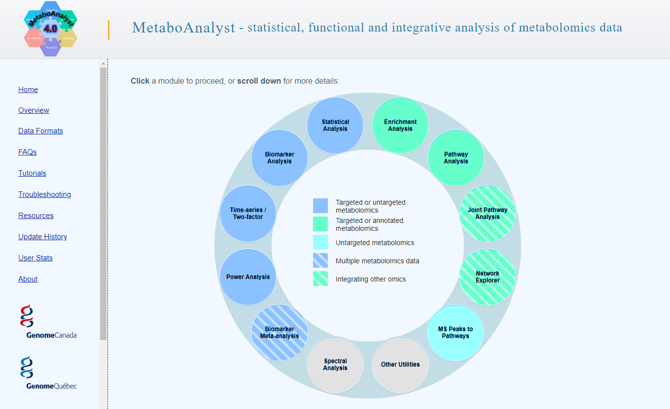
Click this circle to enter the MS Peaks to Pathways module.

Slide 9
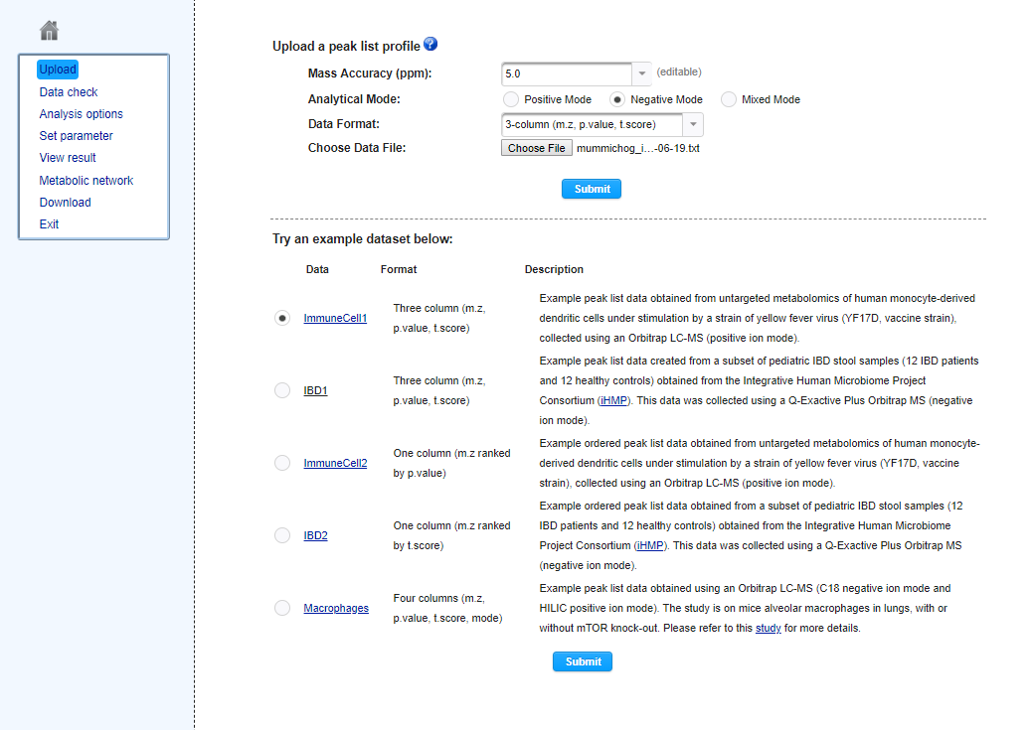
Set the Analytical mode to “Negative”.
Click “Choose File” and select “mummichog_input.txt”.
Click “Submit” to upload the data.
Alternatively, use any example dataset.

Slide 10
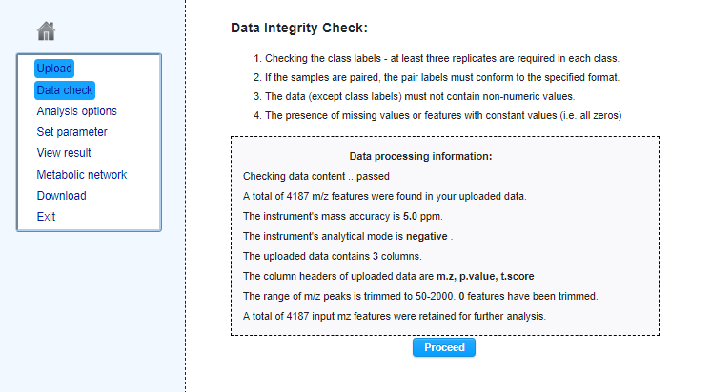
Data Integrity Check evaluates whether the data is suitable for analysis. Click “Proceed” to move forward.

Slide 11
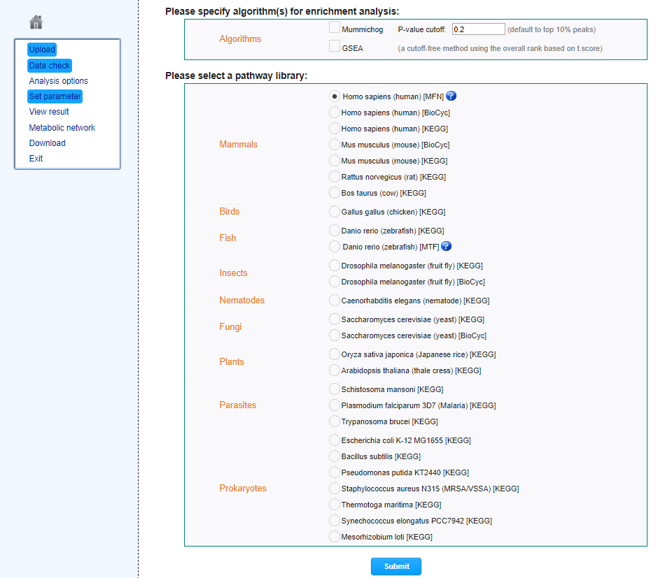

MS Peaks to Paths library. Here users can select which algorithm to use to calculate pathway enrichment (mummichog, GSEA, or their integration) and their desired species-specific pathway library. For the mummichog algorithm, users can either use the “Default cutoff”, which uses the top 10% or top 500 peaks (whichever is smaller) as significant or specify a p-value cutoff. Select the mummichog algorithm and keep the default p-value cutoff. Keep the pathway library selection to “Homo sapiens [MFN]”, which was constructed from the human BiGG and Edinburgh genome-scale metabolic networks, and click “Submit”.

Slide 12
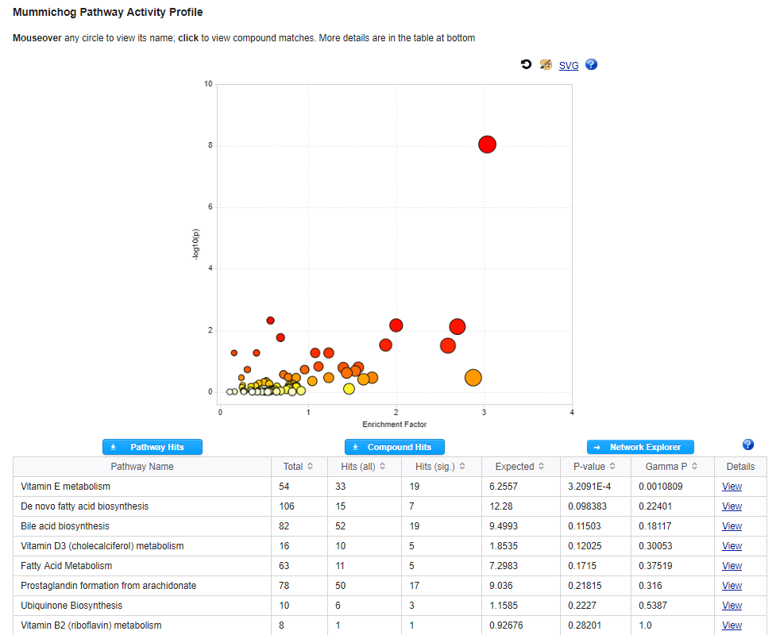
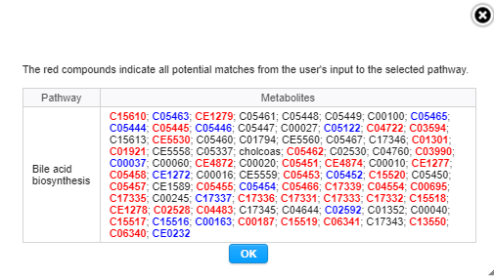
Pathway summary plot that displays all matched pathways as circles. The color and size of each circle corresponds to its p-value and enrichment factor, respectively. The plot is also interactive, hover over any circle to view the pathway label and double-click the circle to view all potential compound hits.

Slide 13
Download results from the “Pathway Hits” button, all matched metabolites from the “Compound Hits” button, and explore the results in the “Network Explorer”.

Slide 14
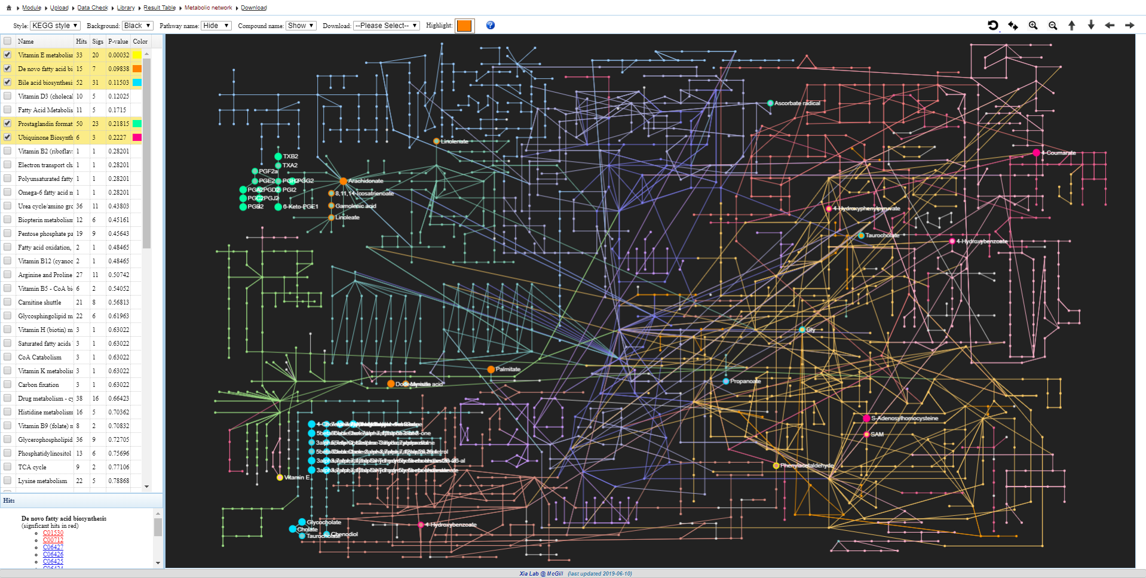
Use the top toolbar to customize the network. Click on the colored box to highlight enriched pathways on the KEGG global metabolic network.
Colored nodes represent putatively-matched compounds. Double-click any node to view its adduct matches.

Slide 15
Return to the Library View and try out the GSEA algorithm, as well as their integration. Also try different human pathway libraries and compare the results.

Slide 16
Session Download
Click the “Download” link and save the entire analysis results.

Slide 17
Further Exploration
Refer to the FAQs, Tutorials, and Resources page of MetaboAnalyst for more information.
For a detailed step-by-step tutorial, read the “Using MetaboAnalyst 4.0 for Comprehensive and Integrative Metabolomics Data Analysis”
Caution! There are 178 pages, containing 12 sections covering all modules within MetaboAnalyst and an introduction to our MetaboAnalystR package.
https://www.dropbox.com/s/vsmcmvsup85h55u/CPBI_MetaboAnalyst_2019.pdf?dl=0

Slide 18
References
Chong J, Soufan O, Li C, Caraus I, Li S, Bourque G, Wishart DS, Xia J. MetaboAnalyst 4.0: towards more transparent and integrative metabolomics analysis. Nucleic acids research. 2018 May 14;46(W1):W486-94.
Li S, Park Y, Duraisingham S, Strobel FH, Khan N, Soltow QA, Jones DP, Pulendran B. Predicting network activity from high throughput metabolomics. PLoS computational biology. 2013 Jul 4;9(7):e1003123.
Subramanian A, Tamayo P, Mootha VK, Mukherjee S, Ebert BL, Gillette MA, Paulovich A, Pomeroy SL, Golub TR, Lander ES, Mesirov JP. Gene set enrichment analysis: a knowledge-based approach for interpreting genome-wide expression profiles. Proceedings of the National Academy of Sciences. 2005 Oct 25;102(43):15545-50.

