Slide 1
Targeted Metabolomics Data Analysis and Integration Using MetaboAnalyst 4.0
Metabolomics 2019
Jasmine Chong and Jianguo (Jeff) Xia
jasmine.chong@mcgill.ca | www.xialab.ca
McGill University
June 23, 2019

Slide 2
Today’s Workshop
Use MetaboAnalyst 4.0 to perform statistical analysis and data integration on a subset of fecal metabolome colorectal cancer (CRC) samples.
First, use the Statistical Analysis Module to identify important metabolic features.
Next, use the Network Explorer Module to integrate metabolomic and metagenomic features.

Slide 3
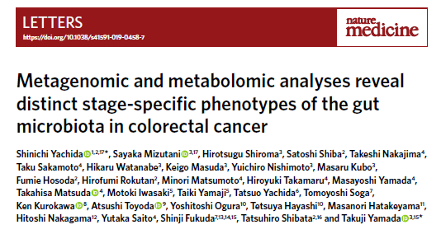
The Data
Subset of samples from a large-scale cohort study of intramucosal carcinoma (Yachida et al. 2019).
Comprehensive metagenomic + metabolomic analysis of fecal samples.
149 healthy and 68 stage 3/4 CRC subjects.
Download the “crc_data.zip” zipped folder from the tutorials page of OmicsNet.

Slide 4
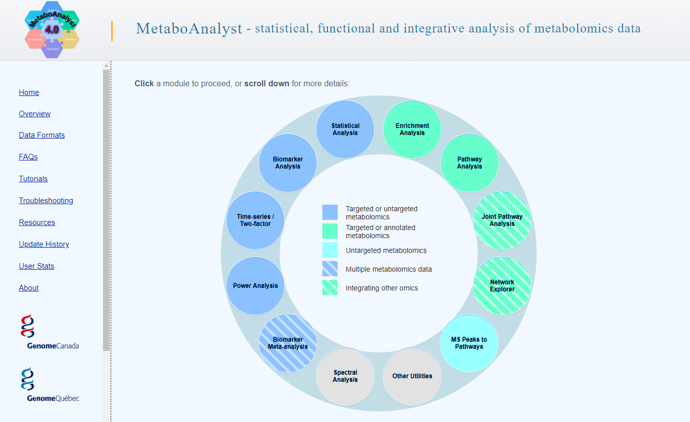
Click this circle to enter the Statistical Analysis module

Slide 5
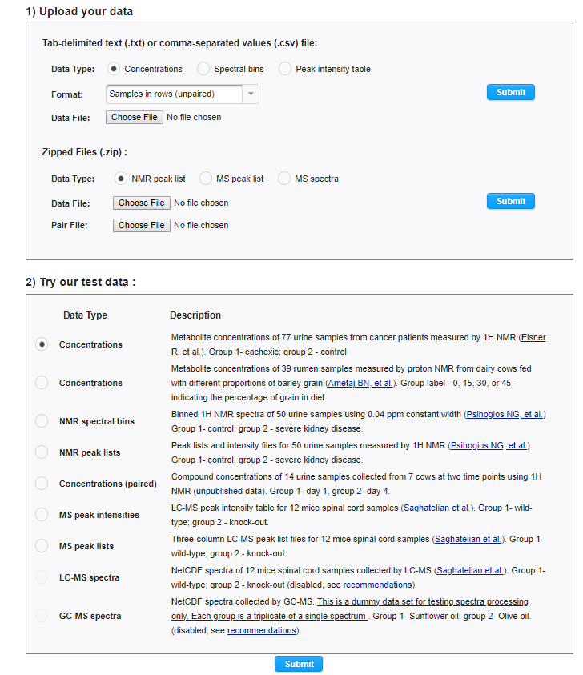
Set the “Format” to “Samples in columns (unpaired)”
Click “Choose File” and select “metabolite_data_S4.csv”.
Click “Submit” to continue.
Alternatively use example data to explore this module.

Slide 6
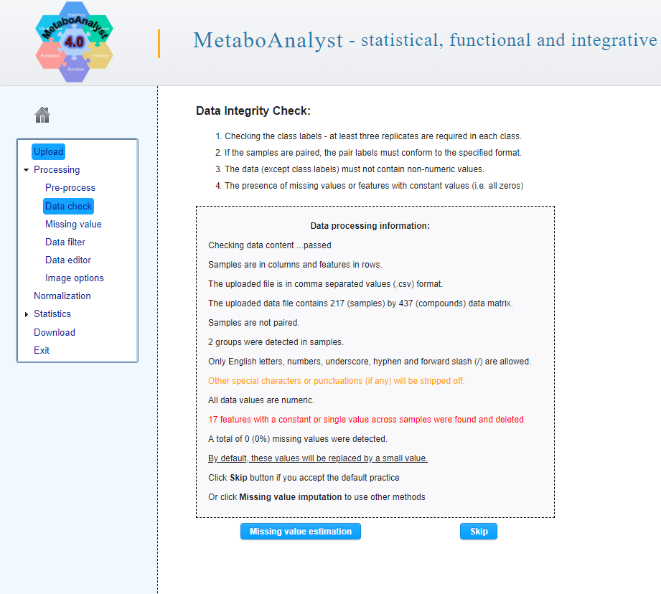
Click “Skip” to move forward.

Slide 7
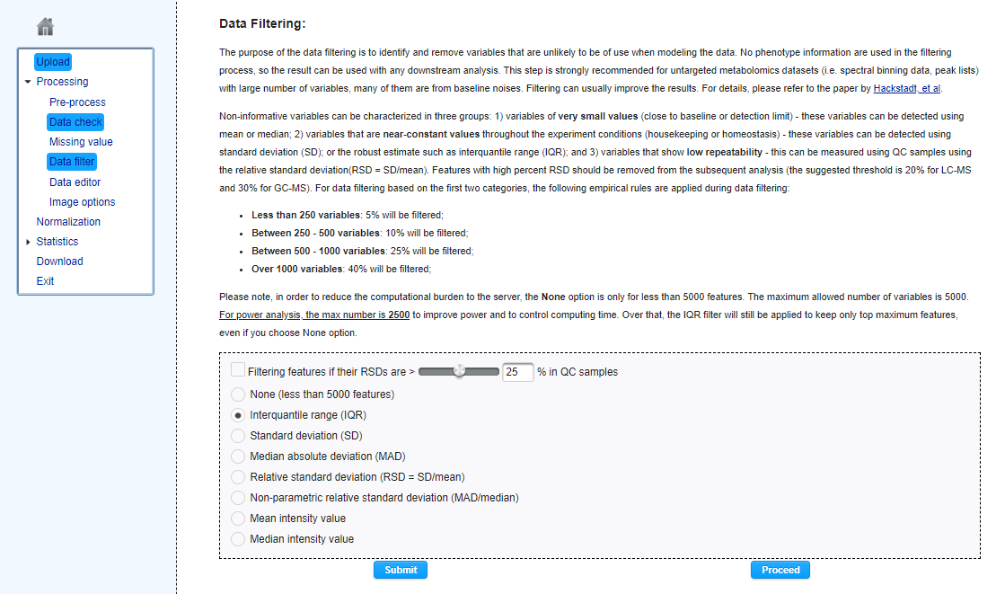
Click “Submit” to perform data filtering.
Click “Proceed” to move forward.

Slide 8
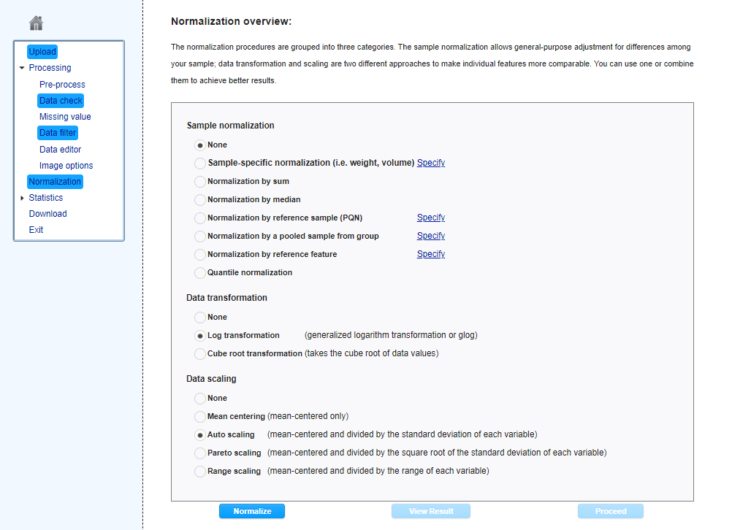
MetaboAnalyst offers three types of normalization: (i) Sample or row-wise normalization to make each sample (row) comparable, (ii) data transformation which transforms values independently, and (iii) data scaling which takes the distribution of features into account.
Set the Data transformation to “Log transformation”, the Data scaling to “Auto scaling”, and click “Normalize”.
Click “View Result” to inspect the results of the normalization.
Click “Proceed” to move to the next page.

Slide 9
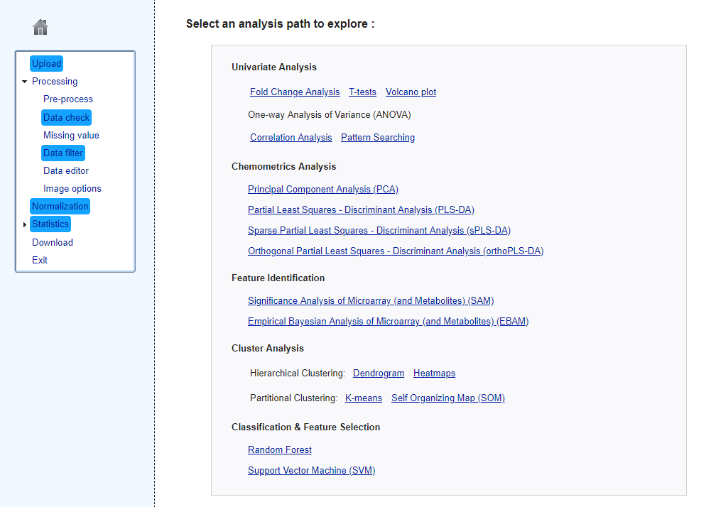
The Analysis Overview page. All available analyses for this dataset are highlighted in blue.
For this tutorial, the aim is to identify important features to use later for omics data integration. For instance, click “Volcano plot”.

Slide 10
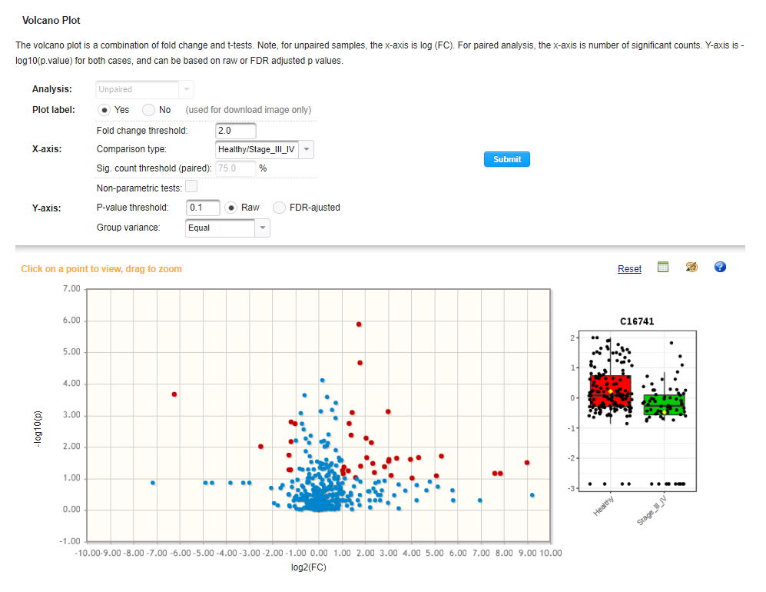
Click the table icon to view the results table.
Double click any feature to view a boxplot of that feature between the CRC and healthy controls.

Slide 11
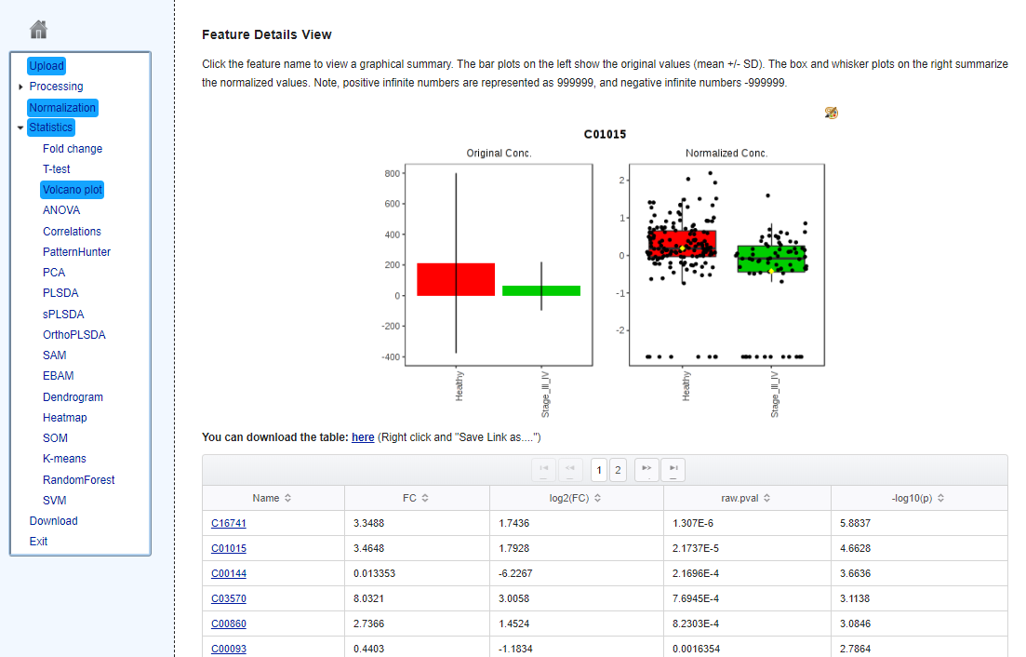
Right click “here”, select “Save link as…”, and click “Save” to download the results table. This list of metabolites will be used next for multi-omics data integration.

Slide 12
Use the Navigation Track if you wish to continue exploring the dataset, following the extra slides “Further individual metabolomics data analysis”.

Slide 13
Now we will combine the metagenomic and metabolomic data. Click this circle to enter the Network Explorer module.

Slide 14
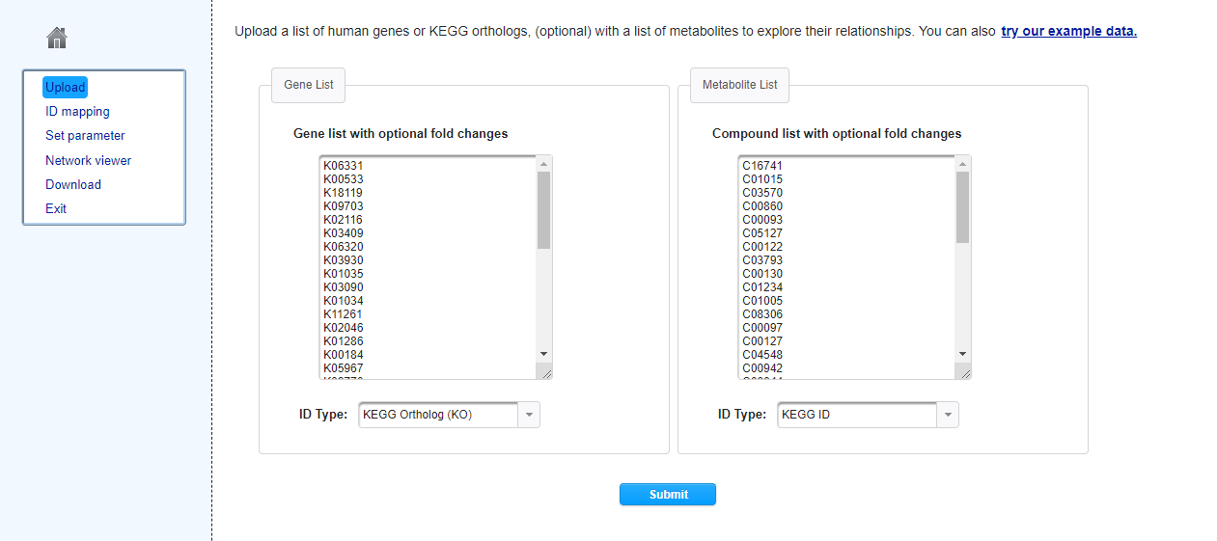
The Network Explorer module accepts a list of genes and metabolites as input.
Copy and paste a list of important genes identified using MicrobiomeAnalyst (or use the “metageno_de_output_CRC.csv” file).
Copy and paste a list of metabolites identified as important using MetaboAnalyst.
Set the ID types to KEGG Ortholog and KEGG ID, respectively.
Click “Submit” to continue.

Slide 15
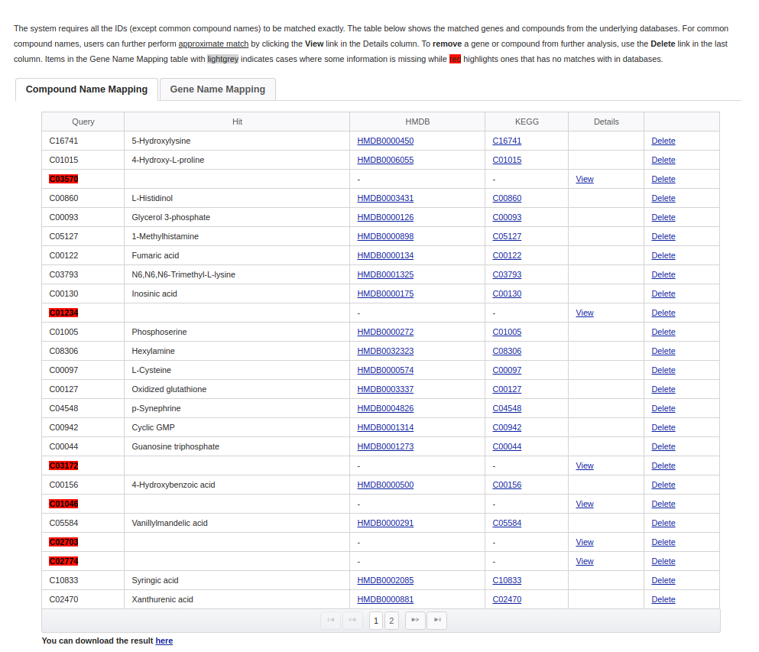
Compound and Gene Name Mapping. These tables contain the results of mapping the inputted metabolites/genes to the MetaboAnalyst knowledgebase. Features without matches are highlighted in red and will be excluded from downstream analysis. Click “Submit” at the bottom of the page to continue.

Slide 16
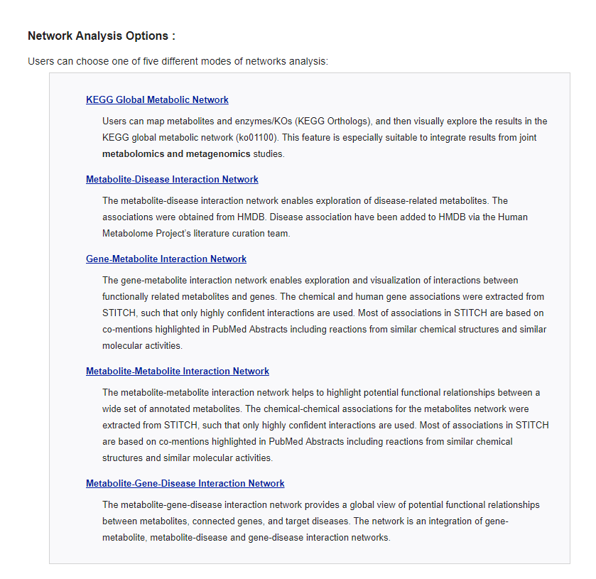
Network Analysis Options. For this tutorial, we will only use the KEGG Global Metabolic Network to integrate the metagenomic and metabolic data. Click “KEGG Global Metabolic Network” to view the results.

Slide 17
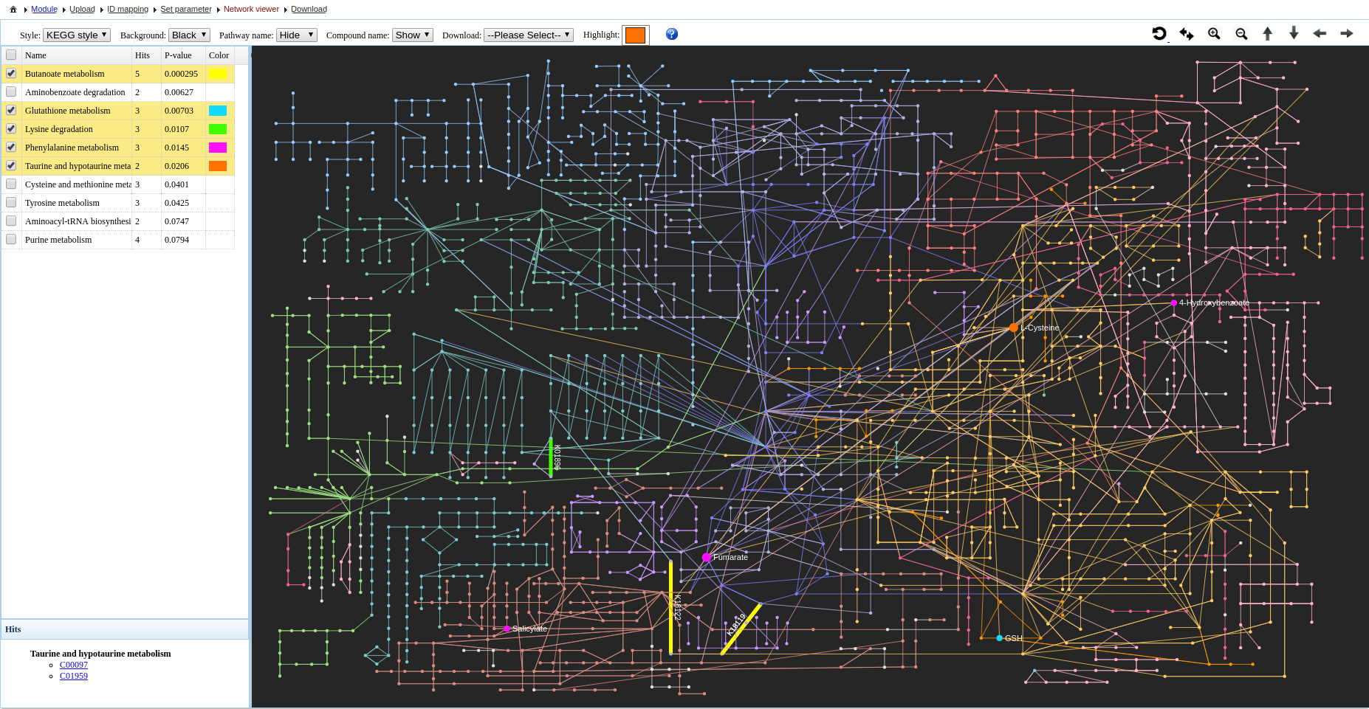
Top toolbar contains various tools to customize the network.
Highlight enriched pathways on the network by clicking these boxes. Here, the top enriched pathway is Butanoate metabolism, better known as Butyrate metabolism, which is known to play an important role in colorectal cancer.
Nodes represent mapped KEGG compounds while edges represent KEGG KOs.

Slide 18
Download the created network here.

Slide 19
Further individual metabolomics data analysis

Slide 20
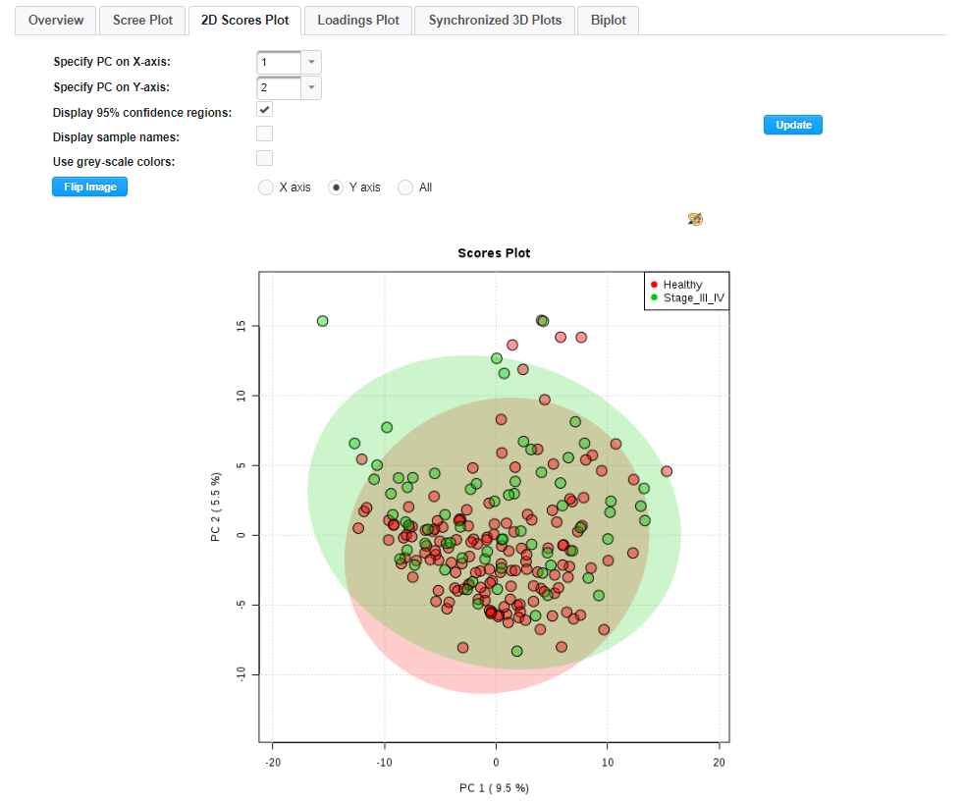
PCA
PCA is an unsupervised multivariate method used to identify inherent patterns in data. From the score plot, we do not see a good separation between the CRC patients and healthy controls. Explore the other tabs.

Slide 21
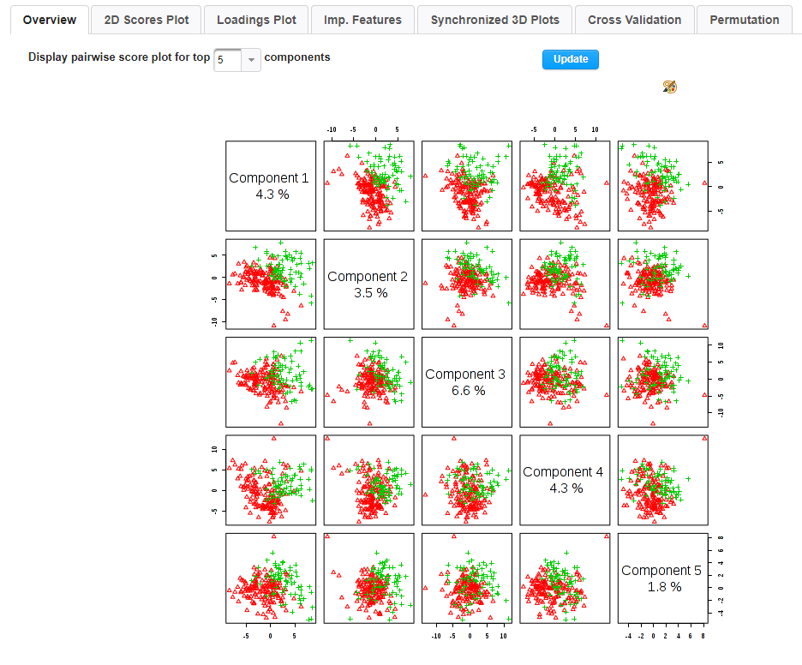
PLS-DA
PLS-DA is a supervised multivariate method that uses class labels for biomarker discovery and classification. From the pairwise score plot, we see a good separation between the CRC and healthy controls.

Slide 22
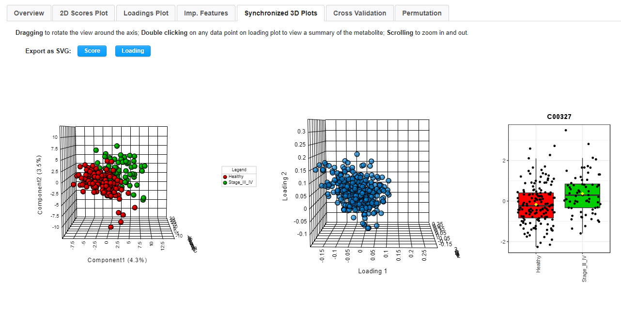
PLS-DA
Interactive 3D PLS-DA score (left) and loadings plot (right). Use your mouse to rotate and zoom in/out of the plots. Double click any feature from the loadings plot to view a boxplot of that feature’s concentrations.

Slide 23
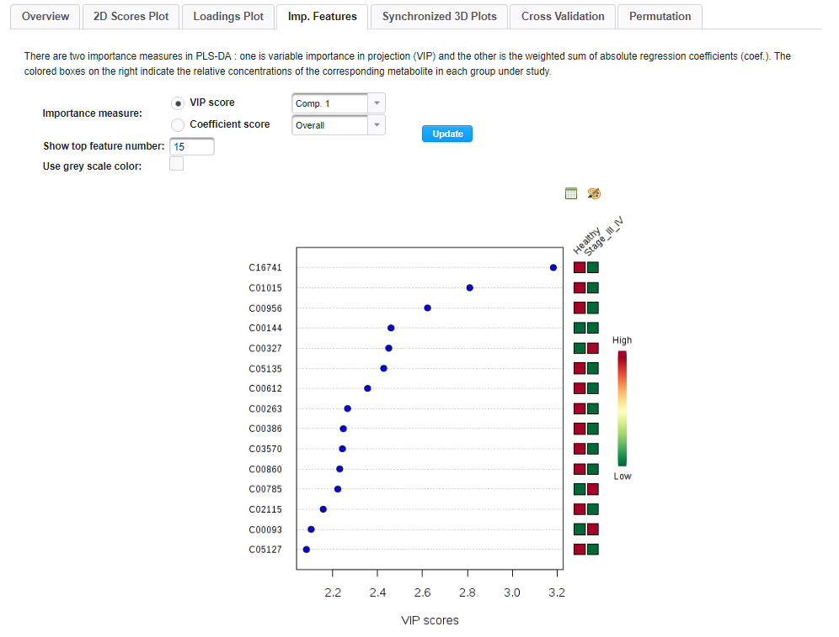
PLS-DA
PLS-DA important features plot, showing the top 15 features according to their VIP score.

Slide 24
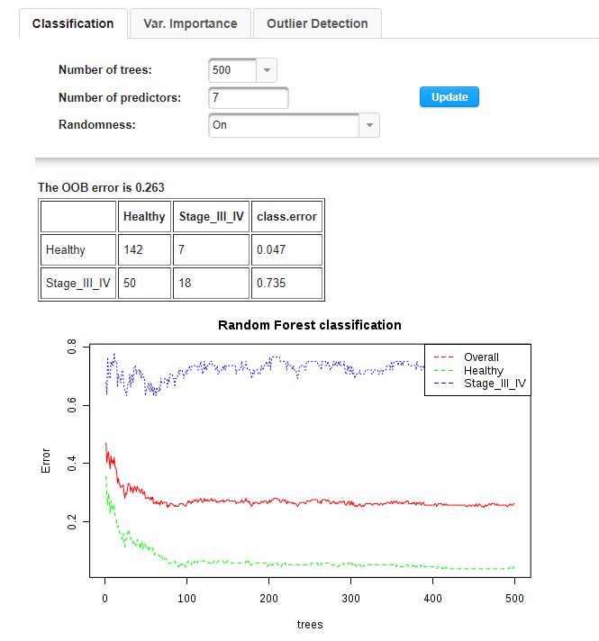
Random Forest
Random Forest is an ensemble machine learning method that builds and combines decision trees to improve model accuracy and prediction. Change the number of trees built and see if the OOB error changes.

Slide 25
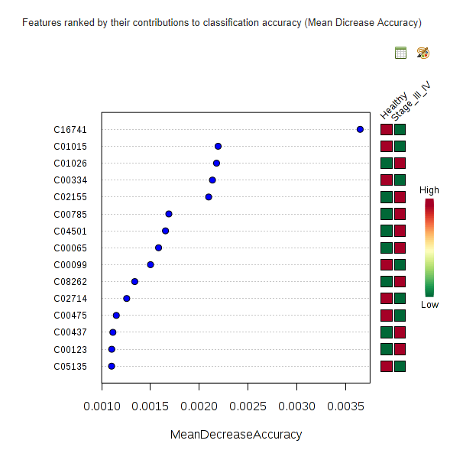
Random Forest
Important features identified using RF (“Var. Importance” tab). Features are ranked by how much the OOB error increases when they are left out of the model. The top 2 features are identical to the PLS-DA plot.

Slide 26
Session Download
Click the “Download” hyperlink to generate an Analysis Report and download all results.

Slide 27
Further Exploration
Refer to the FAQs, Tutorials, and Resources page of MetaboAnalyst for more information.
For a detailed step-by-step tutorial, read the “Using MetaboAnalyst 4.0 for Comprehensive and Integrative Metabolomics Data Analysis”
Caution! There are 178 pages, containing 12 sections covering all modules within MetaboAnalyst and an introduction to our MetaboAnalystR package.
Joint Pathway Analysis (i.e. transcriptome/proteome and metabolome integration) is covered here!
https://www.dropbox.com/s/vsmcmvsup85h55u/CPBI_MetaboAnalyst_2019.pdf?dl=0

Slide 28
References
Chong J, Soufan O, Li C, Caraus I, Li S, Bourque G, Wishart DS, Xia J. MetaboAnalyst 4.0: towards more transparent and integrative metabolomics analysis. Nucleic acids research. 2018 May 14;46(W1):W486-94.
Yachida S, Mizutani S, Shiroma H, Shiba S, Nakajima T, Sakamoto T, Watanabe H, Masuda K, Nishimoto Y, Kubo M, Hosoda F. Metagenomic and metabolomic analyses reveal distinct stage-specific phenotypes of the gut microbiota in colorectal cancer. Nature medicine. 2019 Jun 6:1.

