Slide 1
Implementation of Client- Server Architecture
using
Linux Socket programming
PRESENTED BY: Navdeep Kaur Dillon
Ashwini Upasani
Partho Ghosal
Rahul Ranjan
This presentation is submitted to Professor Mahmud Hasan in partial fulfillment of the requirements for ELG5374 course

Slide 2
Objective
Our project deals with the transfer of data/information in the Intradomain system using TCP/IP protocol.
We will be using the socket programming interface that provides the routines required for the Interprocess communication between the applications in a TCP/IP based network environment.
Furthermore we will be focussing on client-server architecture, which is a computing module in which the server hosts, delivers and manages most of the resources and services to be consumed by the client.

Slide 3
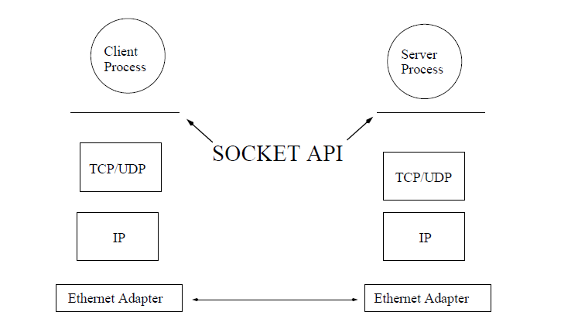
Motivation - Socket API
Process-to-process communication is the job of the transport layer protocol.
The application does not need to know how this is done.
The application simply uses the interface that the transport layer provides to it to send messages.
This interface is referred to as socket API.

Slide 4
Socket Application Program Interface (sAPI)
Transport control protocol
[TCP]

Slide 5
Transmission Control Protocol
Connection oriented
Means that a virtual connection is established before any user data is transferred.
Stream-of-bytes service
Sends and receives a stream of bytes, not messages
Reliable, in-order delivery
Checksums to detect corrupted data
Acknowledgments & retransmissions for reliable delivery
Sequence numbers to detect losses and reorder data
Flow Control
Prevent overflow of the receiver’s buffer space
Congestion control
Adapt to network congestion for the greater good

Slide 6
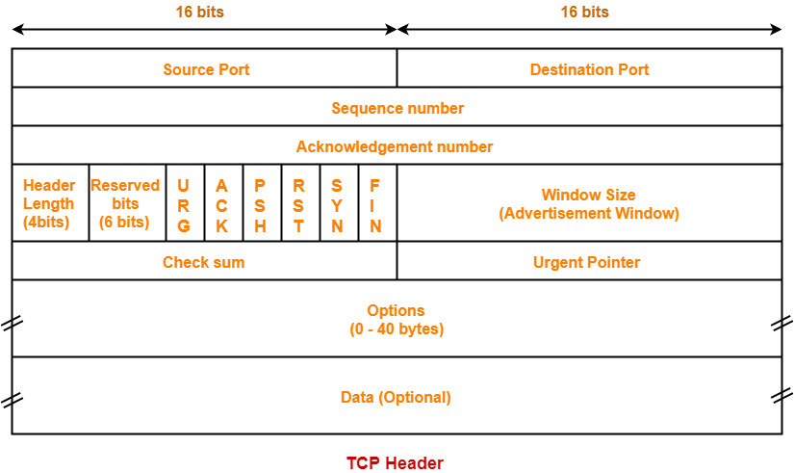
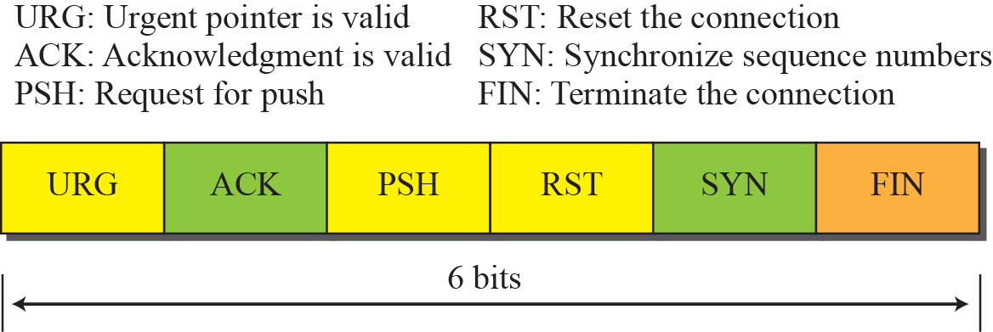
TCP Header

Slide 7
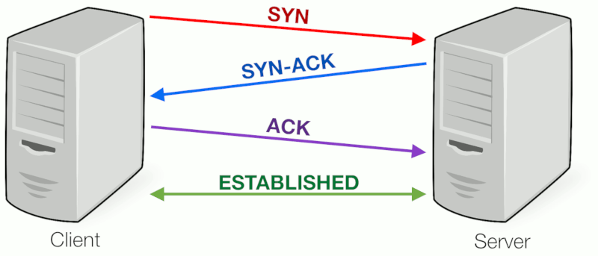
TCP Connection Establishment
Three-way handshake to establish connection-
Host A sends a SYN (open) to the host B
Host B returns a SYN acknowledgment (SYN ACK)
Host A sends an ACK to acknowledge the SYN ACK

Slide 8
Usage of the socket programming and Wireshark
Socket programming has been used to show how to use socket APIs to establish communication links between remote and local applications.
Socket application program interfaces (APIs) are the network standard for TCP/IP.
Wireshark is basically a free and open source packet analyzer which is used for network troubleshooting and analysis of the data being send back and forth. It is basically used to let us know the status of the packets being send over TCP connection.

Slide 9
Linux Socket (API) Application programming interface

Slide 10
Sockets
An interface between an application process and transport layer.
The application process can send/receive messages to/from another application process (local or remote)via a socket.
An active socket
An passive socket
Socket Identification

Slide 11
Socket Identification
Process
A
Process
B
port X
port Y
Port Number
TCP/UDP
Protocol
IP
Host Address
Ethernet Adapter
Notes:
Communication Protocol
TCP (Stream Socket): streaming, reliable
UDP (Datagram Socket): packets, best effort
Receiving host
Destination address that uniquely identifies the host
An IP address is a 32-bit quantity
Receiving socket
Host may be running many different processes
Destination port that uniquely identifies the socket
A port number is a 16-bit quantity

Slide 12
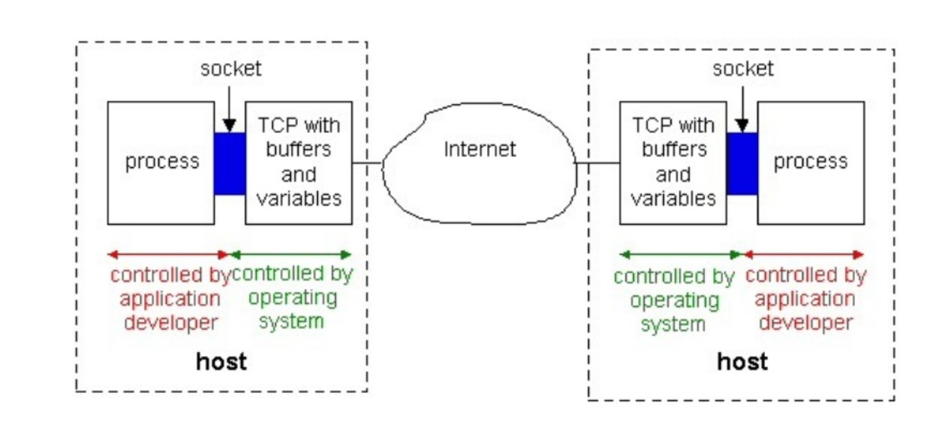
Process communicating using TCP SOCKETS

Slide 13
Client-Server Communication Stream Sockets (TCP): Connection-oriented
Server
Create a socket
Bind the socket
(what port am I on?)
Client
Listen for client
(Wait for incoming connections)
Create a socket
establish connection
Accept connection
Connect to server
Receive Request
data (request)
Send the request
data (reply)
Send response
Receive response

Slide 14
Connection-oriented Example (Linux - Stream Sockets -TCP)
Server
socket()
bind()
Client
listen()
socket()
accept()
establish connection
connect()
recv()
data (request)
send()
send()
data (reply)
recv()

Slide 15
Creating a Socket : create()
Creating a socket
int socket(int domain, int type, int protocol)
Domain: protocol family
AF_INET for IPv4
AF_INET6 for IPv6
Type: semantics of the communication
SOCK_STREAM: reliable byte stream (TCP)
SOCK_DGRAM: message-oriented service (UDP)
Protocol: The argument should be set to the specific protocol type given below, or 0 to select the system's default .

Slide 16
Connecting Socket to the Server : connect()
Establishing the connection
int connect(int sockfd, struct sockaddr *serv_addr, int addrlen);
sockfd − It is a socket descriptor returned by the socket function.
serv_addr − It is a pointer to struct sockaddr that contains destination IP address and port.
addrlen − Set it to sizeof(struct sockaddr)
This call returns 0 if it successfully connects to the server, otherwise it returns -1 on error

Slide 17
Server to accept connections : listen()
Waiting to accept connections
int listen(int sockfd,int backlog);
sockfd − It is a socket descriptor returned by the socket function.
backlog − It is the number of allowed connections.
Notes:
The listen function converts an unconnected socket into a passive socket, indicating that the kernel should accept incoming connection requests directed to this socket.
The second argument to this function specifies the maximum number of connections the kernel should queue for this socket.

Slide 18
Binding socket : bind()
Bind the packet to address:
int bind(int sockfd, struct sockaddr *my_addr,int addrlen);
sockfd − It is a socket descriptor returned by the socket function.
Myaddr − It is a pointer to struct sockaddr that contains the local IP address and port.
addrlen − Set it to sizeof(struct sockaddr)
This call returns 0 if it successfully connects to the server, otherwise it returns -1 on error

Slide 19
Sending Data : send()
Sending data using Sockets
int send(int sockfd, void *msg, size_t len, int flags)
Arguments: socket descriptor, pointer to buffer of data to send, and length of the buffer
Returns the number of bytes written, and -1 on error
send is blocking: return only after data is sent
Write short messages into a buffer and send once

Slide 20
Receiving Data : recv()
Receiving data from socket
int recv(int sockfd, void *buf, size_t len, int flags)
-It has socket descriptor, pointer to buffer to place the data, size of the buffer
-Returns the number of characters read (where 0 implies “end of file”), and -1 on error
-recv() is blocking: return only after data is received

Slide 21
High Level Design of Inter-Process Communication Using Linux TCP Sockets & C++ - OPPS concept

Slide 22
Inter Process Communication (IPC) - Using Linux TCP Scokets
Application 1
Process
Application 2
Process
LoopBack: 127.0.0.1
Port :8080
socket
socket
LoopBack: 127.0.0.1
Port :8080
bind
open_listenfd
open_clientfd
listen
connect
Connection Request
accept
Multi Threaded
Multi Threaded
Read & Write O/P
DATA COMUNICATION
Read & Write O/P
Close
Connection Termination ACK
Close

Slide 23
CODE WALK-THROUGH

Slide 24
Topics To Cover:
Application 1- a.k.a Server – Initialization
Application 2- a.k.a Client – Initialization
Multi Thread - Dispatcher and Receiver Model
Read & Write Operation

Slide 25
Application 1 – aka Client Initialization Sequence
bool applicationOne::initalize() {
if ((sockFD = socket(AF_INET, SOCK_STREAM, 0)) < 0) {
cout << "[SYSTEM ERROR]- can't catch SIGUSR2" << endl;
return FAILURE;
}
serv_addr.sin_family = AF_INET;
serv_addr.sin_port = htons(PORT);
// Convert IPv4 and IPv6 addresses from text to binary form
if (inet_pton(AF_INET, "127.0.0.1", &serv_addr.sin_addr) <= 0) {
cout << "[ERROR]-Invalid address/ Address not supported " << endl;
return FAILURE;
}
if (connect(sockFD, (struct sockaddr *) &serv_addr, sizeof(serv_addr))
< 0) {
cout << "[ERROR] - Connection Failed \n" << endl;
return FAILURE;
}
return SUCCESS;
}
Initialization Code

Slide 26
Application 2 – aka Server Initialization Sequence
bool applicationTwo::initalize() {
int opt = 1;
if ((serverSockFD = socket(AF_INET, SOCK_STREAM, 0)) < 0) {
cout << "[SYSTEM ERROR]- cannot obtain valid FD" << endl;
return FAILURE;
}
if (setsockopt(serverSockFD, SOL_SOCKET, SO_REUSEADDR | SO_REUSEPORT, &opt,
sizeof(opt))) {
perror("setsockopt");
exit (EXIT_FAILURE);
}
address.sin_family = AF_INET;
address.sin_addr.s_addr = INADDR_ANY;
address.sin_port = htons( PORT);
if (bind(serverSockFD, (struct sockaddr *) &address, sizeof(address)) < 0) {
perror("bind failed");
exit (EXIT_FAILURE);
}
if (listen(serverSockFD, 3) < 0) {
perror("listen");
exit (EXIT_FAILURE);
}
return SUCCESS;
}
cv
Initialization Code

Slide 27
Multi Thread - Dispatcher and Receiver Model
bool applicationOne::execute(applicationOne *objPtrHandler) {
if (connect(sockFD, (struct sockaddr *) &serv_addr, sizeof(serv_addr))
< 0) {
cout << "[ERROR] - Connection Failed \n" << endl;
return FAILURE;
}
/*
* Thread create
*/
if (pthread_create(&tid[0], NULL,
(ThreadFunPtr) &applicationOne::dispatcher, objPtrHandler) != 0) {
cout << "[SYSTEM ERROR]- Failed to create Dispatcher thread\n" << endl;
}
if (pthread_create(&tid[1], NULL, (ThreadFunPtr) &applicationOne::recieve,objPtrHandler) != 0) {
cout << "[SYSTEM ERROR]- Failed to create Receiver thread\n" << endl;
}
int i = 0;
while (i < 2) {
pthread_join(tid[i++], NULL);
printf("Thread %d:\n", i);
}
return SUCCESS;
}
POSIX THREAD Creation
Dispatcher (Write Thread)
&
Receiver (Read Thread)

Slide 28
Read & Write Operation
Receiver
Dispatcher
void * applicationTwo::recieve(void *arg) {
cout << "[INFO] !START! - Receiver Thread" << endl;
char buffer[1024] = { 0 };
string conTerminateReqMsg = "App1 going Offline";
if (signal(SIGUSR2, destory) == SIG_ERR)
cout << "[SYSTEM ERROR]- can't catch SIGUSR2" << endl;
while (1) {
read(conSocket, buffer, 1024);
cout << "[INFO] Message from Application 2:" << buffer << endl;
if (strcmp(buffer, conTerminateReqMsg.c_str()) == 0) {
close(conSocket);
cout << "[WARN]-Application 2 Requested for Disconnection!" << endl;
appGoesOffline();
break;
}
memset(buffer,0,1024);
}
}
void * applicationTwo::dispatcher(void *arg) {
cout << "[INFO] - !STARTS! Dispatcher Thread " << endl;
string msgInformation;
if (signal(SIGUSR1, destory) == SIG_ERR)
cout << "[SYSTEM ERROR]-can't catch SIGUSR1" << endl;
while (1) {
cin >> msgInformation;
send(conSocket, msgInformation.c_str(), msgInformation.length(), 0);
}
}

Slide 29
Wireshark and its Implementation

Slide 30
What is Wireshark
Wireshark is a network packet analyzer. A network packet analyzer will try to capture network packets and tries to display that packet data as detailed as possible.
You could think of a network packet analyzer as a measuring device used to examine what's going on inside a network cable, just like a voltmeter is used by an electrician to examine what's going on inside an electric cable (but at a higher level, of course).
Wireshark is perhaps one of the best open source packet analyzers available today

Slide 31
Use of Wireshark:
network administrators use it to troubleshoot network problems
network security engineers use it to examine security problems
developers use it to debug protocol implementations
people use it to learn network protocol internals
Beside these examples, Wireshark can be helpful in many other situations too.

Slide 32
Features
Live capture from many different network media
Wireshark can capture traffic from many different network media types - and despite its name - including wireless LAN as well. Which media types are supported, depends on many things like the operating system you are using.
Import files from many other capture programs
Wireshark can open packets captured from a large number of other capture programs.
Export files for many other capture programs
Wireshark can save packets captured in a large number of formats of other capture programs.
Open Source Software
Wireshark is an open source software project, and is released under theGNU. You can freely use Wireshark on any number of computers youlike, without worrying about license keys or fees or such

Slide 33
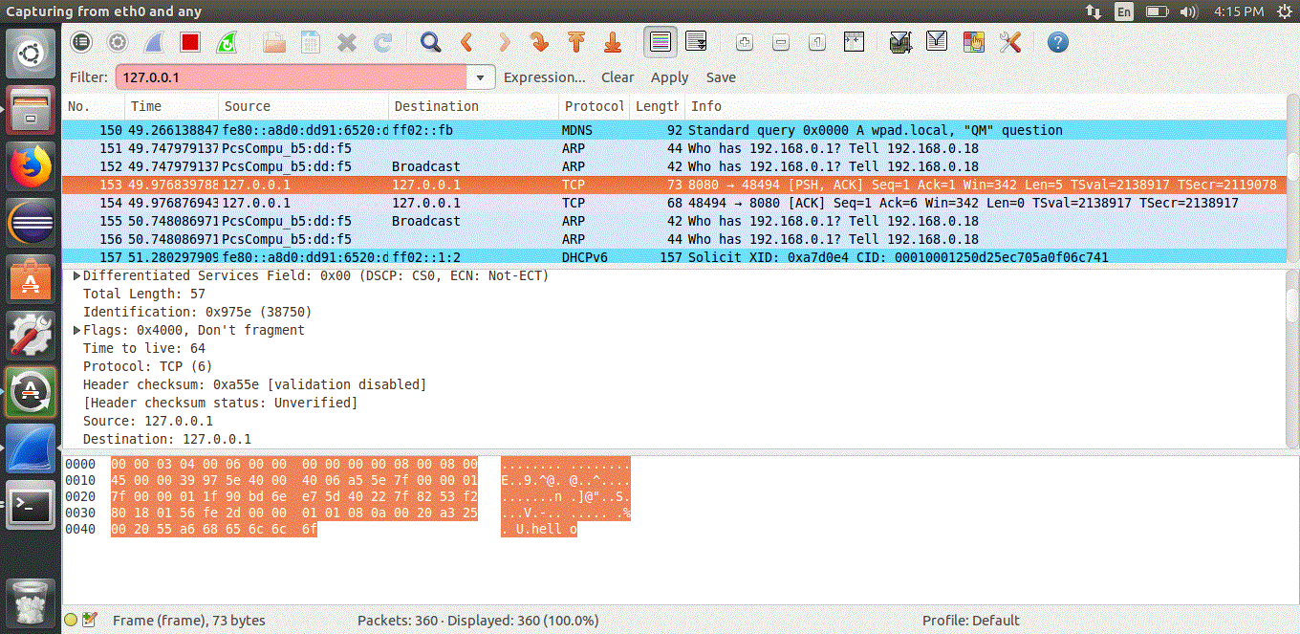
Implementation

Slide 34
Conclusion
The Code Was designed and developed using Object Oriented concepts
Applications is designed to handle – 1024 Byte of data
Application can Handle any User or System level Interrupt
Interrupt Service Routine (I.S.R) update was taken care accordingly
Process’s Signal Handling mechanism was developed.

Slide 35

! Our Project is Hosted on GitHub Repository !
https://github.com/parthoUniversityOttawa/uOttawa-CCN-Project.git

Slide 36
!Actions Time! (Project Demonstration)

Slide 37
Thank you

