Slide 1

CS – 4661 FINAL PROJECT PRESENTATION CREDIT SCORE CLASSIFICATION
PRESENTED BY:
LIBINA BOVAN THOMAS
PARTH BARAHATE
TEJAS GHIYA
VENKATA GOWTHAM REDDY ISKA

Slide 2
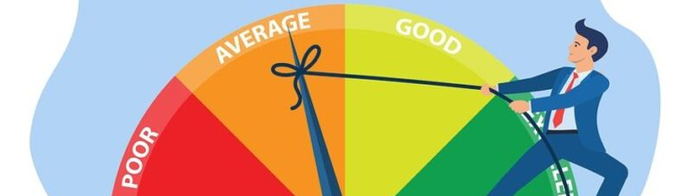
INTRODUCTION
What is a Credit Score?
A credit score is a three-digit number that rates your creditworthiness. The higher the score, the more likely you are to get approved for loans and for better rates.
A credit score is based on your credit history, it includes information like - number accounts, total levels of debt, repayment history, and other factors. Lenders use credit scores to evaluate your credit worthiness, or the likelihood that you will repay loans in a timely manner.

Slide 3
Why is good credit important?
Allows you to obtain loans and credit cards with the best interest rate
Can improve your ability to rent an apartment, buy insurance coverage or even get certain jobs
Landlords, insurance companies and some employers can have access to (may vary by state):
Personal information
View payment history
Past lawsuits against you
Bankruptcy
How often you’ve applied for credit
OBJECTIVE
Thus, our objective through this project is to build a machine learning model that can classify the credit score, if a person’s credit-related information is given.

Slide 4
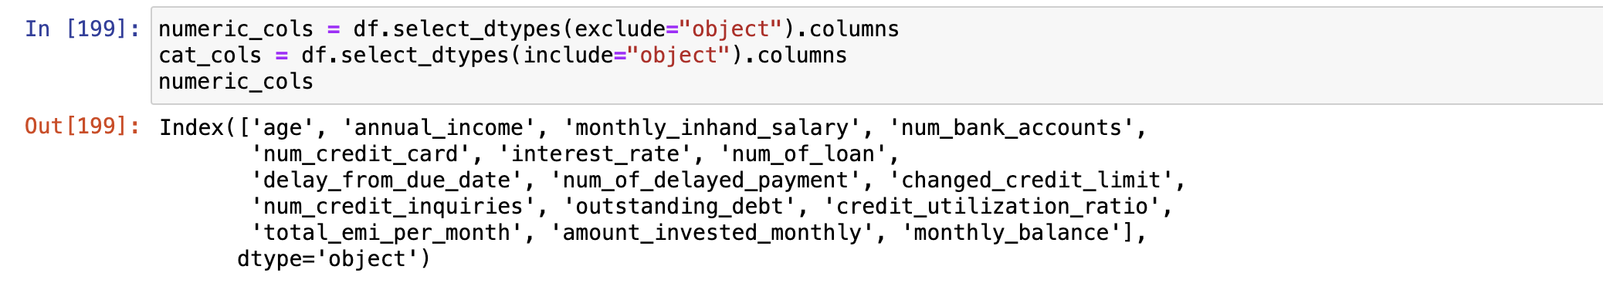
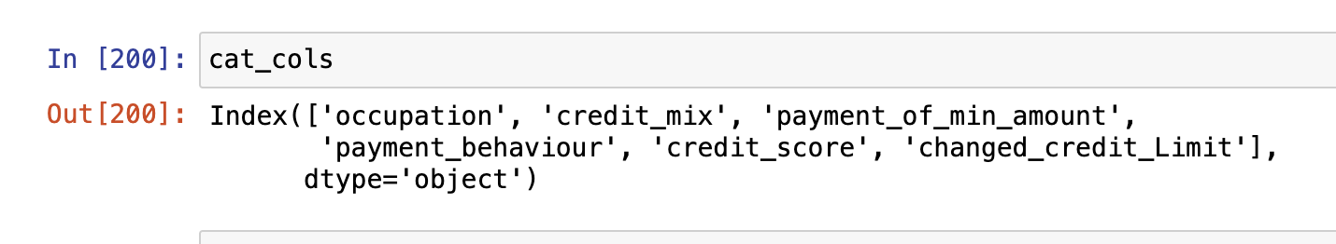
DATASET OVERVIEW
The dataset that we’ve used for this project is from Kaggle - https://www.kaggle.com/datasets/parisrohan/credit-score-classification/data
This collection consists of training and testing datasets.
Data contains 100000 rows × 28 columns.
Data size: 31 MB (10 MB archived)
The dataset contains both numerical and categorical data as show below

Slide 5
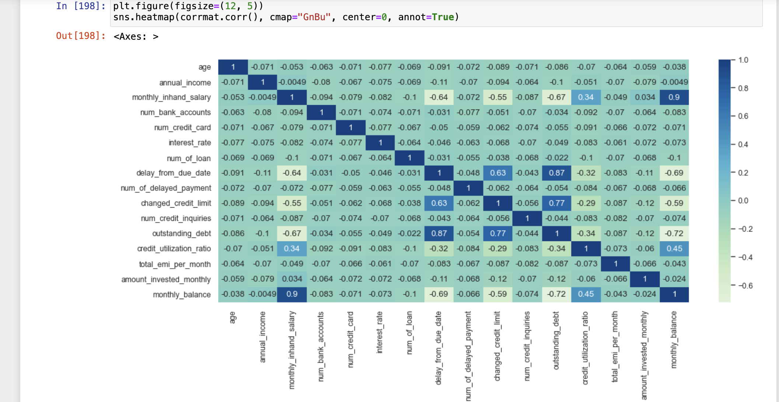
DATA EXPLORATION
Moving on to the exploratory data analysis, let's start by examining the distribution of credit scores. We explore the relationship between key features and credit scores.
The heatmap reveals interesting correlations, within its features showing a strong positive correlation (dark blue) , while some of them are seen to have negative correlation.

Slide 6
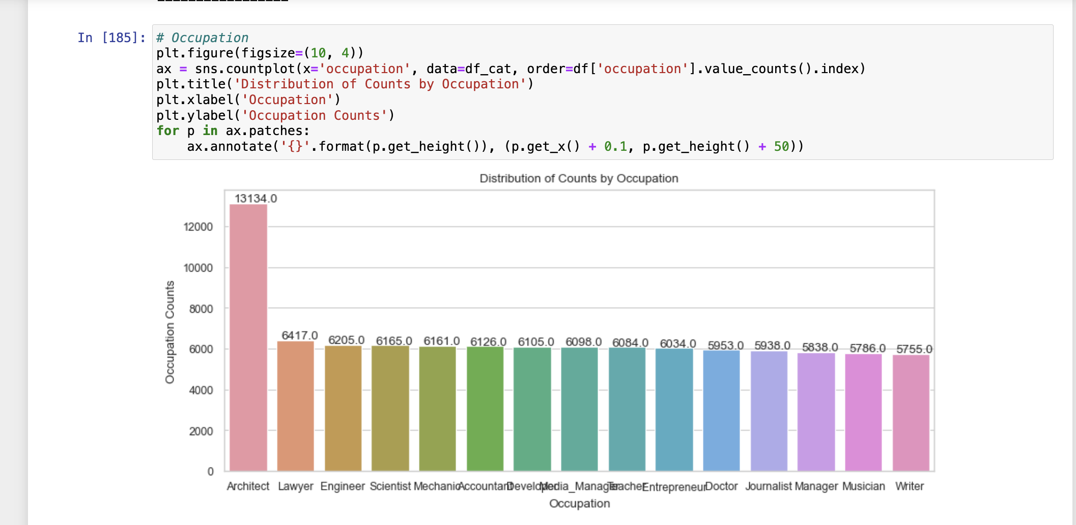
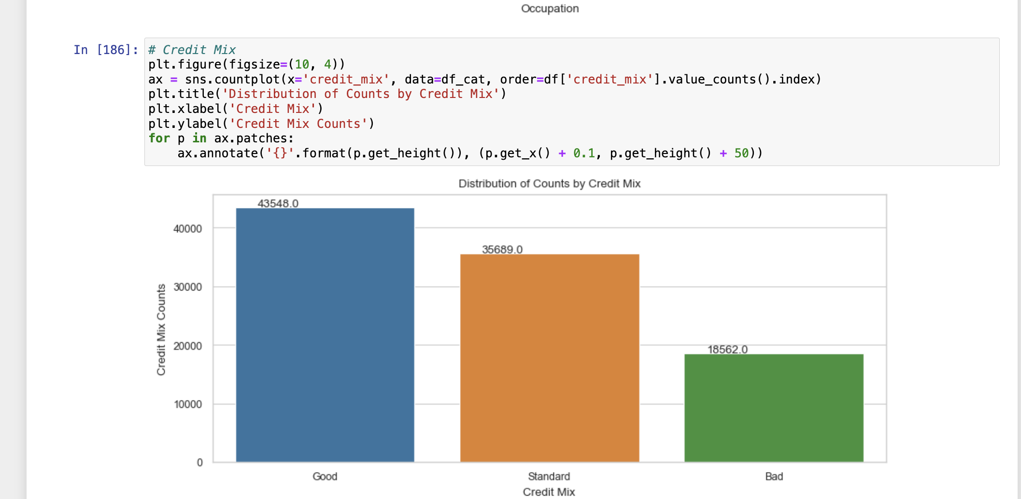
DATA EXPLORATION
Based on the given dataset, a few visualizations can be achieved from the categorical features.
BASED ON OCCUPATION
BASED ON CREDIT MIX

Slide 7
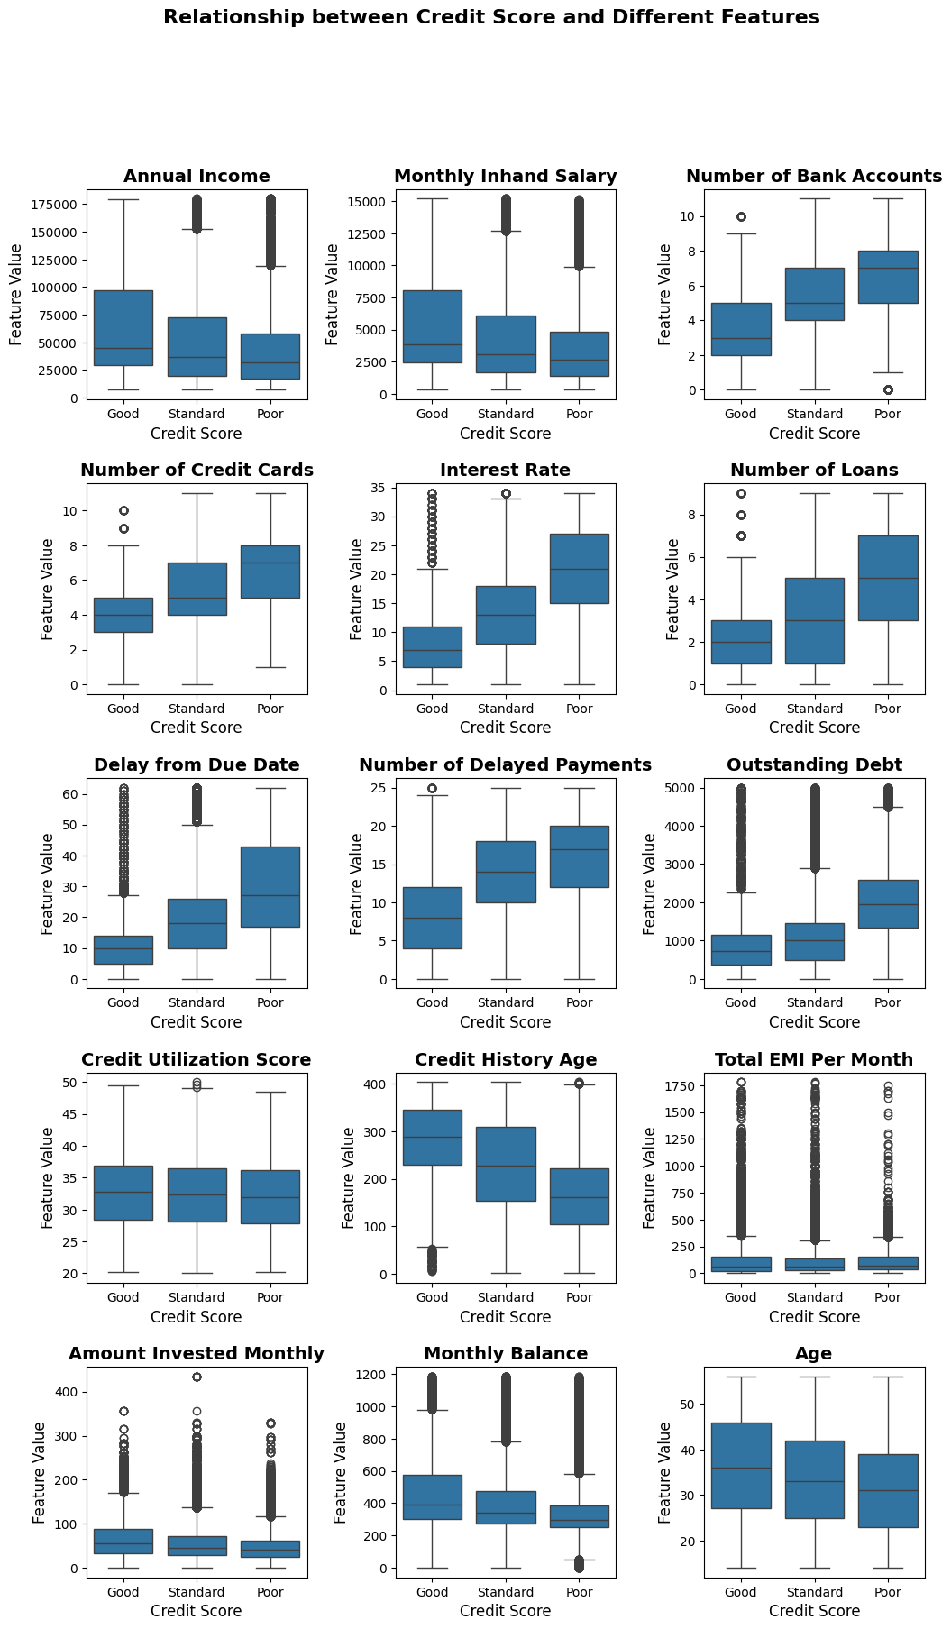
DATA EXPLORATION OUTPUTS
Explored relationships between credit scores and key features such as age, annual income, and monthly in-hand salary and many more features as shown in the output below

Slide 8
MODEL TRAINING AND EVALUATION
Random Forest Classifier - Random forests is an ensemble of classification or regression trees, induced from bootstrap samples of the training data, using random feature selection in the tree induction process.

Slide 9
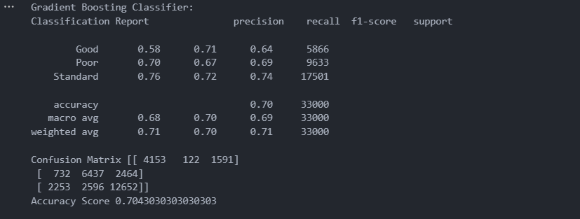
MODEL TRAINING AND OUTPUTS
Decision Tree Algorithm- Decision trees have been available since the 1980s, and have been applied to the implementation of credit scoring models. They are a powerful and flexible classifier.
. Using Decision tree classifier we have classified the data into Good, Poor and Standard.
Accuracy of Decision Tree Algorithm - 0.756090909090909

Slide 10
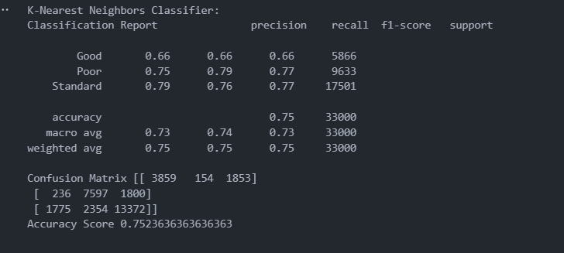
MODEL TRAINING AND OUTPUTS
K –Nearest Neighbor Classifier - The k-nearest neighbor algorithm stores all the available data and classifies a new data point based on the similarity measure
This means when new data appears. Then it can be easily classified into a well-suited category by using K-NN algorithm.
Using KNN, we have obtained an accuracy of 0.7523636363636363, in classifying the credits.

Slide 11
MODEL TRAINING AND OUTPUTS
Gradient Boost Algorithm- Among the integrated methods, gradient boosting has always been one of the most popular techniques.
Gradient boosting is a method used for regression and classification. Using GBA we have classified the data into Good, Poor and Standard.
Accuracy of Gradient Boost Algorithm - 0.7043030303030303

Slide 12
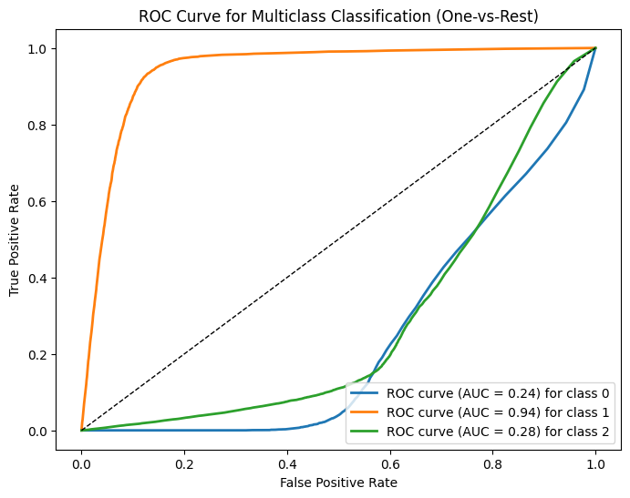
ROC CURVE AND AUC FOR EACH CLASS
The visualization of AUC- ROC curve for the Credit Score Classification is as shown.

Slide 13
RESPONSIBILITY OF EACH TEAM MEMBER
Team Members:
1. Libina Bovan Thomas (Project Lead) : Responsible for coordinating team efforts and ensuring effective communication among team members. Also, will be taking care of data acquisition, cleaning, and preprocessing while ensuring data quality and integrity, while overviewing the project documentation. 2. Tejas Ghiya: Contributing to preprocessing and analyzing the dataset, implementing machine learning algorithms, and fine-tuning model parameters.
3. Parth Barahate: Tasked with data cleaning, feature engineering, and ensuring the dataset is ready for analysis and model training. 4. Venkata Gowtham Reddy Iska: Responsible for creating and maintaining project documentation, as well as organizing findings and insights for future reference, while contributing to the model training.

Slide 14
CONCLUSION
In wrapping up, our Credit Score Classification project successfully tackled challenges in financial data, making sure our predictions about creditworthiness are accurate. We've worked hard to keep things clear and understandable in the lending decisions we're helping with.
So, in a nutshell, we not only hit our goals but also set the stage for more improvements in how we figure out credit scores. We're committed to making our model better and keeping it useful in the ever-changing world of finance.

