Slide 1
CS3220 Web and Internet Programming
Introduction to Web Application Development
Chengyu Sun
California State University, Los Angeles

Slide 2
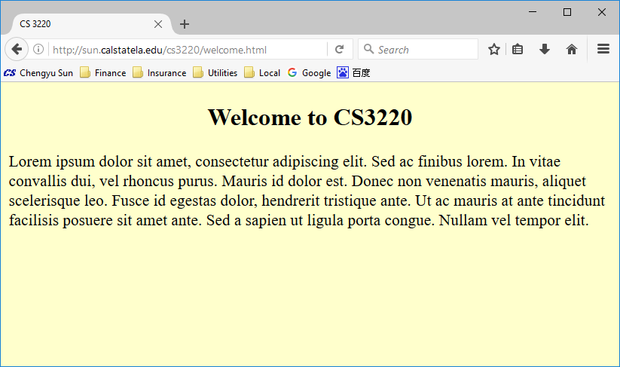
Browsing the Web

Slide 3
How the Web Works
HTTP Server
Browser
HTTP request
HTTP response
Client
/var
/www
cs3220.html
… …
Server

Slide 4
HTTP
HyperText Transfer Protocol
Specifies how the client and the server communicate with each other, i.e. requests and responses

Slide 5
Browser and HTTP Server
Browser
  Chrome
  Internet Explorer (IE)
  Safari
  Firefox
  …
HTTP Server
  Apache
  Internet Information Server (IIS)
  NGINX
  …

Slide 6
URL
Uniform Resource Locator – the address of a web resource
http :// sun.calstatela.edu /cs3220/welcome.html
Protocol
Host name or IP address
Path

Slide 7
From Path to File
Apache 2 Configuration
000-default.conf:
DocumentRoot /var/www
userdir.conf:
UserDir public_html

Slide 8
More About URL
“File” Protocol
file:///C:/CS3220/cs3220.html
Port number and default port number
http://sun.calstatela.edu:8080/cs3220.html
Directory index and directory listing
http://sun.calstatela.edu/cs3220/
Root path
http://sun.calstatela.edu/
http://sun.calstatela.edu
User directory URL mapping
http://sun.calstatela.edu/~cysun/index.html

Slide 9
HTML
HyperText Markup Language
<html>
<head><title>CS3220</title></head>
<body>
<h2>Welcome to CS3220!</h2>
</body>
</html>

Slide 10
Access Static Web Content
User specify a URL
Based on the URL, browser sends an HTTP request to a server
Based on the path component of the URL, server locates a file on disk and send it back to the client in an HTTP response
Browser displays the file
The file must be pre-created and cannot be changed
based on the user request → static

Slide 11
Dynamic Content
Web search results
Shopping cart
…
Anything that need to be generated on the fly based on user request

Slide 12
Deliver Dynamic Content
Application Server
Browser
HTTP request
HTTP response
input
output
Client
program
Server

Slide 13
A Little Terminology
HTTP Server
Application Server
  Servlet Container
Web Server

Slide 14
Web Application
Application Server
Browser
HTTP request
Client-side
program
HTTP response
input
output
Client
Service-side
program
Server

Slide 15
Server-side Technologies
CGI
Java
ASP.NET
PHP
JavaScript
Ruby
Python
old
mainstream
new
other

Slide 16
Client-side Technologies
HTML, CSS
JavaScript
Java Applet
Rich Internet Application (RIA) technologies
  JavaFX
  Adobe Flex and Flash
  Microsoft Silverlight

Slide 17
Why Web Applications?
Take traditional businesses to larger audience
  Amazon, Netflix
Replace desktop applications
  Google Docs, MS Office Live
Open up new opportunities
  Facebook, Twitter, Youtube

Slide 18
Advantages of Web Applications
Low publishing and distribution cost
Potentially large user base
Centralized administration
  No client side installation
  Professional maintenance and security
  Easy data backup
  Easy upgrade
Available anywhere, anytime
Piracy proof

