Slide 1
CCENT Study Guide
Chapter 10
Layer 2 Switching

Slide 2
Chapter 10 Objectives
The CCENT Topics Covered in this chapter include:
2.0 LAN Switching Technologies
2.1 Describe and verify switching concepts.
2.1.a MAC learning and aging
2.1.b Frame switching
2.1.c Frame flooding
2.1.d MAC address table
2.7 Configure, verify, and troubleshoot port security.
2.7.a Static
2.7.b Dynamic
2.7.c Sticky
2.7.d Max MAC addresses
2.7.e Violation actions
2.7.f Err-disable recovery
2

Slide 3
Three Switch Functions at Layer 2
There are three distinct functions of layer 2 switching that are vital for you to remember: address learning, forward/filter decisions, and loop avoidance.
Address learning Layer 2 switches remember the source hardware address of each frame received on an interface and enter this information into a MAC database called a forward/filter table.
Forward/filter decisions When a frame is received on an interface, the switch looks at the destination hardware address, then chooses the appropriate exit interface for it in the MAC database. This way, the frame is only forwarded out of the correct destination port.
Loop avoidance If multiple connections between switches are created for redundancy purposes, network loops can occur. Spanning Tree Protocol (STP) is used to prevent network loops while still permitting redundancy.

Slide 4
Figure 10.1: Empty forward/filter table on a switch
When a switch is first powered on, the MAC forward/filter table (CAM) is empty.

Slide 5
Figure 10.2: How switches learn hosts’ locations
In this figure, you can see four hosts attached to a switch. When the switch is powered on, it has nothing in its MAC address forward/filter table.

Slide 6
Figure 10.2: How switches learn hosts’ locations
Let me give you an example of how a forward/filter table is populated using Figure 10.2:
1. Host A sends a frame to Host B. Host A’s MAC address is 0000.8c01.000A; Host B’s MAC address is 0000.8c01.000B.
2. The switch receives the frame on the Fa0/0 interface and places the source address in the MAC address table.
3. Since the destination address isn’t in the MAC database, the frame is forwarded out all interfaces except the source port.
4. Host B receives the frame and responds to Host A. The switch receives this frame on interface Fa0/1 and places the source hardware address in the MAC database.
5. Host A and Host B can now make a point-to-point connection and only these two, specific devices will receive the frames. Hosts C and D won’t see the frames, nor will their MAC addresses be found in the database because they haven’t sent a frame to the switch yet.

Slide 7
Figure 10.3: Forward/filter table
Host A sends a data frame to Host D. What do you think the switch will do when it receives the frame from Host A?

Slide 8
Figure 10.4: Forward/filter table answer
Since Host A’s MAC address is not in the forward/filter table, the switch will add the source address and port to the MAC address table, then forward the frame to Host D.

Slide 9
Figure 10.5: “Port security” on a switch port restricts port access by MAC address
Figure 10.5 shows two hosts connected to the single switch port Fa0/3 via either a hub or access point (AP). Port Fa0/3 is configured to observe and allow only certain MAC addresses to associate with the specific port, so in this example, Host A is denied access, but Host B is allowed to associate with the port.

Slide 10
Port Security
Here are your options for configuring port security:
Switch#config t
Switch(config)#int f0/1
Switch(config-if)#switchport mode access
Switch(config-if)#switchport port-security
Switch(config-if)#switchport port-security ?
aging Port-security aging commands
mac-address Secure mac address
maximum Max secure addresses
violation Security violation mode
<cr>
Switch(config-if)#switchport port-security maximum 1
Switch(config-if)#switchport port-security violation shutdown

Slide 11
Figure 10.6: Protecting a PC in a lobby
What can you do to ensure that only the MAC address of the lobby PC is allowed by switch port Fa0/1?
The solution is pretty straightforward because in this case, the defaults for port security will work well. All I have left to do is add a static MAC entry:
Switch(config-if)#switchport port-security
Switch(config-if)#switchport port-security violation restrict
Switch(config-if)#switchport port-security mac-address aa.bb.cc.dd.ee.ff

Slide 12
Figure 10.7: Broadcast storm
Redundant links between switches are important to have in place because they help prevent nasty network failures in the event one link stops working.
If no loop avoidance schemes are put in place, the switches will flood broadcasts endlessly throughout the internetwork. This is sometimes referred to as a broadcast storm.

Slide 13
Figure 10.8: Multiple frame copies
A device can receive multiple copies of the same frame because that frame can arrive from different segments at the same time. Figure 10.8 demonstrates how a whole bunch of frames can arrive from multiple segments simultaneously. The server in the figure sends a unicast frame to Router C.

Slide 14
Figure 10.9: A Cisco Catalyst switch

Slide 15
Switch>en
Switch#config t
Switch(config)#hostname S1
S1(config)#enable secret todd
S1(config)#int f0/1
S1(config-if)#int f0/15
S1(config-if)#description 1st connection to S3
S1(config-if)#int f0/16
S1(config-if)#description 2nd connection to S3
S1(config-if)#int f0/17
S1(config-if)#description 1st connection to S2
S1(config-if)#int f0/18
S1(config-if)#description 2nd connection to S2
S1(config-if)#int f0/8
S1(config-if)#desc Connection to IVR
S1(config-if)#line con 0
S1(config-line)#password console
S1(config-line)#login
S1(config-line)#line vty 0 15
S1(config-line)#password telnet
S1(config-line)#login
S1(config-line)#int vlan 1
S1(config-if)#ip address 192.168.10.17 255.255.255.240
S1(config-if)#no shut
S1(config-if)#exit
S1(config)#banner motd #this is my S1 switch#
S1(config)#exit
S1#copy run start
Destination filename [startup-config]? [enter]

Slide 16
Verifying IOS Switches
Show mac address-table
Show interface vlan 1

Slide 17
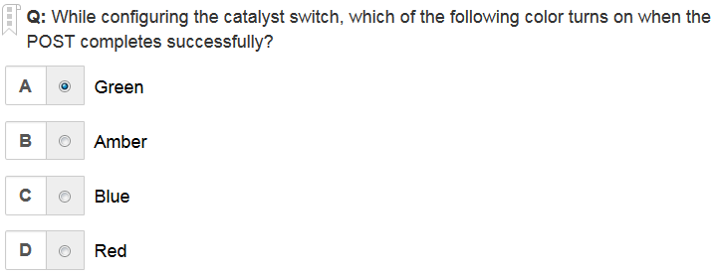
A is the correct answer

Slide 18
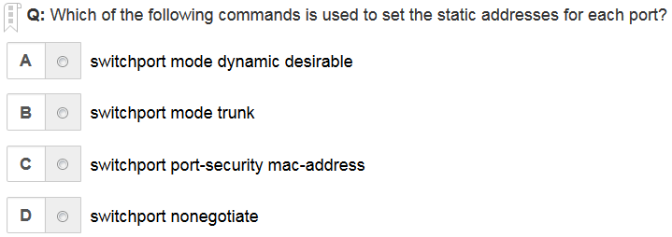
C is the correct answer

Slide 19
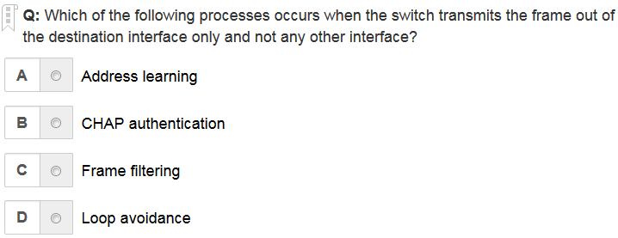
C is the correct answer

Slide 20
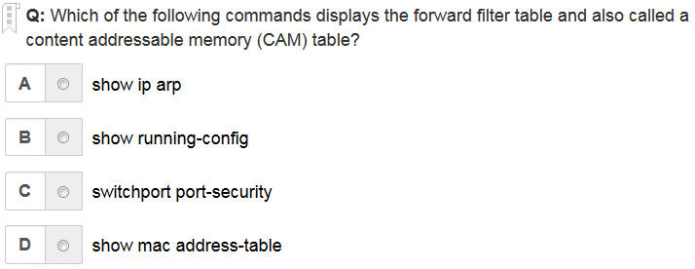
D is the correct answer

Slide 21
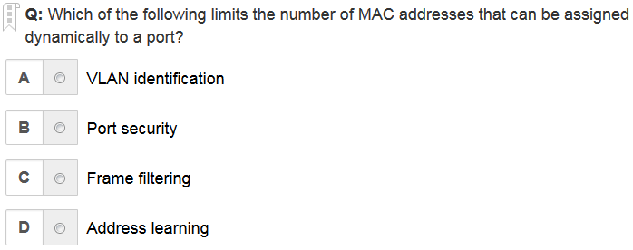
B is the correct answer

Slide 22
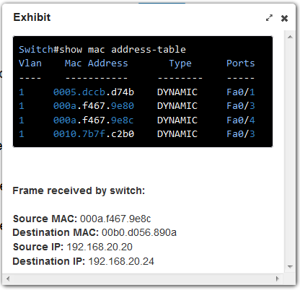
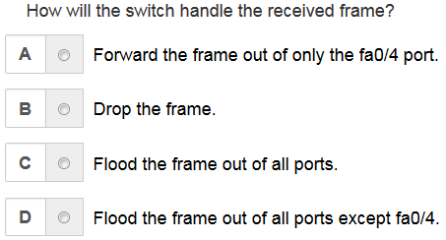
D is the correct answer

Slide 23
Written Labs and Review Questions
Read through the Exam Essentials section together in class.
Open your books and go through all the written labs and the review questions.
Review the answers in class.
23

