Slide 1
CCENT Study Guide
Chapter 14
Internet Protocol Version 6 (IPv6)

Slide 2
Chapter 14 Objectives
The CCENT Topics Covered in this chapter include:
1.11 Identify the appropriate IPv6 addressing scheme
to satisfy addressing requirements in a LAN/WAN
environment.
1.12 Configure, verify, and troubleshoot IPv6 addressing.
1.13 Configure and verify IPv6 Stateless Address Auto
Configuration.
1.14 Compare and contrast IPv6 address types.
1.14.a Global unicast
1.14.b Unique local
1.14.c Link local
1.14.d Multicast
1.14.e Modified EUI 64
1.14.f Autoconfiguration
1.14.g Anycast
3.6 Configure, verify, and troubleshoot IPv4 and IPv6
static routing.
3.6.a Default route
2

Slide 3
Why Do We Need IPv6?
Well, the short answer is because we need to communicate and our current system isn’t really cutting it anymore. It’s kind of like the Pony Express trying to compete with airmail!
Consider how much time and effort we’ve been investing for years while we scratch our heads to resourcefully come up with slick new ways to conserve bandwidth and IP addresses. Sure, variable length subnet masks (VLSMs) are wonderful and cool, but they’re really just another invention to help us cope while we desperately struggle to overcome the worsening address drought.
IPv4 has only about 4.3 billion addresses available—in theory—and we know that we don’t even get to use most of those! Sure, the use of Classless Inter-Domain Routing (CIDR) and Network Address Translation (NAT) has helped to extend the inevitable dearth of addresses, but we will still run out of them, and it’s going to happen within a few years.
China is barely online, and we know there’s a huge population of people and corporations there that surely want to be.

Slide 4
Figure 14.1: IPv6 address example
48-bits
16-bits
2001:0db8:3c4d:0012:0000:0000:1234:56ab
Global prefix
Subnet
Interface ID
64 bits
64 bits
As you can clearly see, the address is definitely much larger. But what else is different? Well, first, notice that it has eight groups of numbers instead of four, and also that those groups are separated by colons instead of periods. And hey, wait a second… there are letters in that address! Yep, the address is expressed in hexadecimal just like a MAC address is, so you could say this address has eight 16-bit hexadecimal colon-delimited blocks.

Slide 5
Shortened Expression
First, you can drop any leading zeros in each of the individual blocks. After you do that, the sample address 2001:0db8:3c4d:0012:0000:0000:1234:56ab would then look like this:
2001:db8:3c4d:12:0:0:1234:56ab
we can remove the two consecutive blocks of zeros by replacing them with a doubled colon, like this:
2001:db8:3c4d:12::1234:56ab
you can replace only one contiguous block of such zeros in an address
Check out this example:
2001:0000:0000:0012:0000:0000:1234:56ab
And just know that you can’t do this:
2001::12::1234:56ab
Instead, the best you can do is this:
2001::12:0:0:1234:56ab

Slide 6
Address Types
Unicast
Packets addressed to a unicast address are delivered to a single interface. For load balancing, multiple interfaces across several devices can use the same address, but we’ll call that an anycast address.
Global unicast addresses (2000::/3)
These are your typical publicly routable addresses and they’re the same as in IPv4. Global addresses start at 2000::/3. Figure 14.2 shows how a unicast address breaks down. The ISP can provide you with a minimum /48 network ID, which in turn provides you with 16-bits to create a unique 64-bit router interface address. The last 64-bits are the unique host ID.
Link-local addresses (FE80::/10)
These are like the Automatic Private IP Address (APIPA) addresses that Microsoft uses to automatically provide addresses in IPv4 in that they’re not meant to be routed. In IPv6 they start with FE80::/10.
Unique local addresses (FC00::/7)
Unique local addresses were designed to replace site-local addresses, so they basically do almost exactly what IPv4 private addresses do: allow communication throughout a site while being routable to multiple local networks.
Multicast (FF00::/8)
Again, same as in IPv4, packets addressed to a multicast address are delivered to all interfaces tuned into the multicast address. Sometimes people call them “one-to-many” addresses. It’s really easy to spot a multicast address in IPv6 because they always start with FF.
Anycast
anycast packet is delivered to only one device—actually, to the closest one it finds defined in terms of routing distance. And again, this address is special because you can apply a single address to more than one host. These are referred to as "one-to-nearest" addresses. Anycast addresses are typically only configured on routers, never hosts, and a source address could never be an anycast address. addresses.

Slide 7
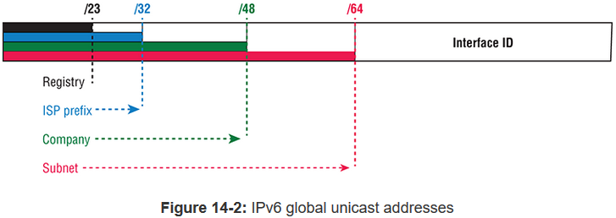
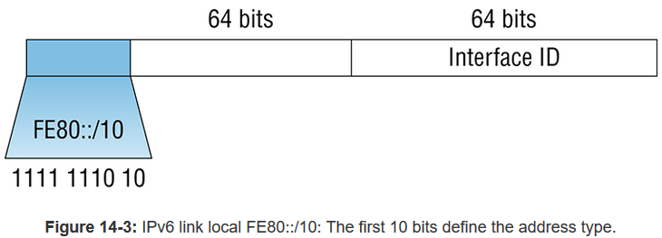

Slide 8
Figure 14.2: IPv6 global unicast addresses
/23
/32
/48
/64
Interface ID
Registry
ISP Prefix
Company
Subnet

Slide 9
Manual Address Assignment
In order to enable IPv6 on a router, you have to use the ipv6 unicast-routing global configuration command:
Corp(config)#ipv6 unicast-routing
By default, IPv6 traffic forwarding is disabled, so using this command enables it.
You can now use the interface configuration command ipv6 address <ipv6prefix>/<prefix-length> [eui-64]
Here’s an example:
Corp(config-if)#ipv6 address 2001:db8:3c4d:1:0260:d6FF.FE73:1987/64
or you can use the eui-64 option. Remember, the EUI-64 (extended unique identifier) format allows the device to use its MAC address and pad it to make the interface ID. Check it out:
Corp(config-if)#ipv6 address 2001:db8:3c4d:1::/64 eui-64

Slide 10
Figure 14.4: EUI-64 interface ID assignment
Autoconfiguration is an especially useful solution because it allows devices on a network to address themselves with a link-local unicast address as well as with a global unicast address.
64 bit Interface ID
OUI
Unique address
FF
FE
000000X0
Insert 16-bits
The 7th bit (U/L)
10= Universally unique
00= Locally unique
Let’s say I have a device with a MAC address that looks like this: 0060:d673:1987. After it’s been padded, it would look like this: 0260:d6FF:FE73:1987.
So where did that 2 in the beginning of the address come from?

Slide 11


Figure 14.5: Two steps to IPv6 autoconfiguration
Step 2: Router sends RA message
FF02::1
ICMP type 134
Step 1: Host sends RS message
FF02::2
ICMP type 133
Host receives the RA and included prefix, allowing it to auto-configure its interface.
This type of autoconfiguration is also known as stateless autoconfiguration because it doesn't contact or connect to and receive any further information from the other device.

Slide 12
Figure 14.6: IPv6 autoconfiguration example
In this figure, the Branch router needs to be configured, but I just don’t feel like typing in an IPv6 address on the interface connecting to the Corp router. I also don’t feel like typing in any routing commands, but I need more than a link-local address on that interface. So basically, I want to have the Branch router work with IPv6 on the internetwork with the least amount of effort.
Branch(config-if)#ipv6 address autoconfig default
Gi0/0
Gi0/1
Internet
Branch
Corp
IPv6 Address
Default Route
Using the command ipv6 address autoconfig, the interface will listen for RAs and then, via the EUI-64 format, it will assign itself a global address

Slide 13
Figure 14.7: IPv6 header
4 Bytes
Version
Class
Flow Label
Payload Length
Next Header
Hop Limit
Source Address
16 Bytes, 128 bits
40 Bytes
Destination Address
16 Bytes, 128 bits
When IPv6 designers devised the header, they created fewer, streamlined fields that would also result in a faster routed protocol at the same time.

Slide 14
DHCPv6 (Stateful)
In IPv6, the RS and RA process happens first, so if there's a DHCPv6 server on the network, the RA that comes back to the client will tell it if DHCP is available for use.
If a router isn't found, the client will respond by sending out a DHCP solicit message, which is actually a multicast message addressed with a destination of ff02::1:2 that calls out, "All DHCP agents, both servers and relays."

Slide 15
Figure 14.8: ICMPv6
Next Header = 58
ICMPv6 packet
IPv6 Header
ICMPv6 Type
ICMPv6 Code
Checksum
ICMPv6 Data
Figure 14.8 shows how ICMPv6 has evolved to become part of the IPv6 packet itself.

Slide 16
Figure 14.9: Router solicitation (RS) and router advertisement (RA)
FF02::2 All routers respond! (RS)
Internet
Branch
FF02::1 Use me! (RA)
Corp
FF02::1 Use me! (RA)
Corp2
IPv6 hosts send a router solicitation (RS) onto their data link asking for all routers to respond, and they use the multicast address FF02::2 to achieve this. Routers on the same link respond with a unicast to the requesting host, or with a router advertisement (RA) using FF02::1.

Slide 17
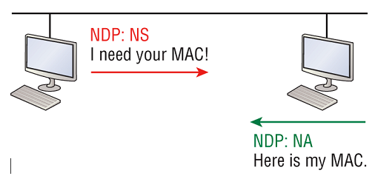
Figure 14-10: Neighbor solicitation (NS) and neighbor advertisement (NA)
So what do you think are the odds that two hosts will assign themselves the same random IPv6 address? To make sure this doesn't ever happen, duplicate address detection (DAD) was created

Slide 18
Figure 14.12: IPv6 static and default routing
2001:DB8:43:91::1
2001:DB8:43:91::2
2001:1234:4321:1::/64
Gi0/0
Gi0/1
Internet
Branch
Corp
Default Route
Static Route
ipv6 route 2001:1234:0:1::/64 2001:db8:43:91::1
ipv6 route ::/0 gi0/0
First, I created a static route on the Corp router to the remote network 2001:1234:4321:1::/64 using the next hop address. I could’ve just as easily used the Corp router’s exit interface. Next, I just set up a default route for the Branch router with ::/0 and the Branch exit interface of Gi0/0.

Slide 19
Configuring IPv6 on Our Internetwork
Corp#config t
Corp(config)#ipv6 unicast-routing
Corp(config)#int f0/0
Corp(config-if)#ipv6 address 2001:db8:3c4d:11::/64 eui-64
Corp(config-if)#int s0/0
Corp(config-if)#ipv6 address 2001:db8:3c4d:12::/64 eui-64
Corp(config-if)#int s0/1
Corp(config-if)#ipv6 address 2001:db8:3c4d:13::/64 eui-64
Corp(config-if)#^Z
Corp#copy run start

Slide 20
Configuring IPv6 on Our Internetwork
Corp(config-if)#do sho ipv6 route
C 2001:DB8:3C4D:11::/64 [0/0]
via ::, FastEthernet0/0
L 2001:DB8:3C4D:11:20D:BDFF:FE3B:D80/128 [0/0]
via ::, FastEthernet0/0
C 2001:DB8:3C4D:12::/64 [0/0]
via ::, Serial0/0
L 2001:DB8:3C4D:12:20D:BDFF:FE3B:D80/128 [0/0]
via ::, Serial0/0
C 2001:DB8:3C4D:13::/64 [0/0]
via ::, Serial0/1
L 2001:DB8:3C4D:13:20D:BDFF:FE3B:D80/128 [0/0]
via ::, Serial0/1
L FE80::/10 [0/0]
via ::, Null0
L FF00::/8 [0/0]
via ::, Null0
Corp(config-if)#

Slide 21
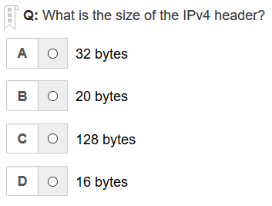
B is the correct answer

Slide 22
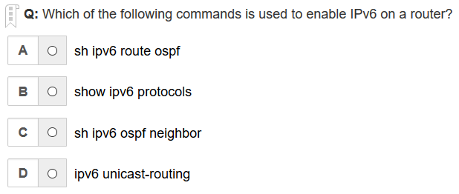
D is the correct answer

Slide 23
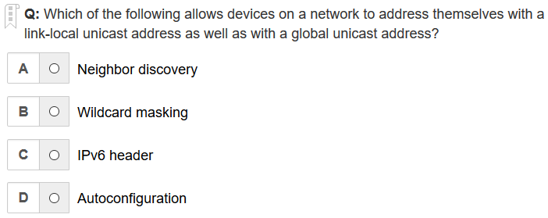
D is the correct answer

Slide 24
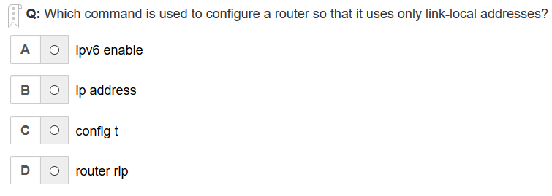
A is the correct answer

Slide 25
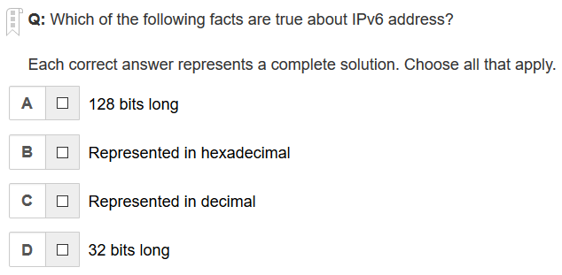
A, B are the correct answers

Slide 26
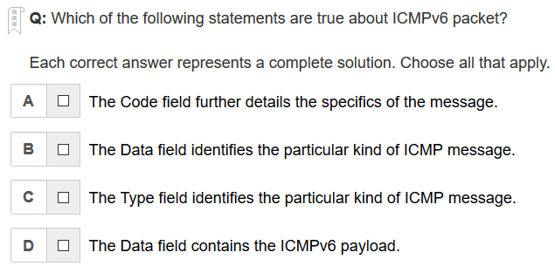
A, C, D are the correct answers

Slide 27
Written Labs and Review Questions
Read through the Exam Essentials section together in class.
Open your books and go through all the written labs and the review questions.
Review the answers in class.
27

