Slide 1
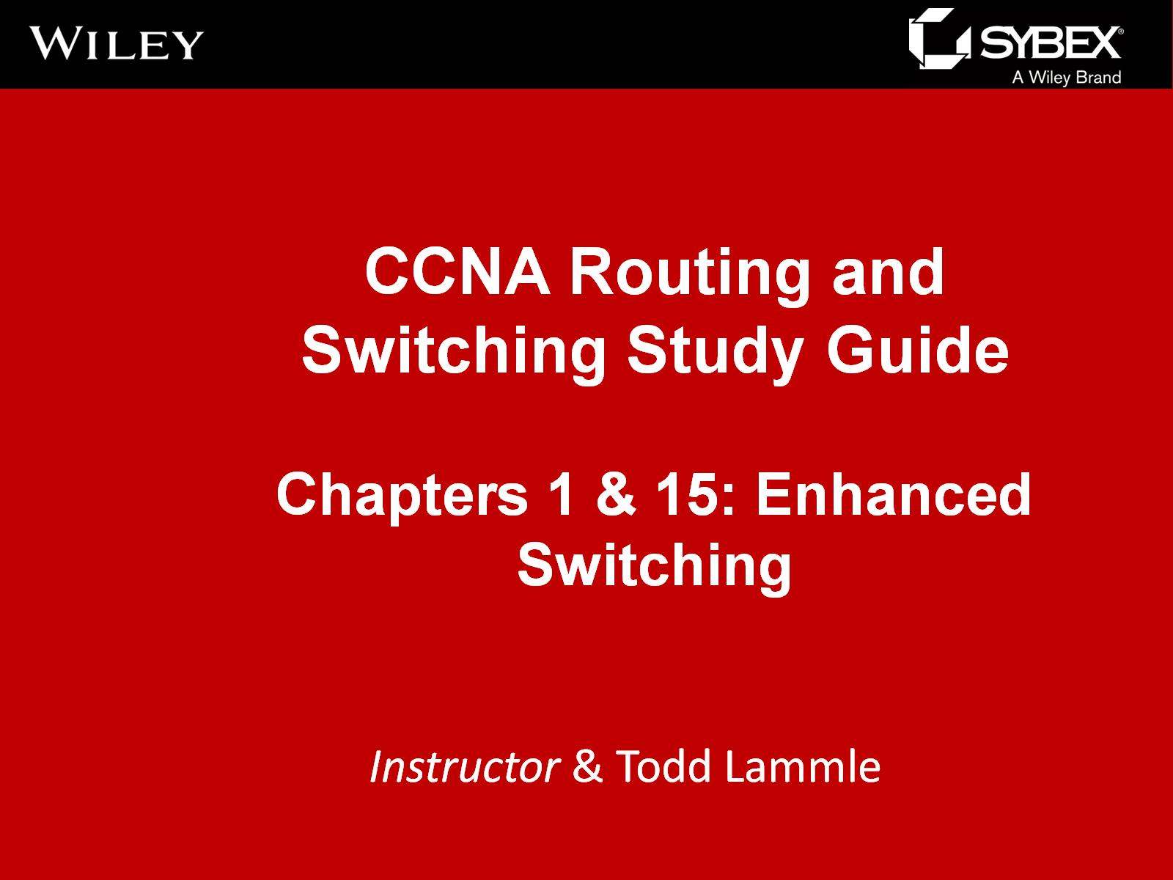

Slide 2
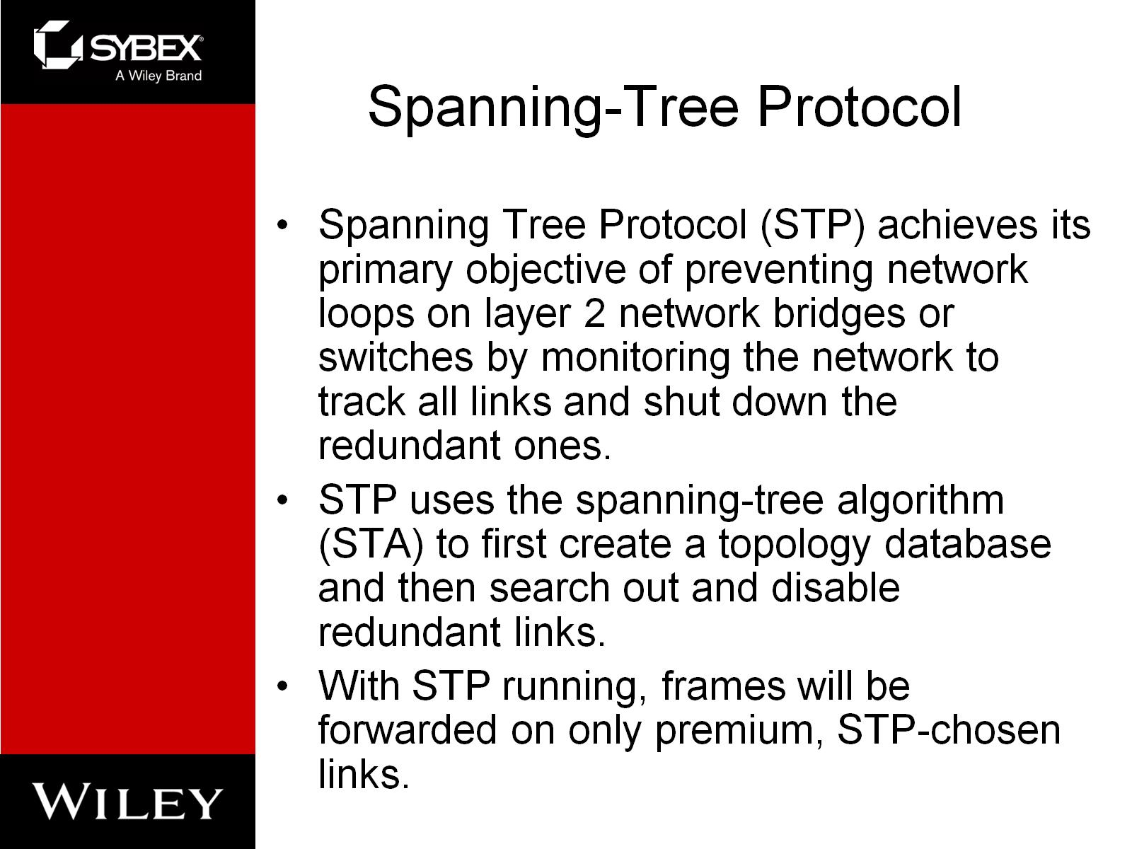
Spanning-Tree Protocol

Slide 3
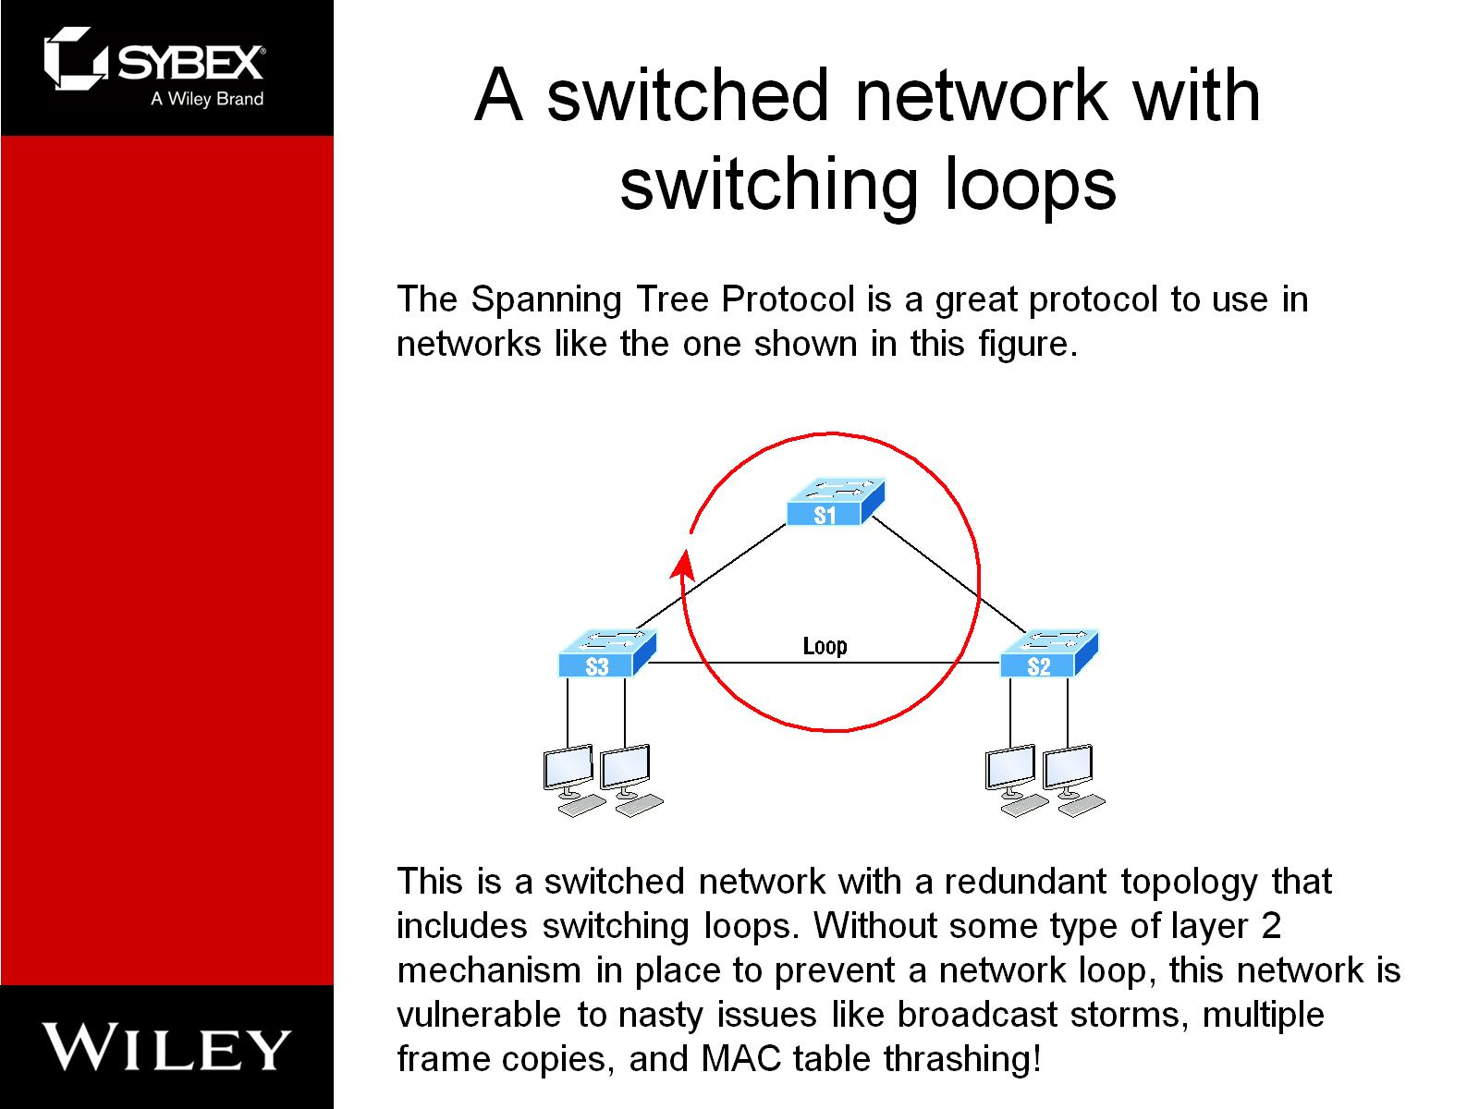
A switched network with switching loops

Slide 4
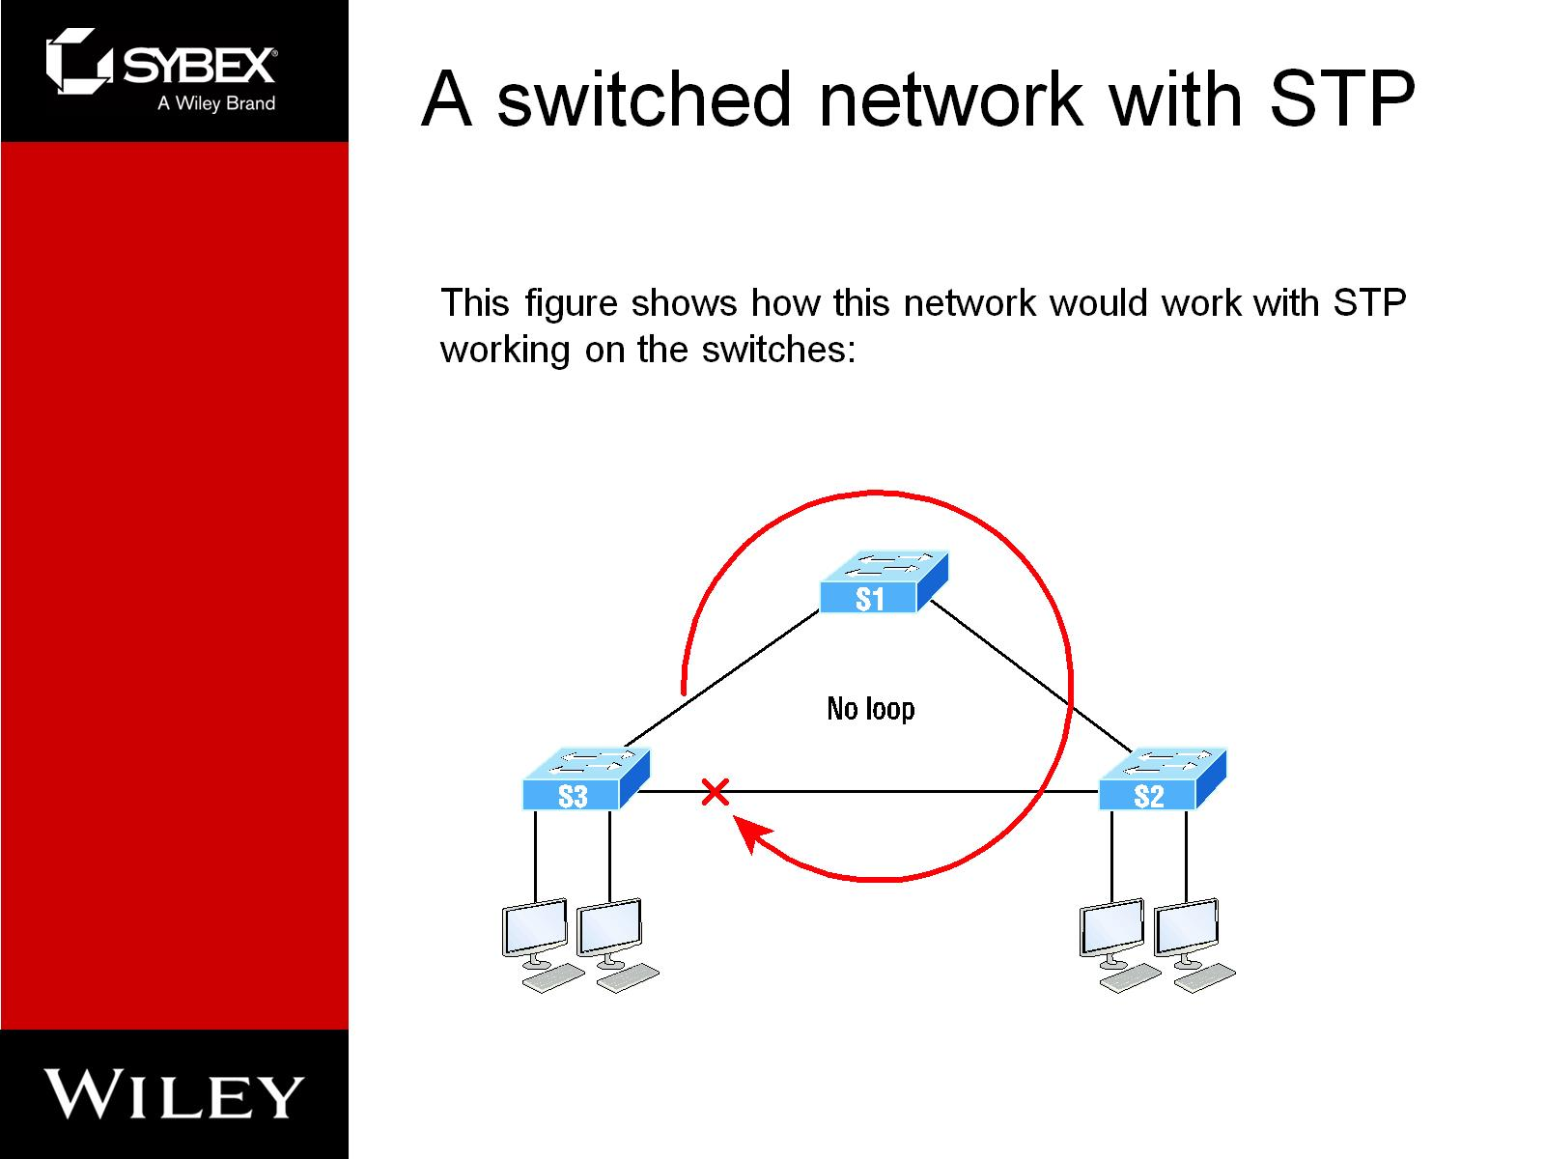
A switched network with STP

Slide 5
Spanning-tree Terms
Root bridge: The root bridge is the bridge with the lowest and, therefore, the best bridge ID.
Bridge ID: It's determined by a combination of the bridge priority, which is 32,768 by default on all Cisco switches, and the base MAC address. The bridge with the lowest bridge ID becomes the root bridge in the network.
BPDU: All switches exchange information to use for the subsequent configuration of the network. Each switch compares the parameters in the Bridge Protocol Data Unit (BPDU) . Inside the BPDU is the bridge ID.

Slide 6
Bridge Port Roles
Root port: The root port is the link with the lowest path cost to the root bridge.
Designated port: A designated port is one that's been determined to have the best (lowest) cost to get to on a given network segment, compared to other ports on that segment.
Forwarding port: A forwarding port forwards frames and will be either a root port or a designated port.
Blocked port: A blocked port won't forward frames in order to prevent loops.

Slide 7
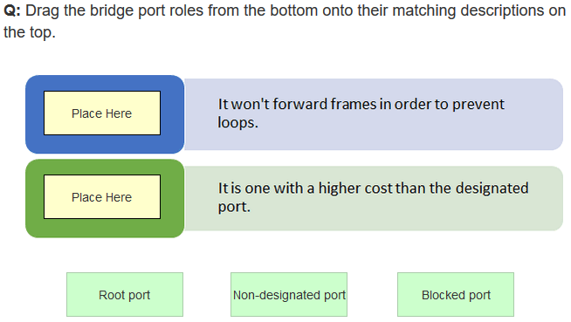
In-class Practice

Slide 8
Convergence
Convergence occurs when all ports on bridges and switches have transitioned to either forwarding or blocking modes.
No data will be forwarded until convergence is complete. Yes—you read that right: When STP is converging, all host data stops transmitting through the switches!

Slide 9
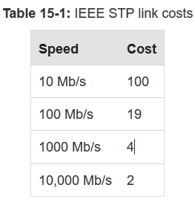
Link Cost
Port cost is the cost of a single link whereas path cost is the sum of the various port costs to the root bridge.

Slide 10
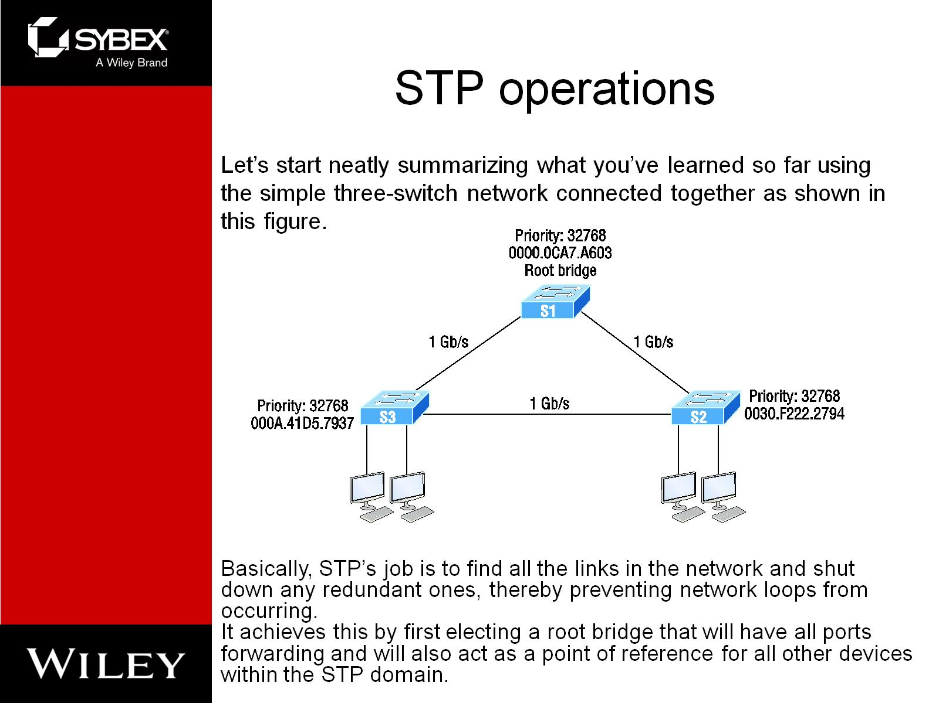
STP operations

Slide 11
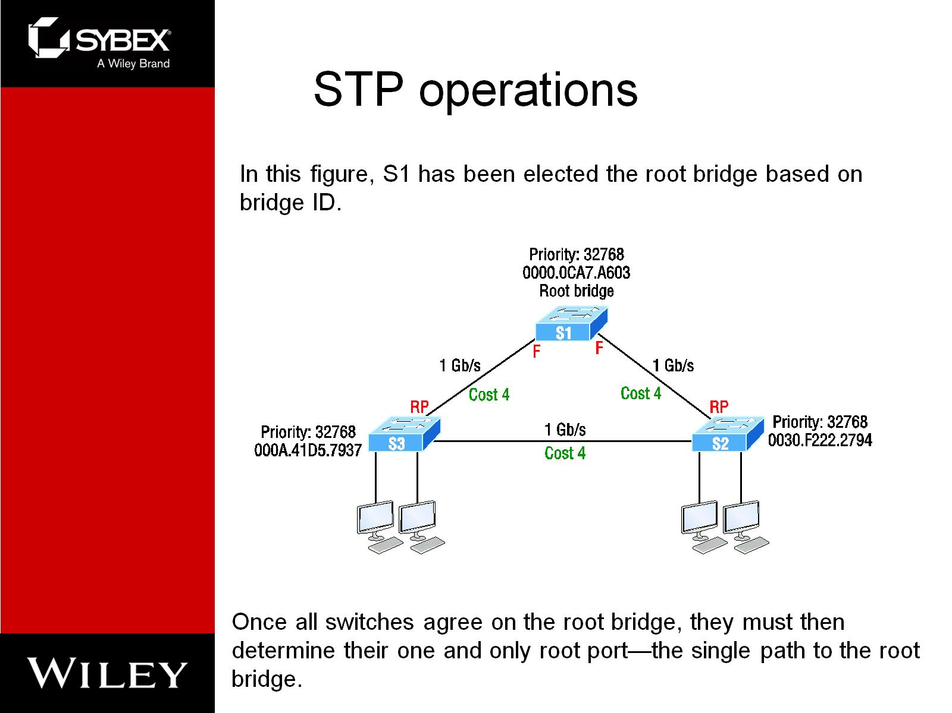
STP operations

Slide 12
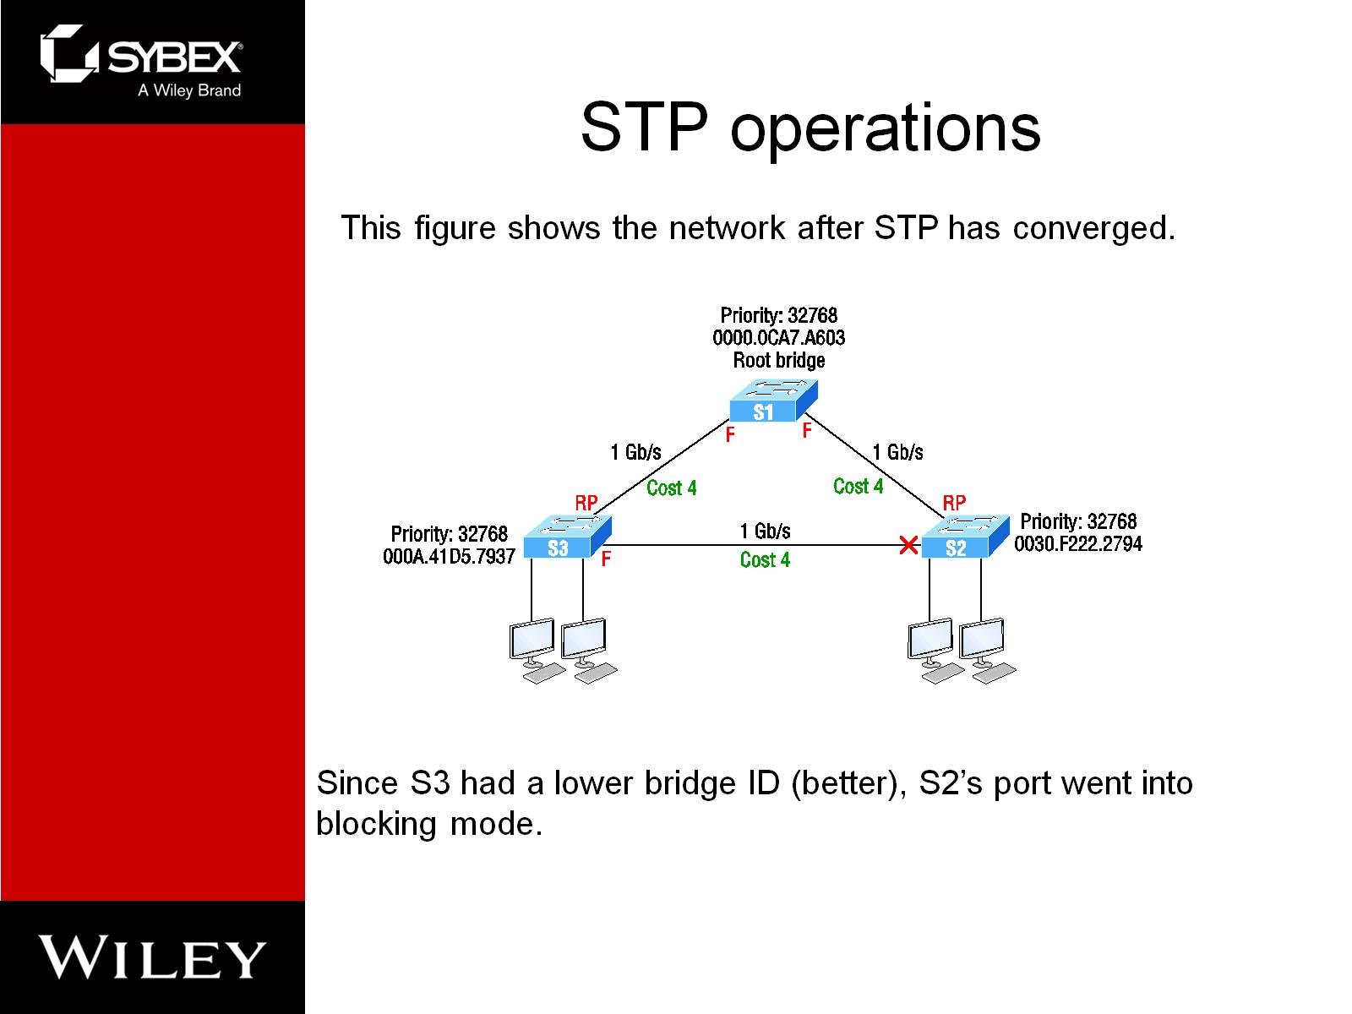
STP operations

Slide 13
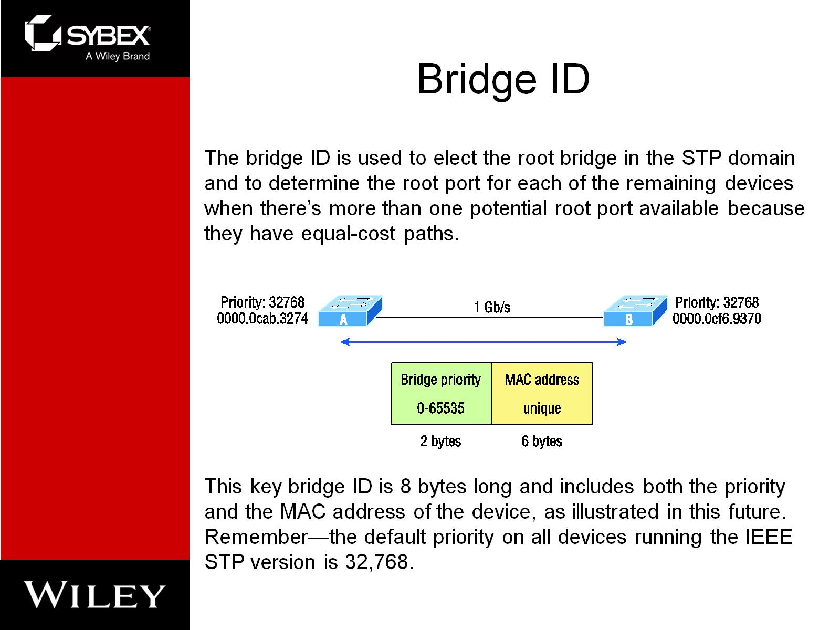
Bridge ID

Slide 14
Types of Spanning-tree Protocols
IEEE 802.1d: The original standard for bridging and STP, which is really slow but requires very little bridge resources. It's also referred to as Common Spanning Tree (CST). PVST+: The Cisco proprietary enhancement for STP that provides a separate 802.1d spanning-tree instance for each VLAN. Know that this is just as slow as the CST protocol, but with it, we get to have multiple root bridges.
IEEE 802.1w: Also called Rapid Spanning Tree Protocol (RSTP), this iteration enhanced the BPDU exchange and paved the way for much faster network convergence, but it still only allows for one root bridge per network like CST. Rapid PVST+: Cisco's version of RSTP that also uses PVST+ and provides a separate instance of 802.1w per VLAN. It gives us really fast convergence times and optimal traffic flow but predictably requires the most CPU and memory of all.

Slide 15
Common STP example

Slide 16
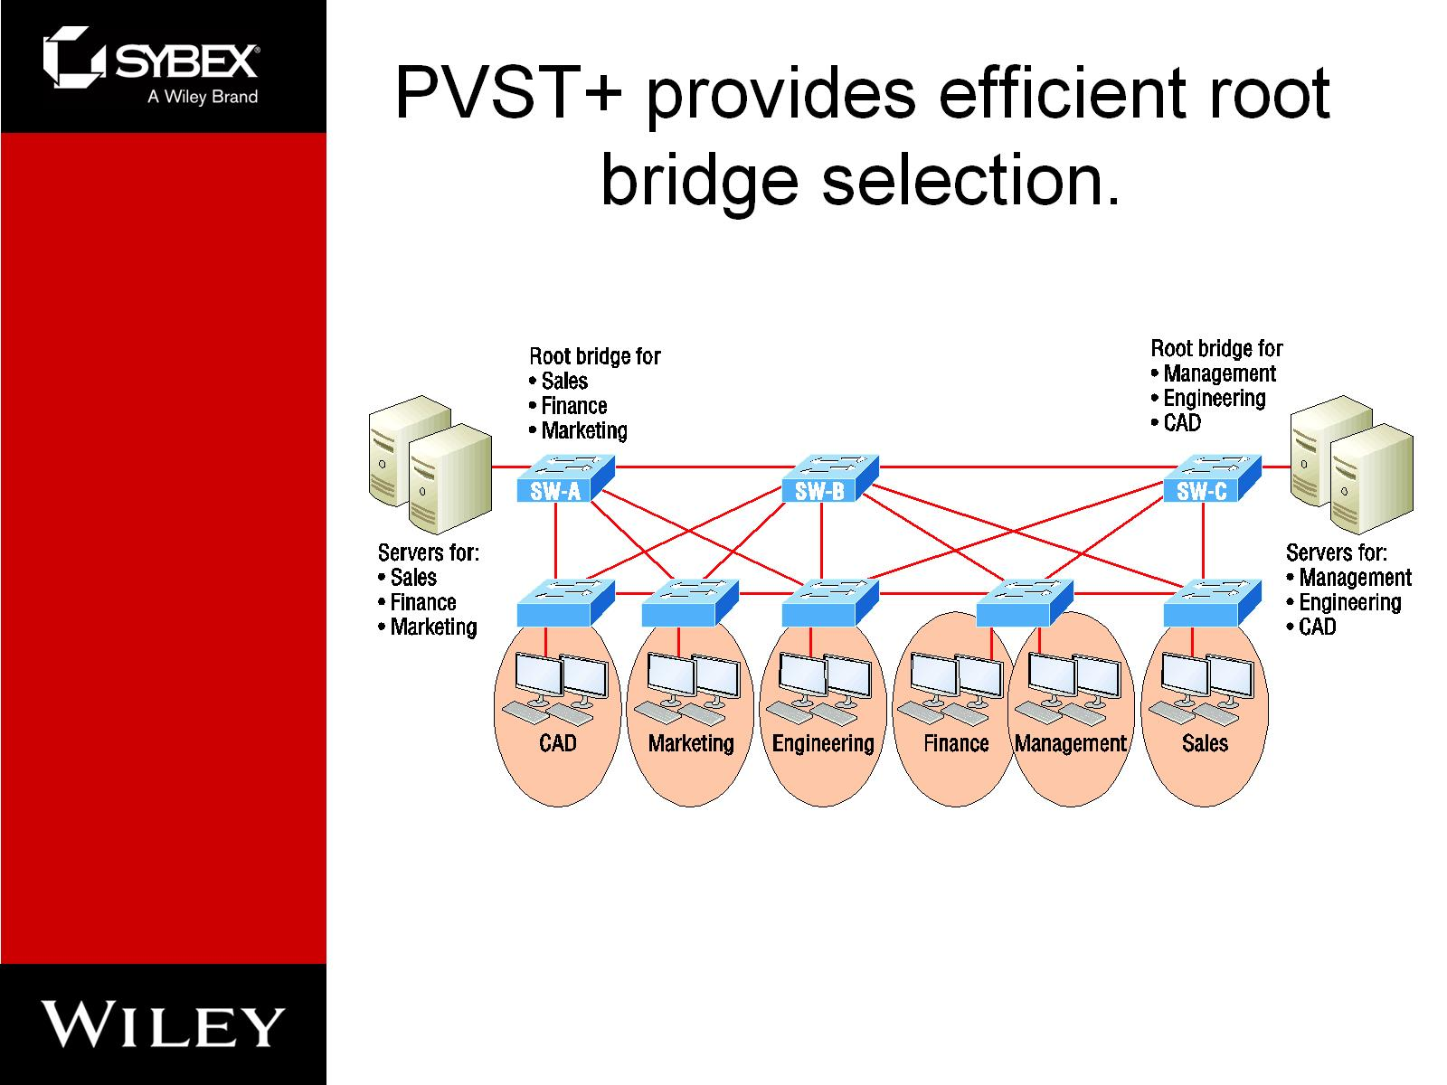
PVST+ provides efficient root bridge selection.

Slide 17
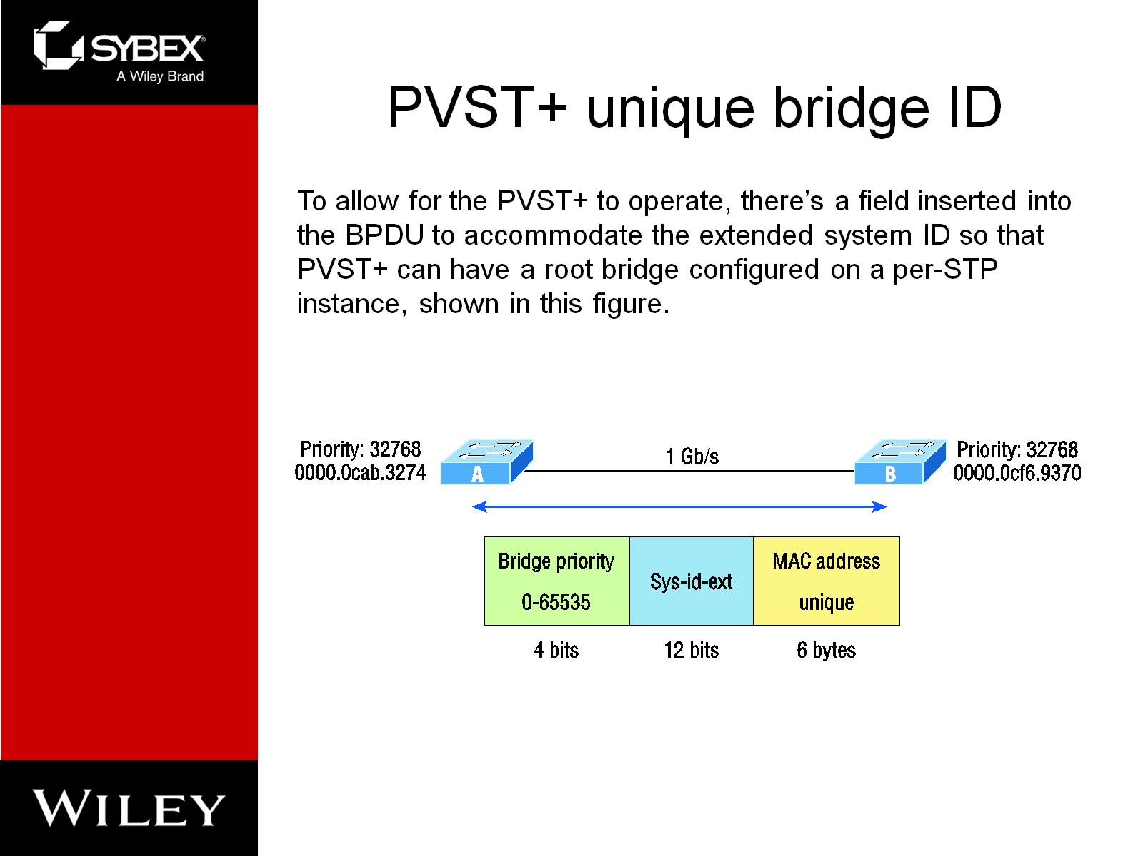
PVST+ unique bridge ID

Slide 18
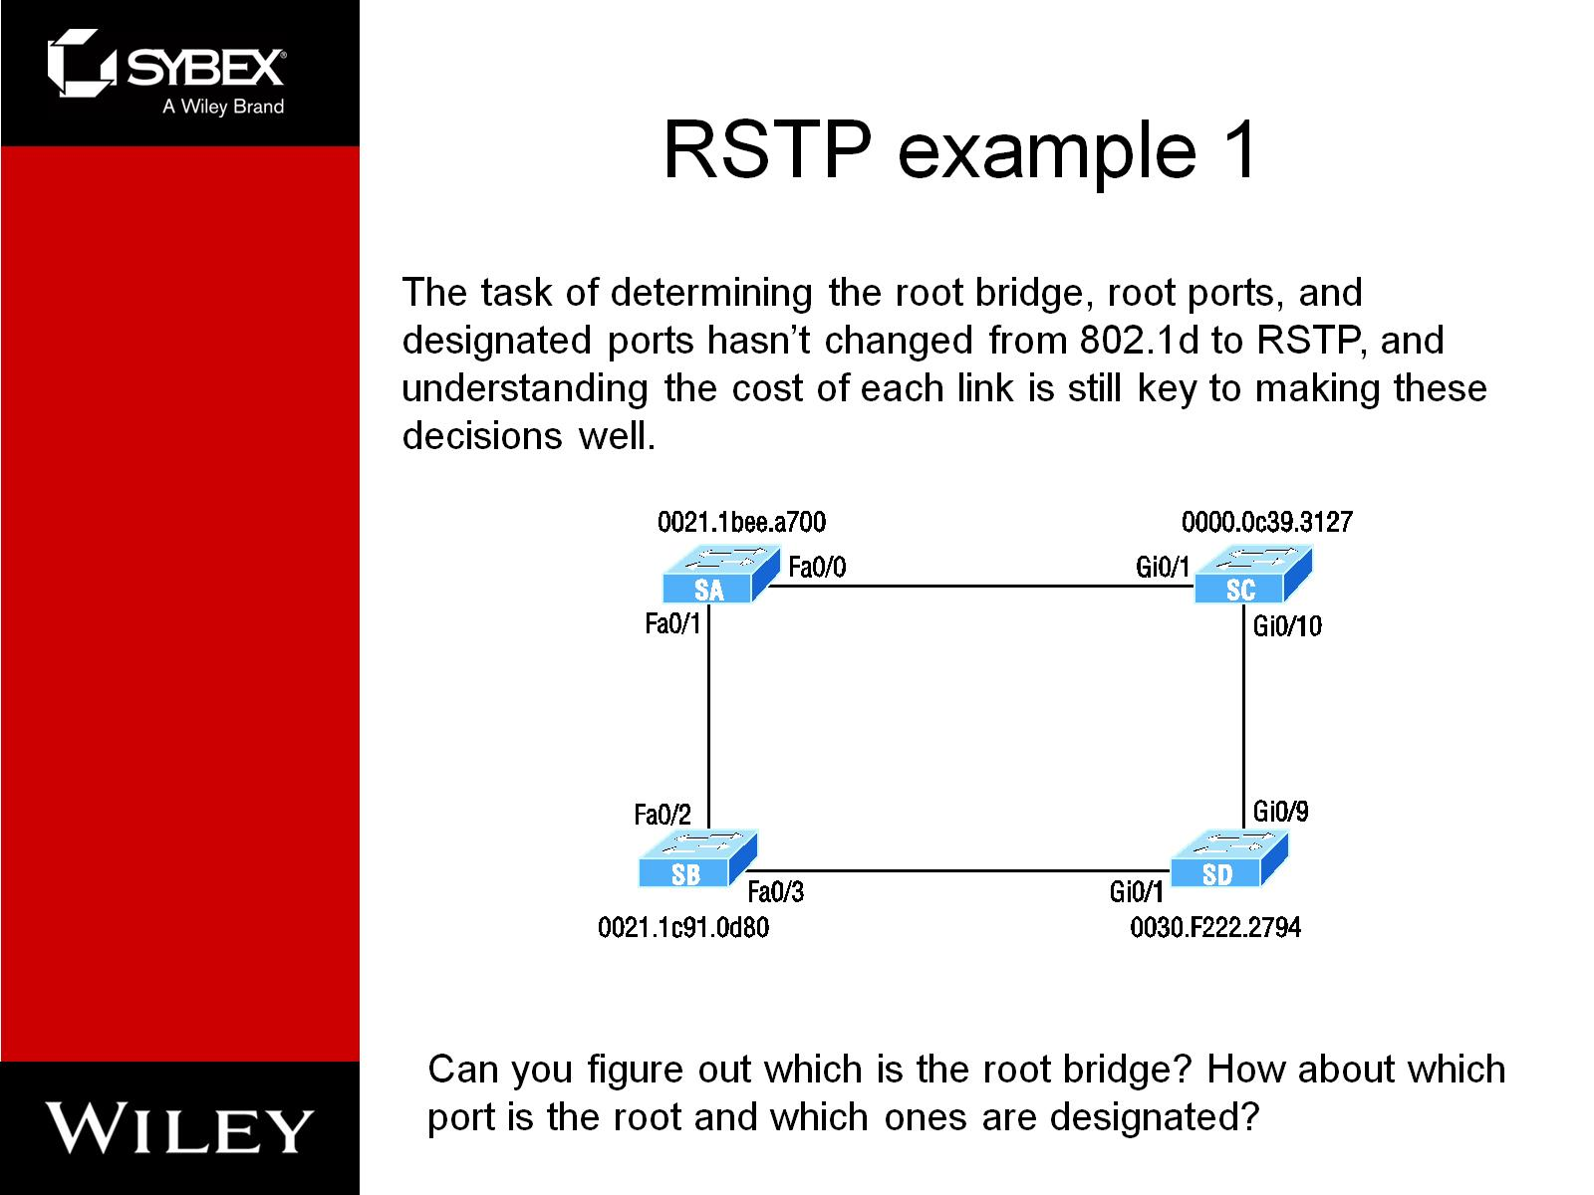
RSTP example 1

Slide 19
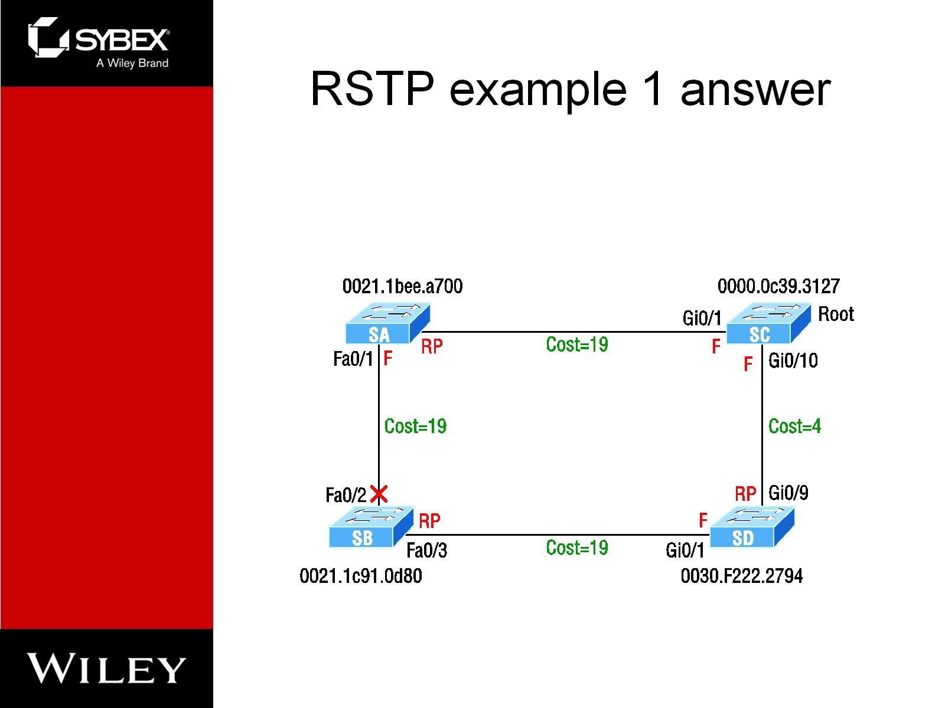
RSTP example 1 answer

Slide 20
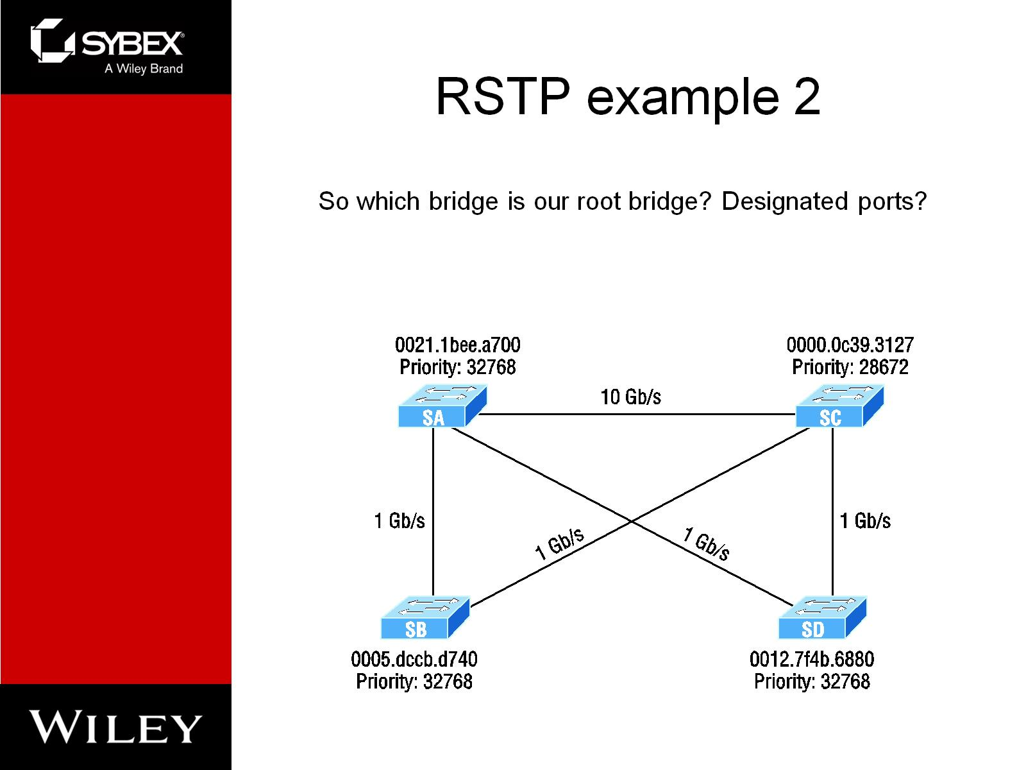
RSTP example 2

Slide 21
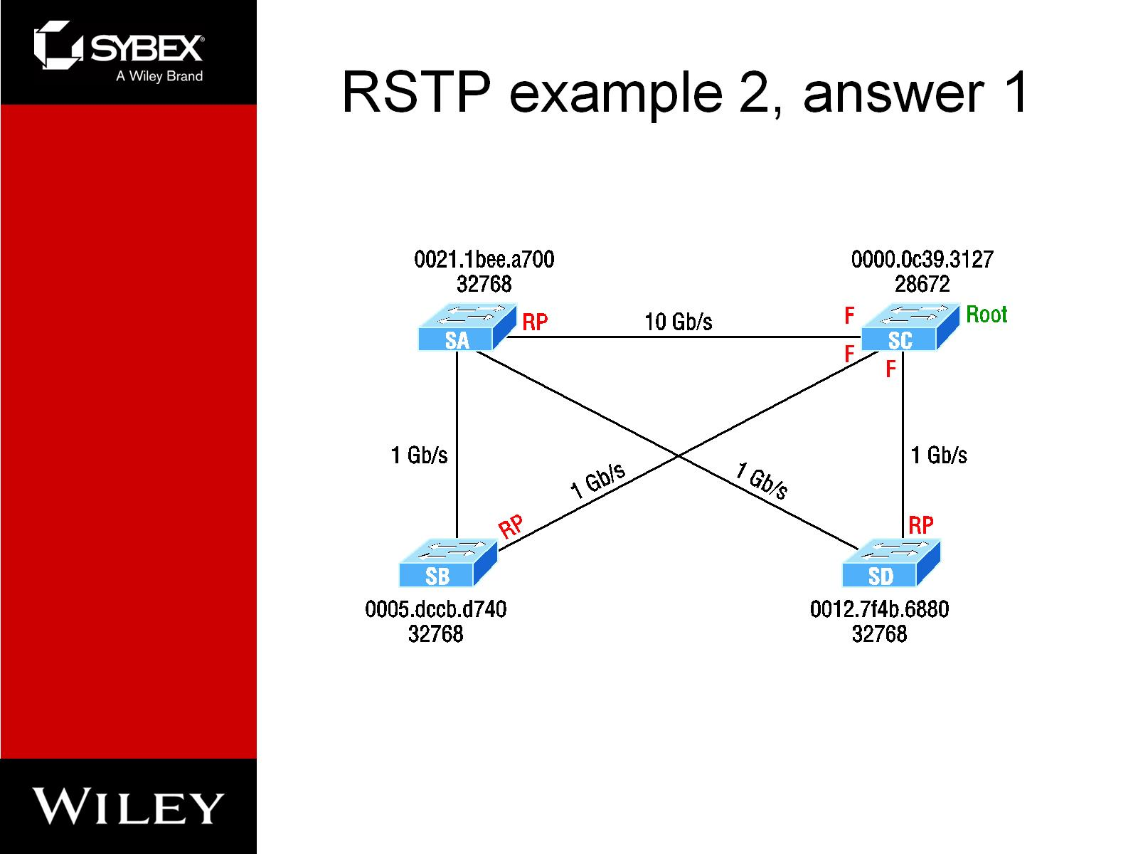
RSTP example 2, answer 1

Slide 22
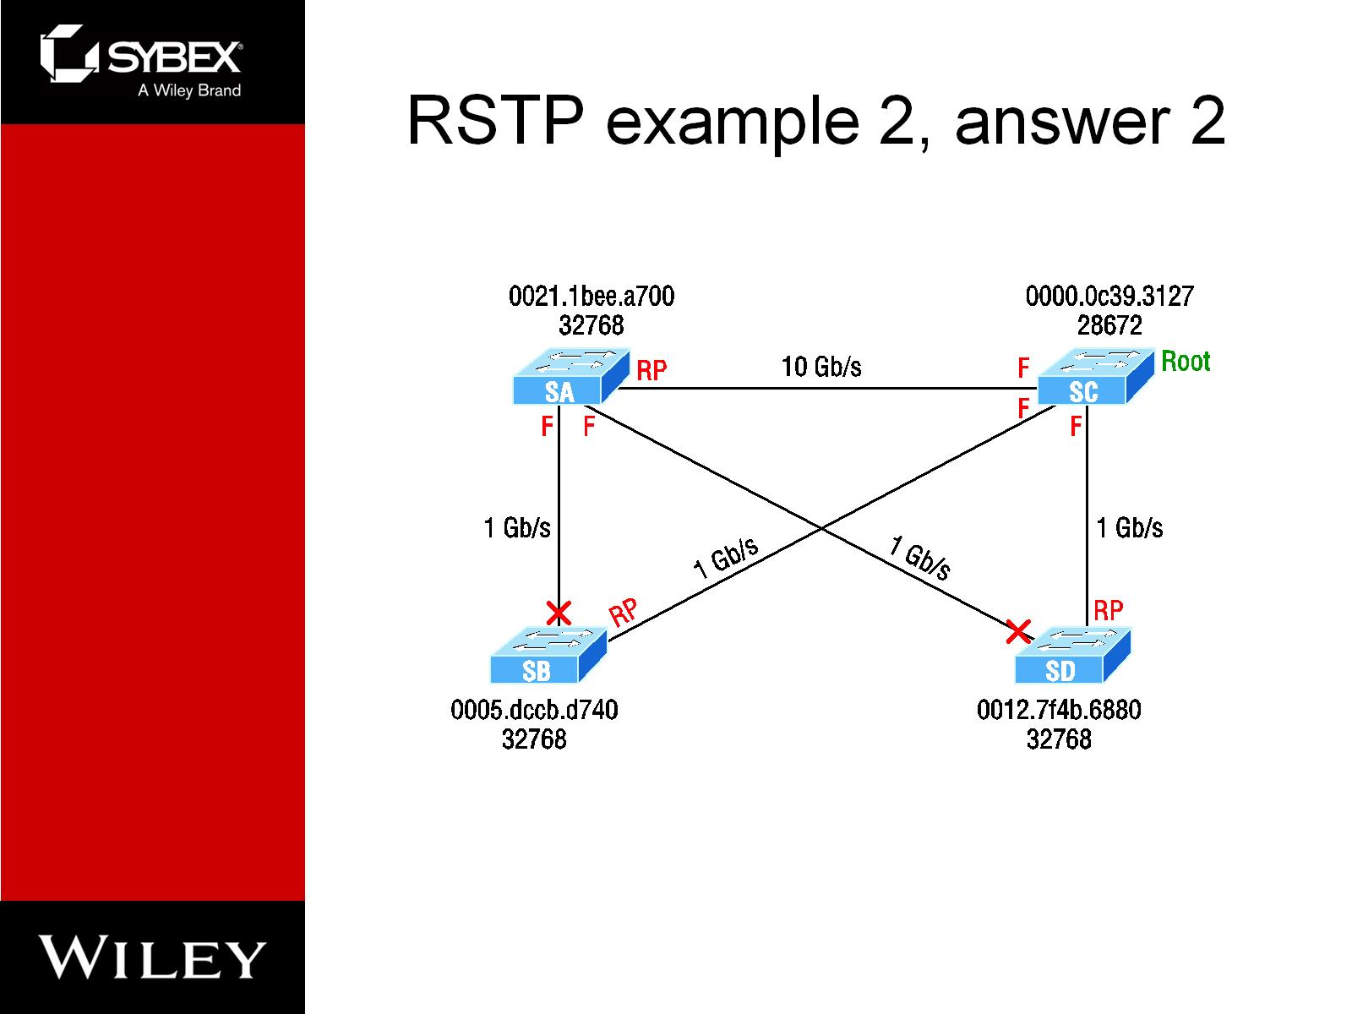
RSTP example 2, answer 2

Slide 23
How are the designated ports chosen?
To choose the switch that will forward on the segment, we select the switch with the lowest accumulated path cost to the root bridge. We want the fast path to the root bridge.
If there is a tie on the accumulated path cost from both switches to the root bridge, then we'll use bridge ID
Port priorities can be set manually if we want a specific port chosen. The default priority is 32, but we can lower that if needed.
If there are two links between switches, and the bridge ID and priority are tied, the port with the lowest number will be chosen—for example, Fa0/1 would be chosen over Fa0/2.

Slide 24
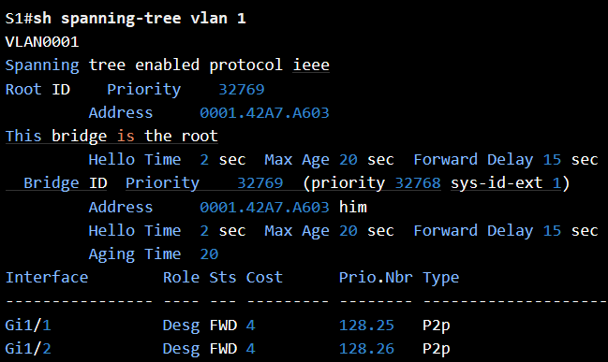
Modifying and Verifying the Bridge ID

Slide 25
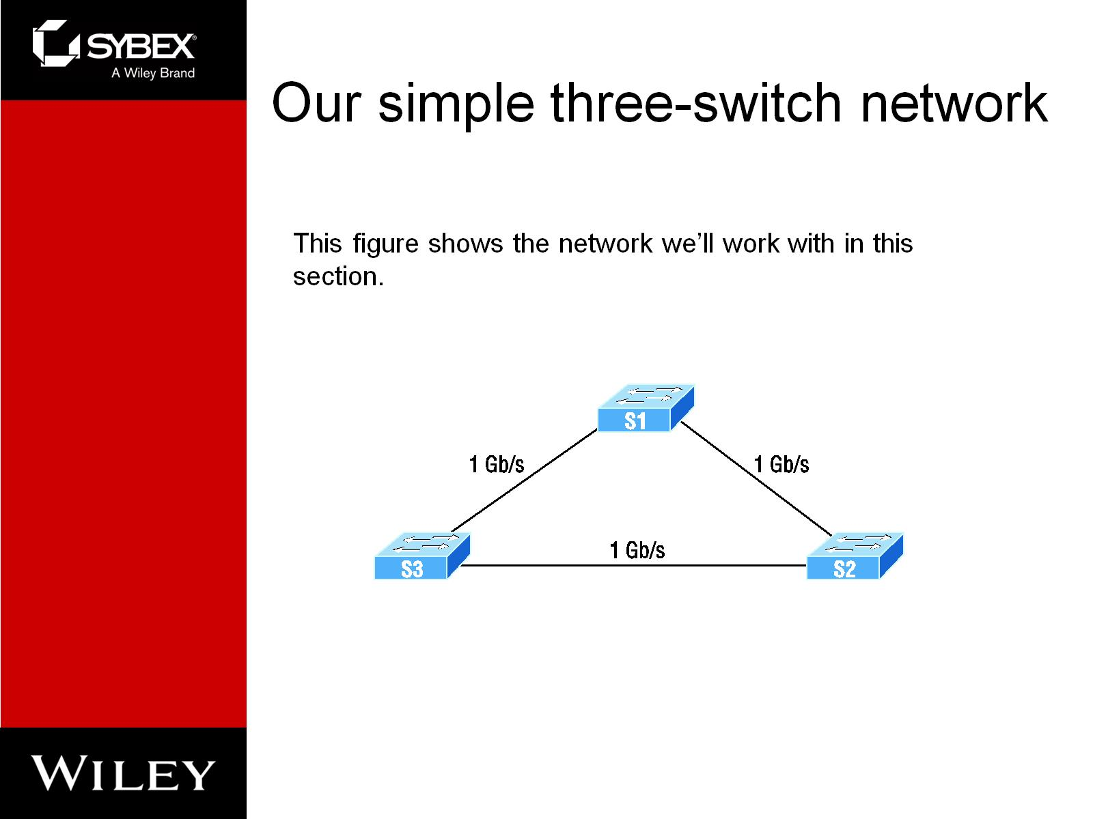
Our simple three-switch network

Slide 26
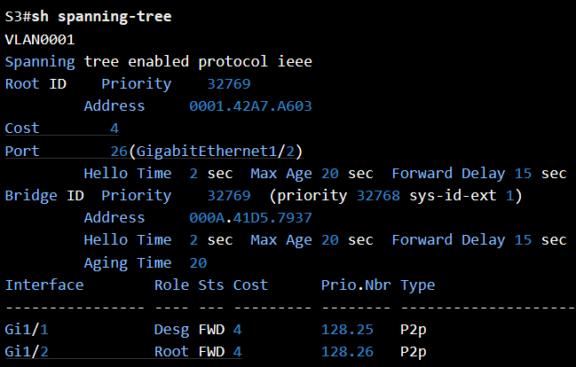
S3’s output

Slide 27
Set the priority
You can set the priority to any value from 0 through 61440 in increments of 4096.
Setting it to zero (0) means that the switch will always be a root as long as it has a lower MAC address than another switch that also has its bridge ID set to 0.

Slide 28
Enable RSTP on a Cisco switch

Slide 29
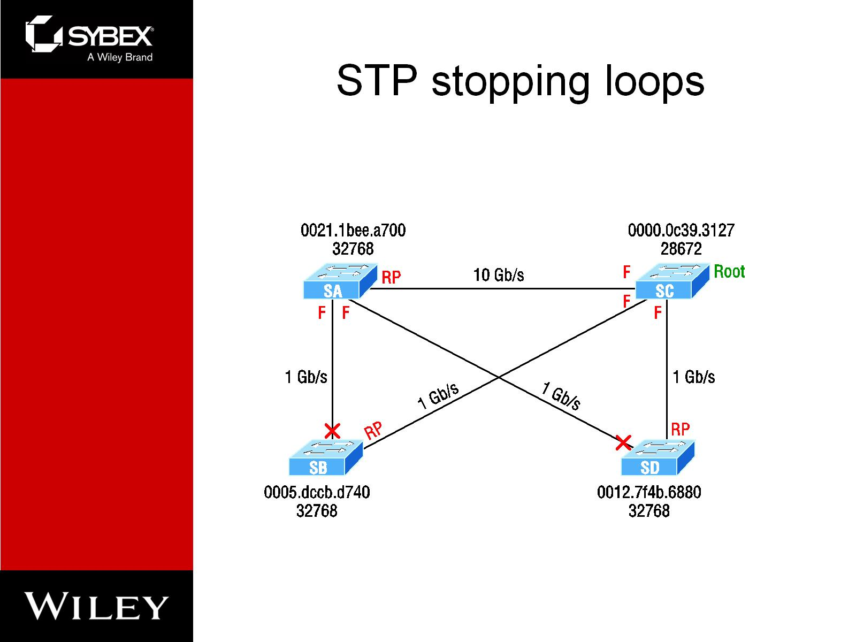
STP stopping loops

Slide 30
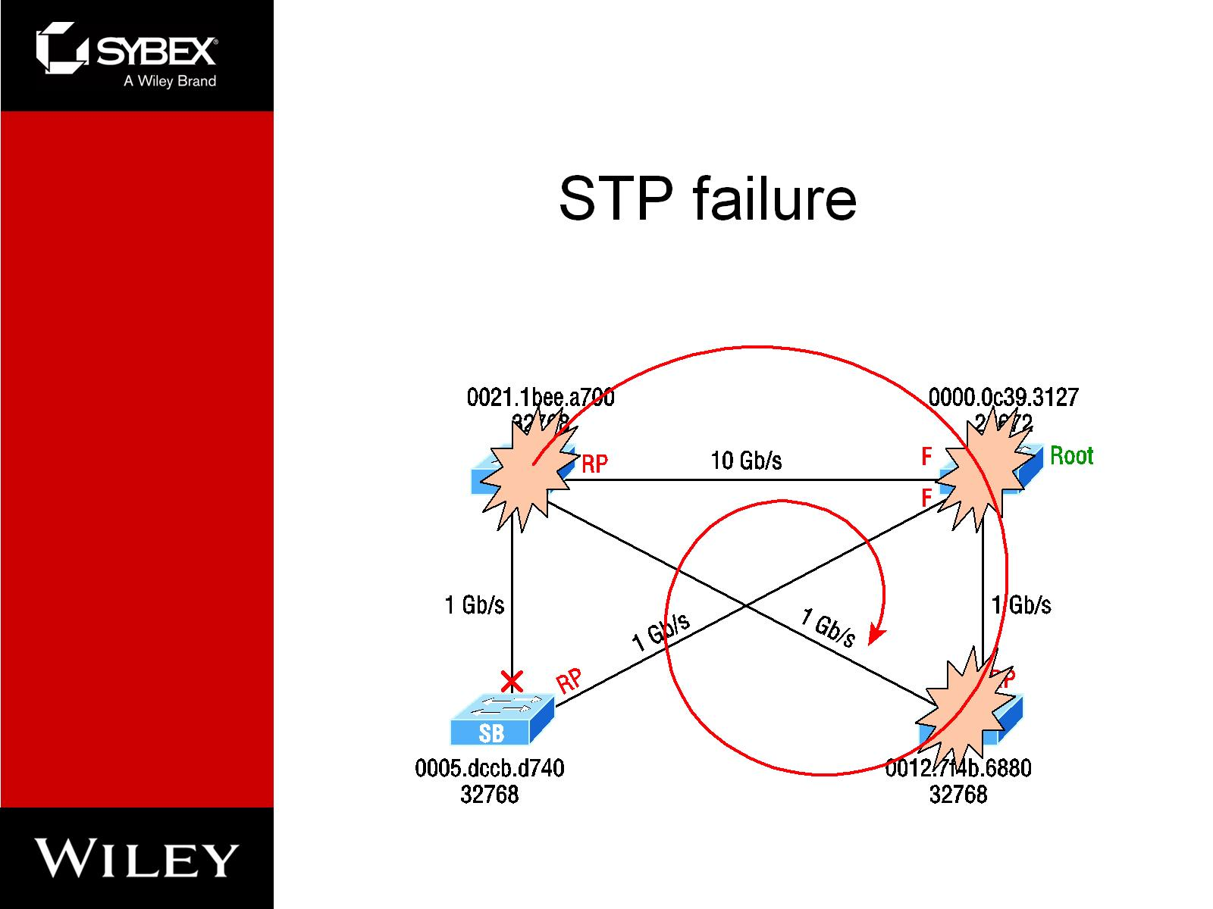
STP failure

Slide 31
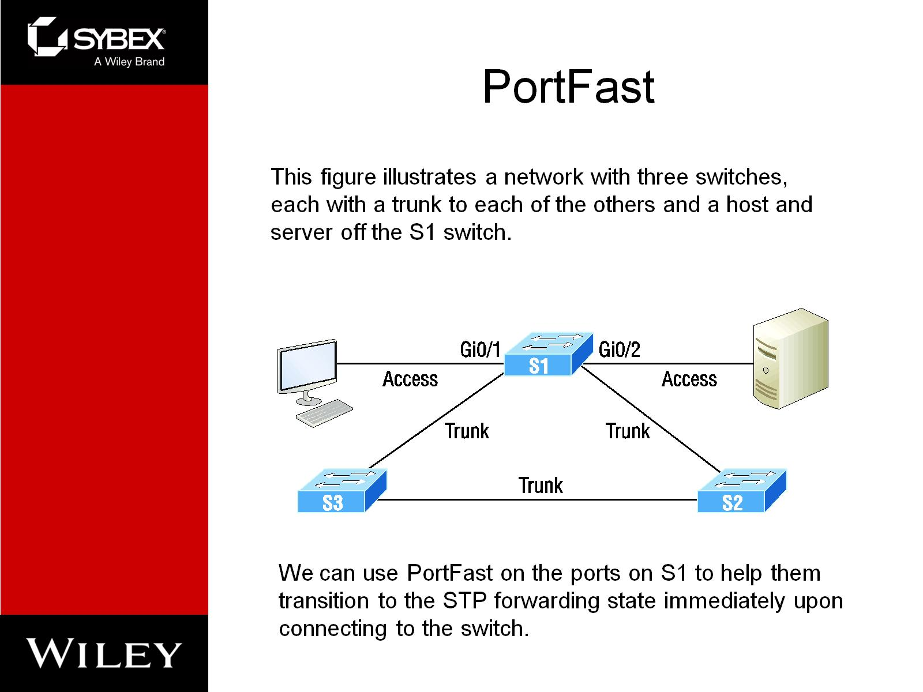
PortFast

Slide 32
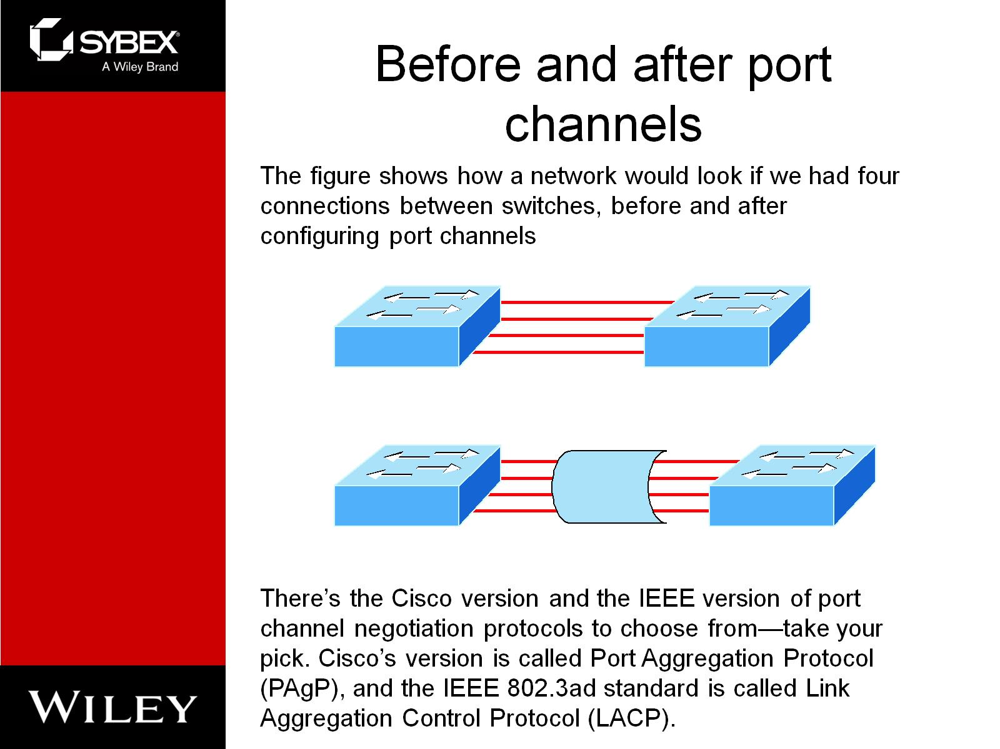
Before and after port channels

Slide 33
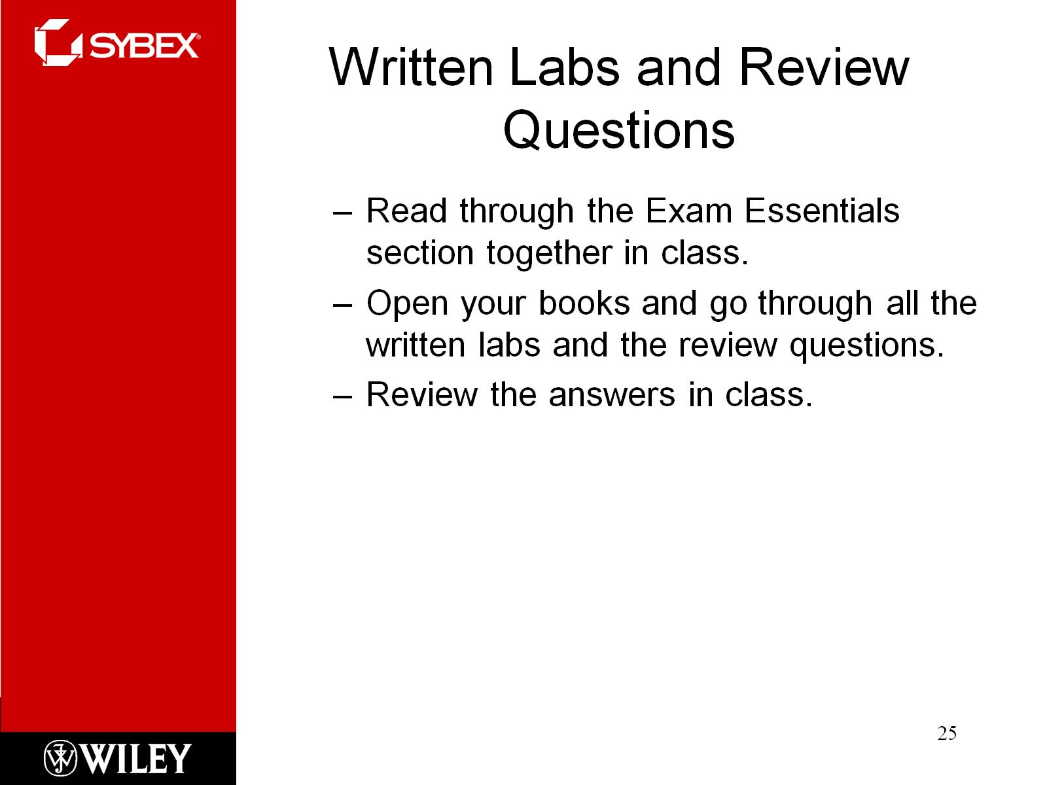
Written Labs and Review Questions

