Slide 1
CCNA Routing and Switching Study Guide
Chapters 2 &16: Network Device Management and Security
Instructor & Todd Lammle

Slide 2
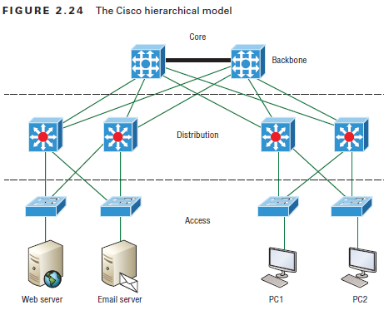
Mitigating Threats at the Access Layer

Slide 3
The Access Layer
The following are some of the functions to be included at the access layer:
Continued (from the distribution layer) use of access control and policies
Creation of separate collision domains (microsegmentation/switches)
Workgroup connectivity into the distribution layer
Device connectivity
Resiliency and security services
Advanced technology capabilities (voice/video, PoE, port-security, etc.). Interfaces like Gigabit or FastEthernet switching frequently seen in the access layer

Slide 4
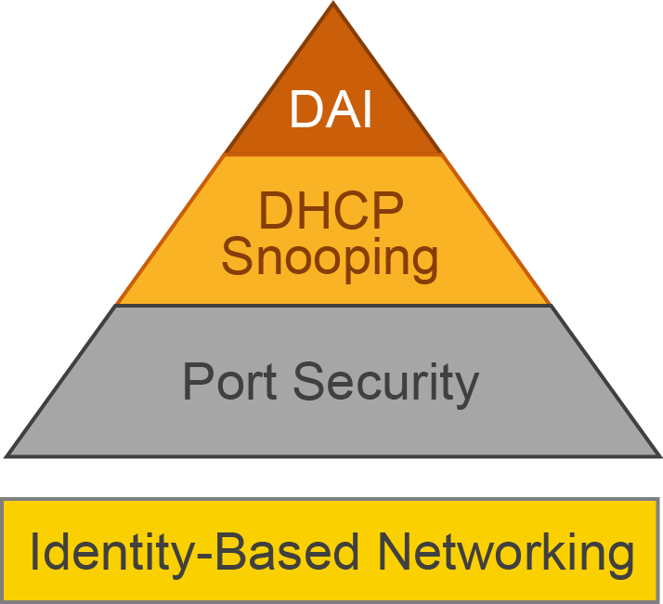
Mitigating threats at the access layer

Slide 5
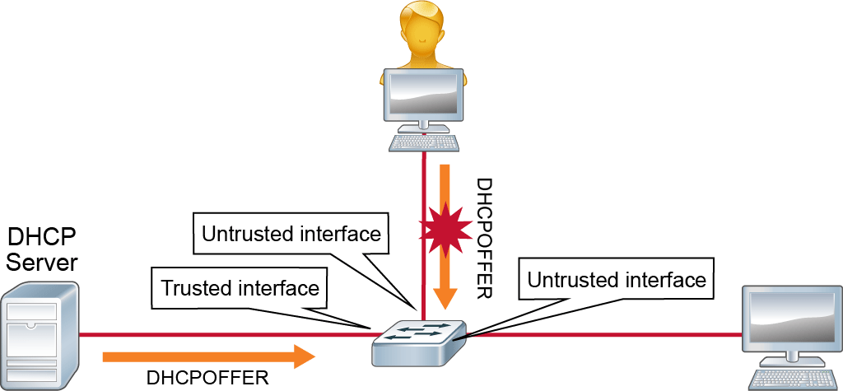
DHCP snooping and DAI
BadGuy

Slide 6
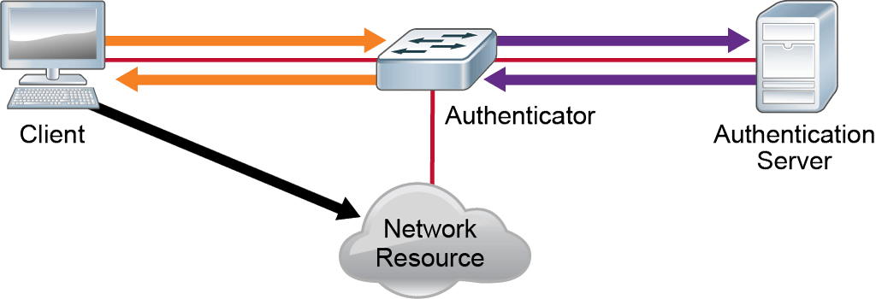
Identity-based networking

Slide 7
802.1x
The IEEE 802.1x standard allows you to implement identity-based networking on wired and wireless hosts by using client/server access control. There are three roles:
Client
Also referred to as a supplicant, this software runs on a client that is 802.1x compliant.
Authenticator
Typically a switch, this controls physical access to the network and is a proxy between the client and the authentication server.
Authentication server (RADIUS)
This is a server that authenticates each client before
making available any services.

Slide 8
Client Redundancy Issues
If you’re wondering how you can possibly configure a client to send data off its local link when its default gateway router has gone down, you’ve targeted a key issue because the answer is that usually, you can’t!

Slide 9
Proxy ARP
If a Proxy ARP–enabled router receives an ARP request for an IP address that it knows isn’t on the same subnet as the requesting host, it will respond with an ARP reply packet to the host.

Slide 10
FHRPs use a virtual router with a virtual IP address and virtual MAC address.
First hop redundancy protocols (FHRPs) work by giving you a way to configure more than one physical router to appear as if they were only a single logical one.

Slide 11
HSRP
HSRP is a Cisco proprietary protocol that can be run on most, but not all, of Cisco’s router and multilayer switch models. It defines a standby group, and each standby group that you define includes the following routers:
Active router
Standby router
Virtual router
Any other routers that maybe attached to the subnet

Slide 12
HSRP active and standby routers
The problem with HSRP is that with it, only one router is active and two or more routers just sit there in standby mode and won’t be used unless a failure occurs—not very cost effective or efficient!
The standby group will always have at least two routers participating in it. The primary players in the group are the one active router and one standby router that communicate to each other using multicast Hello messages.

Slide 13
HSRP virtual MAC
The HSRP MAC address has only one variable piece in it. The first 24 bits still identify the vendor who manufactured the device (the organizationally unique identifier, or OUI).
The next 16 bits in the address tells us that the MAC address is a well-known HSRP MAC.
Here is an example of what an HSRP MAC address would look like:
0000.0c07.ac0a
The first 24 bits (0000.0c) are the vendor ID of the address; in the case of HSRP being a Cisco protocol, the ID is assigned to Cisco.
The next 16 bits (07.ac) are the well-known HSRP ID. This part of the address was assigned by Cisco in the protocol, so it’s always easy to recognize that this address is for use with HSRP.
The last 8 bits (0a) are the only variable bits and represent the HSRP group number that you assign. In this case, the group number is 10 and converted to hexadecimal when placed in the MAC address, where it becomes the 0a that you see.

Slide 14
HSRP Timers
Hello timer
The defined interval during which each of the routers send out Hello messages
Hold timer
Specifies the interval that standby router uses to determine whether the active router is offline or out of communication
Active timer
Monitors the state of the active router and resets each time a router in the standby group receives a Hello packet from the active router
Standby timer
Monitors the state of the standby router and resets anytime a router in the standby group receives a Hello packet from the standby router

Slide 15
Group Roles
Virtual router
A virtual IP and MAC address to which packets are sent
Active router
Receive data sent to the virtual router address and answer any ARP requests destined for the virtual router’s IP address.
Standby router
The backup to the active router.

Slide 16
Interface tracking
HSRP-enabled routers can keep track of the interface status of the outside interfaces
If the outside link of the active router goes down, the standby router will take over and become the active router

Slide 17
Configuring and Verifying HSRP
#standby 1 ip 10.1.1.10
#standby 1 name HSRP_Test
#standby 1 priority 110
#show standby
#show standby brief
#debug standby

Slide 18
Written labs and review questions
Read through the Exam Essentials section together in class.
Open your books and go through all the written labs and the review questions.
Review the answers in class.
18

