Slide 1


Sybex ICND2 200-105
Chapter 4 and 18: OSPF
Instructor & Todd Lammle

Slide 2
OSPF design example.
An OSPF hierarchical design minimizes routing table entries and keeps the impact of any topology changes contained within a specific area.

Slide 3

OSPF Terminology
Link: A link is a network or router interface assigned to any given network. When an interface is added to the OSPF process, it's considered to be a link.
Router ID: The router ID (RID) is an IP address used to identify the router.
Neighbor: Neighbors are two or more routers that have an interface on a common network, such as two routers connected on a point-to-point serial link. OSPF neighbors must have a number of common configuration options to be able to successfully establish a neighbor relationship, and all of these options must be configured exactly the same way:
Area ID
Stub area flag
Authentication password (if using one)
Hello and Dead intervals
3

Slide 4
OSPF Terminology
Adjacency: An adjacency is a relationship between two OSPF routers that permits the direct exchange of route updates.
Unlike EIGRP, which directly shares routes with all of its neighbors, OSPF is really picky about sharing routing information and will directly share routes only with neighbors that have also established adjacencies. And not all neighbors will become adjacent—this depends upon both the type of network and the configuration of the routers.
In multi-access networks, routers form adjacencies with designated and backup designated routers. In point-to-point and point-to-multipoint networks, routers form adjacencies with the router on the opposite side of the connection.
4

Slide 5
OSPF Terminology
Designated router: A designated router (DR) is elected whenever OSPF routers are connected to the same broadcast network。 Elections are won based upon a router‘s priority level, with the one having the highest priority becoming the winner. If there’s a tie, the router ID will be used to break it. All routers on the shared network will establish adjacencies with the DR and the BDR, which ensures that all routers‘ topology tables are synchronized. Backup designated router: A backup designated router (BDR) is a hot standby for the DR on broadcast, or multi-access, links. The BDR receives all routing updates from OSPF adjacent routers but does not disperse Link State Advertisements (LSA) updates.
5

Slide 6
OSPF Terminology
Hello protocol: The OSPF Hello protocol provides dynamic neighbor discovery and maintains neighbor relationships. Hello packets and Link State Advertisements (LSAs) build and maintain the topological database. Neighborship database: The neighborship database is a list of all OSPF routers for which Hello packets have been seen. Topological database: The topological database contains information from all of the Link State Advertisement packets that have been received for an area. The router uses the information from the topology database as input into the Dijkstra algorithm that computes the shortest path to every network.
6

Slide 7
OSPF Terminology
Link State Advertisement: A Link State Advertisement (LSA) is an OSPF data packet containing link-state and routing information that's shared among OSPF routers. An OSPF router will exchange LSA packets only with routers to which it has established adjacencies. OSPF areas: An OSPF area is a grouping of contiguous networks and routers. All routers in the same area share a common area ID. Because a router can be a member of more than one area at a time, the area ID is associated with specific interfaces on the router.
7

Slide 8
OSPF Terminology
Broadcast (multi-access): a single packet is delivered to all nodes on the network. In OSPF, a DR and BDR must be elected for each broadcast multi-access network. Nonbroadcast multi-access: These types of networks allow for multi-access without broadcast ability like Ethernet.
Point-to-point: Point-to-point refers to a type of network topology made up of a direct connection between two routers that provides a single communication path.
Point-to-multipoint: Point-to-multipoint refers to a type of network topology made up of a series of connections between a single interface on one router and multiple destination routers.
8

Slide 9
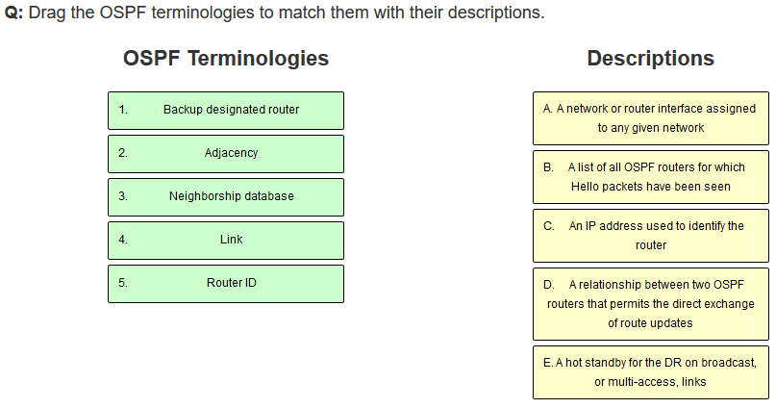
In-class practice
9

Slide 10
OSPF operation
OSPF operation is basically divided into these three categories:
Neighbor and adjacency initialization
LSA flooding
SPF tree calculation
10

Slide 11
The Hello protocol
The Hello protocol is used to discover neighbors, establish adjacencies, and maintain relationships with other OSPF routers. Hello packets are periodically sent out each enabled OSPF interface and in environments that support multicast.

Slide 12
LSA update multicast addresses
Network Type | Multicast Address | Description
Point-to-point | 224.0.0.5 | AllSPFRouters
Broadcast | 224.0.0.6 | AllDRouters
Point-to-multipoint | NA | NA
The network type determines the multicast address used for sending updates. Table 9.2 contains the multicast addresses associated with LSA flooding. Point-to-multipoint networks use the adjacent router’s unicast IP address.

Slide 13
SPF Tree Calculation
Within an area, each router calculates the best/shortest path to every network in that same area.
This calculation is based upon the information collected in the topology database and an algorithm called shortest path first (SPF)
The metric or cost of each potential path to a network is used for the route selection in the SPF algorithm
A cost is associated with every outgoing interface included in an SPF tree, defined in RFC 2338,
13

Slide 14
Enbling OSPF
The easiest and also least scalable way to configure OSPF is to just use a single area. Doing this requires a minimum of two commands.
The first command used to activate the OSPF routing process is as follows:
Router(config)#router ospf ?
<1-65535> Process ID
A value in the range from 1 to 65,535 identifies the OSPF process ID.

Slide 15
Configuring OSPF areas
Here’s an example of basic OSPF basic configuration for you, showing our 2nd minimum command needed, the network command:
Router#config t
Router(config)#router ospf 1
Router(config-router)#network 10.0.0.0 0.255.255.255 area ?
<0-4294967295> OSPF area ID as a decimal value
A.B.C.D OSPF area ID in IP address format
Router(config-router)#network 10.0.0.0 0.255.255.255 area 0
The areas can be any number from 0 to 4.2 billion. Don’t get these numbers confused with the process ID, which ranges from 1 to 65,535.

Slide 16
Wildcard example
In this scenario, you have a router with these four subnets connected to four different interfaces:
192.168.10.64/28
192.168.10.80/28
192.168.10.96/28
192.168.10.8/30
All interfaces need to be in area 0, so it seems to me the easiest configuration would look like this:
Test#config t
Test(config)#router ospf 1
Test(config-router)#network 192.168.10.0 0.0.0.255 area 0
Let’s create a separate network statement for each interface using the subnet numbers and wildcards.
Test#config t
Test(config)#router ospf 1
Test(config-router)#network 192.168.10.64 0.0.0.15 area 0
Test(config-router)#network 192.168.10.80 0.0.0.15 area 0
Test(config-router)#network 192.168.10.96 0.0.0.15 area 0
Test(config-router)#network 192.168.10.8 0.0.0.3 area 0

Slide 17
Sample OSPF wildcard configuration
Here’s the OSPF configuration using wildcards:
Lab_A#config t
Lab_A(config)#router ospf 1
Lab_A(config-router)#network 192.168.10.64 0.0.0.7 area 0
Lab_A(config-router)#network 10.255.255.80 0.0.0.3 area 0
The Lab A router is using a /29, or 255.255.255.248, mask on the Fa0/0 interface. This is a block size of 8, which is a wildcard of 7. The G0/0 interface is a mask of 255.255.255.252—block size of 4, with a wildcard of 3. Notice that I typed in the subnet number, not the interface IP address.

Slide 18
Our new network layout

Slide 19
Corp router's configuration
Corp#sh ip int brief
Interface IP-Address OK? Method Status Protocol
FastEthernet0/0 10.10.10.1 YES manual up up
Serial0/0 172.16.10.1 YES manual up up
FastEthernet0/1 unassigned YES unset administratively down down
Serial0/1 172.16.10.5 YES manual up up
Corp#config t
Corp(config)#no router rip
Corp(config)#router ospf 132
Corp(config-router)#network 10.10.10.1 0.0.0.0 area 0
Corp(config-router)#network 172.16.10.1 0.0.0.0 area 0
Corp(config-router)#network 172.16.10.5 0.0.0.0 area 0

Slide 20
Adding a non-OSPF network to LA router
We can use the same command that we did under that routing process here as well! Take a look:
LA(config)#router ospf 100
LA(config-router)#passive-interface fastEthernet 0/1
I added this command as an example on interface Fa0/1, which happens to be an interface we’re not using in this network because I want OSPF to work on my other router’s interfaces.

Slide 21
OSPF router ID (RID)
The RID is not only used to advertise routes, it’s also used to elect the designated router (DR) and the backup designated router (BDR). These designated routers create adjacencies when a new router comes up and exchanges LSAs to build topological databases.

Slide 22
Configuring Loopback Interfaces
First, let’s see what the RID is on the Corp router with the show ip ospf command:
Corp#sh ip ospf
Routing Process "ospf 1" with ID 172.16.10.5
[output cut]
Okay—we can see that the RID is 172.16.10.5—the Serial0/0 interface of the router. So
let’s configure a loopback interface using a completely different IP addressing scheme:
Corp(config)#int loopback 0
*Mar 22 01:23:14.206: %LINEPROTO-5-UPDOWN: Line protocol on Interface
Loopback0, changed state to up
Corp(config-if)#ip address 172.31.1.1 255.255.255.255

Slide 23
Verifying OSPF Configuration
Show ip route
Show ip ospf
Show ip ospf database
Show ip ospf interface
Show ip ospf neighbor
Show ip protocols

Slide 24
Written Labs and Review Questions
Read through the Exam Essentials section together in class.
Open your books and go through all the written labs and the review questions.
Review the answers in class.
24

