Slide 1
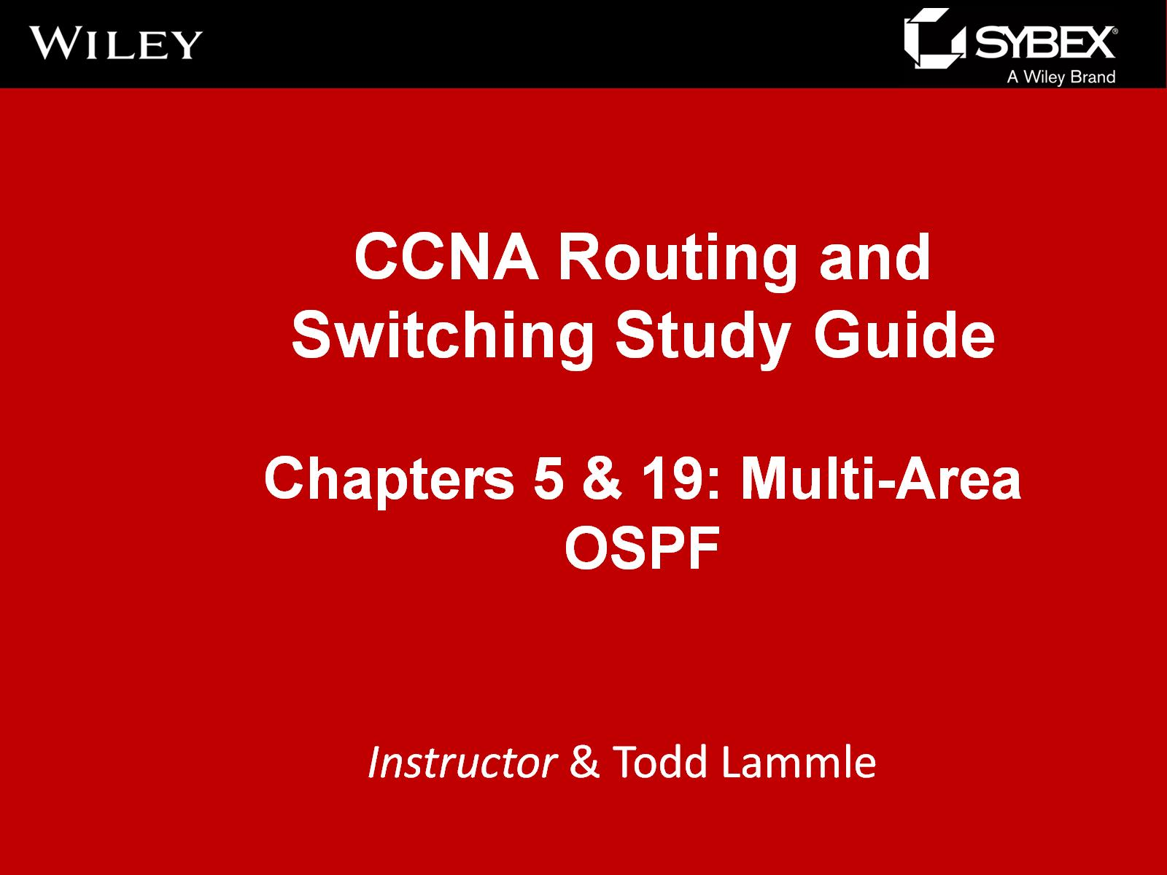

Slide 2
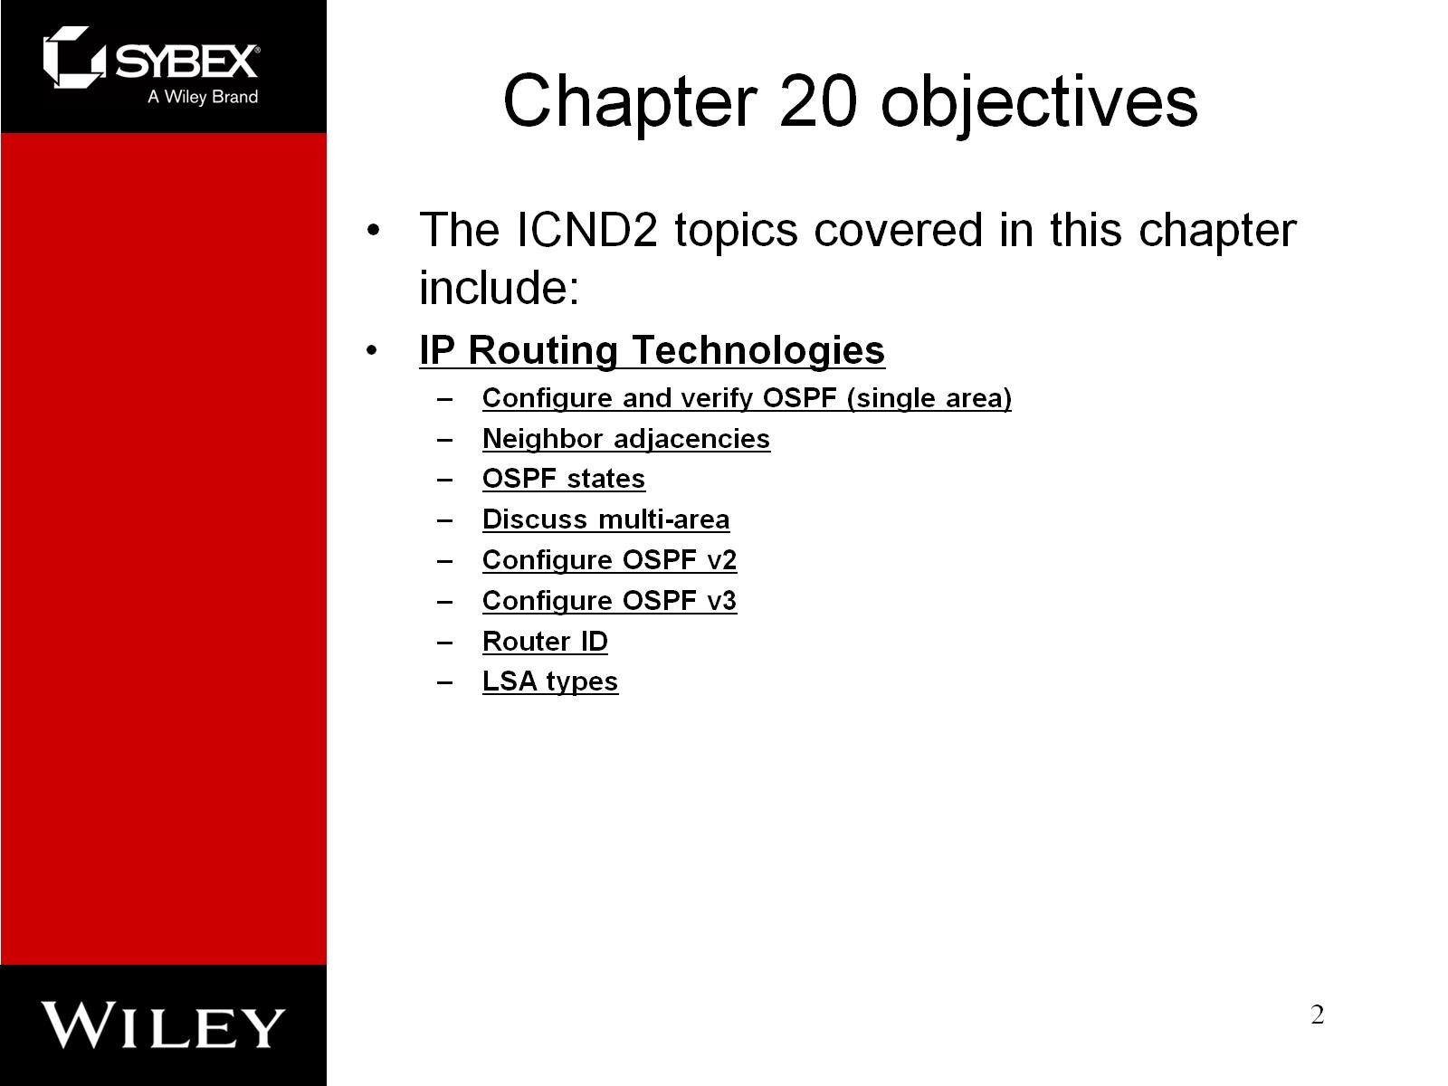
Chapter 20 objectives

Slide 3
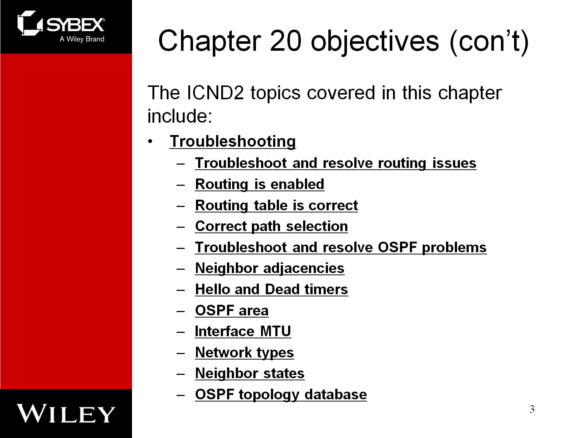
Chapter 20 objectives (con’t)

Slide 4
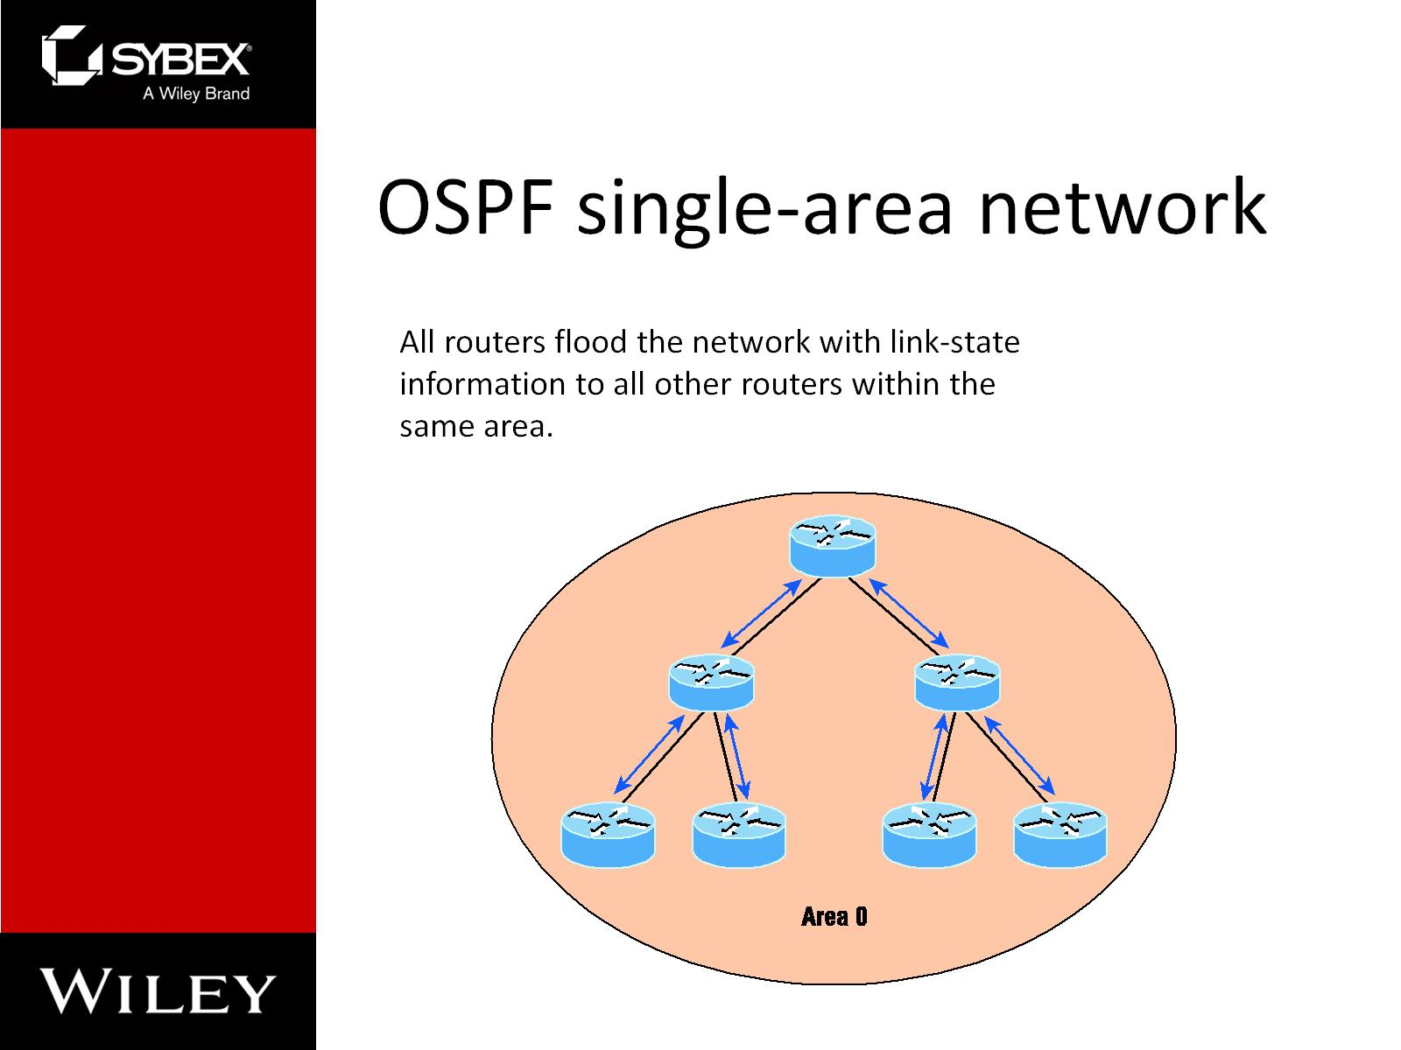
OSPF single-area network

Slide 5
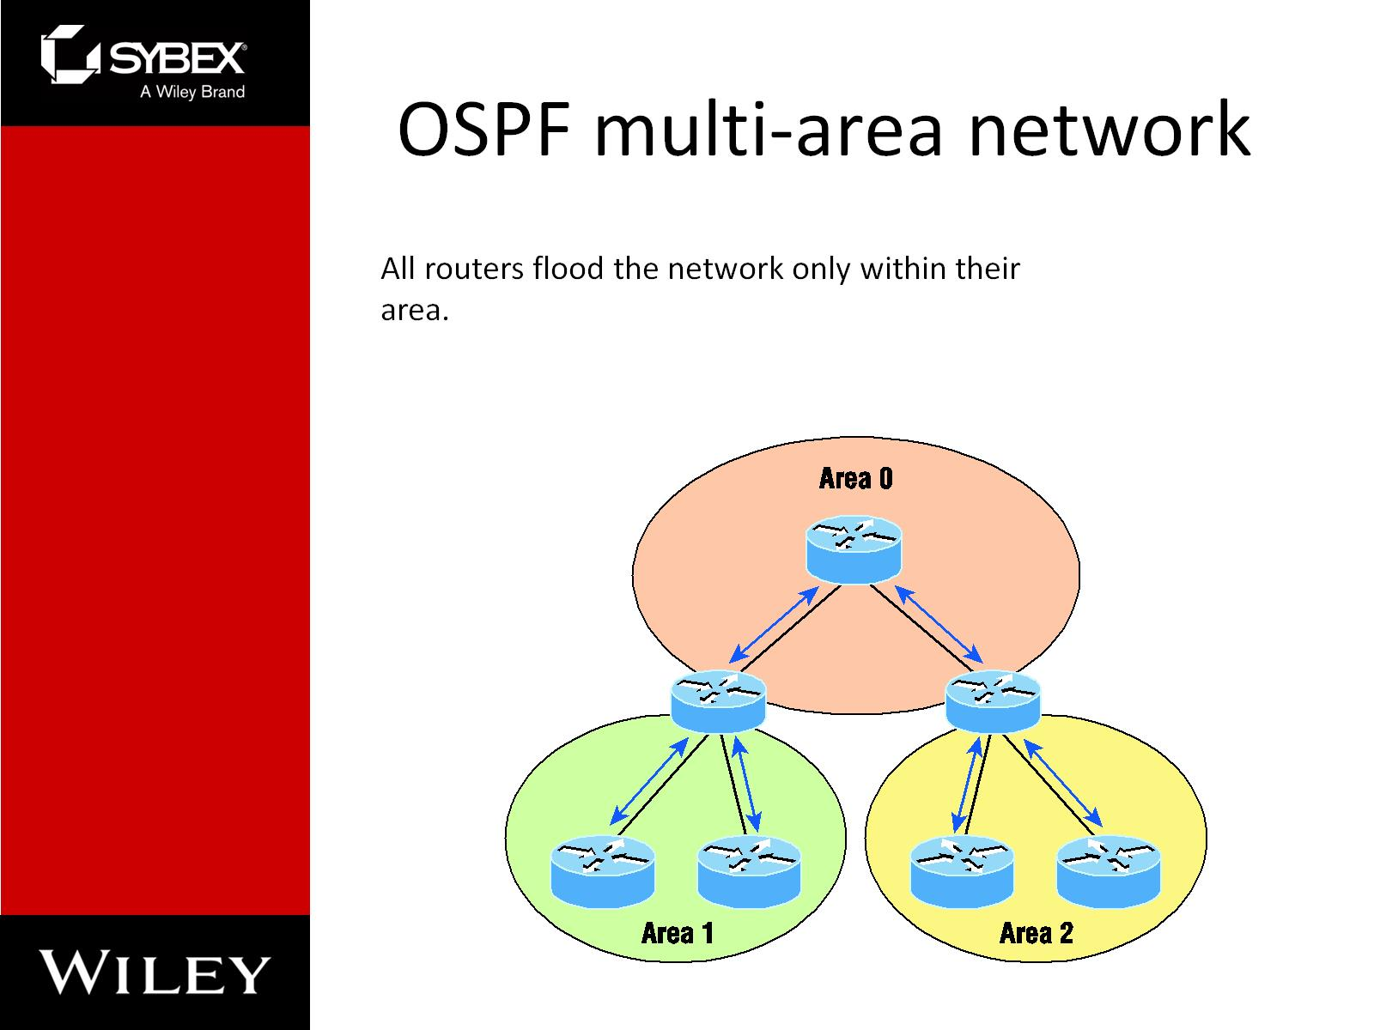
OSPF multi-area network

Slide 6
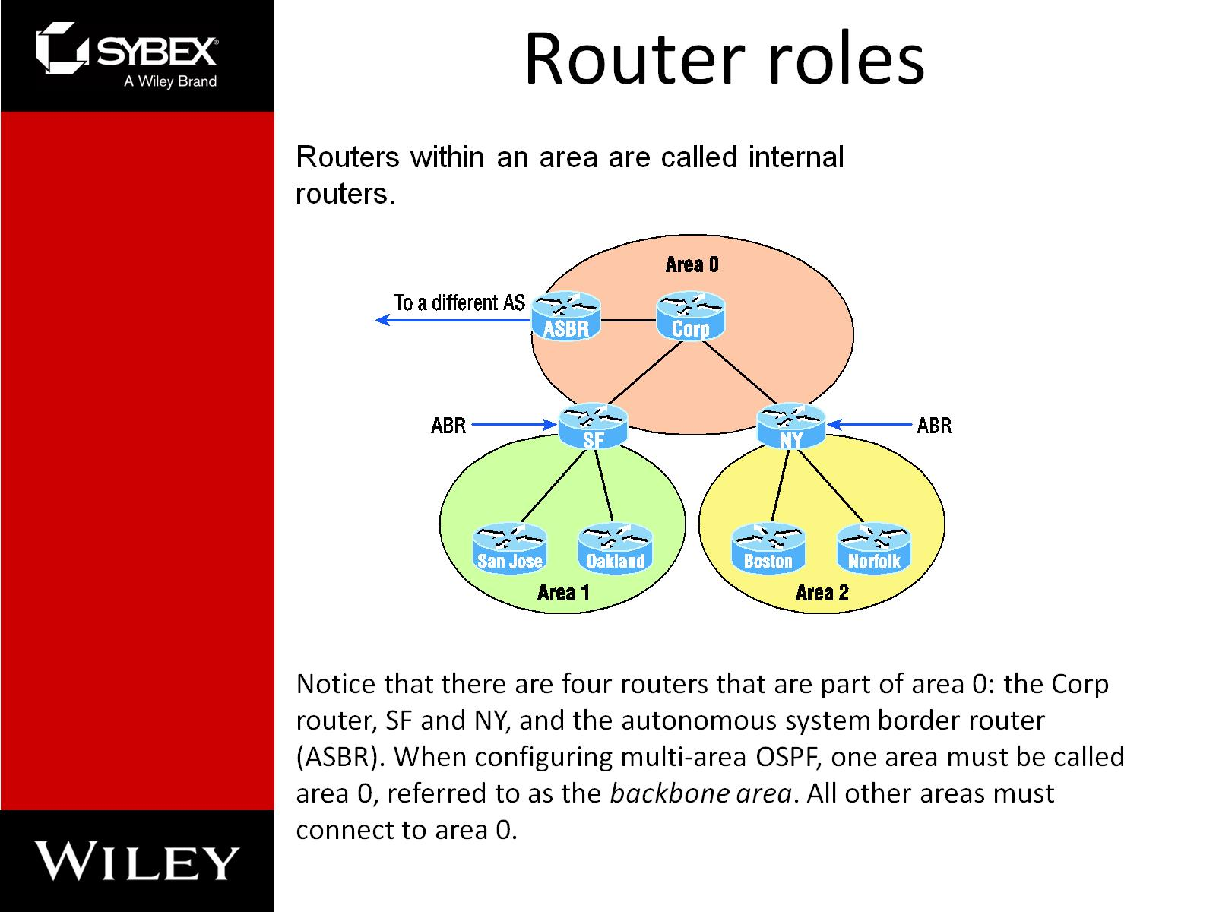
Router roles

Slide 7
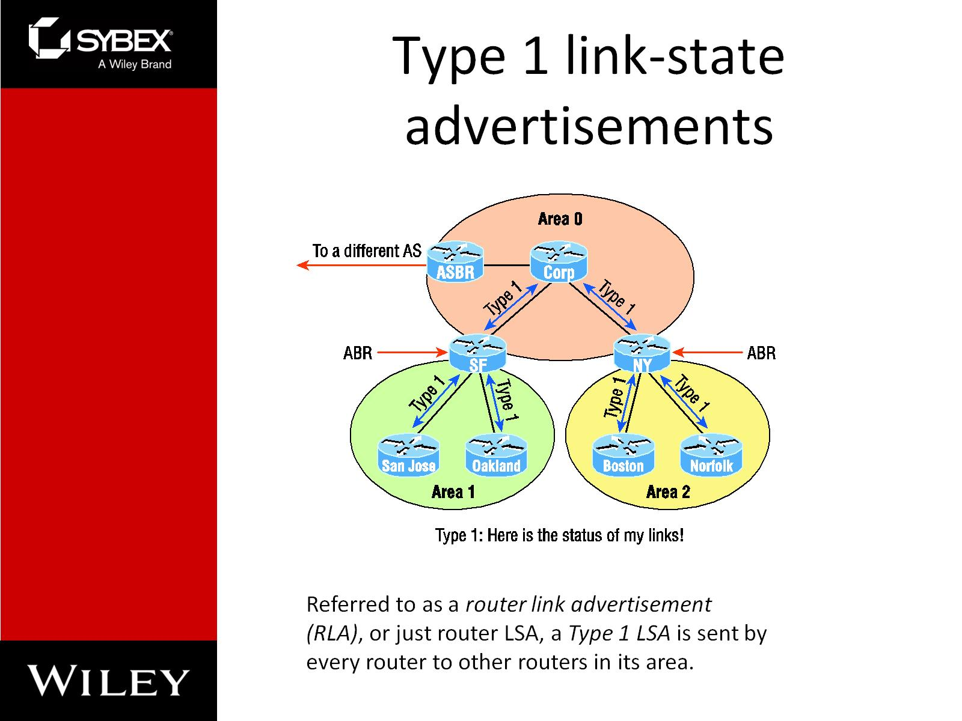
Type 1 link-state advertisements

Slide 8
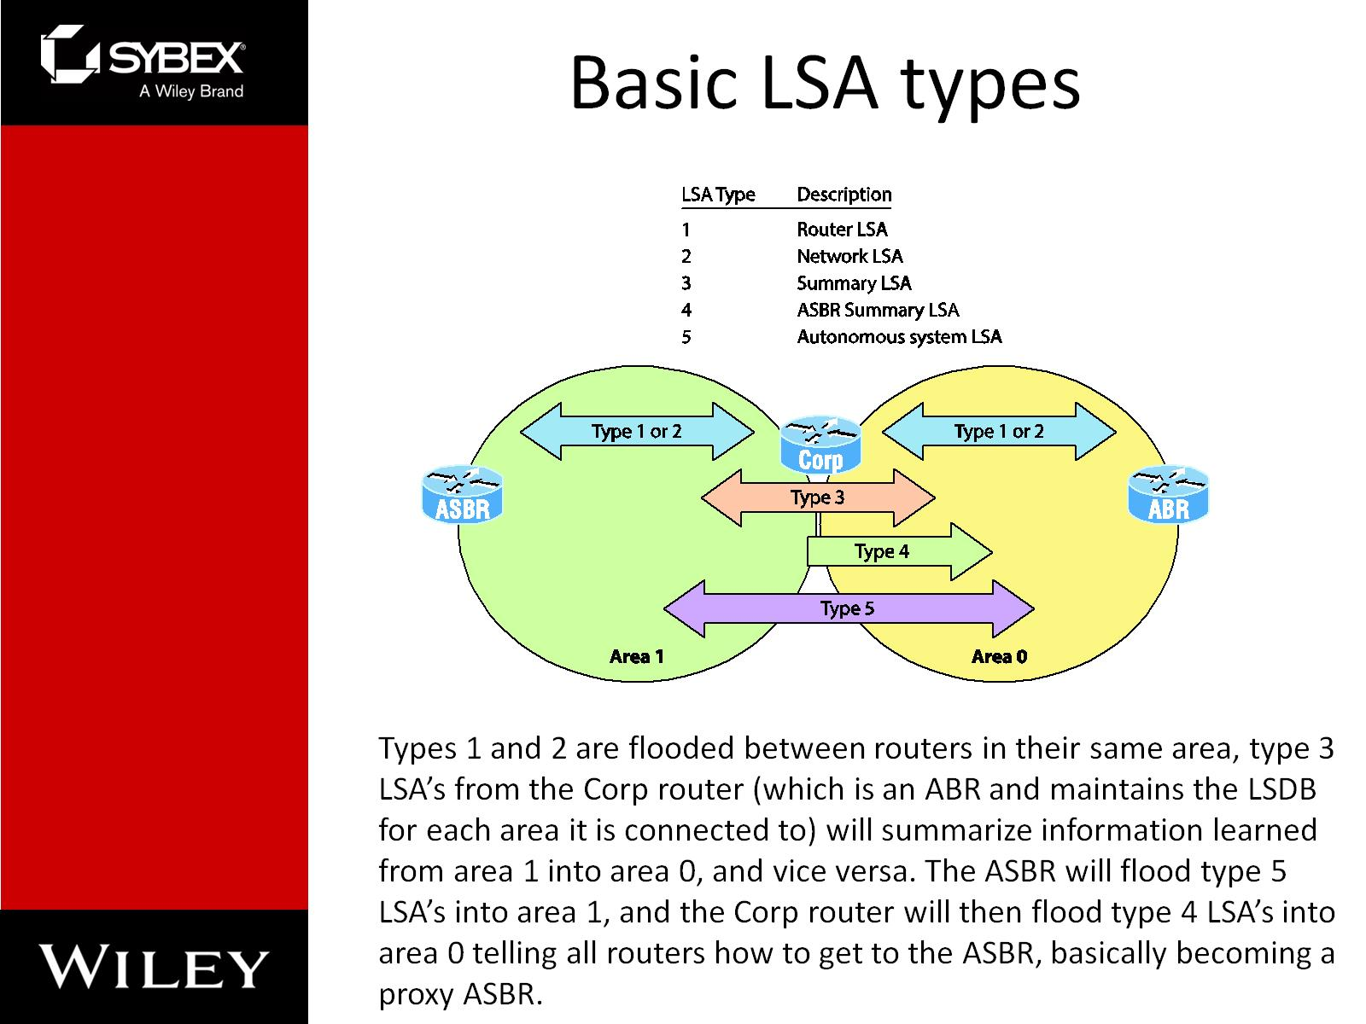
Basic LSA types

Slide 9
OSPF neighbor states, part 1
OSPF Hello Protocol
The Hello protocol provides a lot of information to neighbors. The following is communicated
between neighbors, by default, every 10 seconds:
Router ID (RID)
Hello/Dead interval
Neighbors
Area ID
Router priority
DR IP address
BDR IP address
Authentication data

Slide 10
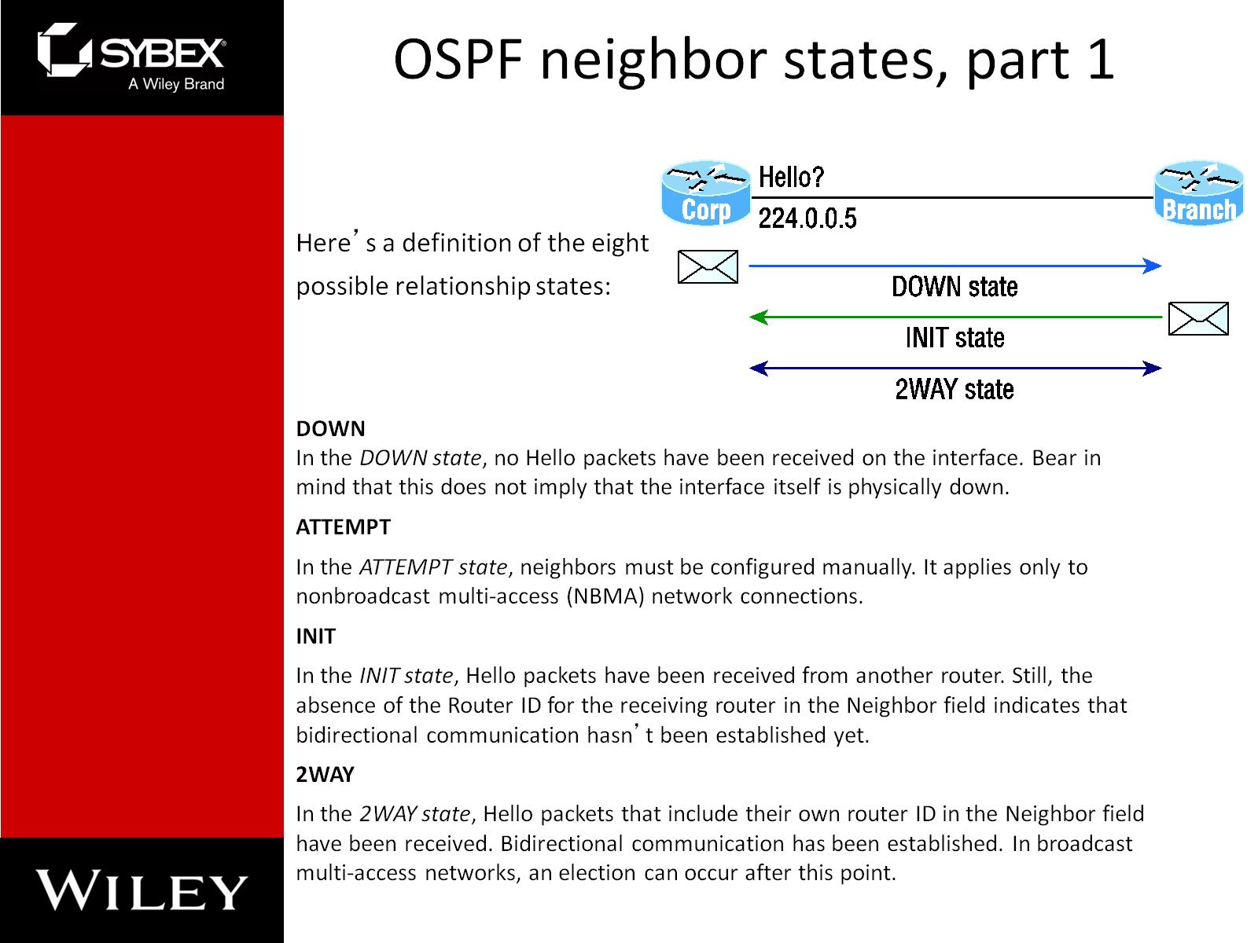
OSPF neighbor states, part 1

Slide 11
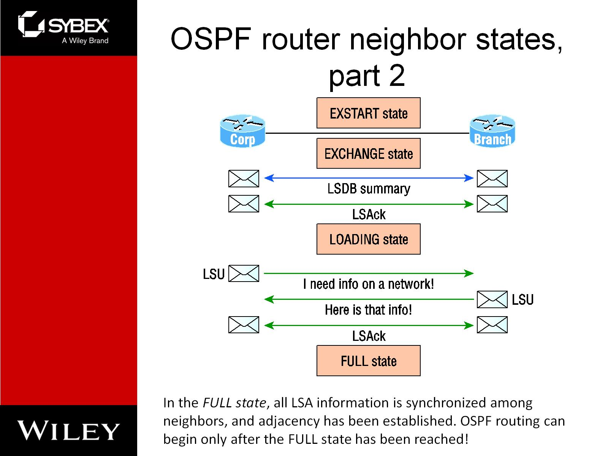
OSPF router neighbor states, part 2

Slide 12
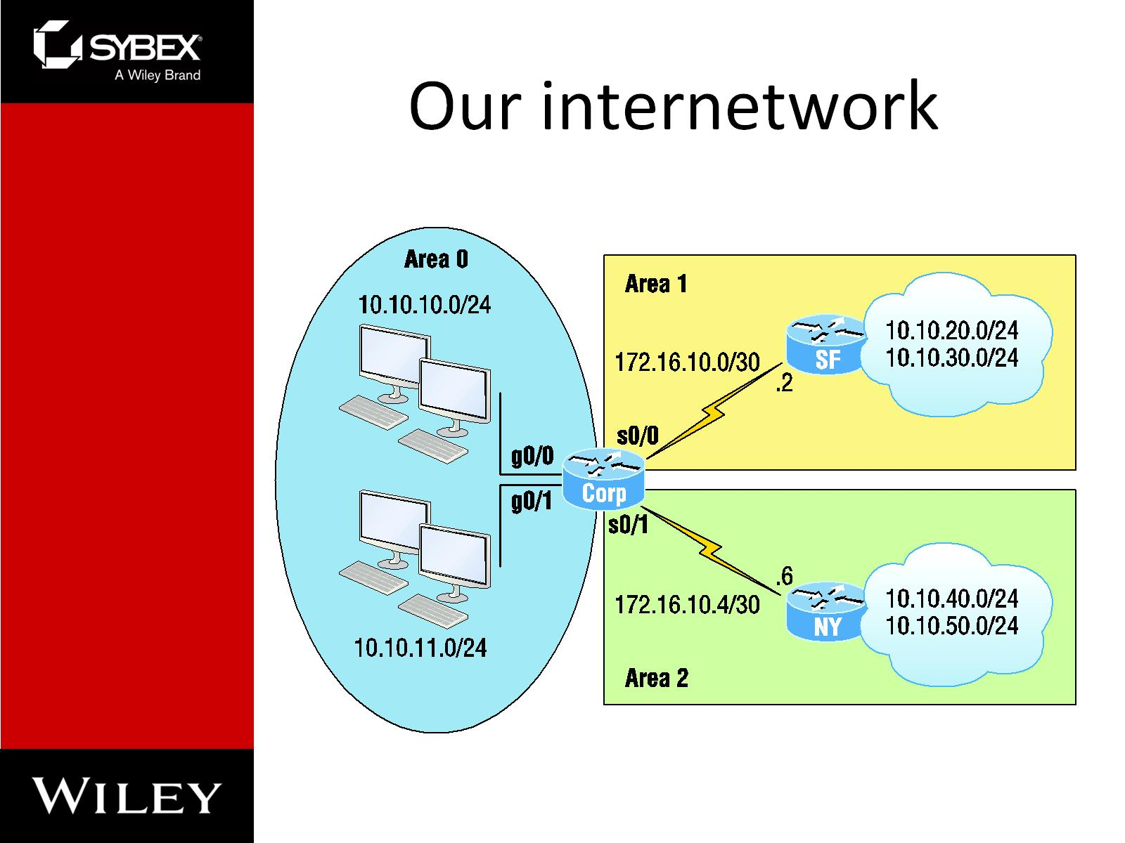
Our internetwork

Slide 13
Corp Configuration
Corp#config t
Corp(config)#router ospf 1
Corp(config-router)#router-id 1.1.1.1
Corp(config-router)#Reload or use "clear ip ospf process" command, for this to take effect
Corp(config-router)#network 10.10.0.0 0.0.255.255 area 0
Corp(config-router)#network 172.16.10.0 0.0.0.3 area 1
Corp(config-router)#network 172.16.10.4 0.0.0.3 area 2

Slide 14
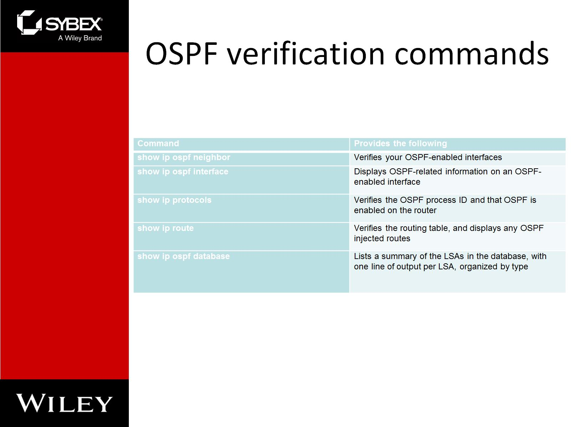
OSPF verification commands

Slide 15
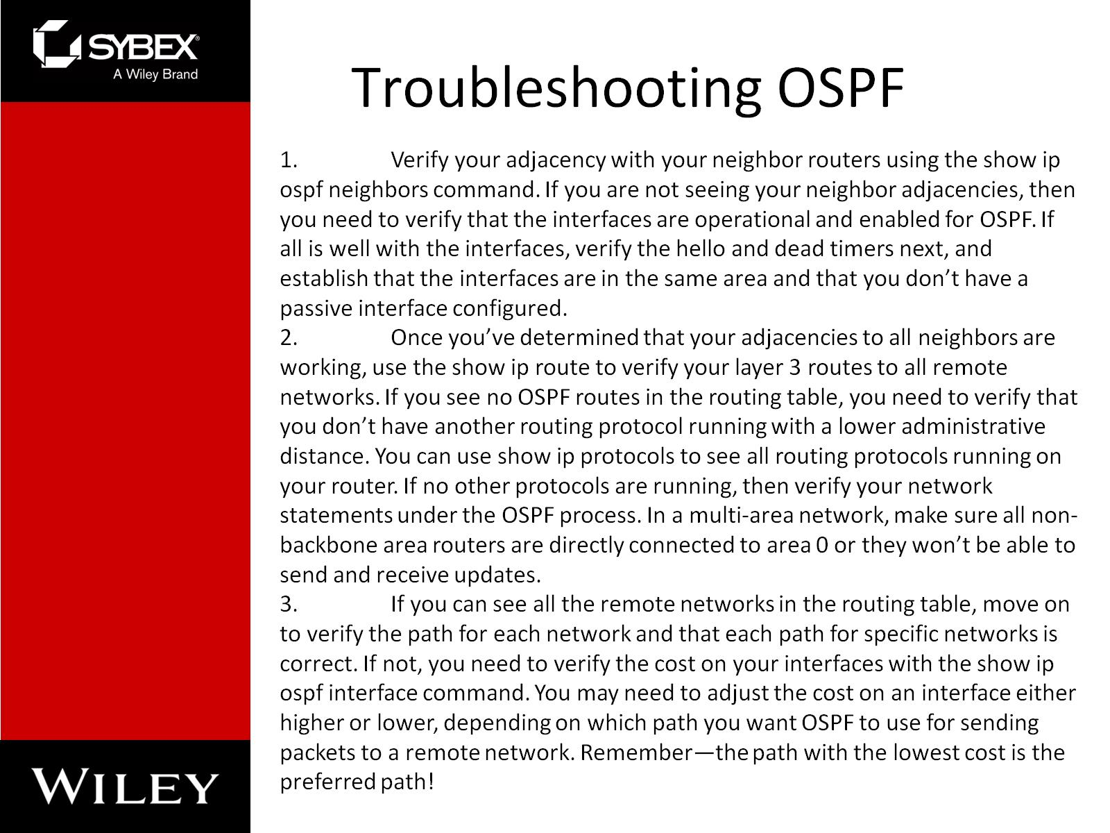
Troubleshooting OSPF

Slide 16
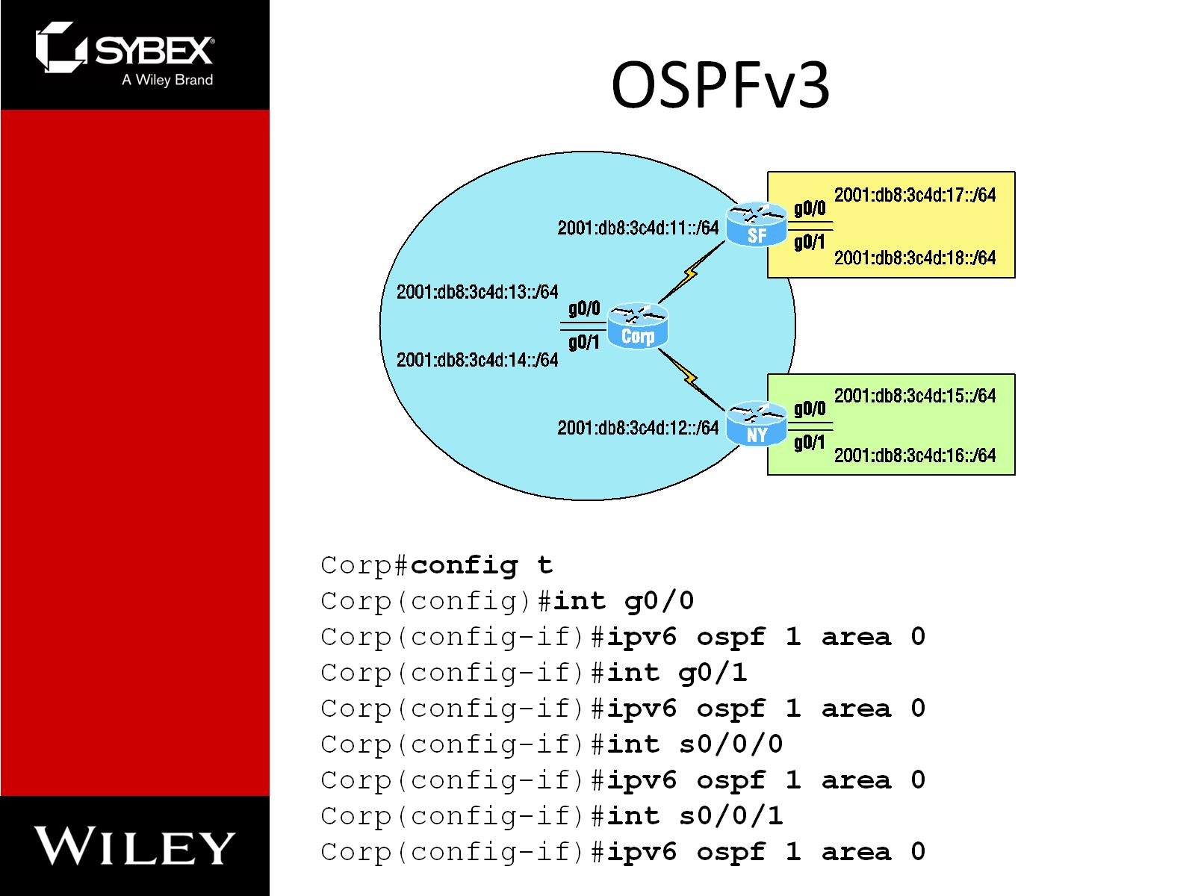
OSPFv3

Slide 17
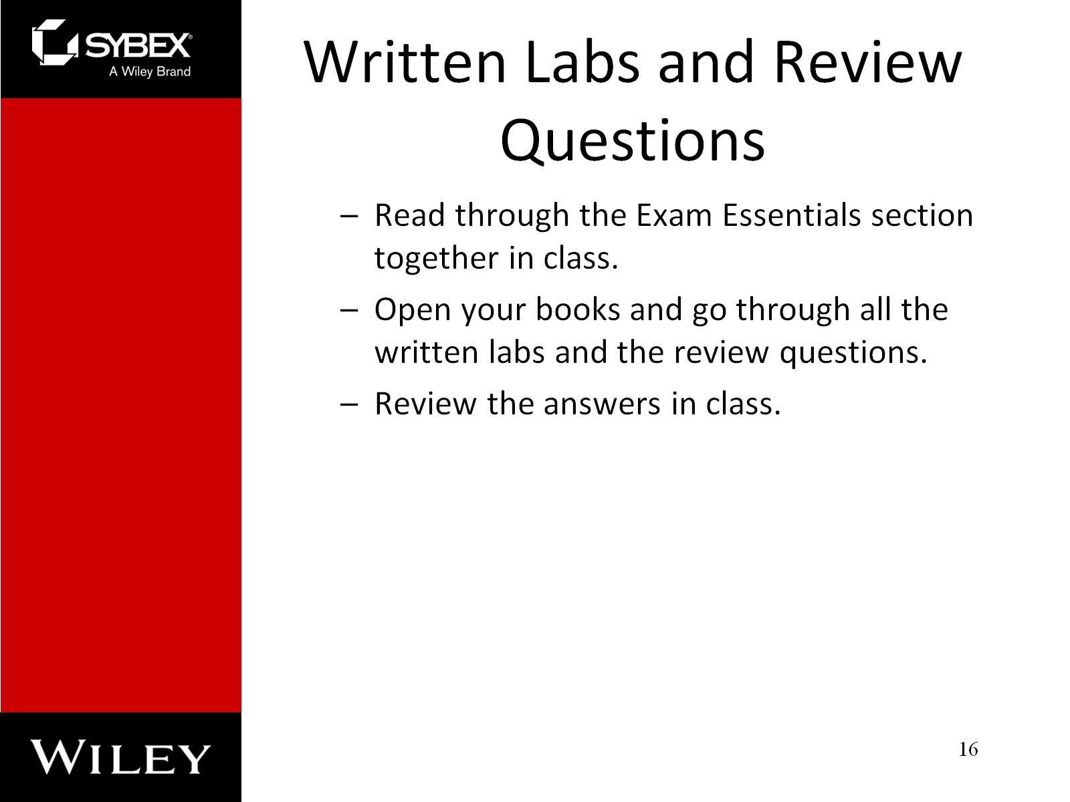
Written Labs and Review Questions

