Slide 1
CCNA Routing and Switching Study Guide
Chapters 6 & 20: Troubleshooting IP, IPv6, and VLANs
Instructor & Todd Lammle

Slide 2
Chapter 18 objectives
The ICND2 topics covered in this chapter include:
Troubleshooting
Identify and correct common network problems
Troubleshoot and resolve routing issues
Routing is enabled
Routing table is correct
Correct path selection
Troubleshoot and resolve interVLAN routing problems
Connectivity
Encapsulation
Subnet
Native VLAN
Port mode trunk status
2

Slide 3
Troubleshooting scenario
The Cisco objectives are clear on the troubleshooting steps you need to take when a problem has been reported, and here they are:
1. Check the cables to find out if there’s a faulty cable or interface in the mix and verify the interface’s statistics.
2. Make sure that devices are determining the correct path from the source to the destination. Manipulate the routing information if needed.
3. Verify that the default gateway is correct.
4. Verify that name resolution settings are correct.
5. Verify that there are no access control lists (ACLs) blocking traffic.

Slide 4
There are four steps for checking the PC1 configuration:
1. Test that the local IP stack is working by pinging the loopback address.
2. Test that the local IP stack is talking to the Data Link layer (LAN driver) by pinging the local IP address.
3. Test that the host is working on the LAN by pinging the default gateway.
4. Test that the host can get to remote networks by pinging remote Server1.

Slide 5
Commands for checking PC1 configuration
check out the PC1 configuration by using the ipconfig command, or ifconfig on a Mac
check the route table on the host with the route print command
ping 127.0.0.1 to verify that the local IP stack is initialized
ping the loopback address (PC1’s IP) to verify that the IP stack is talking to the LAN driver
ping default gateway to check LAN connectivity
ping the remote server next to see if our host is actually getting off the local LAN to communicate remotely. If failed, narrow the problem down further using the traceroute command

Slide 6
Check R2 and Server1
Traceroute from PC1 to Server1 reveals that we didn't get beyond our default gateway
So, we ping server1 from R2 to see if we can talk locally to the server
If ping successful, check Server1 IP configuration check R2 interface Fa0/0 that connects to Server1

Slide 7
Check R1 connectivity
sh ip route to check routing table to make sure both of our directly connected networks are in the table
sh ip int brief to check status of R1’s interface and verify the connectivity to R2 frome R1

Slide 8
Check R2’s routing table
R2>sh ip route
[output cut]
Gateway of last resort is not set
10.0.0.0/24 is subnetted, 1 subnets
S 10.1.1.0 is directly connected, FastEthernet0/0
172.16.0.0/16 is variably subnetted, 2 subnets, 2 masks
C 172.16.20.0/24 is directly connected, FastEthernet0/0
L 172.16.20.1/32 is directly connected, FastEthernet0/0
192.168.10.0/24 is variably subnetted, 2 subnets, 2 masks
C 192.168.10.0/24 is directly connected, FastEthernet0/1
L 192.168.10.254/32 is directly connected, FastEthernet0/1
Let’s fix R2:
R2#config t
R2(config)#no ip route 10.1.1.0 255.255.255.0 fa0/0
R2(config)#ip route 10.1.1.0 255.255.255.0 192.168.10.1

Slide 9
Verify with a higher-level protocol like telnet
If telnet fails, run “sh access-lists” to see fi there’s an ACL on R2
You can remove ACL with “no access-list” command

Slide 10
Using IP SLA for Troubleshooting
Reasons to use IP SLA:
Edge-to-edge network availability monitoring
Network performance monitoring and network performance visibility
Troubleshooting basic network operation
Configure IP SLA
Ip sla 1
Icmp-echo 172.16.20.254
Frequency 10
Ip sla schedule 1 life for ever start-time now

Slide 11
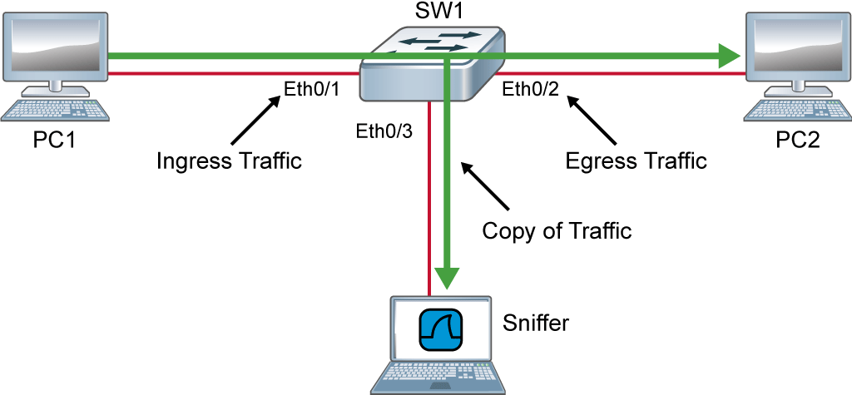
Figure 6.2/20.2: Using SPAN for troubleshooting
Monitor session 1 source interface Eth0/1
Monitor session 1 dest interface Eth0/3
Notes:
.

Slide 12
IPv6 troubleshooting scenario
Notice that I documented both the link-local and global addresses assigned to each router interface in the figure.

Slide 13
ICMPv6
Like in IPv4, ICMPv6 is used for lots of tasks, including error messages like destination unreachable and troubleshooting functions like Ping and Traceroute.
Unlike in IPv4, ICMPv6 isn't a separate layer 3 protocol. Instead, it's an integrated part of IPv6 and is carried after the basic IPv6 header information as an extension header

Slide 14
Neighbor Discovery Protocol (NDP)
Neighbor discovery enables these functions:
Determining the MAC address of neighbors
Router solicitation (RS) FF02::2
Router advertisements (RA) FF02::1
Neighbor solicitation (NS)
Neighbor advertisement (NA)
Duplicate address detection (DAD)

Slide 15
Router solicitation (RS) and router advertisement (RA)
IPv6 hosts send a router solicitation (RS) onto their data link asking for all routers to respond, and they use the multicast address FF02::2 to achieve this. Routers on the same link respond with a unicast to the requesting host, or with a router advertisement (RA) using FF02::1.

Slide 16
Neighbor solicitation (NS) and neighbor advertisement (N)
Hosts also can send solicitations and advertisements between themselves using a neighbor solicitation (NS) and neighbor advertisement (NA).

Slide 17
Troubleshooting steps on IPv6 connectivity
With that foundation review in mind, here are the troubleshooting steps we'll progress through in our investigation:
Check the cables because there might be a faulty cable or interface. Verify interfacs statistics.
Make sure that devices are determining the correct path from the source to the destination. Manipulate the routing information if needed.
Verify that the default gateway is correct.
Verify that name resolution settings are correct, and especially for IPv6, make sure the DNS server is reachable via IPv4 and IPv6.
Verify that there are no ACLs that are blocking traffic.

Slide 18
Commands for troubleshooting IPv6 connectivity
sh ipv6 neighbors to see the neighbor resolution table
verify default gateway with IPv6 with the ipconfig command
ipv6 route to check routing table

Slide 19
R1 routing table
R1#sh ipv6 route
C 2001:DB8:3C4D:2::/64 [0/0]
via FastEthernet0/1, directly connected
L 2001:DB8:3C4D:2:21A:6DFF:FE37:A44F/128 [0/0]
via FastEthernet0/1, receive
C 2001:DB8:3C4D:3::/64 [0/0]
via FastEthernet0/0, directly connected
L 2001:DB8:3C4D:3:21A:6DFF:FE37:A44E/128 [0/0]
via FastEthernet0/0, receive
L FF00::/8 [0/0]
via Null0, receive
Now let’s fix the route problem on R1 by adding a route that gives us access to the Server1 network
R1(config)#ipv6 route ::/0 fastethernet 0/1 FE80::21A:6DFF:FE64:9B3

Slide 20
VLAN connectivity
A couple of key times to troubleshoot VLANs are when and if you lose connectivity between hosts and when you’re configuring new hosts into a VLAN but they’re not working.
Here are the steps we’ll follow to troubleshoot VLANs:
1. Verify the VLAN database on all your switches.
2. Verify your content addressable memory (CAM) table.
3. Verify that your port VLAN assignments are configured correctly.
And here’s a list of the commands we’ll be using in the following sections:
Show vlan
Show mac address-table
Show interfaces interface switchport
switchport access vlan vlan

Slide 21
A list of commands for VLAN troubleshooting
And here’s a list of the commands we’ll be using in the following sections:
Show vlan
Show mac address-table
Show interfaces interface switchport
switchport access vlan vlan

Slide 22
Check switch S2
S2#sh interfaces gi0/3 switchport
Name: Gi0/3
Switchport: Enabled
Administrative Mode: dynamic desirable
Operational Mode: static access
Administrative Trunking Encapsulation: negotiate
Operational Trunking Encapsulation: native
Negotiation of Trunking: On
Access Mode VLAN: 10 (Inactive)
Trunking Native Mode VLAN: 1 (default)
[output cut]

Slide 23
Check switch S2
S2#sh mac address-table
Mac Address Table
-------------------------------------------
Vlan Mac Address Type Ports
---- ----------- -------- -----
All 0100.0ccc.cccc STATIC CPU
[output cut]
1 001b.d40a.0538 DYNAMIC Gi0/13
1 0021.1bee.a70d DYNAMIC Gi0/13
1 b414.89d9.1884 DYNAMIC Gi0/17
1 b414.89d9.1885 DYNAMIC Gi0/18
1 ecc8.8202.8285 DYNAMIC Gi0/16
Total Mac Addresses for this criterion: 26

Slide 24
Check switch S2
S2#sh vlan brief
VLAN Name Status Ports
---- -------------------------------- --------- -------------------------------
1 default active Gi0/1, Gi0/2, Gi0/4, Gi0/5
Gi0/6, Gi0/7, Gi0/8, Gi0/9
Gi0/10, Gi0/11, Gi0/12, Gi0/13
Gi0/14, Gi0/15, Gi0/16, Gi0/17
Gi0/18, Gi0/19, Gi0/20, Gi0/21
Gi0/22, Gi0/23, Gi0/24, Gi0/25
Gi0/26, Gi0/27, Gi0/28
26 Automation10 active
27 VLAN0027 active
30 Engineering active
170 VLAN0170 active
[output cut]
Easy one to fix by simply creating the VLAN in the database:
S2#config t
S2(config)#vlan 10
S2(config-vlan)#name Sales

Slide 25
Trunk Troubleshooting
And here are the commands we’ll use to perform trunk troubleshooting:
Show interfaces trunk
Show vlan
Show interfaces interface trunk
Show interfaces interface switchport
Show dtp interface interface
switchport mode
switchport mode dynamic
switchport trunk native vlan vlan

Slide 26
Written Labs and Review Questions
Read through the Exam Essentials section together in class.
Open your books and go through all the written labs and the review questions.
Review the answers in class.
26

