Slide 1
CCNA Routing and Switching Study Guide
Chapters 8 & 22: Intelligent Networks
Instructor & Todd Lammle

Slide 2
Switch Stacking – Cisco StackWise technology
Three big drawbacks to a typical switch topology:
Management overhead is high
STP will block half of the uplinks
There is no direct communication between switches

Slide 3
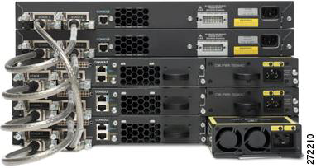
Switch Stacking – Cisco StackWise technology
Cisco StackWise technology connects switches that are mounted in the same rack together so that they basically become one larger switch
All switches in a stack share configuration and routing information
To create a StackWise unit, we combine individual switches into a single, logical unit using special stack interconnect cables.

Slide 4
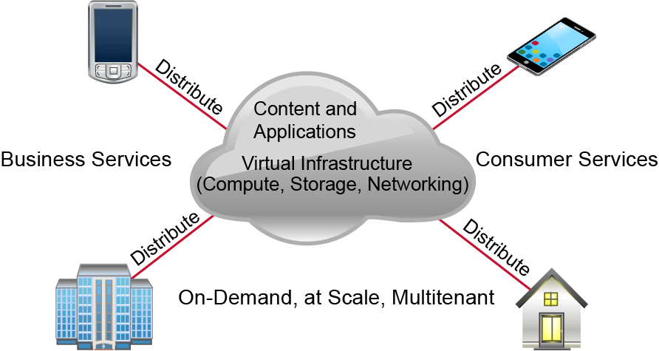
Cloud Computing and Its Effect on the Enterprise Network
Cloud computing can provide virtualized processing, storage, and computing resources to users remotely

Slide 5
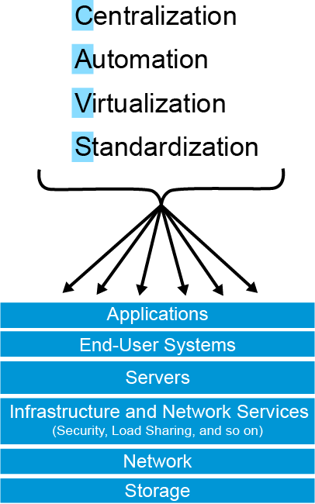
The big benefits cloud services offer

Slide 6
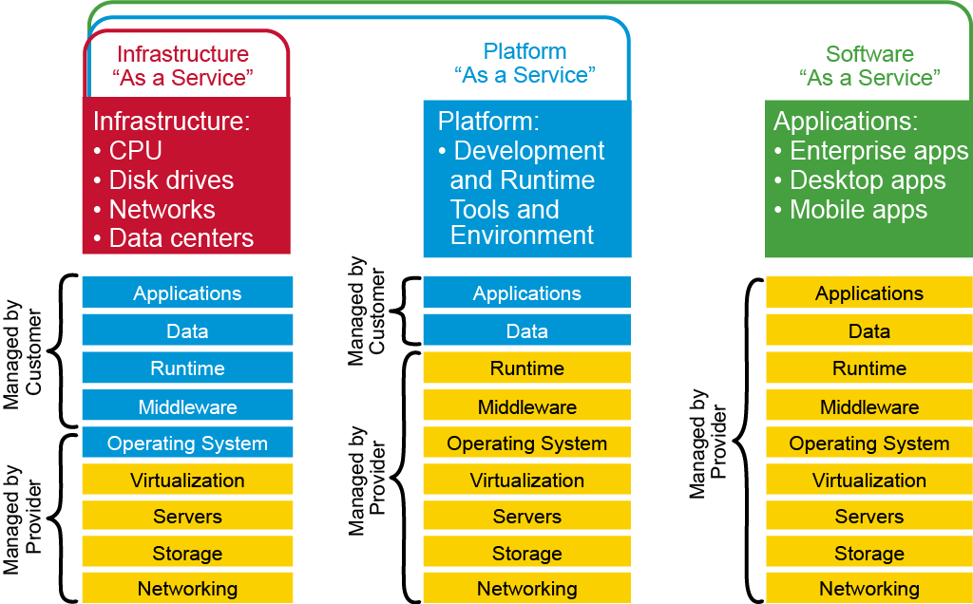
Service Models
Provides only the network
Delivers computer infrastructure (virtualization environment)

Slide 7
Service Models
Provides OS and the network
Delivers a computing platform and solution stack, allowing customers to develop, run, and manage applications

Slide 8
Service Models
Provides the required software, OS and network
SaaS is common application software such as databases, web servers, and email software hosted by SaaS vendors

Slide 9
Service Models

Slide 10
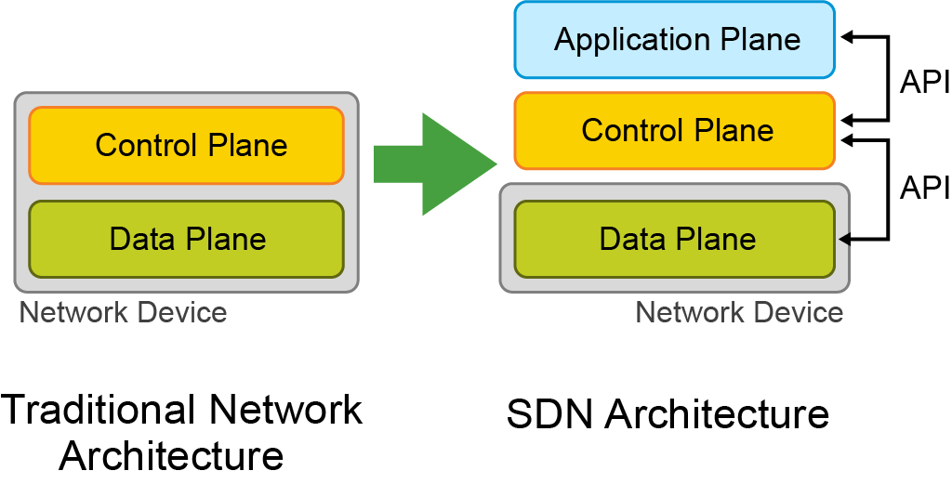
Software Defined Networking (SDN)

Slide 11
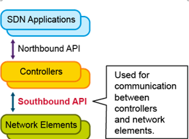
Southbound APIs
Southbound APIs have many standards:
OpenFlow
NETCONF
onePK
OpFlex

Slide 12
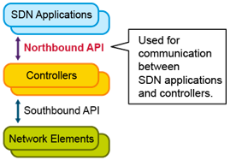
Northbound APIs

Slide 13
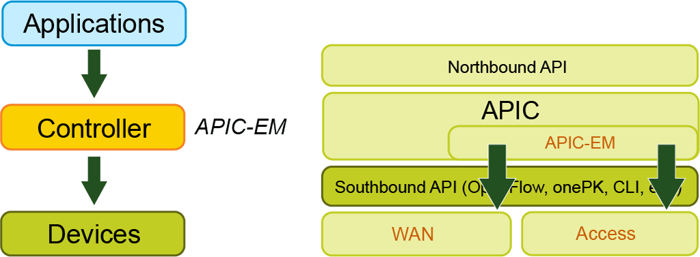
Cisco APIC-EM: Cisco SDN controller
Cisco APIC-EM is used for policy-based management and security through a single controller, abstracting the network and making network services simpler.

Slide 14
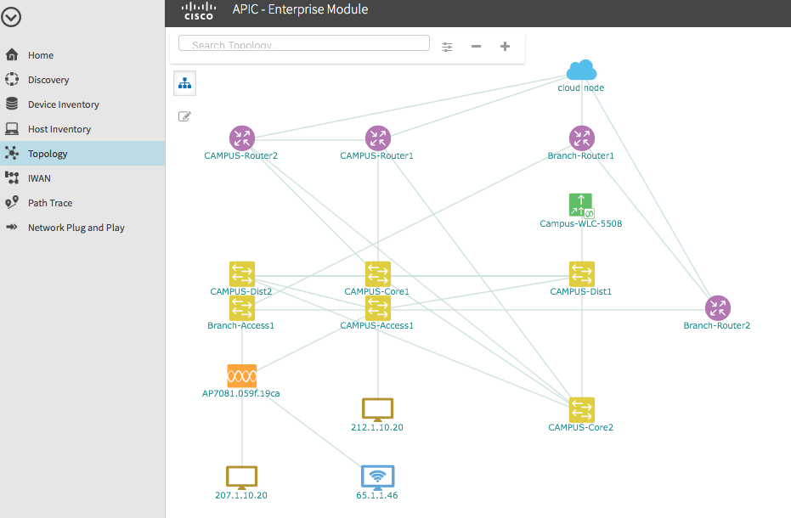

Slide 15
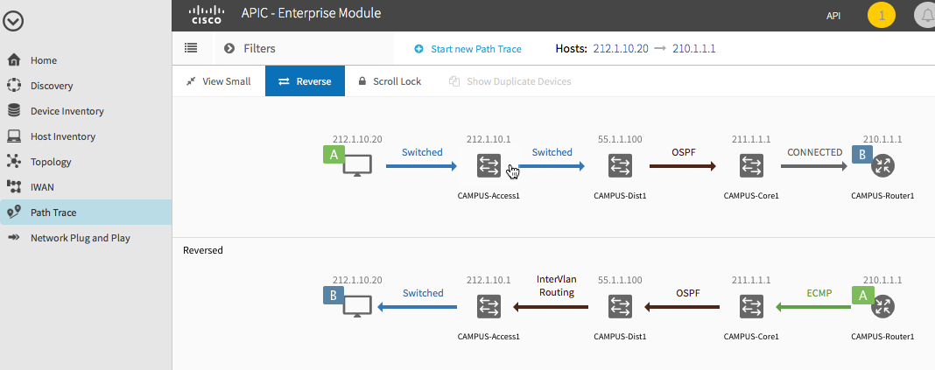
Using APIC-EM for Path Tracing

Slide 16
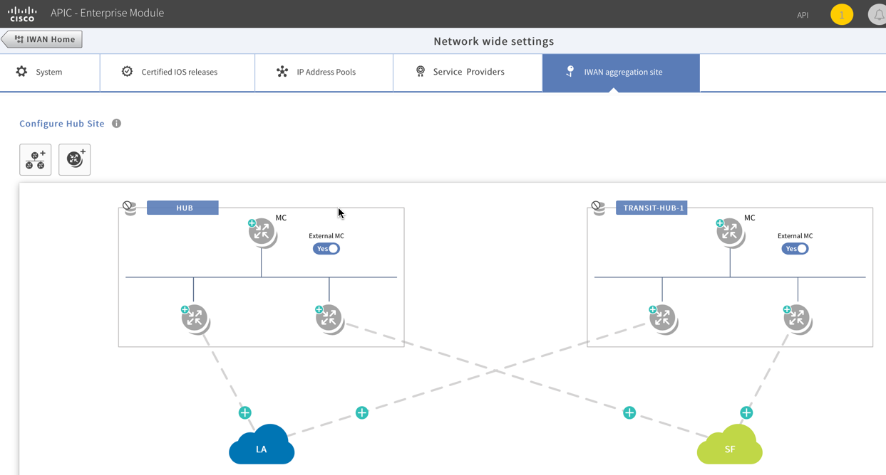
Cisco Intelligent WAN (Cisco IWAN)

Slide 17
Quality of Service
Quality of Service (QoS) is used to manage contention for network resources for better end user experience.
QoS methods focus on
Delay: make real-time applications, such as VoIP, fail
Dropped Packets: with QoS, when there is a contention on a link, less important traffic is delayed or dropped
Error: packets can be corrupted in transit and arrives at the destination in an unaccepted format
Jitter: Variation in packet delay is called jitter, “packet loss” in video streaming
Out-of-Order Delivery: receiving packets are reassembled out of order, user will probably notice degradation of an application quality

Slide 18
QoS Mechanisms
QoS uses the classifier to determine which traffic class the packets belong to and determine how they should be treated
Classify traffic using Markings, Addressing, and Application signatures
Traffic is then directed to a policy-enforcement mechanism for its specific type
Policy-enforcement mechanisms include marking, queuing, policing, and shaping

Slide 19
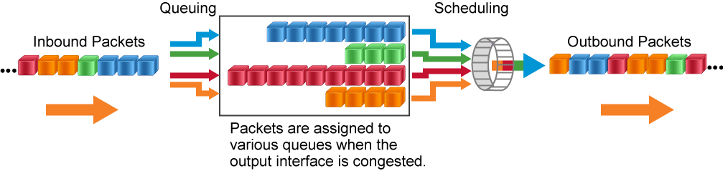
Tools for Managing Congestion
Scheduling:
Priority scheduling
Round-robin scheduling
Weighted fair scheduling
Queuing:
First in, first out
Priority queuing
Custom queuing
Weighted fair queuing
Class-based weighted fair queuing
Low latency queuing

Slide 20
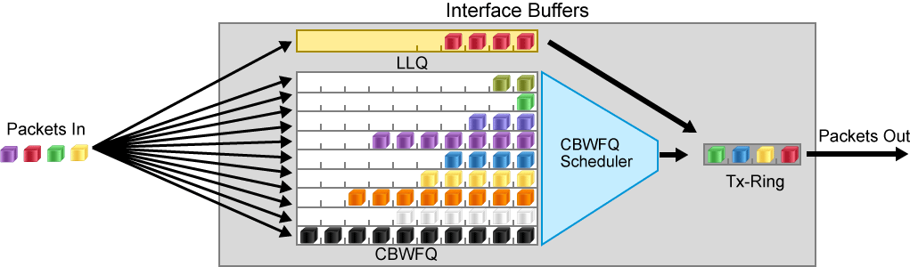
Low latency queuing (LLQ) and Class-based weighted fair queuing (CBWFQ)

Slide 21
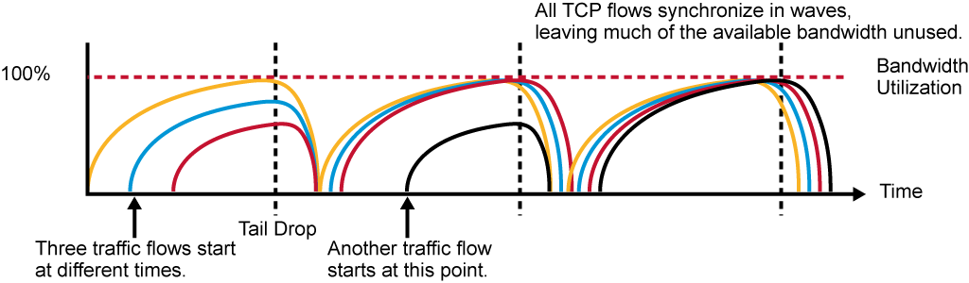
Tools for Congestion Avoidance
Congestion avoidance starts dropping packets before a queue fills
It drops the packets by using traffic weights instead randomness
Cisco use weighted random early detection (WRED) to ensure that high-precedence traffic has lower loss rates during congestion

Slide 22
Written Labs and Review Questions
Read through the Exam Essentials section together in class.
Open your books and go through all the written labs and the review questions.
Review the answers in class.
22

