Slide 1


Sybex CCENT 100-101
Chapter 3: Introduction to TCP/IP
Instructor & Todd Lammle

Slide 2

Chapter 3 Objectives
The CCENT Topics Covered in this chapter include:
Operation of IP Data Networks
Identify common applications and their impact on the network
Describe the purpose and basic operation of the protocols in the OSI and TCP/IP models.
IP addressing (IPv4 / IPv6)
Describe the operation and necessity of using private and public IP addresses for IPv4 addressing
2

Slide 3
Figure 3.2: The TCP/IP protocol suite
The DoD and OSI models are alike in design and concept and have similar functions in similar layers. Figure 3.2 shows the TCP/IP protocol suite and how its protocols relate to the DoD model layers.

Slide 4
Figure 3.3: Telnet (Port 23)
Telnet was one of the first Internet standards, developed in 1969, and is the chameleon of protocols—its specialty is terminal emulation.
Figure 3.3 shows an example of a Telnet client trying to connect to a Telnet server.
The client machine resembles a virtual terminal directly attached to the local network
Drawback: no encryption techniques

Slide 5
Figure 3.4: Secure Shell
Figure 3.4 shows a SSH client trying to connect to a SSH server.
The client must send the data encrypted!

Slide 6
Figure 3.5: FTP
FTP also allows for access to both directories and files and can accomplish certain types of directory operations, such as relocating into different ones.

Slide 7
Figure 3.7: SNMP
Simple Network Management Protocol (SNMP) collects and manipulates valuable network information, as you can see in Figure 3.7.
It gathers data by polling the devices on the network from a network management station (NMS) at fixed or random intervals, requiring them to disclose certain information, or even asking for certain information from the device.

Slide 8
Figure 3.8: HTTP
All those snappy websites comprising a mélange of graphics, text, links, ads and so on rely on the Hypertext Transfer Protocol (HTTP) to make it all possible
Your browser can understand what you need when you enter a Uniform Resource Locator (URL), which we usually refer to as a web address, e.g. http://www.lammle.com/forum and http://www.lammle.com/blog.

Slide 9
Figure 3.9: NTP
Network Time Protocol (NTP) works by synchronizing devices to ensure that all computers on a given network agree on the time

Slide 10
Figure 3.10: DNS (Port 53)
Domain Name Service (DNS) resolves hostnames—specifically, Internet names, such as www.lammle.com. But you don’t have to actually use DNS. You just type in the IP address of any device you want to communicate with and find the IP address of a URL by using the Ping program. For example, >ping www.cisco.com will return the IP address resolved by DNS.

Slide 11
Figure 3.11: DHCP client four-step process
DORA!

Slide 12
Figure 3.12: TCP segment format
Figure 3.12 shows the TCP segment format and shows the different fields within the TCP header.

Slide 13
Figure 3.13: UDP segment
Figure 3.13 clearly illustrates UDP’s markedly lean overhead as compared to TCP’s hungry requirements. Look at the figure carefully—can you see that UDP doesn’t use windowing or provide for acknowledgments in the UDP header?

Slide 14
Key protocols that use TCP and UDP
TCP | UDP
Telnet: 23 | SNMP: 161
SMTP: 25 | TFTP: 69
HTTP: 80 | DNS: 53
FTP: 20 (data), 21 (control) | DHCP: 67
DNS: 53 | NTP:123
HTTPS: 443
SSH: 22
POP3: 110
IMAP4: 143

Slide 15
Figure 3.15: IP header
Figure 3.15 shows an IP header. This will give you a picture of what the IP protocol has to go through every time user data that is destined for a remote network is sent from the upper layers

Slide 16
Figure 3.17: ICMP error message is sent to the sending host from the remote router
provide hosts with information about network problems
encapsulated within IP datagrams

Slide 17
Figure 3.18: ICMP in action

Slide 18
Figure 3.19: Local ARP broadcast
ARP resolves IP addresses to Ethernet (MAC) addresses.

Slide 19
IP Addressing
IPv4: 32 bits; IPv6: 128 bits
IP address is divided into subnet part (high order bits) and host part (low order bits)
The address used by applications and hosts to send information to all nodes on a network is called the broadcast address.
255.255.255.255: any network, all nodes
172.16.255.255: all subnets and hosts on network 172.16.0.0;
10.255.255.255: broadcasts to all subnets and hosts on network 10.0.0.0.

Slide 20
Figure 3.20: Summary of the three classes of networks
Figure 3.20 summarizes the three classes of networks used to address hosts

Slide 21
Class A Network
The first bit turns off, e.g., 0xxxxxxx
Range: 1~126
00000000 ~ 01111111
0 and 127 have been reserved
Subnet mask: 255.0.0.0
The max number of Class A network available: 126, where the 7 bits can be either 0 or 1, so 2^7 - 2 = 128 – 2 = 126 because 0 and 127 have been reserved;
Each Class A network can have 2^24 – 2 available IP addresses;

Slide 22
Class B Network
The first bit turns on while the second bit turns off, e.g., 10xxxxxx
Range: 128~191
10000000 ~ 10111111
Subnet mask: 255.255.0.0
The max number of Class B subnets are 2^14 because the first 2 bits have been used;
Each Class B has 2^16 – 2 = 65534 available IP addresses;

Slide 23
Class C Network
The first two bits turns on while the third bit turns off, e.g., 110xxxxxx
Range: 192~223
11000000 ~ 11011111
Subnet mask: 255.255.255.0
The max number of Class C networks are 2^21 because the first 3 bits have been used;
Each Class C network can have 2^8 – 2 = 254 available IP addresses;

Slide 24
Reserved IP Addresses
Address | Function
Network address all 0s | This network or segment
Network address all 1s | All networks
Network 127.0.0.1 | Loopback test at localhost
Node address all 0s | Network address
Node address all 1s | All nodes in the network
Entire IP all 0s | Any network
Entire IP all 1s | Broadcast

Slide 25
Reserved Private IP addresses
NAT: network address translation protocol, which translate private IP to public IP and vice versa;
Address class | Reserved private address
Class A | 10.0.0.0 to 10.255.255.255
Class B | 172.16.0.0 to 172.31.255.255
Class C | 192.168.0.0 to 192.168.255.255

Slide 26
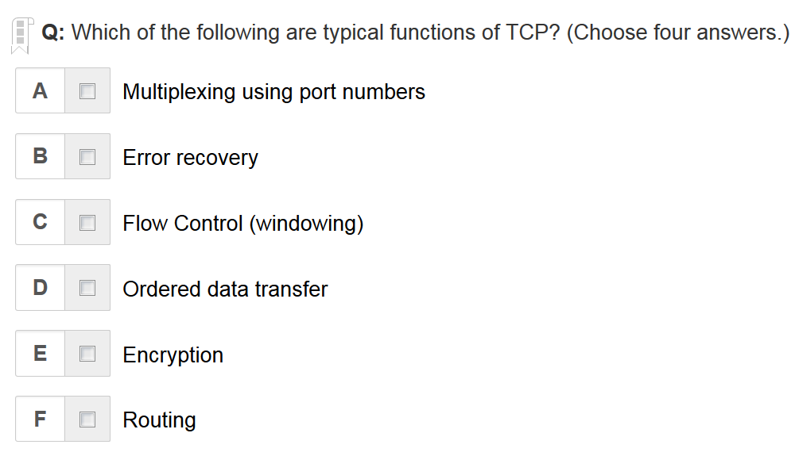
A B C D are the correct answers

Slide 27
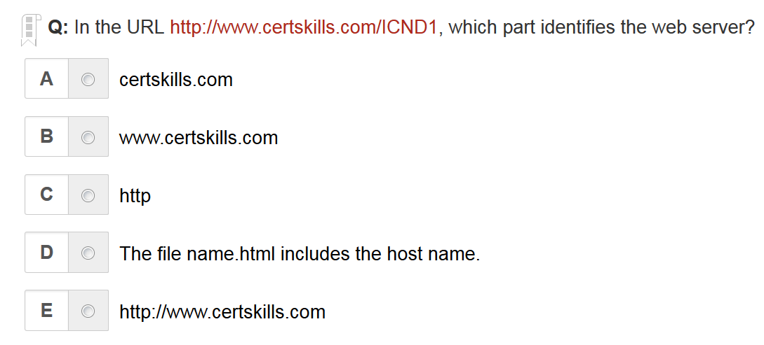
B is the correct answer

Slide 28
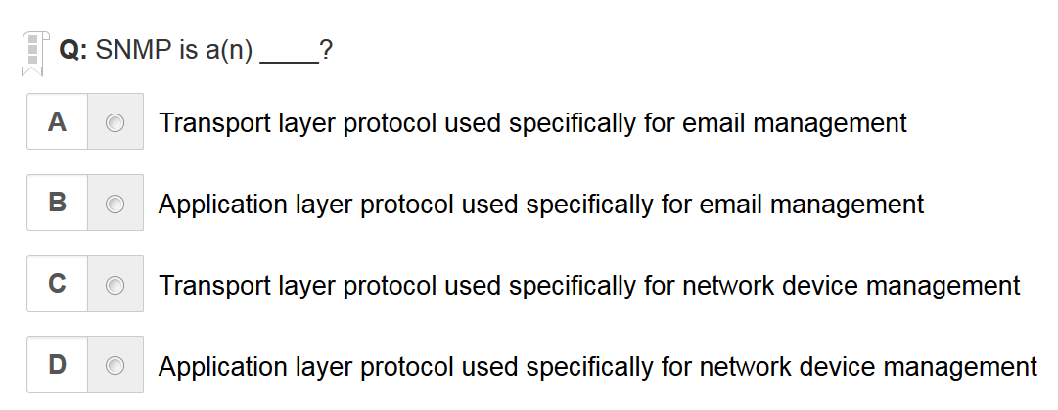
D is the correct answer

Slide 29
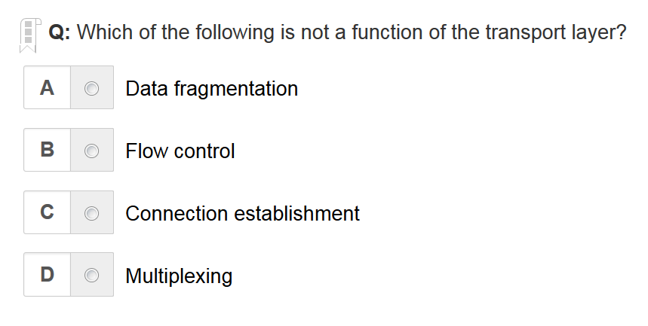
A is the correct answer

Slide 30
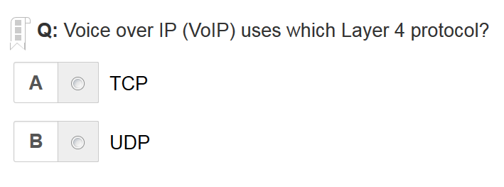
B is the correct answer

Slide 31
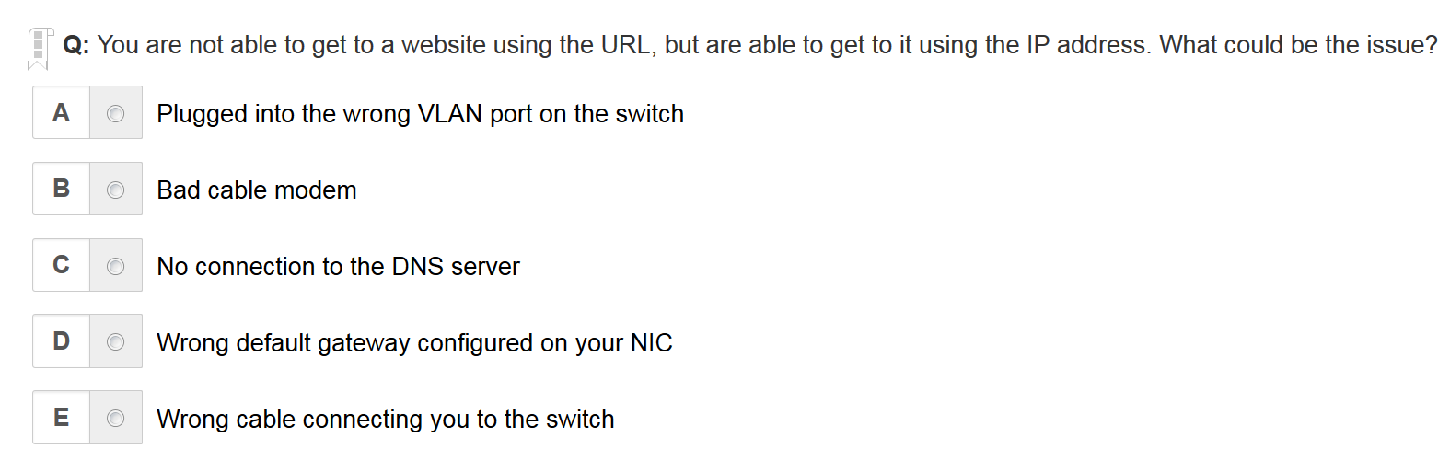
C is the correct answer

Slide 32
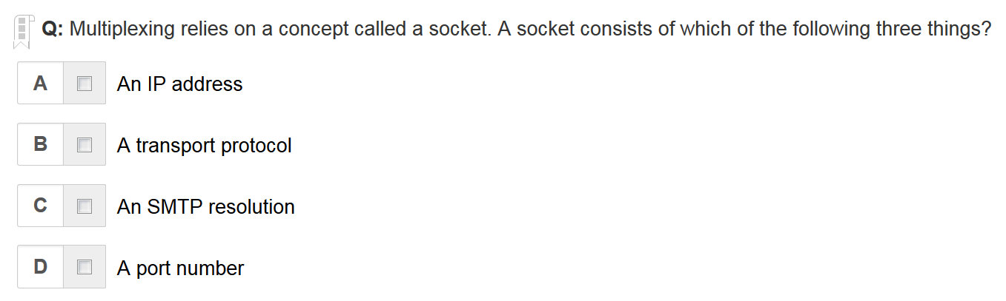
A B D are the correct answers

Slide 33
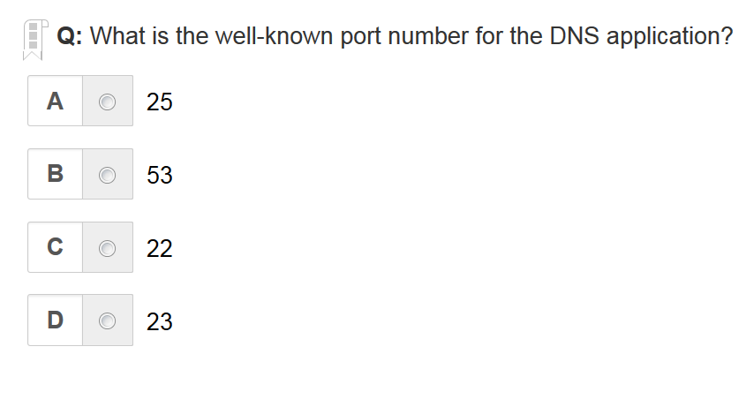
B is the correct answer

Slide 34
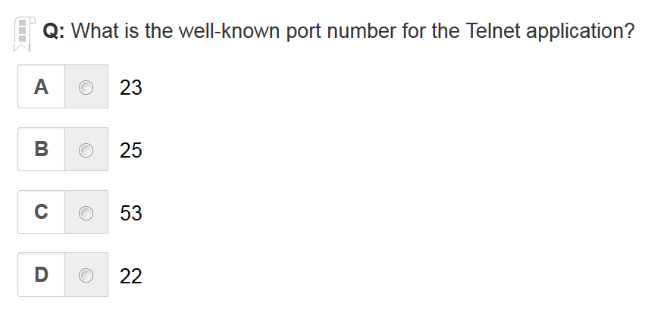
A is the correct answer

Slide 35
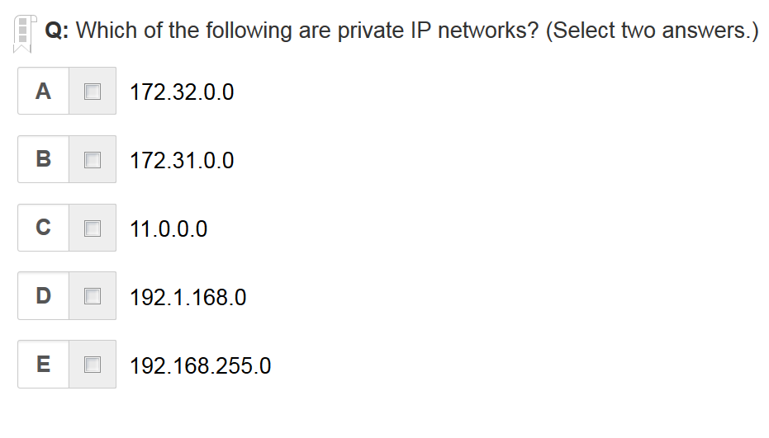
B E are the correct answer

Slide 36
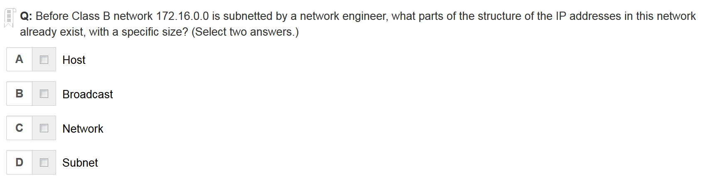
A C are the correct answer

Slide 37
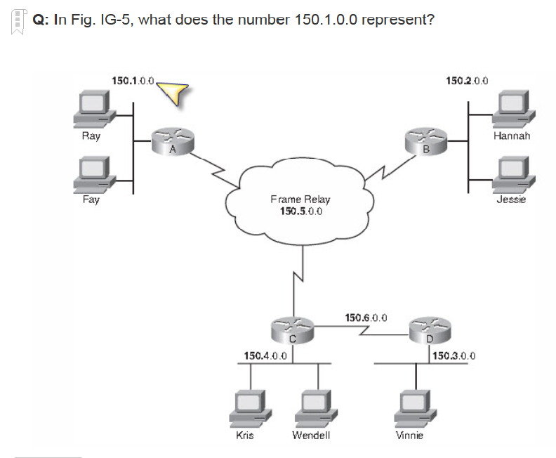
Class B network

Slide 38
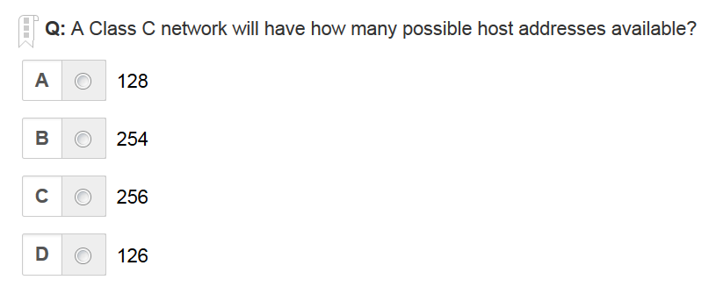
B is the correct answer

Slide 39
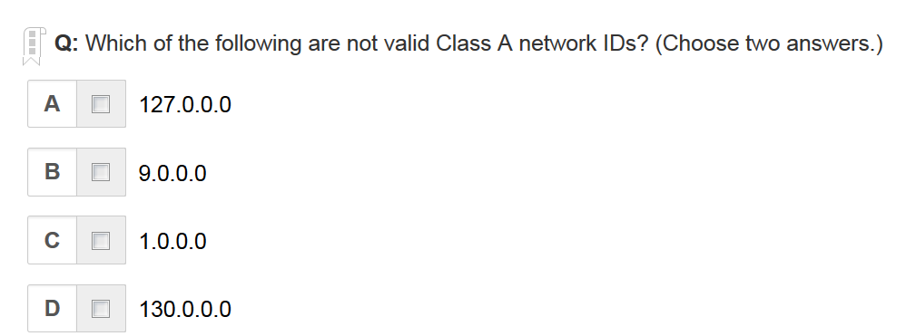
A D are the correct answer

Slide 40
Written Labs and Review Questions
Read through the Exam Essentials section together in class
Open your books and go through all the written labs and the review questions.
Review the answers in class.
40

