Slide 1


Sybex CCENT 100-101
Chapter 4: Easy Subnetting
Instructor & Todd Lammle

Slide 2

Chapter 4 Objectives
The CCENT Topics Covered in this chapter include:
IP addressing (IPv4 / IPv6)
Describe the operation and necessity of using private and public IP addresses for IPv4 addressing
2

Slide 3
Figure 4.1: One network
In Chapter 3, “TCP/IP,” you learned how to define and find the valid host ranges used in a Class A, Class B, and Class C network address by turning the host bits all off and then all on. This is very good, but here’s the catch: you were defining only one network, as shown in Figure 4.1.

Slide 4
Figure 4.2: Multiple networks connected together
Wouldn’t it be nice to be able to break up that one, huge network address and create four manageable networks from it? To make that happen, you would need to apply subnetting because it’s the best way to break up a giant network it into a bunch of smaller ones. Take a look at Figure 4.2 and see how this might look.

Slide 5
To create a subnet, we’ll start by fulfilling these three steps:
Create a subnet is the act of taking bits from the host part and reserve them to define the subnet address instead. This could result in fewer bits being available for defining hosts.
Based on the requirements, create the following:
A unique subnet mask for your entire network.
A unique subnet ID for each physical segment
A range of host IDs for each subnet
Subnet masks, where the 1s represents the positions that refer to the network subnet part.

Slide 6
Table 4.1 shows the default subnet masks for Classes A, B, and C.
Table 4.1: Default subnet mask
Class | Format | Default Subnet Mask
A | network.node.node.node | 255.0.0.0
B | network.network.node.node | 255.255.0.0
C | network.network.network.node | 255.255.255.0

Slide 7
Classless Inter-Domain Routing (CIDR)
It’s basically the method that Internet service providers (ISPs) use to allocate a number of addresses to a company, a home—their customers
Slash notation: Class A default subnet mask 255.0.0.0 is considered a /8 because it has 8 bits that are 1s—that is, 8 bits that are turned on.

Slide 8
Table 4.2 has a listing of every available subnet mask and its equivalent CIDR slash notation.
Subnet Mask | CIDR Value
255.0.0.0 | /8
255.128.0.0 | /9
255.192.0.0 | /10
255.224.0.0 | /11
255.240.0.0 | /12
255.248.0.0 | /13
255.252.0.0 | /14
255.254.0.0 | /15
255.255.0.0 | /16
255.255.128.0 | /17
255.255.192.0 | /18
255.255.224.0 | /19
255.255.240.0 | /20
255.255.248.0 | /21
255.255.252.0 | /22
255.255.254.0 | /23
255.255.255.0 | /24
255.255.255.128 | /25
255.255.255.192 | /26
255.255.255.224 | /27
255.255.255.240 | /28
255.255.255.248 | /29
255.255.255.252 | /30
The /8 through /15 can only be used with Class A network addresses. /16 through /23 can be used by Class A and B network addresses. /24 through /30 can be used by Class A, B, and C network addresses

Slide 9
Subnetting a Class C Address—The Fast Way!
When you’ve chosen a possible subnet mask for your network and need to determine the number of subnets, valid hosts and the broadcast addresses of a subnet that mask will provide, all you need to do is answer five simple questions:
How many subnets does the chosen subnet mask produce?
How many valid hosts per subnet are available?
What are the valid subnets?
What’s the broadcast address of each subnet?
What are the valid hosts in each subnet?

Slide 10
Subnetting Practice Examples: Class C Addresses
Practice Example #1C: 255.255.255.128 (/25)
Since 128 is 10000000 in binary, there is only 1 bit for subnetting and 7 bits for hosts. We’re going to subnet the Class C network address 192.168.10.0.
192.168.10.0 = Network address
255.255.255.128 = Subnet mask
Now, let’s answer our big five:
How many subnets? Since 128 is 1 bit on (10000000), the answer would be 2¹ = 2.
How many hosts per subnet? We have 7 host bits off (10000000), so the equation would be 2⁷ – 2 = 126 hosts. Once you figure out the block size of a mask, the amount of hosts is always the block size minus 2. No need to do extra math if you don’t need to!
What are the valid subnets? 256 – 128 = 128. Remember, we’ll start at zero and count in our block size, so our subnets are 0, 128. By just counting your subnets when counting in your block size, you really don’t need to do steps 1 and 2. We can see we have two subnets, and in the step before this one, just remember that the amount of hosts is always the block size minus 2, and in this example, that give us 2 subnets, each with 126 hosts.
What’s the broadcast address for each subnet? The number right before the value of the next subnet is all host bits turned on and equals the broadcast address. For the zero subnet, the next subnet is 128, so the broadcast of the 0 subnet is 127.
What are the valid hosts? These are the numbers between the subnet and broadcast address. The easiest way to find the hosts is to write out the subnet address and the broadcast address, which makes valid hosts completely obvious. (1~126; 129~254)

Slide 11
Practice Example #2C: 255.255.255.192 (/26)
This time, we’re going to subnet the network address 192.168.10.0 using the subnet mask 255.255.255.192.
192.168.10.0 = Network address
255.255.255.192 = Subnet mask
The subnets (do this first) | 0 | 64 | 128 | 192
Our first host (perform host addressing last) | 1 | 65 | 129 | 193
Our last host | 62 | 126 | 190 | 254
The broadcast address (do this second) | 63 | 127 | 191 | 255

Slide 12
Practice Example #3C: 255.255.255.224 (/27)
This time, we’ll subnet the network address 192.168.10.0 and subnet mask 255.255.255.224.
192.168.10.0 = Network address
255.255.255.224 = Subnet mask
The following table gives you all the subnets for the 255.255.255.224 Class C subnet mask:
The subnet address | 0 | 32 | 64 | 96 | 128 | 160 | 192 | 224
The first valid host | 1 | 33 | 65 | 97 | 129 | 161 | 193 | 225
The last valid host | 30 | 62 | 94 | 126 | 158 | 190 | 222 | 254
The broadcast address | 31 | 63 | 95 | 127 | 159 | 191 | 223 | 255

Slide 13

Practice Example #4C: 255.255.255.240 (/28)
192.168.10.0 = Network address
255.255.255.240 = Subnet mask
Subnets? 240 is 11110000 in binary. 2⁴ = 16.
Hosts? 4 host bits, or 2⁴ – 2 = 14.
Valid subnets? 256 – 240 = 16. Start at 0: 0 + 16 = 16. 16 + 16 = 32. 32 + 16 = 48. 48 + 16 = 64. 64 + 16 = 80. 80 + 16 = 96. 96 + 16 = 112. 112 + 16 = 128. 128 + 16 = 144. 144 + 16 = 160. 160 + 16 = 176. 176 + 16 = 192. 192 + 16 = 208. 208 + 16 = 224. 224 + 16 = 240.
Broadcast address for each subnet?
Valid hosts?

Slide 14
Practice Example #5C: 255.255.255.248 (/29)
192.168.10.0 = Network address
255.255.255.248 = Subnet mask
Subnets? 248 in binary = 11111000. 2⁵ = 32.
Hosts? 2³ – 2 = 6.
Valid subnets? 256 – 248 = 0, 8, 16, 24, 32, 40, 48, 56, 64, 72, 80, 88, 96, 104, 112, 120, 128, 136, 144, 152, 160, 168, 176, 184, 192, 200, 208, 216, 224, 232, 240, and 248.
Broadcast address for each subnet?
Valid hosts?
Take a look at the following table. It shows some of the subnets (first four and last four only), valid hosts, and broadcast addresses for the Class C 255.255.255.248 mask:
Subnet | 0 | 8 | 16 | 24 | … | 224 | 232 | 240 | 248
First host | 1 | 9 | 17 | 25 | … | 225 | 233 | 241 | 249
Last host | 6 | 14 | 22 | 30 | … | 230 | 238 | 246 | 254
Broadcast | 7 | 15 | 23 | 31 | … | 231 | 239 | 247 | 255

Slide 15
Practice Example #6C: 255.255.255.252 (/30)
192.168.10.0 = Network address
255.255.255.252 = Subnet mask
Subnets? 64.
Hosts? 2.
Valid subnets? 0, 4, 8, 12, etc., all the way to 252.
Broadcast address for each subnet (always the number right before the next subnet)?
Valid hosts (the numbers between the subnet number and the broadcast address)?
The following table shows you the subnet, valid host, and broadcast address of the first four and last four subnets in the 255.255.255.252 Class C subnet:
Subnet | 0 | 4 | 8 | 12 | … | 240 | 244 | 248 | 252
First host | 1 | 5 | 9 | 13 | … | 241 | 245 | 249 | 253
Last host | 2 | 6 | 10 | 14 | … | 242 | 246 | 250 | 254
Broadcast | 3 | 7 | 11 | 15 | … | 243 | 247 | 251 | 255

Slide 16
Practice Example #2B: 255.255.255.192 (/18)
172.16.0.0 = Network address
255.255.192.0 = Subnet mask
Subnets? 4 (192 = 1100 0000, same amount as Class C).
Hosts? 2^14 – 2 = 16382 (6 bits in the third byte, and 8 in fourth).
Valid subnets? 256-192=64, so 0, 64, 128, 192.
Broadcast address for each subnet (always the number right before the next subnet)?
Valid hosts (the numbers between the subnet number and the broadcast address)?
The following table shows you the subnet, valid host, and broadcast address of the first four and last four subnets in the 255.255.255.252 Class C subnet:
Subnet | 172.16.0.0 | 172.16.64.0 | 172.16.128.0 | 172.16.192.0
First host | 172.16.0.1 | 172.16.64.1 | 172.16.128.1 | 172.16.192.1
Last host | 172.16.63.254 | 172.16.127.254 | 172.16.191.254 | 172.16.255.254
Broadcast | 172.16.63.255 | 172.16.127.255 | 172.16.191.255 | 172.16.255.255

Slide 17
Practice Example #1A: 255.255.0.0 (/16)
10.0.0.0 = Network address
255.255.0.0 = Subnet mask
Subnets? 2^8 = 256.
Hosts? 2^16 – 2 = 65534.
Valid subnets? 256-255=1, so 0, 1, 2, 3, … , 255.
Broadcast address for each subnet (always the number right before the next subnet)?
Valid hosts (the numbers between the subnet number and the broadcast address)?
The following table shows you the subnet, valid host, and broadcast address of the first four and last four subnets in the 255.255.255.252 Class C subnet:
Subnet | 10.0.0.0 | 10.1.0.0 | …… | 10.255.0.0
First host | 10.0.0.1 | 10.1.0.1 | ……. | 10.255.0.1
Last host | 10.0.255.254 | 10.1.255.254 | …….. | 10.255.255.254
Broadcast | 10.0.255.255 | 10.1.255.255 | …….. | 10.255.255.255

Slide 18
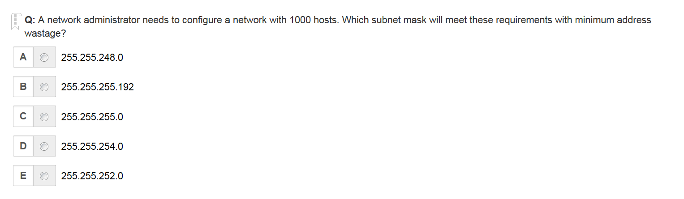
E is the correct answer

Slide 19
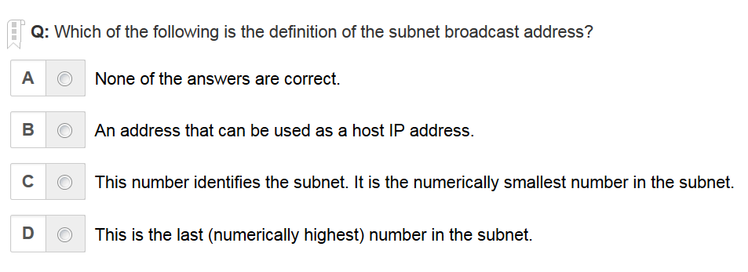
D is the correct answer

Slide 20
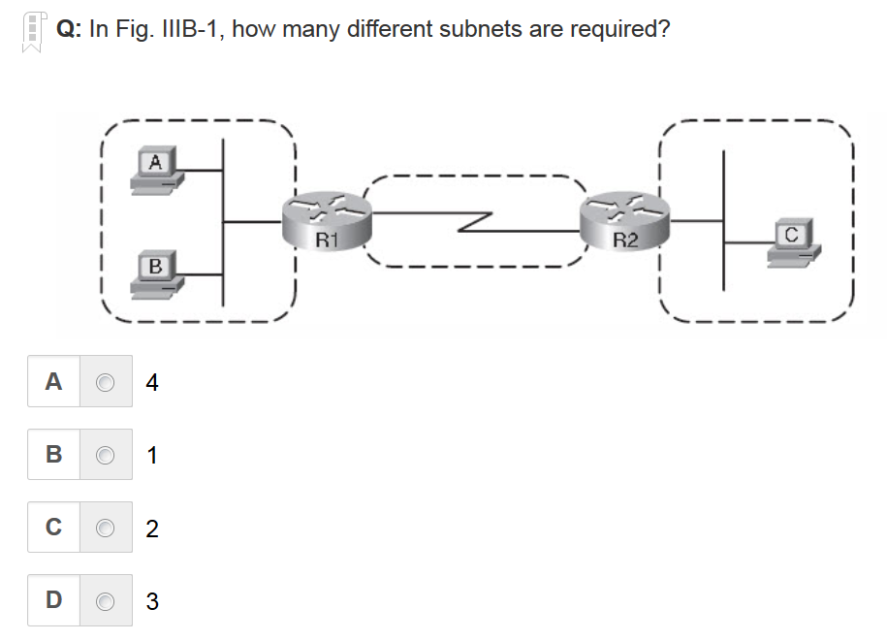
D is the correct answer

Slide 21
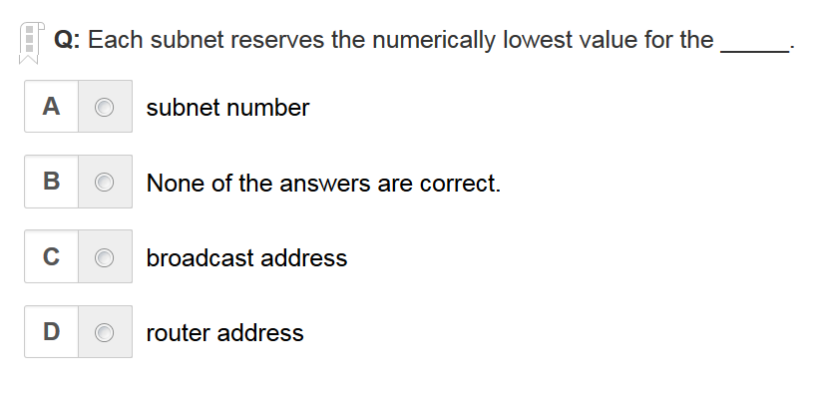
A is the correct answer

Slide 22
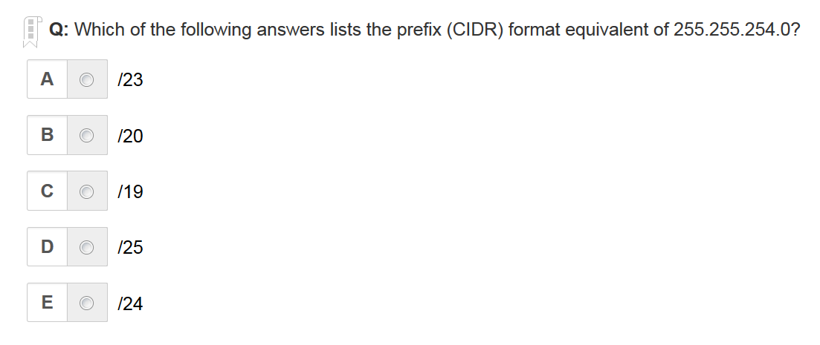
A is the correct answer

Slide 23
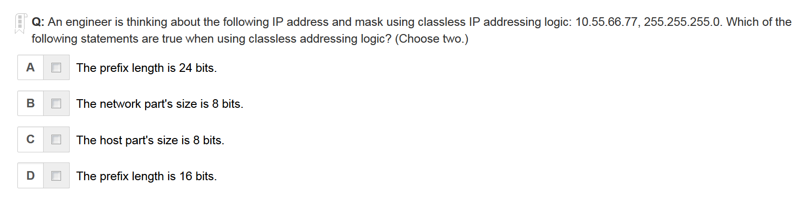
A C are the correct answer

Slide 24
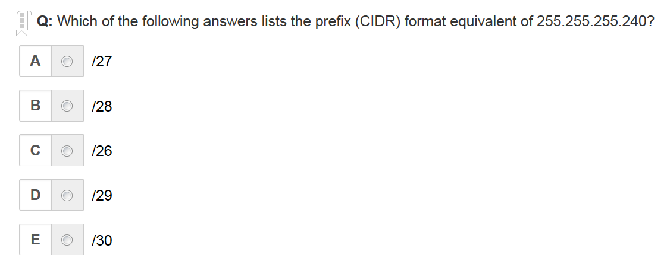
B is the correct answer

Slide 25
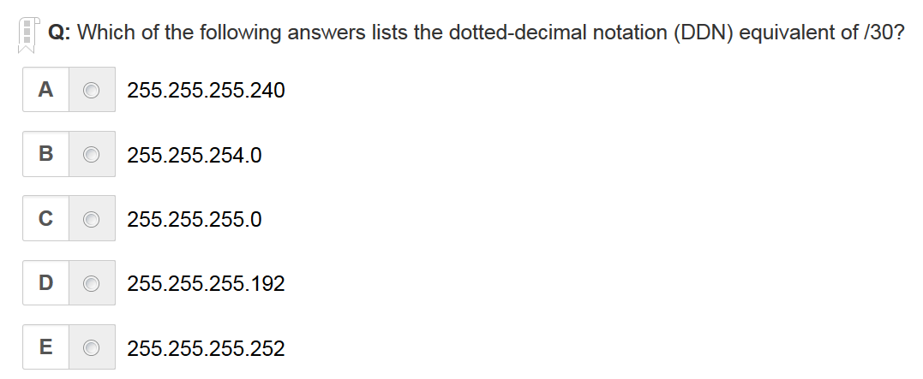
E is the correct answer

Slide 26
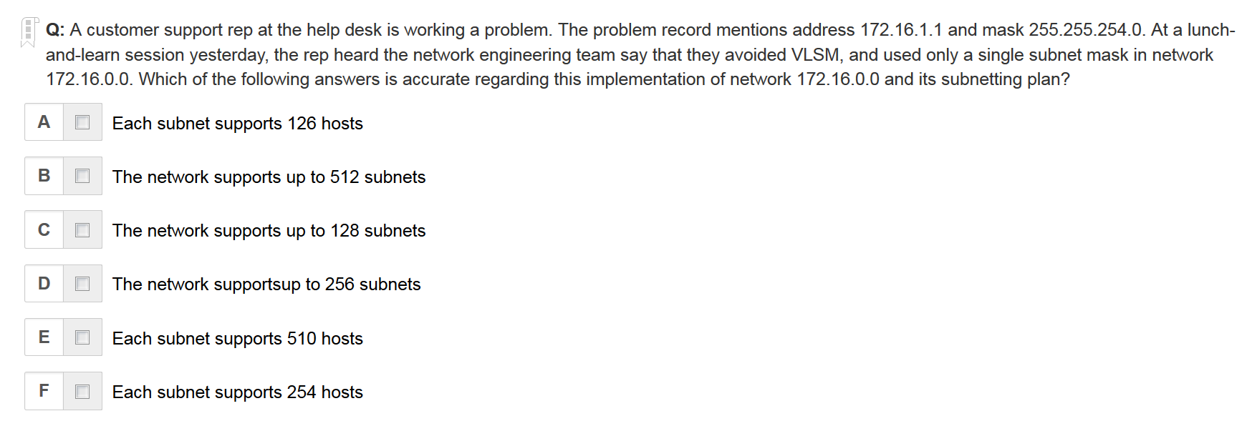
C E are the correct answer

Slide 27
Written Labs and Review Questions
Read through the Exam Essentials section together in class
Open your books and go through all the written labs and the review questions.
Review the answers in class.
27

